Slide 1
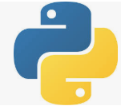
3 Python Ecosystem
Peter H. Chen

Slide 2
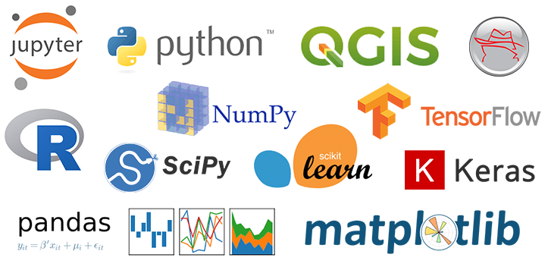
3 Python Ecosystem
https://www.tutorialspoint.com/machine_learning_with_python/machine_learning_with_python_basics.htm
Python Ecosystem:
Anaconda (Package management and deployment), Jupyter, QGIS (Quantum Geographic Information System), NumPy, SciPy, Scikit-Learn, R, Pandas, matplotlib, Keras (Python Deep Learning Library), TensorFlow (GPU, dataflow).

Slide 3
End of Chapter

