Slide 1

5 Data Load
Peter H. Chen

Slide 2
5 Data Load
https://www.tutorialspoint.com/machine_learning_with_python/machine_learning_with_python_data_loading_for_ml_projects.htm
Data Load for Machine Learning
The most common format of data for ML projects is CSV (Comma-Separated Values).
CSV is a simple file format which is used to store tabular data (number and text) such as a spreadsheet in plain text.
CSV data format is the most common format for ML data, but we need to take care about following:

Slide 3
5 Data Load
https://www.tutorialspoint.com/machine_learning_with_python/machine_learning_with_python_data_loading_for_ml_projects.htm
Data Load for Machine Learning
File Header
In CSV data files, the header contains the information for each field. We must use the same delimiter for the header file and for data file because it is the header file that specifies how should data fields be interpreted.
The following are the two cases related to CSV file header which must be considered −
Case-I: When Data file is having a file header − It will automatically assign the names to each column of data if data file is having a file header.
Case-II: When Data file is not having a file header − We need to assign the names to each column of data manually if data file is not having a file header.
In both the cases, we must need to specify explicitly weather our CSV file contains header or not.

Slide 4
5 Data Load
https://www.tutorialspoint.com/machine_learning_with_python/machine_learning_with_python_data_loading_for_ml_projects.htm
Data Load for Machine Learning
Comments
Comments in any data file are having their significance. In CSV data file, comments are indicated by a hash (#) at the start of the line.
We need to consider comments while loading CSV data into ML projects because if we are having comments in the file then we may need to indicate, depends upon the method we choose for loading, whether to expect those comments or not.
Delimiter
In CSV data files, comma (,) character is the standard delimiter. The role of delimiter is to separate the values in the fields. It is important to consider the role of delimiter while uploading the CSV file into ML projects because we can also use a different delimiter such as a tab or white space. But in the case of using a different delimiter than standard one, we must have to specify it explicitly.

Slide 5
5 Data Load
https://www.tutorialspoint.com/machine_learning_with_python/machine_learning_with_python_data_loading_for_ml_projects.htm
Data Load for Machine Learning
Quotes
In CSV data files, double quotation (“ ”) mark is the default quote character.
It is important to consider the role of quotes while uploading the CSV file into ML projects because we can also use other quote character than double quotation mark.
But in case of using a different quote character than standard one, we must have to specify it explicitly.

Slide 6
5 Data Load
https://www.tutorialspoint.com/machine_learning_with_python/machine_learning_with_python_data_loading_for_ml_projects.htm
Data Load for Machine Learning
Methods to Load CSV Data File
While working with ML projects, the most crucial task is to load the data properly into it.
The most common data format for ML projects is CSV and it comes in various flavors and varying difficulties to parse.
In this section, we are going to discuss about three common approaches in Python to load CSV data file
Load CSV with Python Standard Library
The first and most used approach to load CSV data file is the use of Python standard library which provides us a variety of built-in modules namely csv module and the reader()function.
The following is an example of loading CSV data file with the help of it −

Slide 7
5.1 Read CSV with Open

Slide 8
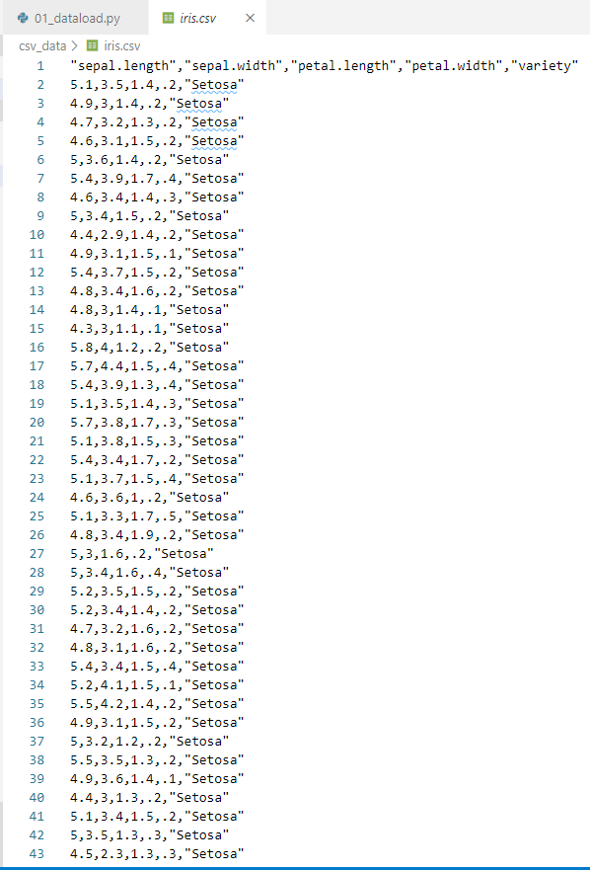
5.1 Read CSV with Open
https://www.tutorialspoint.com/machine_learning_with_python/machine_learning_with_python_data_loading_for_ml_projects.htm
Data Load for Machine Learning
Example
Given an iris.csv file.
First line is headers
Data is 150 rows, 5 columns of each row.

Slide 9
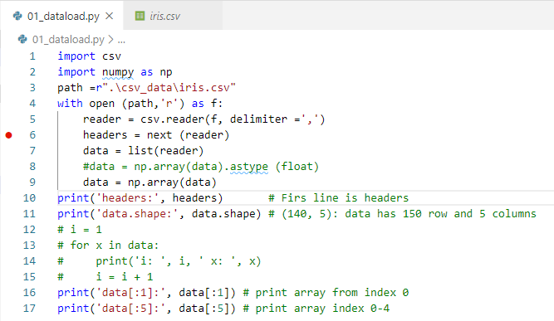
5.1 Read CSV with Open
https://www.tutorialspoint.com/machine_learning_with_python/machine_learning_with_python_data_loading_for_ml_projects.htm
Data Load for Machine Learning
Example
Load the iris.csv file
Read the header section of csv.
Put all the other data into a list.
Convert list into numpy array with 150 rows x 5 columns.

Slide 10
5.1 Read CSV with Open
https://www.tutorialspoint.com/machine_learning_with_python/machine_learning_with_python_data_loading_for_ml_projects.htm
Data Load for Machine Learning
Read data by Python Open function.
Use ‘next’ to skip one line.
Assign the rest of lines into data list.
Convert the list into array by numpy function.
Perform the numpy array operation.
Print array shape/dimension: 150x5 (150 row x 5 columns)
Print array data[:3], i.e., data[0], data[1], and data[2]

Slide 11
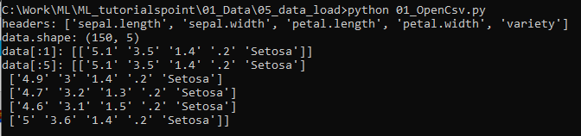
5.1 Read CSV with Open
https://www.tutorialspoint.com/machine_learning_with_python/machine_learning_with_python_data_loading_for_ml_projects.htm
Data Load for Machine Learning
> python 01_OpenCsv.py

Slide 12
5.2 Read CSV with numpy

Slide 13
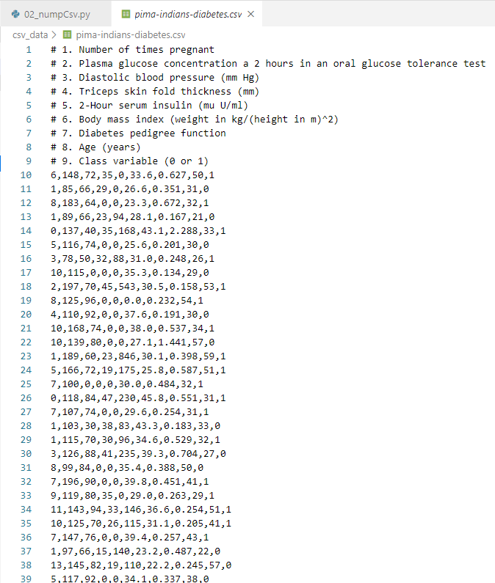
5.2 Read CSV with numpy
https://www.tutorialspoint.com/machine_learning_with_python/machine_learning_with_python_data_loading_for_ml_projects.htm
Data Load for Machine Learning
Given the data as right.
Use numpy to read
Data (767 x 9): 767 row with 9 columns

Slide 14
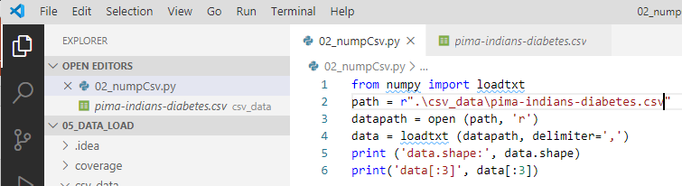
5.2 Read CSV with numpy
https://www.tutorialspoint.com/machine_learning_with_python/machine_learning_with_python_data_loading_for_ml_projects.htm
Data Load for Machine Learning
From numpy package import loadtxt function/module
data = loadtxt (path, delimiter = ‘,’)
Print shape/dimension: 767 (rows) x 9 (columns)
Print array data[:3]: data[0], data[1], and data[2].

Slide 15
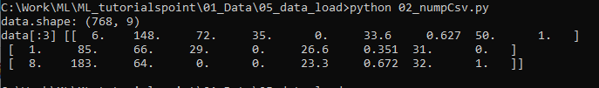
5.2 Read CSV with numpy
https://www.tutorialspoint.com/machine_learning_with_python/machine_learning_with_python_data_loading_for_ml_projects.htm
Data Load for Machine Learning
> python 02_NumpyCsv.py

Slide 16
5.3 Read CVS with Pandas

Slide 17
5.3 Read CVS with Pandas
https://www.tutorialspoint.com/machine_learning_with_python/machine_learning_with_python_data_loading_for_ml_projects.htm
Data Load for Machine Learning
Given iris.csv as right
Use pandas to read the CVS data.

Slide 18
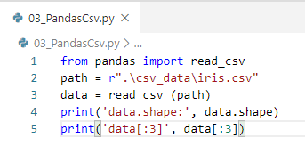
5.3 Read CVS with Pandas
https://www.tutorialspoint.com/machine_learning_with_python/machine_learning_with_python_data_loading_for_ml_projects.htm
Data Load for Machine Learning
From pandas package import function/module read_csv
Read CSV data by read_csv() function from Pandas.
Print array shape/dimension: 150x5 (150 row x 5 columns)
Print array data[:3], i.e., data[0], data[1], and data[2]

Slide 19
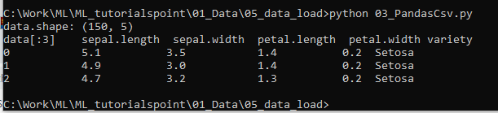
5.3 Read CVS with Pandas
https://www.tutorialspoint.com/machine_learning_with_python/machine_learning_with_python_data_loading_for_ml_projects.htm
Data Load for Machine Learning
> python 03_PandasCsv.py
Print shape = (150 x 5)
Print Data [0:3] = data[0], data[1], data[2]

Slide 20
5.4 Pandas with skip rows and Headers

Slide 21
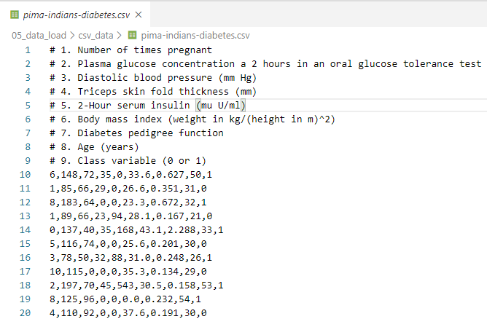
5.4 Pandas with skip rows and Headers
https://www.tutorialspoint.com/machine_learning_with_python/machine_learning_with_python_data_loading_for_ml_projects.htm
Data Load for Machine Learning
Given pima-Indians-diabetes.csv as right
Use pandas to read the CVS data with skip rows and headers alignment

Slide 22
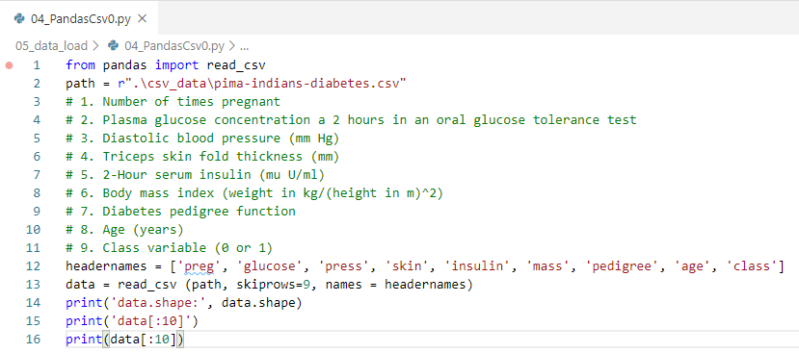
5.4 Pandas with skip rows and Headers
https://www.tutorialspoint.com/machine_learning_with_python/machine_learning_with_python_data_loading_for_ml_projects.htm
Data Load for Machine Learning
From pandas package import read_csv function.
Add headernames = [‘preg’, …., ‘class’]
data = read_csv (path, skiprows=9, names = headernames)
Print csv data

Slide 23
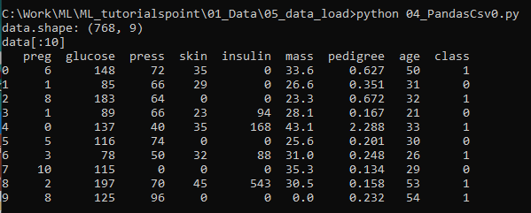
5.4 Pandas with skip rows and Headers
https://www.tutorialspoint.com/machine_learning_with_python/machine_learning_with_python_data_loading_for_ml_projects.htm
Data Load for Machine Learning
> python 04_PandasCsv.py
Print shape = (768 x 9)
Print Data [0:10] = data[0], data[1], data[2], …, data[9]

Slide 24
5.5 Summary

Slide 25
5.5 Summary
https://www.tutorialspoint.com/machine_learning_with_python/machine_learning_with_python_data_loading_for_ml_projects.htm
In Machine Learning, there are three ways to read CSV data:
Python open() function
Numpy readtxt() function
Pandas read_csv() function

Slide 26
End of Chapter

