Slide 1

6 Statistics
Peter H. Chen

Slide 2
6 Statistics
https://www.tutorialspoint.com/machine_learning_with_python/machine_learning_with_python_understanding_data_with_statistics.htm
Statistics
Head function:

Slide 3
6.1 Observe Raw Data

Slide 4
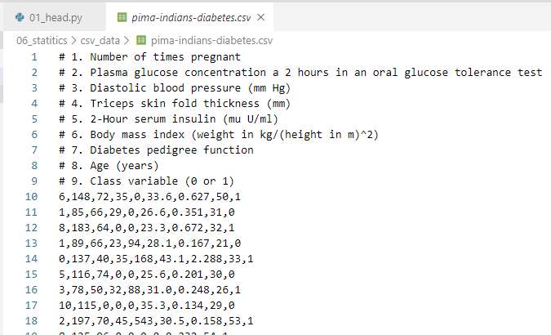
6.1 Observe Raw Data
https://www.tutorialspoint.com/machine_learning_with_python/machine_learning_with_python_data_loading_for_ml_projects.htm
Observe Raw Data
Example
Given an pima-Indians-diabetes.csv file.
Print header and skip 9 comment lines.

Slide 5
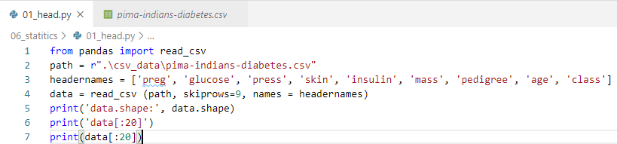
6.1 Observe Raw Data
https://www.tutorialspoint.com/machine_learning_with_python/machine_learning_with_python_data_loading_for_ml_projects.htm
Observe Raw Data
from pandas package import read_csv function
read_csv, skip 9 comment lines, and place the headers.
Print the first 20 lines of data with header.

Slide 6
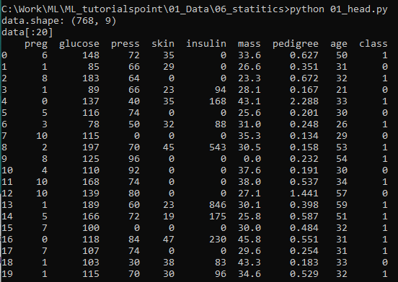
6.1 Observe Raw Data
https://www.tutorialspoint.com/machine_learning_with_python/machine_learning_with_python_data_loading_for_ml_projects.htm
Observe Raw Data
> python 01_head.py
Observe the raw data.

Slide 7
6.2 Check Dimension

Slide 8
6.2 Check Dimension
https://www.tutorialspoint.com/machine_learning_with_python/machine_learning_with_python_data_loading_for_ml_projects.htm
Check Dimension
It is always a good practice to know the dimension of the data, in terms of rows and columns of the Machine Learning Project.
If there too many rows and columns, it will take long time to run the algorithm and train the model
If there is too less rows and columns, then it will be not enough data to well train the model

Slide 9
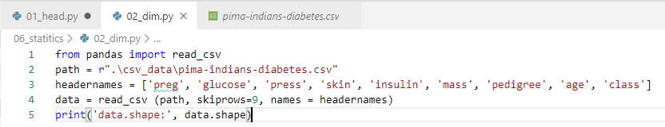

6.2 Check Dimension
https://www.tutorialspoint.com/machine_learning_with_python/machine_learning_with_python_data_loading_for_ml_projects.htm
Check Dimension
Print the dimension: 768 x 9

Slide 10
6.3 Check Data Type

Slide 11
6.3 Check Data Type
https://www.tutorialspoint.com/machine_learning_with_python/machine_learning_with_python_data_loading_for_ml_projects.htm
Check Data Type
It is another good practice to know data type of each attributes.
The reason behind that is sometimes, we may need to convert one data to another.
For example, we may need to convert the string into floating point or int for representing categorial or ordinal values.
We can use dtypes property of Pandas DataFrame.
With the help of dtypes property, we can categorize each attributes data type.

Slide 12
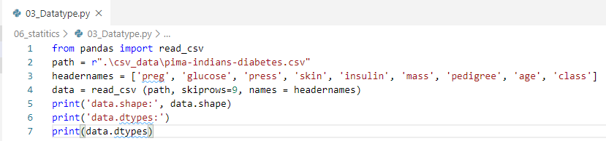
6.3 Check Data Type
https://www.tutorialspoint.com/machine_learning_with_python/machine_learning_with_python_data_loading_for_ml_projects.htm
Check Data Type
Array.dtypes

Slide 13
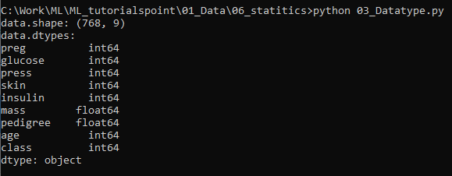
6.3 Check Data Type
https://www.tutorialspoint.com/machine_learning_with_python/machine_learning_with_python_data_loading_for_ml_projects.htm
Check Data Type
We get the data type of all the attributes.

Slide 14
6.4 Statistical Data

Slide 15
6.4 Statistical Data
https://www.tutorialspoint.com/machine_learning_with_python/machine_learning_with_python_data_loading_for_ml_projects.htm
Statistical Data
We get the shape of data, i.e., number of rows and columns.
In many times, we need to review the summary data.
This can be done with the help of describe() function of Pandas DataFrame.
The describes() funciton provides the following 8 statistical properties of every data attribute
Count
Mean
Standard Deviation
Minimum Value
Maximum value
25%
Median, i.e., 50%
75%

Slide 16
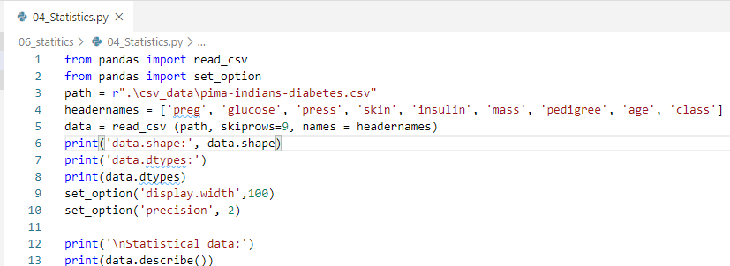
6.4 Statistical Data
https://www.tutorialspoint.com/machine_learning_with_python/machine_learning_with_python_data_loading_for_ml_projects.htm
Statistical Data
Example:

Slide 17
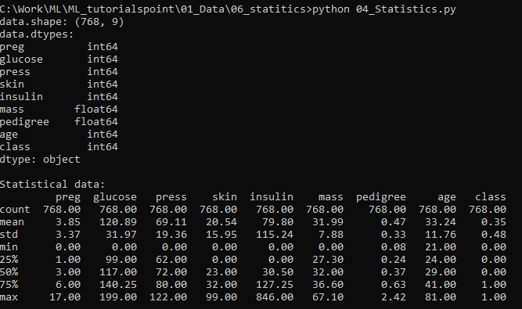
6.4 Statistical Data
https://www.tutorialspoint.com/machine_learning_with_python/machine_learning_with_python_data_loading_for_ml_projects.htm
Statistical Data
Summary of data:

Slide 18
6.5 Class Distribution

Slide 19
6.5 Class Distribution
https://www.tutorialspoint.com/machine_learning_with_python/machine_learning_with_python_data_loading_for_ml_projects.htm
Class Distribution
Class distribution statistics is useful in classification problems where we need to know the class values of each group.
It is important to know class value distribution because if we have highly imbalanced class distribution, i.e., one class is having lots more observations than other class, then it may need special handling at data preparation stage of our Machine Learning project.
We can get class distribution in Python with Pandas DataFrame.

Slide 20
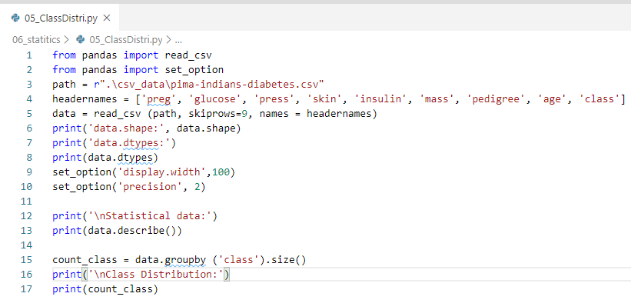
6.5 Class Distribution
https://www.tutorialspoint.com/machine_learning_with_python/machine_learning_with_python_data_loading_for_ml_projects.htm
Class Distribution
Array.groupby (‘class’).size()

Slide 21
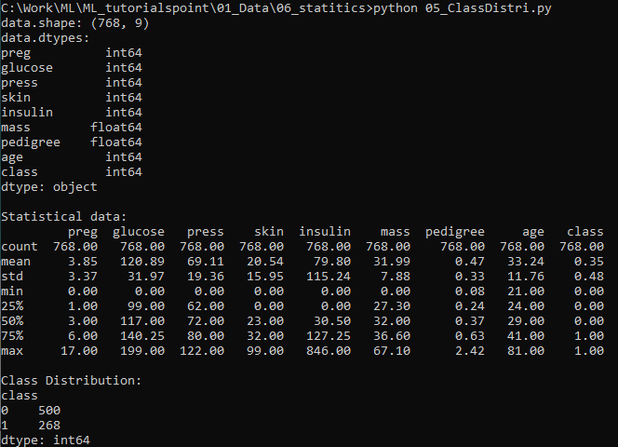
6.5 Class Distribution
https://www.tutorialspoint.com/machine_learning_with_python/machine_learning_with_python_data_loading_for_ml_projects.htm
Class Distribution
> python 05_ClassDistri.py

Slide 22
6.6 Correlation between Attributes

Slide 23
6.6 Correlation between Attributes
https://www.tutorialspoint.com/machine_learning_with_python/machine_learning_with_python_data_loading_for_ml_projects.htm
Correlation between Attributes
The relationship between two variables is called correlation.
In statistics, the most common method for calculating correlation is Pearson’s Correlation Coefficient.
It can have three values as follows:
Coefficient value = 1 − It represents full positive correlation between variables.
Coefficient value = -1 − It represents full negative correlation between variables.
Coefficient value = 0 − It represents no correlation at all between variables.
It is good to review the pairwise correlations of the attributes in our dataset before using it into Machine Learning project.
Some Machine Learning algorithms, such as, linear regression and logistic regression will perform poorly if we have highly correlated attributes.
In Python, we can easily calculate a correlation matrix of dataset attributes with corr() function on Pandas DataFrame.

Slide 24
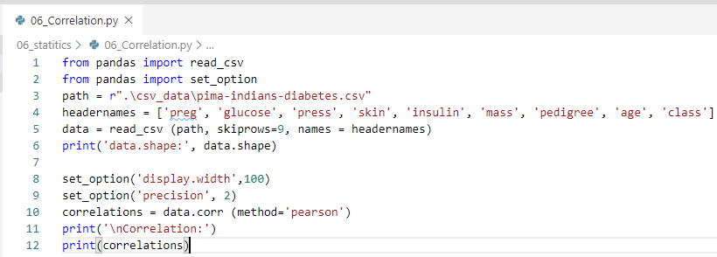
6.6 Correlation between Attributes
https://www.tutorialspoint.com/machine_learning_with_python/machine_learning_with_python_data_loading_for_ml_projects.htm
Correlation between Attributes
Correlation

Slide 25
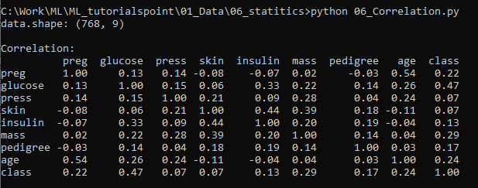
6.6 Correlation between Attributes
https://www.tutorialspoint.com/machine_learning_with_python/machine_learning_with_python_data_loading_for_ml_projects.htm
Correlation between Attributes
> python 06_correlation.py
Correlation Matrix

Slide 26
6.7 Skew of Attributes

Slide 27
6.7 Skew of Attributes
https://www.tutorialspoint.com/machine_learning_with_python/machine_learning_with_python_data_loading_for_ml_projects.htm
Skew of Attributes
Skewness may be defined as the distribution that is assumed to be Gaussian but appears distorted or shifted in one direction or another, or either to the left or right.
The skewness of attributes is one of the important tasks due to following reasons:
Presence of skewness in data requires the correction at data preparation stage so that we can get more accuracy from our model.
Most of the Machine Learning algorithms assumes that data has a Gaussian distribution, i.e., either normal of bell curved data.
In Python, we can easily calculate the skew of each attribute by using skew() function on Pandas DataFrame.

Slide 28
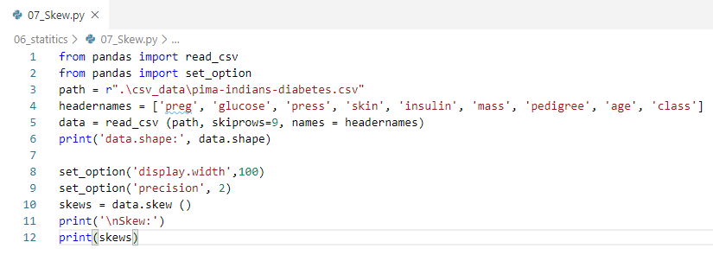
6.7 Skew of Attributes
https://www.tutorialspoint.com/machine_learning_with_python/machine_learning_with_python_data_loading_for_ml_projects.htm
Skew of Attributes
Skew

Slide 29
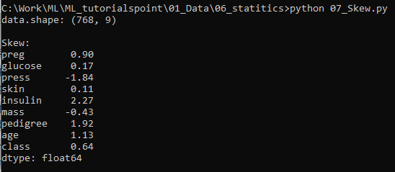
6.7 Skew of Attributes
https://www.tutorialspoint.com/machine_learning_with_python/machine_learning_with_python_data_loading_for_ml_projects.htm
Skew of Attributes
> python 07_Skew.py

Slide 30
End of Chapter

