Slide 1

8 Data Prepare
Peter H. Chen

Slide 2
8 Data Prepare
https://www.tutorialspoint.com/machine_learning_with_python/machine_learning_with_python_preparing_data.htm
Data Preparation
Machine Learning algorithms are completely dependent on data.
The data is the most crucial aspect that makes model training possible.
If we cannot make sense for the data, a machine will be useless.
We always need to feed right data, i.e., the data in correct scale, format, and with meaningful features, for the Example we want machine to solve.
The Data preparation is the most important step in Machine Learning process.
Data preparation is defined as the procedure that makes dataset more appropriate for Machine Learning process.

Slide 3
8 Data Prepare
https://www.tutorialspoint.com/machine_learning_with_python/machine_learning_with_python_preparing_data.htm
Data Pre-processing
After selecting the raw data for machine Learning training, the most important task is data pre-processing.
The data preprocessing convert the selected data into a form we can work with or can feed to Machine Learning algorithms.
We always need to preprocess our data so that the data can be meet the expectation of machine learning algorithm.

Slide 4
8 Data Prepare
https://www.tutorialspoint.com/machine_learning_with_python/machine_learning_with_python_preparing_data.htm
Data Pre-processing
After selecting the raw data for machine Learning training, the most important task is data pre-processing.
The data preprocessing convert the selected data into a form we can work with or can feed to Machine Learning algorithms.
We always need to preprocess our data so that the data can be meet the expectation of machine learning algorithm.

Slide 5
8.1 Scaling

Slide 6
8.1 Scaling
https://www.tutorialspoint.com/machine_learning_with_python/machine_learning_with_python_preparing_data.htm
Scaling
Our dataset comprises of the attributes with varying scale, but we cannot provide such data to Machine Learning algorithm, therefore, the dataset requires rescaling.
Data rescaling scale the attributes at same scale.
Generally, attributes are rescaled into the range of 0 and 1.
Machine Learning algorithms like gradient descent and K-Nearest Neighbors requires scaled data.
We rescale the data with MinMaxScaler class of scikit-learn of Python library.

Slide 7
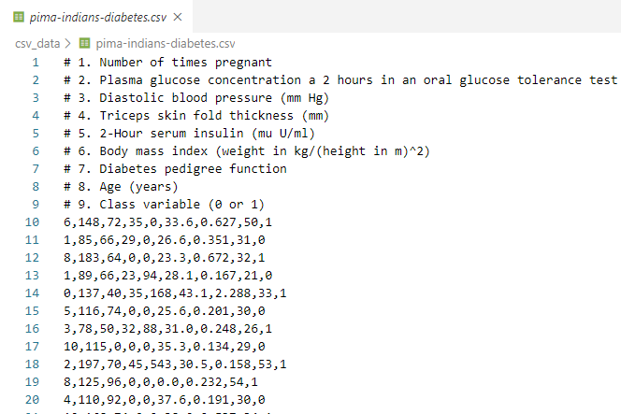
8.1 Scaling
https://www.tutorialspoint.com/machine_learning_with_python/machine_learning_with_python_preparing_data.htm
Scaling Example
Given Pima (North America) Indians Diabetes dataset.

Slide 8
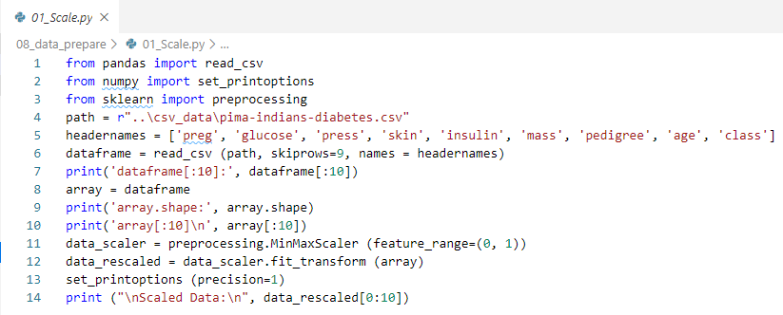
8.1 Scaling
https://www.tutorialspoint.com/machine_learning_with_python/machine_learning_with_python_preparing_data.htm
Scaling Example
Read dataset by Pandas read_csv
Rescale data by MinMaxScaler of sklearn
Set print precision option by numpy

Slide 9
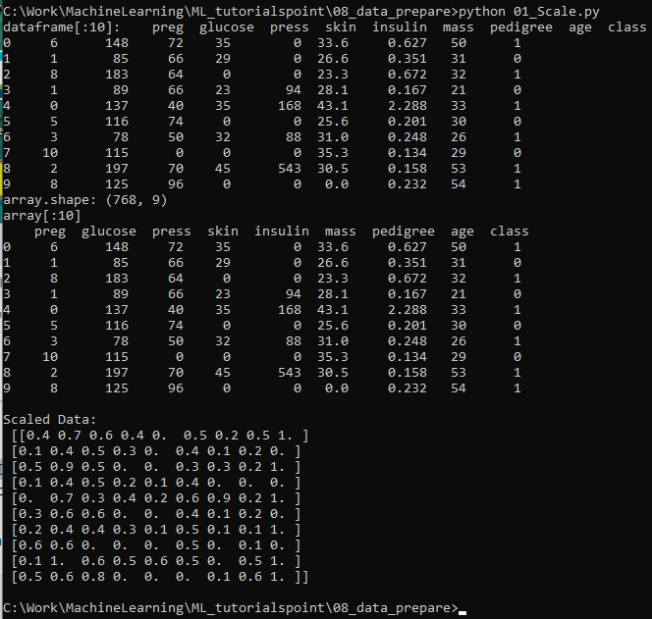
8.1 Scaling
https://www.tutorialspoint.com/machine_learning_with_python/machine_learning_with_python_preparing_data.htm
Scaling Example
> python 01_Scale.py

Slide 10
8.2 Normalization

Slide 11
8.2 Normalization
https://www.tutorialspoint.com/machine_learning_with_python/machine_learning_with_python_preparing_data.htm
Normalization
Normalization rescale each row of data to have a length of 1.
Normalization is mainly used in sparse dataset where we have lots of zeros.
We rescale the data with Normalizer class of scikit-learn of Python library.
Types of Normalization
In Machine Learning, there are two types of normalization preprocessing:
L1 Normalization: Cost = (y- X β)^{T} (y- X β) + λ β^{T} β
L2 Normalization: Cost = (y- X β)^{T} (y- X β) + λ |β|

Slide 12
8.2 Normalization
https://www.tutorialspoint.com/machine_learning_with_python/machine_learning_with_python_preparing_data.htm
L1 Normalization Example
Given Pima (North America) Indians Diabetes dataset.

Slide 13
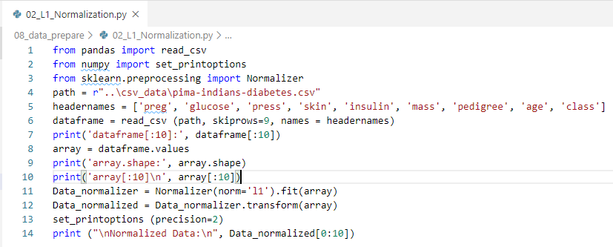
8.2 Normalization
https://www.tutorialspoint.com/machine_learning_with_python/machine_learning_with_python_preparing_data.htm
L1 Normalization Example
Read CSV by Pandas read_csv
Import Normalizer function from sklearn.preprocessing
Normalizer return an object of Data_normalizer.

Slide 14
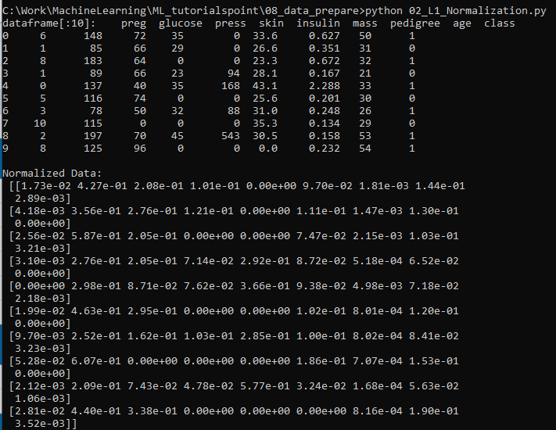
8.2 Normalization
https://www.tutorialspoint.com/machine_learning_with_python/machine_learning_with_python_preparing_data.htm
L1 Normalization Example
> python 02_L1_Normalization.py

Slide 15
8.2 Normalization
https://www.tutorialspoint.com/machine_learning_with_python/machine_learning_with_python_preparing_data.htm
L2 Normalization Example
Given Pima (North America) Indians Diabetes dataset.

Slide 16
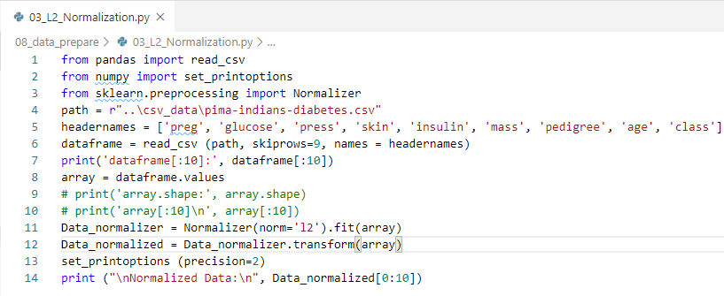
8.2 Normalization
https://www.tutorialspoint.com/machine_learning_with_python/machine_learning_with_python_preparing_data.htm
L2 Normalization Example
Read CSV by Pandas read_csv
Import Normalizer function from sklearn.preprocessing
Normalizer (‘l2’)

Slide 17
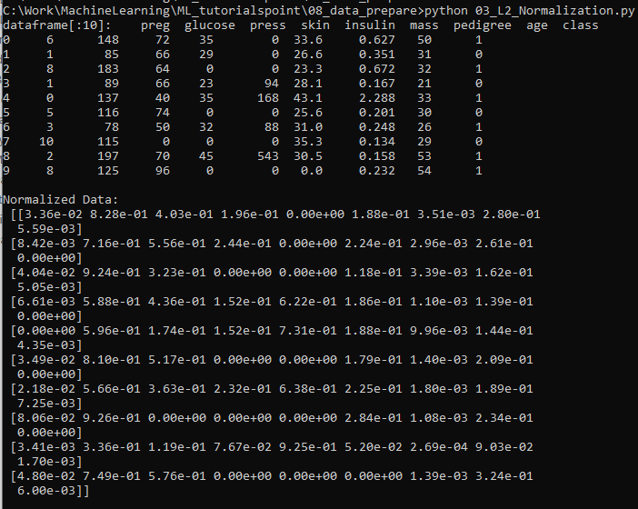
8.2 Normalization
https://www.tutorialspoint.com/machine_learning_with_python/machine_learning_with_python_preparing_data.htm
L2 Normalization Example
> python 02_L2_Normalization.py

Slide 18
8.4 Standardization

Slide 19
8.4 Standardization
https://www.tutorialspoint.com/machine_learning_with_python/machine_learning_with_python_preparing_data.htm
Standardization
Standardization is used to transform the data attributes (for each column) with a Gaussian distribution.
Standardization has mean and SD (Standard Deviation) to a standard Gaussian distribution with a mean of 0 and a SD of 1.
Standardization is used in Machine Learning algorithms, such as, linear regression and logistic regression which assumes a Gaussian distribution in input dataset and will produce better results with rescaled data.
We can standardize the data (mean = 0 and SD =1) with StandardScaler class of scikit-learn of Python library.

Slide 20
8.4 Standardization
https://www.tutorialspoint.com/machine_learning_with_python/machine_learning_with_python_preparing_data.htm
Standardization Example
Given Pima (North America) Indians Diabetes dataset.

Slide 21
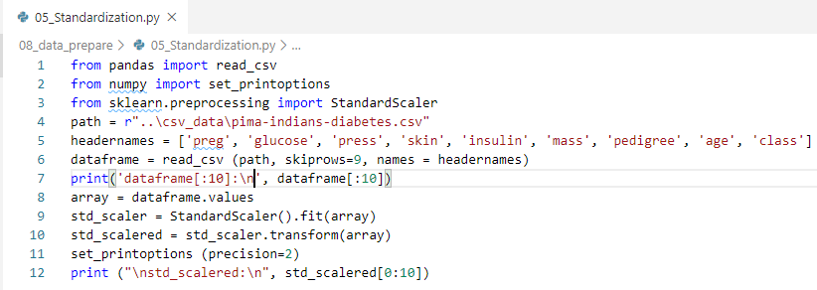
8.4 Standardization
https://www.tutorialspoint.com/machine_learning_with_python/machine_learning_with_python_preparing_data.htm
Standardization Example
Read CSV by Pandas read_csv
Import StandardScaler function from sklearn.preprocessing
Standardization transform

Slide 22
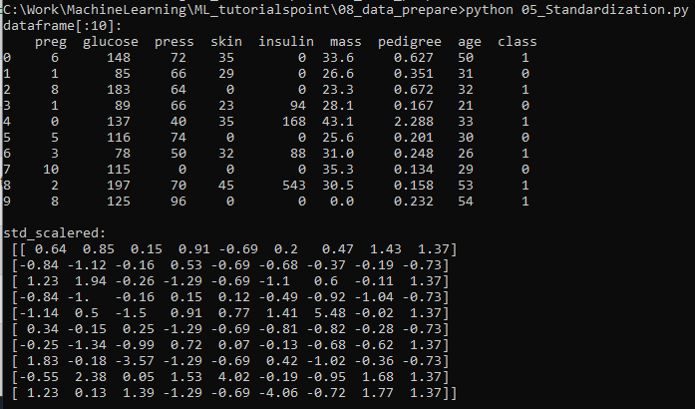
8.4 Standardization
https://www.tutorialspoint.com/machine_learning_with_python/machine_learning_with_python_preparing_data.htm
Standardization Example
> python 05_Standardization.py

Slide 23
8.5 Data Labeling

Slide 24
8.5 Data Labeling
https://www.tutorialspoint.com/machine_learning_with_python/machine_learning_with_python_preparing_data.htm
Data Labeling
We discussed the importance of good data and the techniques to pre-process the data before sending the data to Machine Learning algorithms.
The Machine Learning algorithms need to have proper data labeling.
For example, in case of classification problems, there are a lot of labels in the form of words, numbers, and etc. in the dataset.
What is Label Encoding?
Most of the sklearn functions expect the data with number labels rather than word labels.
Therefore, we need to convert such labels into number labels.
This process to convert the word label into data label is called label encoding.
We can perform label encoding of data with of LabelEncoder() function of scikit-learn of Python library.

Slide 25
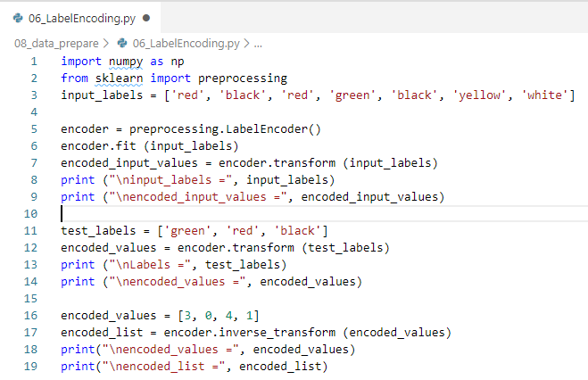
8.5 Data Labeling
https://www.tutorialspoint.com/machine_learning_with_python/machine_learning_with_python_preparing_data.htm
Data Labeling Example
Define label
input_labels = ['red', 'black', 'red', 'green', 'black', 'yellow', 'white’]
Print encoded_input_labels
test_labels = ['green', 'red', 'black’]
Print encoded_test_labels
Encoded_values = [3, 0, 4, 1]
Print encoded_list

Slide 26
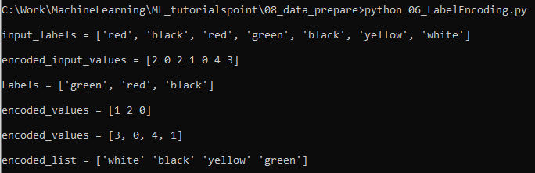
8.5 Data Labeling
https://www.tutorialspoint.com/machine_learning_with_python/machine_learning_with_python_preparing_data.htm
Data Labeling Example
> python 06_LabelEncoding.py

Slide 27
End of Chapter

