Slide 1

11 Logic Regression
Peter H. Chen

Slide 2
11 Logic Regression
https://www.tutorialspoint.com/machine_learning_with_python/machine_learning_with_python_classification_algorithms_logistic_regression.htm
Logic Regression
Logistic regression is a supervised learning classification algorithm used to predict the probability of a target variable.
The nature of target or dependent variable is dichotomous (dicho: two, tomous: cut into), which means there would be only two possible classes.
In simple words, the dependent variable is binary in nature having data coded as either 1 (stands for success/yes) or 0 (stands for failure/no).
Mathematically, a logistic regression model predicts P(Y=1) as a function of X.
It is one of the simplest ML algorithms that can be used for various classification problems, such as, spam detection, Diabetes prediction, cancer detection, and etc.

Slide 3
11.1 Types of Logistic Regression

Slide 4
11.1 Types of Logistic Regression
https://www.tutorialspoint.com/machine_learning_with_python/machine_learning_with_python_classification_algorithms_logistic_regression.htm
Types of Logic Regression
The logistic regression means binary logistic regression having binary target variables.
There can be two more categories of target variables that can be predicted by it.

Slide 5
11.1 Types of Logistic Regression
https://www.tutorialspoint.com/machine_learning_with_python/machine_learning_with_python_classification_algorithms_logistic_regression.htm
Based on those number of categories, Logistic regression can be divided into following types:
Binary or Binomial
In such a kind of classification, a dependent variable will have only two possible types either 1 and 0.
For example, these variables may represent success or failure, yes or no, win or loss etc.
Multinomial
In such a kind of classification, dependent variable can have 3 or more possible unordered types or the types having no quantitative significance.
For example, these variables may represent “Type A”, “Type B”, or “Type C”.
Ordinal
In such a kind of classification, dependent variable can have 3 or more possible ordered types or the types having a quantitative significance.
For example, these variables may represent “poor”, “good”, “very good”, or “Excellent” and each category can have the scores like 0, 1, 2, or 3.

Slide 6
11.2 Logistic Regression Assumption

Slide 7
11.2 Logistic Regression Assumption
https://www.tutorialspoint.com/machine_learning_with_python/machine_learning_with_python_classification_algorithms_logistic_regression.htm
Logistic Regression Assumption
Before diving into the implementation of logistic regression, we must be aware of the following assumptions about the same:
In case of binary logistic regression, the target variables must be binary always and the desired outcome is represented by the factor level 1.
There should not be any multi-collinearity in the model, which means the independent variables must be independent of each other.
We must include meaningful variables in our model.
We should choose a large sample size for logistic regression.

Slide 8
11.3 Binary Regression Models

Slide 9
11.3 Binary Regression Models
https://www.tutorialspoint.com/machine_learning_with_python/machine_learning_with_python_classification_algorithms_logistic_regression.htm
Regression Models
Binary Logic Regression Model: The simplest form of logistic regression is binary or binomial logistic regression in which the target or dependent variable can have only 2 possible types either 1 or 0.
Multinomial Logistic Regression Model: Another useful form of logistic regression is multinomial logistic regression in which the target or dependent variable can have 3 or more possible unordered types, i.e., the types having no quantitative significance.

Slide 10
11.3 Binary Regression Models
https://www.tutorialspoint.com/machine_learning_with_python/machine_learning_with_python_classification_algorithms_logistic_regression.htm
Binary Logic Regression Model:
The simplest form of logistic regression is binary or binomial logistic regression in which the target or dependent variable can have only 2 possible types either 1 or 0.
It allows us to model a relationship between multiple predictor variables and a binary/binomial target variable. In case of logistic regression, the linear function is basically used as an input to another function such as 𝑔 in the following relation :
h∅(x) = g(∅^{T}x) where 0≤ h∅ ≤1
Here, 𝑔 is the logistic or sigmoid function which can be given as follows
g(z)=1/(1+e^{−z}) where z = ∅^{T}x

Slide 11
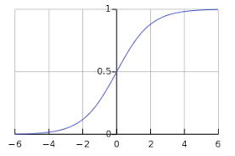
11.3 Binary Regression Models
https://www.tutorialspoint.com/machine_learning_with_python/machine_learning_with_python_classification_algorithms_logistic_regression.htm
To sigmoid curve can be represented with the help of following graph. We can see the values of y-axis lie between 0 and 1 and crosses the axis at 0.5.
The classes can be divided into positive or negative.
The output comes under the probability of positive class if it lies between 0 and 1.
For our implementation, we are interpreting the output of hypothesis function as positive if it is ≥ 0.5, otherwise negative.

Slide 12
11.3 Binary Regression Models
https://www.tutorialspoint.com/machine_learning_with_python/machine_learning_with_python_classification_algorithms_logistic_regression.htm
We also need to define a loss function to measure how well the algorithm performs using the weights on functions, represented by theta as follows:
H = g(X∅)
J(∅) = (1/m) . [−y^{T}log(h) − (1−y)^{T} log(1−h)]
Now, after defining the loss function our prime goal is to minimize the loss function.
It can be done with the help of fitting the weights which means by increasing or decreasing the weights. With the help of derivatives of the loss function w.r.t each weight, we would be able to know what parameters should have high weight and what should have smaller weight.

Slide 13
11.3 Regression Models
https://www.tutorialspoint.com/machine_learning_with_python/machine_learning_with_python_classification_algorithms_logistic_regression.htm
The following gradient descent equation tells us how loss would change if we modified the parameters
∂J(∅)/∂∅_{j} = (1/m) X^{T} (g(X∅)−y)

Slide 14
11.3 Binary Regression Models
https://www.tutorialspoint.com/machine_learning_with_python/machine_learning_with_python_classification_algorithms_logistic_regression.htm
Implement Binary Logistic Regression:
> pip install seaborn

Slide 15
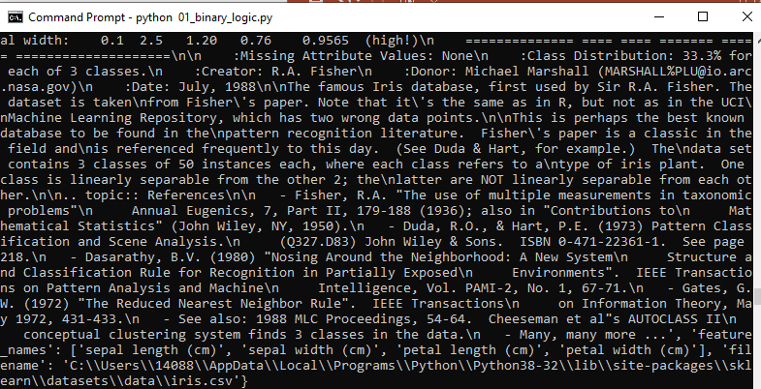
11.3 Binary Regression Models
https://www.tutorialspoint.com/machine_learning_with_python/machine_learning_with_python_classification_algorithms_logistic_regression.htm
Implement Binary Logistic Regression:
Print the iris.
Check the “filename’: ‘C:\Users\14088\AppData\Local\Programs\Python\Pyhton38-21\lib\site-packages\sklearn\dataset\data\iris.csv’

Slide 16
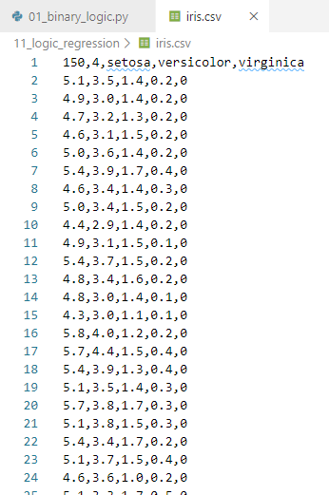
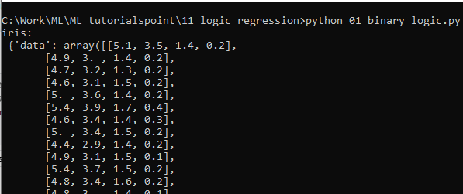
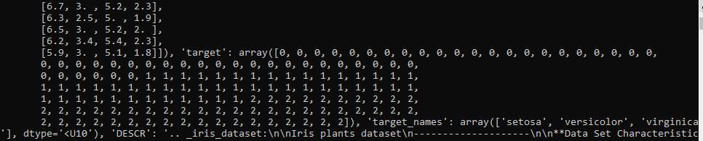
11.3 Binary Regression Models
https://www.tutorialspoint.com/machine_learning_with_python/machine_learning_with_python_classification_algorithms_logistic_regression.htm
Implement Binary Logistic Regression:
The original iris.csv is 151x5. The iris (151x5) is separate into 151 x 4 for data (features) array and 151 x 2 for targets (labels) array.

Slide 17
11.3 Binary Regression Models
https://www.tutorialspoint.com/machine_learning_with_python/machine_learning_with_python_classification_algorithms_logistic_regression.htm
Implement Binary Logistic Regression:
The target_names (label_names) array are: ‘setosa’, ‘versicolor’, and ‘virginica’.

Slide 18
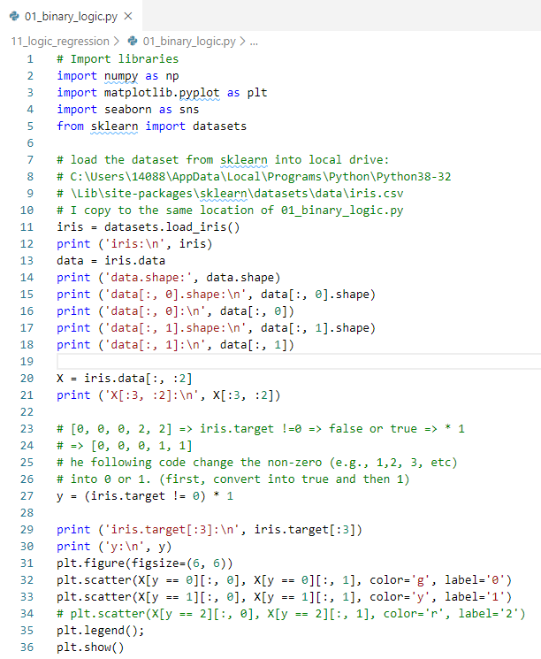
11.3 Binary Regression Models
https://www.tutorialspoint.com/machine_learning_with_python/machine_learning_with_python_classification_algorithms_logistic_regression.htm
Implement Binary Logistic Regression:
The following statement convert nonzero data, such as, 1, 2, 3, and etc. into 1.
> y = (iris.target !=0) * 1
> (iris.targe !=0) will return true or false.
> e.g., 0 return false, 1, 2, 3, and etc. become true.
> (true or false ) * 1 will become 0 or 1.

Slide 19
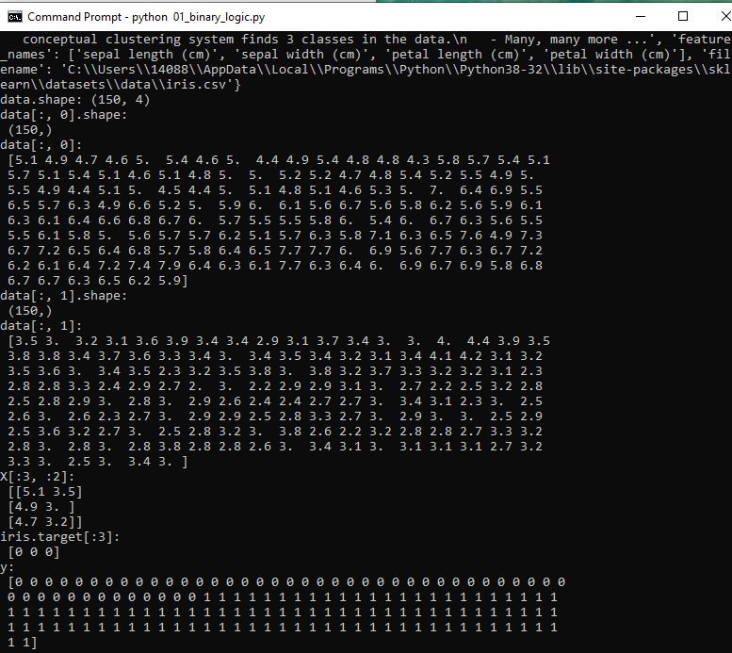
11.3 Binary Regression Models
https://www.tutorialspoint.com/machine_learning_with_python/machine_learning_with_python_classification_algorithms_logistic_regression.htm
Implement Binary Logistic Regression:
> python 01_binary_logic.py

Slide 20
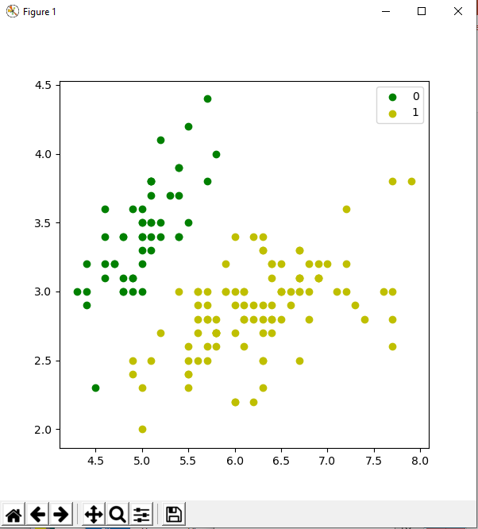
11.3 Binary Regression Models
https://www.tutorialspoint.com/machine_learning_with_python/machine_learning_with_python_classification_algorithms_logistic_regression.htm
Implement Binary Logistic Regression:
Plot the data

Slide 21
11.3 Binary Regression Models
https://www.tutorialspoint.com/machine_learning_with_python/machine_learning_with_python_classification_algorithms_logistic_regression.htm
Implement Binary Logistic Regression:
https://medium.com/@martinpella/logistic-regression-from-scratch-in-python-124c5636b8ac
There is extra column added in X. X[m x 3] * theta [2] causes problem.

Slide 22
End of Chapter

