Slide 1

17 Linear Regression
Peter H. Chen

Slide 2
17 Linear Regression
https://www.tutorialspoint.com/machine_learning_with_python/machine_learning_with_python_regression_algorithms_linear_regression.htm
Introduction to Linear Regression
Linear regression may be defined as the statistical model that analyzes the linear relationship between a dependent variable with given set of independent variables. Linear relationship between variables means that when the value of one or more independent variables will change (increase or decrease), the value of dependent variable will also change accordingly (increase or decrease).
Mathematically the relationship can be represented with the help of following equation.
y = m X + b
Here, y is the dependent variable we are trying to predict.
X is the independent variable we are using to make predictions.
m is the slop of the regression line which represents the effect X has on y.
b is a constant, known as the y-intercept. If X = 0, y would be equal to 𝑏.

Slide 3
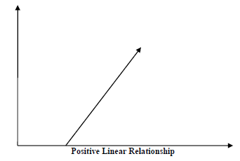
17 Linear Regression
https://www.tutorialspoint.com/machine_learning_with_python/machine_learning_with_python_regression_algorithms_linear_regression.htm
Positive Linear Relationship
A linear relationship will be called positive if both independent and dependent variable increases.

Slide 4
17 Linear Regression
https://www.tutorialspoint.com/machine_learning_with_python/machine_learning_with_python_regression_algorithms_linear_regression.htm
Types of Linear Regression
Linear regression is of the following two type:
Simple Linear Regression
Multiple Linear Regression

Slide 5
17.1 Simple Linear Regression

Slide 6
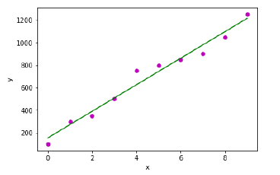
17.1 Simple Linear Regression
https://www.tutorialspoint.com/machine_learning_with_python/machine_learning_with_python_regression_algorithms_linear_regression.htm
Simple Linear Regression
Single input variable
Single output variable.

Slide 7
17.2 Multiple Linear Regression

Slide 8


17.2 Multiple Linear Regression
https://www.tutorialspoint.com/machine_learning_with_python/machine_learning_with_python_regression_algorithms_linear_regression.htm
Multiple Linear Regression
It is the extension of simple linear regression that predicts a response using two or more features.
Mathematically we can explain it as follows −
Consider a dataset having n observations, p features i.e. independent variables and y as one response, i.e., dependent variable the regression line for p features can be calculated as follows
We can also write the above equation as follows.

Slide 9
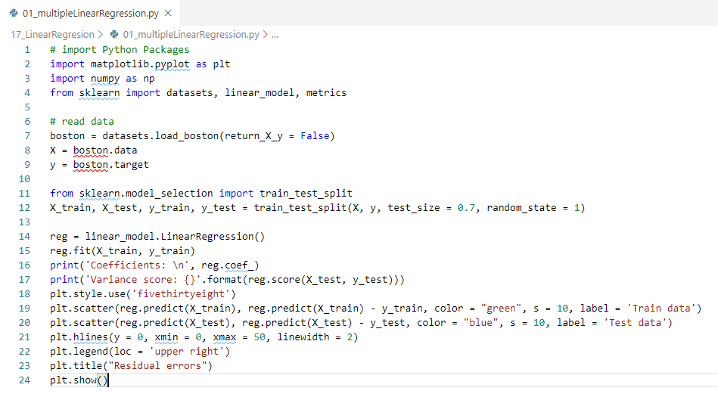
17.2 Multiple Linear Regression
https://www.tutorialspoint.com/machine_learning_with_python/machine_learning_with_python_regression_algorithms_linear_regression.htm
Python Multiple Linear Regression:

Slide 10
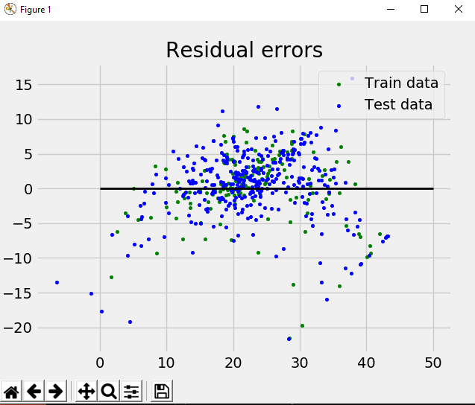
17.2 Multiple Linear Regression
https://www.tutorialspoint.com/machine_learning_with_python/machine_learning_with_python_regression_algorithms_linear_regression.htm
Plot result
https://www.tutorialspoint.com/machine_learning_with_python/machine_learning_with_python_multiple_linear_regression.htm

Slide 11
End of Chapter

