Slide 1

22 KNN
Peter H. Chen

Slide 2
22 KNN
https://www.tutorialspoint.com/machine_learning_with_python/machine_learning_with_python_knn_algorithm_finding_nearest_neighbors.htm
KNN
K-nearest neighbors (KNN) algorithm is a type of supervised ML algorithm.
KNN can be used for both classification as well as regression predictive problems. However, it is mainly used for classification predictive problems in industry.
The following two properties would define KNN well −
Lazy learning algorithm − KNN is a lazy learning algorithm because it does not have a specialized training phase and uses all the data for training while classification.
Non-parametric learning algorithm − KNN is also a non-parametric learning algorithm because it doesn’t assume anything about the underlying data.

Slide 3
22 KNN
https://www.tutorialspoint.com/machine_learning_with_python/machine_learning_with_python_knn_algorithm_finding_nearest_neighbors.htm
Working of KNN Algorithm
K-nearest neighbors (KNN) algorithm uses ‘feature similarity’ to predict the values of new datapoints which further means that the new data point will be assigned a value based on how closely it matches the points in the training set.

Slide 4
22 KNN
https://www.tutorialspoint.com/machine_learning_with_python/machine_learning_with_python_knn_algorithm_finding_nearest_neighbors.htm
KNN Steps
Step 1 − For implementing any algorithm, we need dataset. So during the first step of KNN, we must load the training as well as test data.
Step 2 − Next, we need to choose the value of K i.e. the nearest data points. K can be any integer.
Step 3 − For each point in the test data do the following −
3.1 − Calculate the distance between test data and each row of training data with the help of any of the method namely: Euclidean, Manhattan or Hamming distance. The most commonly used method to calculate distance is Euclidean.
3.2 − Now, based on the distance value, sort them in ascending order.
3.3 − Next, it will choose the top K rows from the sorted array.
3.4 − Now, it will assign a class to the test point based on most frequent class of these rows.
Step 4 − End

Slide 5
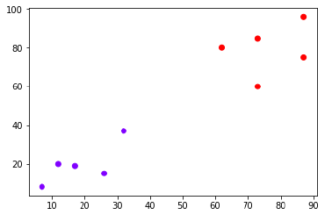
22 KNN
https://www.tutorialspoint.com/machine_learning_with_python/machine_learning_with_python_knn_algorithm_finding_nearest_neighbors.htm
KNN
The following is an example to understand the concept of K and working of KNN algorithm −
Suppose we have a dataset which can be plotted as follows

Slide 6
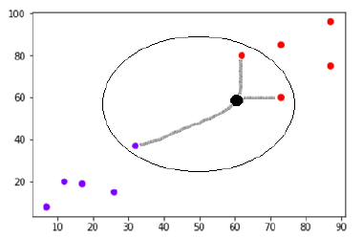
22 KNN
https://www.tutorialspoint.com/machine_learning_with_python/machine_learning_with_python_knn_algorithm_finding_nearest_neighbors.htm
KNN
Now, we need to classify new data point with black dot (at point 60,60) into blue or red class.
We are assuming K = 3, i.e., it would find three nearest data points. It is shown in the next diagram.
We can see in the above diagram the three nearest neighbors of the data point with black dot.
Among those three, two of them lies in Red class hence the black dot will also be assigned in red class.

Slide 7
22.1 KNN Example 1

Slide 8
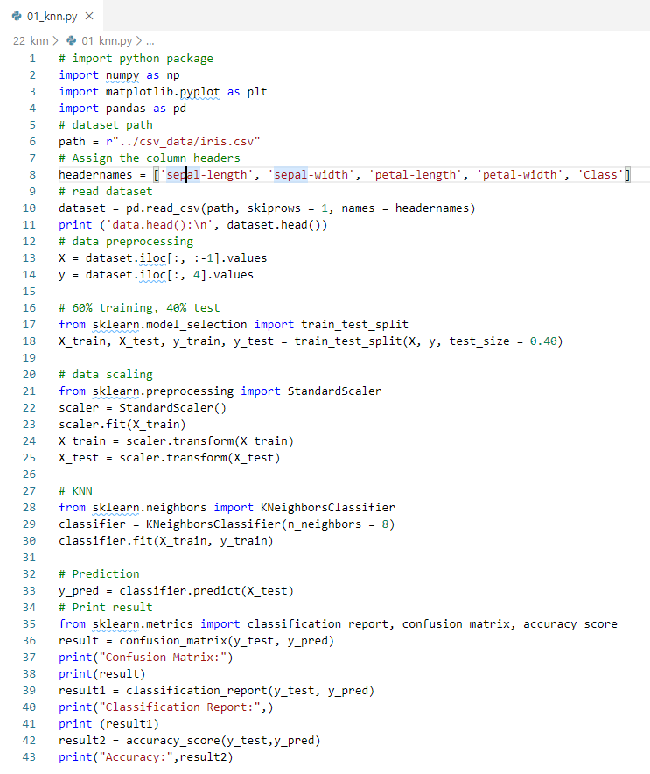
22.1 KNN Example 1
https://www.tutorialspoint.com/machine_learning_with_python/machine_learning_with_python_knn_algorithm_finding_nearest_neighbors.htm
KNN Example 1

Slide 9
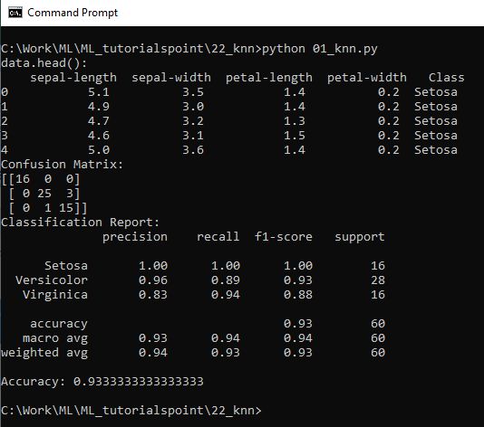
22.1 KNN Example 1
https://www.tutorialspoint.com/machine_learning_with_python/machine_learning_with_python_knn_algorithm_finding_nearest_neighbors.htm
KNN Example 1
Display Result

Slide 10
22.2 KNN Example 2

Slide 11
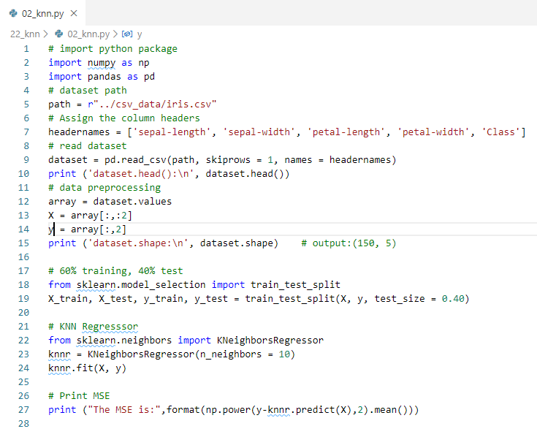
22.2 KNN Example 2
https://www.tutorialspoint.com/machine_learning_with_python/machine_learning_with_python_knn_algorithm_finding_nearest_neighbors.htm
KNN Example 2
Regressor

Slide 12
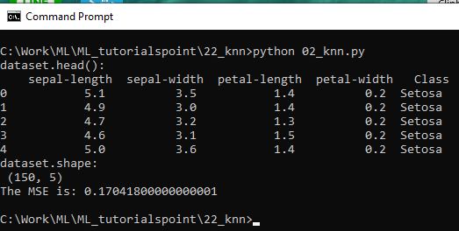
22.2 KNN Example 2
https://www.tutorialspoint.com/machine_learning_with_python/machine_learning_with_python_knn_algorithm_finding_nearest_neighbors.htm
KNN Example 1
Display Result

Slide 13
22.3 KNN Pros and Cons

Slide 14
22.3 KNN Pros and Cons
https://www.tutorialspoint.com/machine_learning_with_python/machine_learning_with_python_knn_algorithm_finding_nearest_neighbors.htm
Pros and Cons of KNN
Pros
It is very simple algorithm to understand and interpret.
It is very useful for nonlinear data because there is no assumption about data in this algorithm.
It is a versatile algorithm as we can use it for classification as well as regression.
It has relatively high accuracy but there are much better supervised learning models than KNN.

Slide 15
22.3 KNN Pros and Cons
https://www.tutorialspoint.com/machine_learning_with_python/machine_learning_with_python_knn_algorithm_finding_nearest_neighbors.htm
Pros and Cons of KNN
Cons
It is computationally a bit expensive algorithm because it stores all the training data.
High memory storage required as compared to other supervised learning algorithms.
Prediction is slow in case of big N.
It is very sensitive to the scale of data as well as irrelevant features.

Slide 16
22.3 KNN Pros and Cons
https://www.tutorialspoint.com/machine_learning_with_python/machine_learning_with_python_knn_algorithm_finding_nearest_neighbors.htm
Applications of KNN
Banking System
KNN can be used in banking system to predict weather an individual is fit for loan approval? Does that individual have the characteristics similar to the defaulters one?
Calculating Credit Ratings
KNN algorithms can be used to find an individual’s credit rating by comparing with the persons having similar traits.
Politics
With the help of KNN algorithms, we can classify a potential voter into various classes like “Will Vote”, “Will not Vote”, “Will Vote to Party ‘Congress’, “Will Vote to Party ‘BJP’.
Other areas in which KNN algorithm can be used are Speech Recognition, Handwriting Detection, Image Recognition and Video Recognition.

Slide 17
End of Chapter

