Slide 1

14 Naïve Bayes
Peter H. Chen

Slide 2
14 Naïve Bayes
https://www.tutorialspoint.com/machine_learning_with_python/machine_learning_with_python_classification_algorithms_naive_bayes.htm
Introduction to Naïve Bayes Algorithm
Naïve Bayes algorithms is a classification technique based on Bayes’ theorem with a strong assumption that all the predictors are independent to each other.
In simple words, the assumption is that the presence of a feature in a class is independent to the presence of any other feature in the same class.
For example, a phone may be considered as smart if it is having touch screen, internet facility, good camera, and etc.
Though all these features are dependent on each other, they contribute independently to the probability of that the phone is a smart phone.
In Bayesian classification, the main interest is to find the posterior probabilities i.e. the probability of a label given some observed features, 𝑃(𝐿 | 𝑓𝑒𝑎𝑡𝑢𝑟𝑒𝑠).

Slide 3
14 Naïve Bayes
https://www.tutorialspoint.com/machine_learning_with_python/machine_learning_with_python_classification_algorithms_naive_bayes.htm
Introduction to Naïve Bayes Algorithm
With the help of Bayes theorem, we can express this in quantitative form as follows
P(L|features)=P(L)P(features|L) / P(features)
Here, (𝐿 | 𝑓𝑒𝑎𝑡𝑢𝑟𝑒𝑠) is the posterior probability of class.
𝑃(𝐿) is the prior probability of class.
𝑃(𝑓𝑒𝑎𝑡𝑢𝑟𝑒𝑠|𝐿) is the likelihood which is the probability of predictor given class.
𝑃(𝑓𝑒𝑎𝑡𝑢𝑟𝑒𝑠) is the prior probability of predictor.

Slide 4
14.1 Build Model by Naïve Bayes

Slide 5
14.1 Build Model by Naïve Bayes
https://www.tutorialspoint.com/machine_learning_with_python/machine_learning_with_python_classification_algorithms_naive_bayes.htm
Build Model by Naïve Bayes
Scikit learn is the most useful library that helps us to build a Naïve Bayes model in Python.
We have the three types of Naïve Bayes model under Scikit learn Python library −
Gaussian Naïve Bayes
It is the simplest Naïve Bayes classifier having the assumption that the data from each label is drawn from a simple Gaussian distribution.
Multinomial Naïve Bayes
Another useful Naïve Bayes classifier is Multinomial Naïve Bayes in which the features are assumed to be drawn from a simple Multinomial distribution. Such kind of Naïve Bayes are most appropriate for the features that represents discrete counts.
Bernoulli Naïve Bayes
Another important model is Bernoulli Naïve Bayes in which features are assumed to be binary (0s and 1s). Text classification with ‘bag of words’ model can be an application of Bernoulli Naïve Bayes.

Slide 6
14.2 Naïve Bayes Example

Slide 7
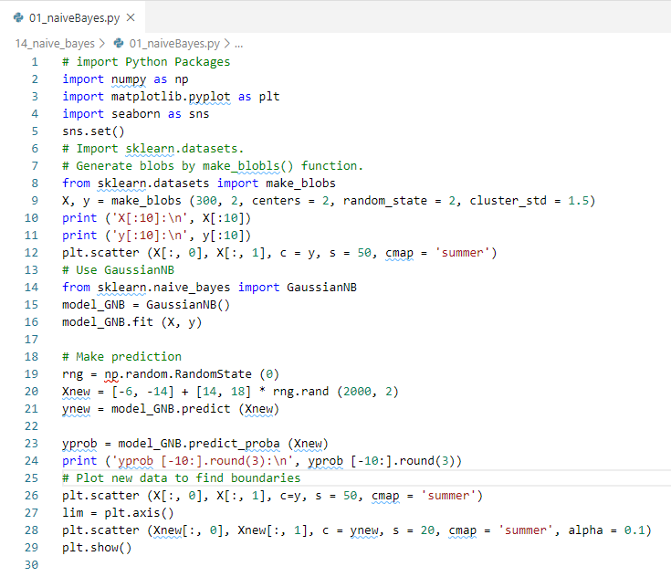
14.2 Naïve Bayes Example
https://www.tutorialspoint.com/machine_learning_with_python/machine_learning_with_python_classification_algorithms_naive_bayes.htm
Naïve Bayes Example

Slide 8
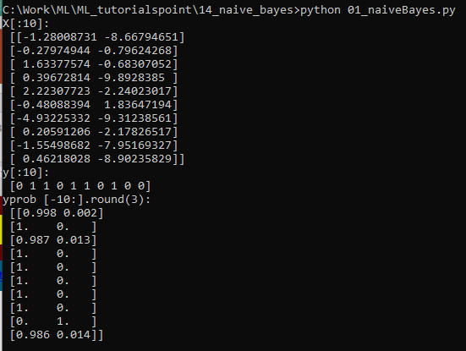
14.2 Naïve Bayes Example
https://www.tutorialspoint.com/machine_learning_with_python/machine_learning_with_python_classification_algorithms_naive_bayes.htm
Display Naïve Bayes Example

Slide 9
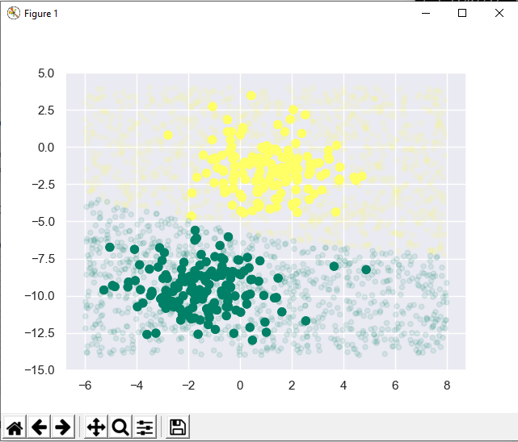
14.2 Naïve Bayes Example
https://www.tutorialspoint.com/machine_learning_with_python/machine_learning_with_python_classification_algorithms_naive_bayes.htm
Display Naïve Bayes Plot

Slide 10
14.3 Props and Cons

Slide 11
14.3 Pros and Cons
https://www.tutorialspoint.com/machine_learning_with_python/machine_learning_with_python_classification_algorithms_naive_bayes.htm
Pros and Cons
Pros
The followings are some pros of using Naïve Bayes classifiers −
Naïve Bayes classification is easy to implement and fast.
It will converge faster than discriminative models like logistic regression.
It requires less training data.
It is highly scalable in nature, or they scale linearly with the number of predictors and data points.
It can make probabilistic predictions and can handle continuous as well as discrete data.
Naïve Bayes classification algorithm can be used for binary as well as multi-class classification problems both.

Slide 12
14.3 Pros and Cons
https://www.tutorialspoint.com/machine_learning_with_python/machine_learning_with_python_classification_algorithms_naive_bayes.htm
Pros and Cons
Cons
The followings are some cons of using Naïve Bayes classifiers −
One of the most important cons of Naïve Bayes classification is its strong feature independence because in real life it is almost impossible to have a set of features which are completely independent of each other.
Another issue with Naïve Bayes classification is its ‘zero frequency’ which means that if a categorial variable has a category but not being observed in training data set, then Naïve Bayes model will assign a zero probability to it and it will be unable to make a prediction.

Slide 13
14.3 Pros and Cons
https://www.tutorialspoint.com/machine_learning_with_python/machine_learning_with_python_classification_algorithms_naive_bayes.htm
Pros and Cons
Applications of Naïve Bayes classification
The following are some common applications of Naïve Bayes classification −
Real-time prediction − Due to its ease of implementation and fast computation, it can be used to do prediction in real-time.
Multi-class prediction − Naïve Bayes classification algorithm can be used to predict posterior probability of multiple classes of target variable.
Text classification − Due to the feature of multi-class prediction, Naïve Bayes classification algorithms are well suited for text classification. That is why it is also used to solve problems like spam-filtering and sentiment analysis.
Recommendation system − Along with the algorithms like collaborative filtering, Naïve Bayes makes a Recommendation system which can be used to filter unseen information and to predict weather a user would like the given resource or not.

Slide 14
End of Chapter

