Slide 1

16 Regression Overview
Peter H. Chen

Slide 2
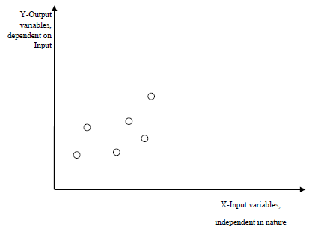
16 Regression Overview
https://www.tutorialspoint.com/machine_learning_with_python/machine_learning_with_python_regression_algorithms_overview.htmt.htm
Introduction to Regression
Regression is another important and broadly used statistical and machine learning tool.
The key objective of regression-based tasks is to predict output labels or responses which are continues numeric values, for the given input data.
The output will be based on what the model has learned in training phase.
The regression models use the input data features (independent variables) and their corresponding continuous numeric output values (dependent or outcome variables) to learn specific association between inputs and corresponding outputs.

Slide 3
16.1 Types of Regression Model

Slide 4
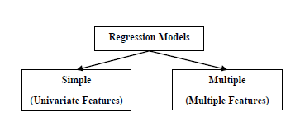
16.1 Types of Regression Model
https://www.tutorialspoint.com/machine_learning_with_python/machine_learning_with_python_regression_algorithms_overview.htmt.htm
Types of Regression Model
Regression models are of following two types −
Simple regression model − This is the most basic regression model in which predictions are formed from a single, univariate feature of the data
Multiple regression model − As name implies, in this regression model the predictions are formed from multiple features of the data.

Slide 5
16.2 Build Regressor

Slide 6
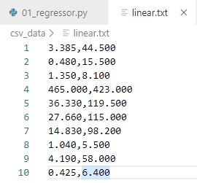
16.2 Build Regressor
https://www.tutorialspoint.com/machine_learning_with_python/machine_learning_with_python_regression_algorithms_overview.htmt.htm
Input Data: linear.txt

Slide 7
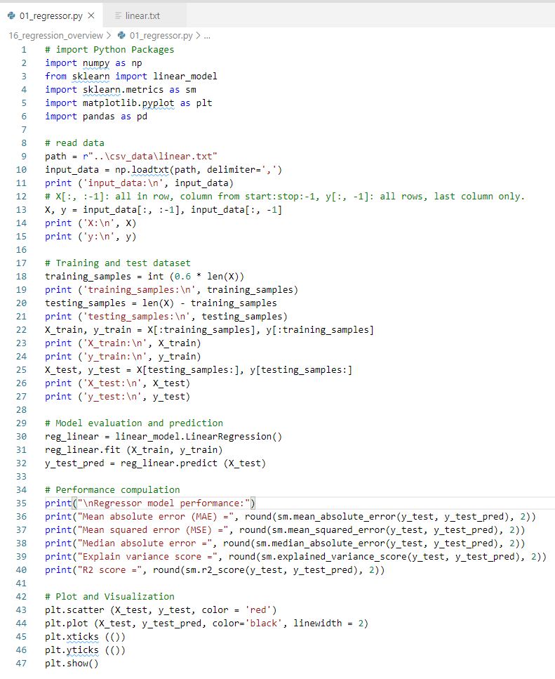
16.2 Build Regressor
https://www.tutorialspoint.com/machine_learning_with_python/machine_learning_with_python_regression_algorithms_overview.htmt.htm
Read in Data
Separate dataset into training and test
Model evaluation and Prediction
Performance compilation
Plot data

Slide 8
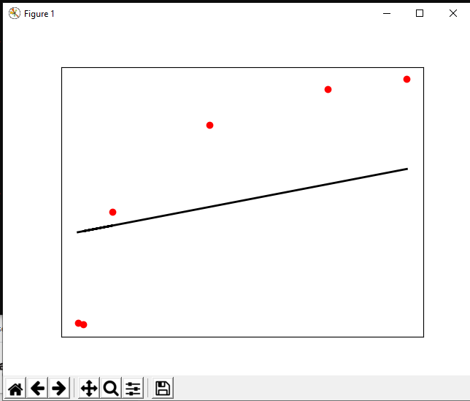
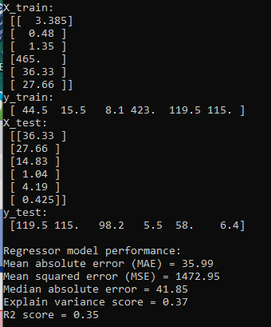
16.2 Build Regressor
https://www.tutorialspoint.com/machine_learning_with_python/machine_learning_with_python_regression_algorithms_overview.htmt.htm
Display Result

Slide 9
16.3 Types of ML Algorithm

Slide 10
16.3 Types of ML Algorithm
https://www.tutorialspoint.com/machine_learning_with_python/machine_learning_with_python_regression_algorithms_overview.htmt.htm
Types of ML Algorithm
Types of ML Regression Algorithms
The ML regression algorithm is Linear regression algorithm.
The ML regression algorithm is divided into two types namely:
Simple Linear Regression algorithm
Multiple Linear Regression algorithm

Slide 11
16.3 Types of ML Algorithm
https://www.tutorialspoint.com/machine_learning_with_python/machine_learning_with_python_regression_algorithms_overview.htmt.htm
Types of ML Algorithm
Applications
The applications of ML regression algorithms are as follows −
Forecasting or Predictive analysis − One of the important uses of regression is forecasting or predictive analysis. For example, we can forecast GDP, oil prices or in simple words the quantitative data that changes with the passage of time.
Optimization − We can optimize business processes with the help of regression. For example, a store manager can create a statistical model to understand the peek time of coming of customers.
Error correction − In business, taking correct decision is equally important as optimizing the business process. Regression can help us to take correct decision as well in correcting the already implemented decision.
Economics − It is the most used tool in economics. We can use regression to predict supply, demand, consumption, inventory investment etc.
Finance − A financial company is always interested in minimizing the risk portfolio and want to know the factors that affects the customers. All these can be predicted with the help of regression model.

Slide 12
End of Chapter

