Slide 1

24 Automatic Workflow
Peter H. Chen

Slide 2
24 Automatic Workflow
https://www.tutorialspoint.com/machine_learning_with_python/machine_learning_with_pipelines_automatic_workflows.htm
Automatic Workflow
In order to execute and produce results successfully, a machine learning model must automate some standard workflows.
The process of automate these standard workflows can be done with the help of Scikit-learn Pipelines.
From a data scientist’s perspective, pipeline is a generalized, but very important concept. It basically allows data flow from its raw format to some useful information.
The working of pipelines can be understood with the help of following diagram
Data Ingestion
Data Preparation
ML Model Training
Model Evaluation
Deployment
ML Model Re-Training

Slide 3
24 Automatic Workflow
https://www.tutorialspoint.com/machine_learning_with_python/machine_learning_with_pipelines_automatic_workflows.htm
Automatic Workflow
The blocks of ML pipelines are as follows:
Data ingestion − As the name suggests, it is the process of importing the data for use in ML project. The data can be extracted in real time or batches from single or multiple systems. It is one of the most challenging steps because the quality of data can affect the whole ML model.
Data Preparation − After importing the data, we need to prepare data to be used for our ML model. Data preprocessing is one of the most important technique of data preparation.
ML Model Training − Next step is to train our ML model. We have various ML algorithms, such as, supervised, unsupervised, or reinforcement, to extract the features from data, and make predictions.
Model Evaluation − Next, we need to evaluate the ML model. In case of AutoML pipeline, ML model can be evaluated with the help of various statistical methods and business rules.
ML Model retraining − In case of AutoML pipeline, it is not necessary that the first model is best one. The first model is considered as a baseline model and we can train it repeatably to increase model’s accuracy.
Deployment − At last, we need to deploy the model. This step involves applying and migrating the model to business operations for their use.

Slide 4
24 Automatic Workflow
https://www.tutorialspoint.com/machine_learning_with_python/machine_learning_with_pipelines_automatic_workflows.htm
Challenges Accompanying ML Pipelines
In order to create ML pipelines, data scientists face many challenges. These challenges fall into the following three categories −
Quality of Data
The success of any ML model depends heavily on the quality of data. If the data we are providing to ML model is not accurate, reliable and robust, then we are going to end with wrong or misleading output.
Data Reliability
Another challenge associated with ML pipelines is the reliability of data we are providing to the ML model. As we know, there can be various sources from which data scientist can acquire data but to get the best results, it must be assured that the data sources are reliable and trusted.
Data Accessibility
To get the best results out of ML pipelines, the data itself must be accessible which requires consolidation, cleansing and curation of data. As a result of data accessibility property, metadata will be updated with new tags.

Slide 5
24 Automatic Workflow
https://www.tutorialspoint.com/machine_learning_with_python/machine_learning_with_pipelines_automatic_workflows.htm
Modelling ML Pipeline and Data Preparation
Data leakage, happening from training dataset to testing dataset, is an important issue for data scientist to deal with while preparing data for ML model.
Generally, at the time of data preparation, data scientist uses techniques like standardization or normalization on entire dataset before learning.
But these techniques cannot help us from the leakage of data because the training dataset would have been influenced by the scale of the data in the testing dataset.
By using ML pipelines, we can prevent this data leakage because pipelines ensure that data preparation like standardization is constrained to each fold of our cross-validation procedure.

Slide 6
24.1 Automatic Workflow Example 1

Slide 7
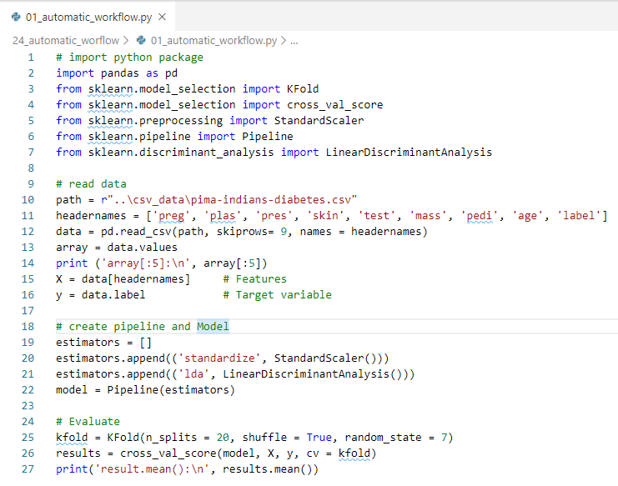
24.1 Automatic Workflow Example 1
https://www.tutorialspoint.com/machine_learning_with_python/machine_learning_with_pipelines_automatic_workflows.htm
Automatic Workflow Example 1

Slide 8
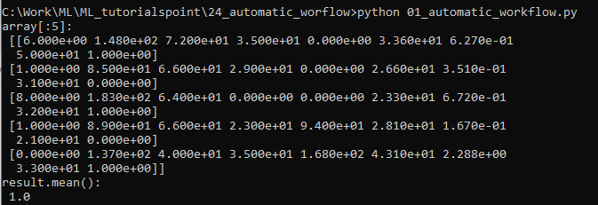
24.1 Automatic Workflow Example 1
https://www.tutorialspoint.com/machine_learning_with_python/machine_learning_with_pipelines_automatic_workflows.htm
Automatic Workflow Example 1
Display Result

Slide 9
24.2 Automatic Workflow Example 2

Slide 10
24.2 Automatic Workflow Example 2
https://www.tutorialspoint.com/machine_learning_with_python/machine_learning_with_pipelines_automatic_workflows.htm
Model ML Pipeline and Feature Extraction
Data leakage can also happen at feature extraction step of ML model.
That is why feature extraction procedures should also be restricted to stop data leakage in our training dataset.
As in the case of data preparation, by using ML pipelines, we can prevent this data leakage also.
FeatureUnion, a tool provided by ML pipelines can be used for this purpose.

Slide 11
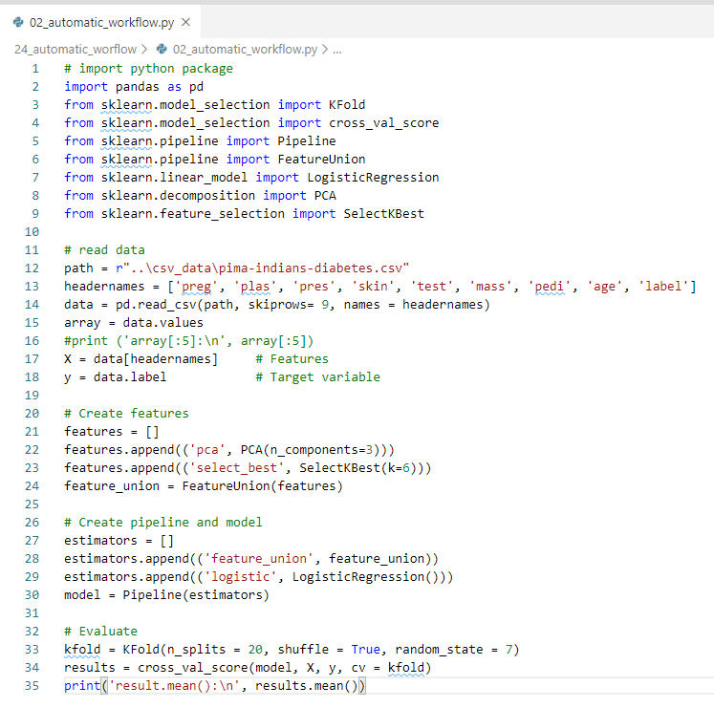
24.2 Automatic Workflow Example 2
https://www.tutorialspoint.com/machine_learning_with_python/machine_learning_with_pipelines_automatic_workflows.htm
Automatic Workflow Example 2: Model ML Pipeline and Feature Extraction
Example of feature extraction and model evaluation workflow.
For this purpose, we use Pima Indian Diabetes dataset from Sklearn.

Slide 12
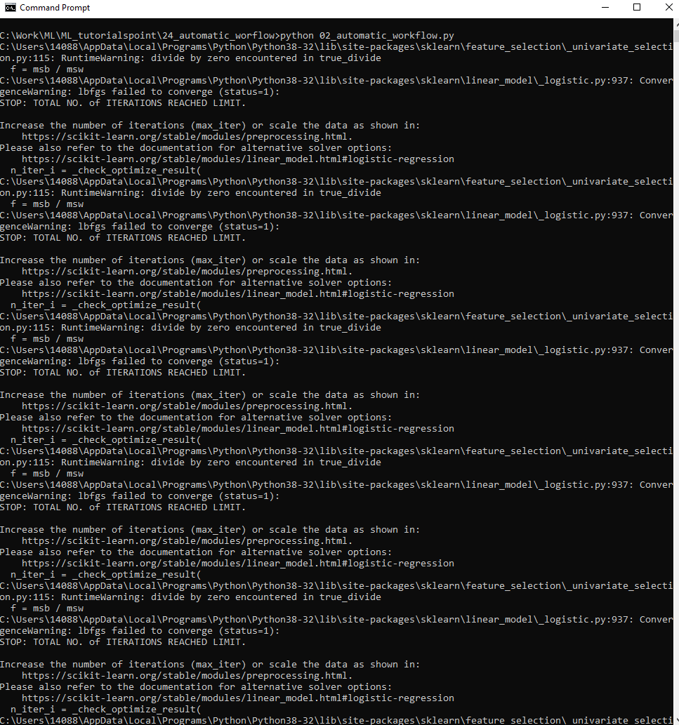
24.2 Automatic Workflow Example 2
https://www.tutorialspoint.com/machine_learning_with_python/machine_learning_with_pipelines_automatic_workflows.htm
Automatic Workflow Example 2: Model ML Pipeline and Feature Extraction
Display result

Slide 13
End of Chapter

