Slide 1

1 Nginx
Peter H. Chen

Slide 2
1 Nginx
https://www.nginx.com/resources/glossary/load-balancing/
Nginx: This document uses nginx to Horizontal Scale out the web service.
Nginx is used for load balance.
Different load balancing algorithm (Round Robin, Least connection, Least time, Hash, IP Hash, Random with two servers) provide different benefits, the choice of the load balancing depends one what you need.
Benefit of load balancing: reduce down time, scalable, redundancy, flexibility, efficiency, global server load balancing.
You also can use nginx, xmapp, apache, and etc. to scale out the Web service.

Slide 3
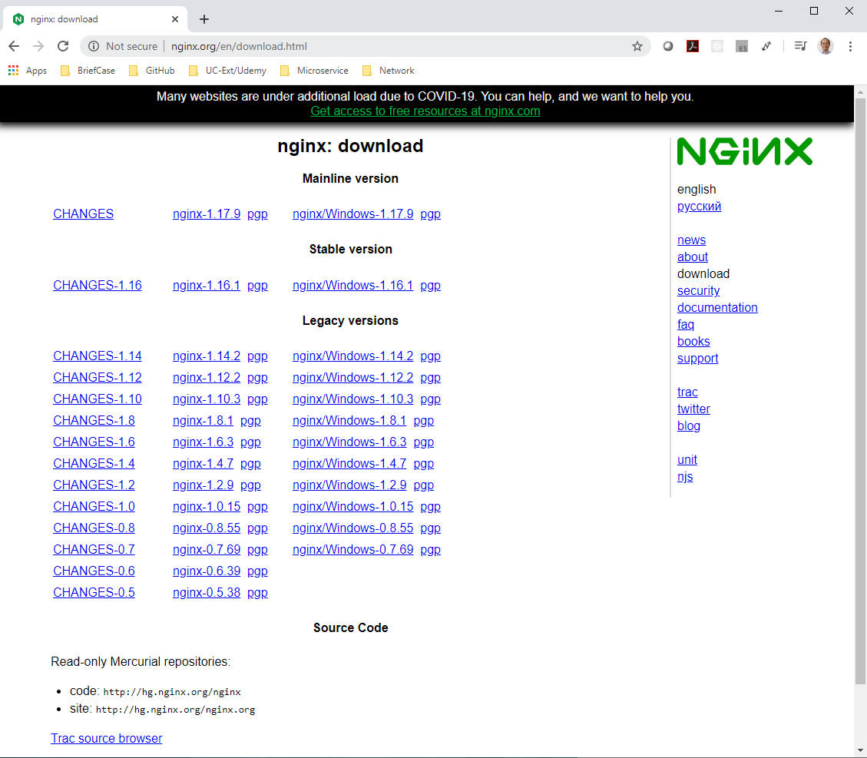
1 Nginx
https://www.youtube.com/watch?v=4BSgMbLucgM
First, download nginx: http://nginx.org/en/download.html
Pick up the mainline version

Slide 4
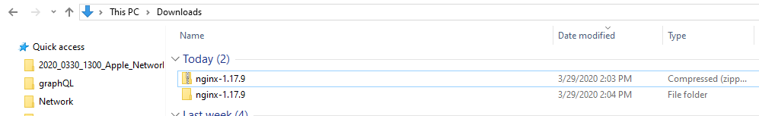
1 Nginx
https://www.youtube.com/watch?v=4BSgMbLucgM
Second, extract into folder or directory.

Slide 5
1 Nginx
https://www.youtube.com/watch?v=4BSgMbLucgM
Second, extract into folder or directory.
Go to the nginx.exe folder. Type nginx.exe
Some error message shown. The port “80” is already been used.
https://stackoverflow.com/questions/39586692/nginx-error-bind-to-0-0-0-080-failed-permission-denied

Slide 6
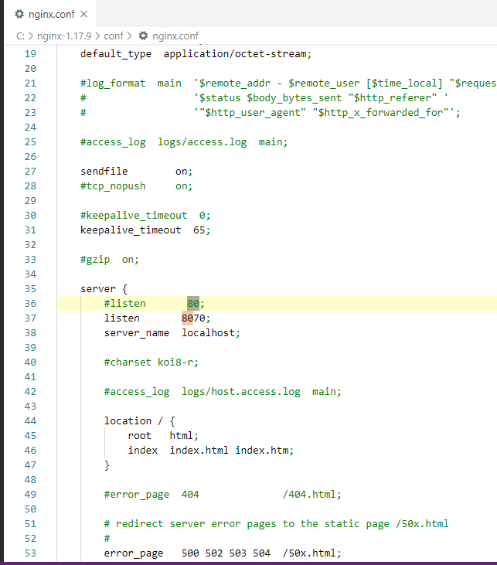
1 Nginx
https://www.youtube.com/watch?v=4BSgMbLucgM
In the conf/nginx.confg
Change port 80 into “8087” or any other number.

Slide 7

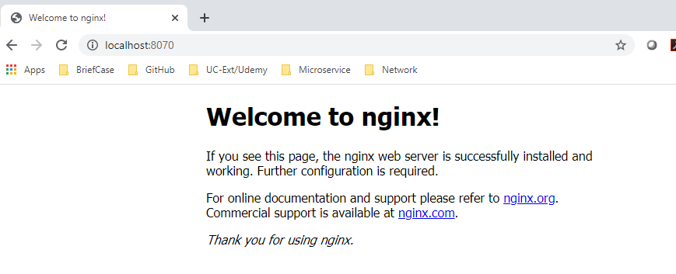
1 Nginx
https://www.youtube.com/watch?v=4BSgMbLucgM
Restart nginx
> nginx.exe
Open Browser
> localhost:8087

Slide 8
1.1 Change html or server

Slide 9
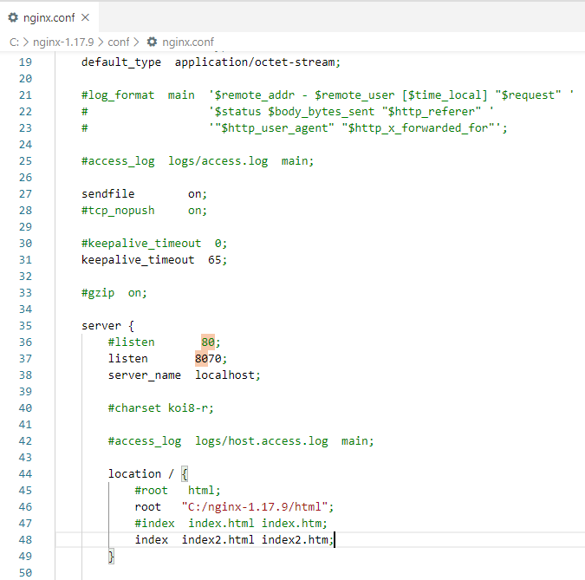
1.1 Change html or server
https://www.youtube.com/watch?v=4BSgMbLucgM
Change nginx.conf: change root point to your folder and file index2.html

Slide 10
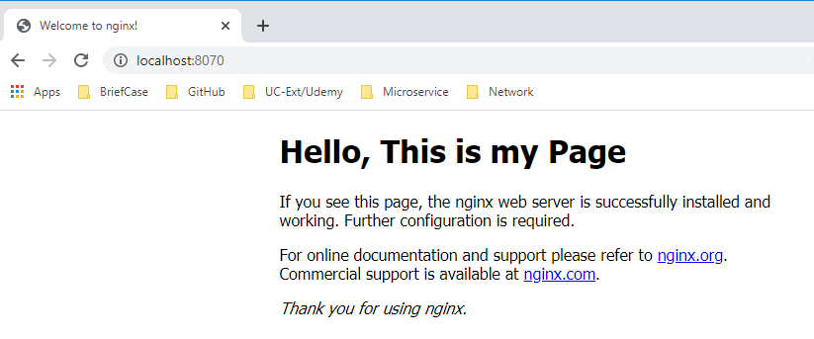
1.1 Change html or server
https://www.youtube.com/watch?v=4BSgMbLucgM
Kill the nginx.exe and restart again.

Slide 11
1.2 Configure Load Balancer

Slide 12
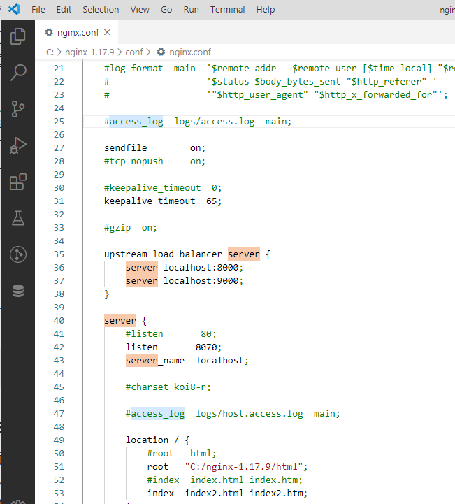
1.2 Configure Load Balancer
https://upcloud.com/community/tutorials/configure-load-balancing-nginx/
In nginx.conf, add upstream load_balance_server for port 8000 and port 9000.
upstream load_balancer_server {
server localhost:8000;
server localhost:9000;
}
server {
listen 8070;
server_name localhost;
}

Slide 13
1.2 Configure Load Balancer
https://upcloud.com/community/tutorials/configure-load-balancing-nginx/
Start the nginx server

Slide 14
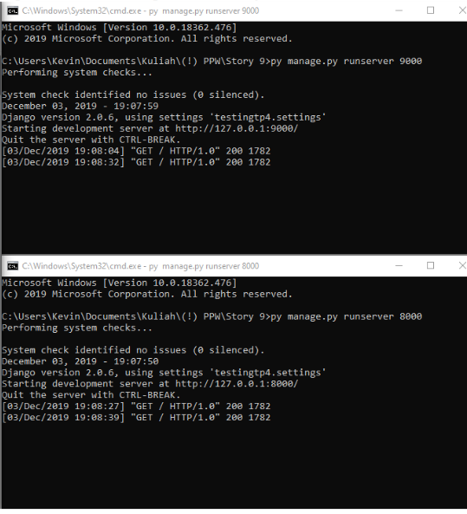
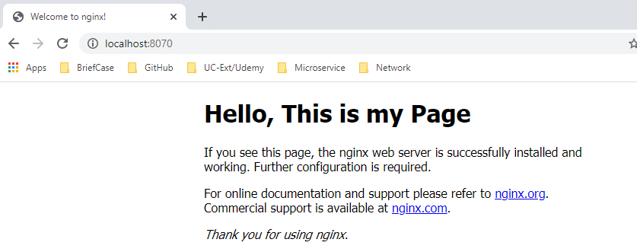
1.2 Configure Load Balancer
https://upcloud.com/community/tutorials/configure-load-balancing-nginx/
Now, we can start django or flask app from port number 8000 and port number 9000.
> py manage.py runserver 8000
> py manage.py runserver 9000

Slide 15
End of Chapter

