Slide 1

46 Chain Rule
Peter H. Chen

Slide 2
46 Chain Rule
https://www.youtube.com/watch?v=wl1myxrtQHQ&list=PLblh5JKOoLUICTaGLRoHQDuF_7q2GfuJF&index=49
We have Weight to Height Data, we can fit these data into a line.
Given a person weight, we can use fit line to predict height.
Height
We fit a line to the Data
Weight

Slide 3
46 Chain Rule
https://www.youtube.com/watch?v=wl1myxrtQHQ&list=PLblh5JKOoLUICTaGLRoHQDuF_7q2GfuJF&index=49
Now, people height to Shoe Size data. We fit them into a line.
From people height, we can predict the shoe size.
Shoe Size
We fit a line to the Data
Height

Slide 4
46 Chain Rule
https://www.youtube.com/watch?v=wl1myxrtQHQ&list=PLblh5JKOoLUICTaGLRoHQDuF_7q2GfuJF&index=49
Now, we can combine fit line of weight to height and fit line of height to shoes size.
We can use Weight to predict Height, and then use Height to predict the Shoe Size.
Height
Shoe Size
We fit a line to the Data
Height
Weight

Slide 5
46.1 Relation From Weight to Size

Slide 6
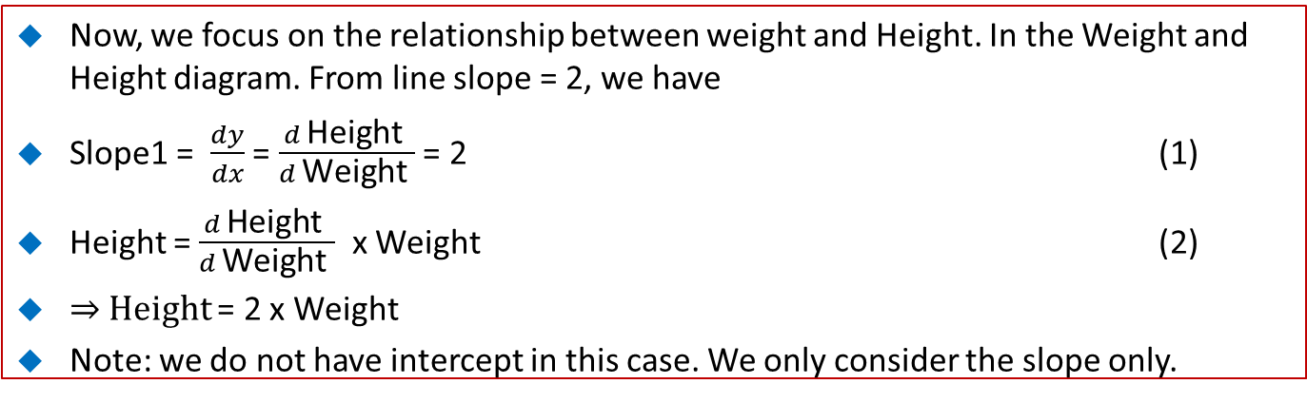
46.1 Relation From Weight to Size
https://www.youtube.com/watch?v=wl1myxrtQHQ&list=PLblh5JKOoLUICTaGLRoHQDuF_7q2GfuJF&index=49
Now, we focus on the relationship between weight and Height. In the Weight and Height diagram. From line slope = 2, we have
Slope1 = $\frac{dy}{dx}$ = $\frac{d \text{Height} }{d \text{Weight} }$ = 2 (1)
Height = $\frac{d \text{Height} }{d \text{Weight} }$ x Weight (2)
⇒ Height = 2 x Weight
Note: we do not have intercept in this case. We only consider the slope only.
Height
Weight

Slide 7
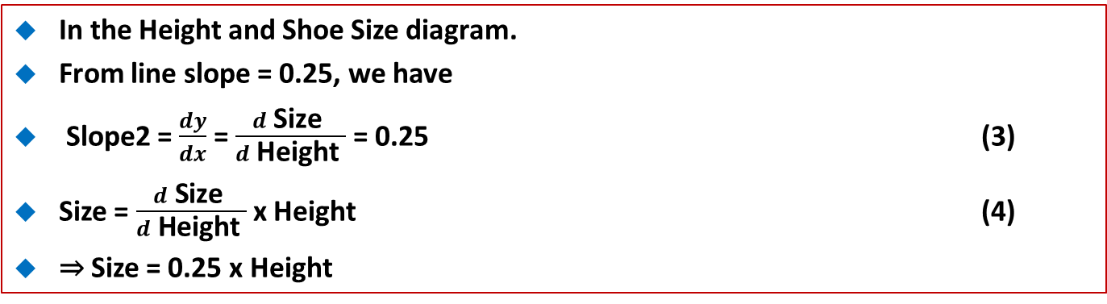
46.1 Relation From Weight to Size
https://www.youtube.com/watch?v=wl1myxrtQHQ&list=PLblh5JKOoLUICTaGLRoHQDuF_7q2GfuJF&index=49
In the Height and Shoe Size diagram.
From line slope = 0.25, we have
Slope2 = $\frac{dy}{dx}$ = $\frac{d \text{Size} }{d \text{H}\text{eight} }$ = 0.25 (3)
Size = $\frac{d \text{Size} }{d \text{Height} }$x Height (4)
⇒ Size = 0.25 x Height
Shoe Size
We fit a line to the Data
Height

Slide 8
46.2 Chain Rule Relation

Slide 9
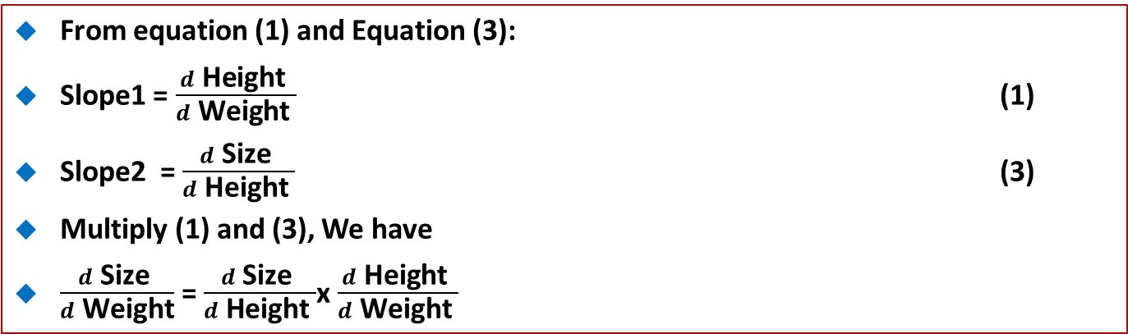
46.2 Chain Rule Relation
https://www.youtube.com/watch?v=wl1myxrtQHQ&list=PLblh5JKOoLUICTaGLRoHQDuF_7q2GfuJF&index=49
From equation (1) and Equation (3):
Slope1 = $\frac{d \text{Height} }{d \text{Weight} }$ (1)
Slope2 = $\frac{d \text{Size} }{d \text{Height} }$ (3)
Multiply (1) and (3), We have
$\frac{d \text{Size} }{d \text{Weight}}$ = $\frac{d \text{Size} }{d \text{Height} }$x $\frac{d \text{Height} }{d \text{Weight} }$
Height
Shoe Size
Weight
Height

Slide 10
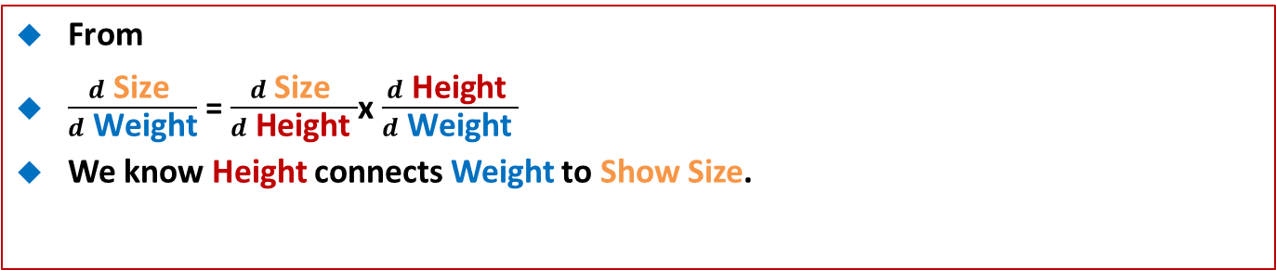
46.2 Chain Rule Relation
https://www.youtube.com/watch?v=wl1myxrtQHQ&list=PLblh5JKOoLUICTaGLRoHQDuF_7q2GfuJF&index=49
From
$\frac{d \text{Size} }{d \text{Weight}}$ = $\frac{d \text{Size} }{d \text{Height} }$x $\frac{d \text{Height} }{d \text{Weight} }$
We know Height connects Weight to Show Size.
Height
Shoe Size
Weight
Height

Slide 11
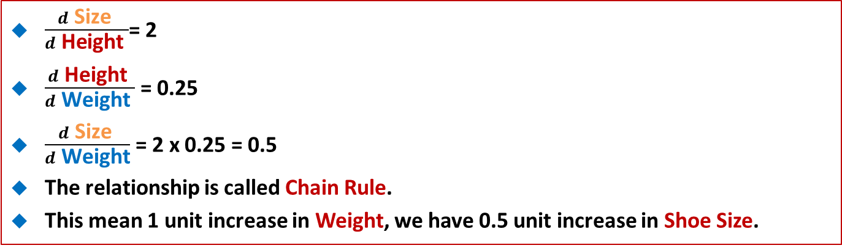
46.2 Chain Rule Relation
https://www.youtube.com/watch?v=wl1myxrtQHQ&list=PLblh5JKOoLUICTaGLRoHQDuF_7q2GfuJF&index=49
$\frac{d \text{Size} }{d \text{Height} }$= 2
$\frac{d \text{Height} }{d \text{Weight} }$ = 0.25
$\frac{d \text{Size} }{d \text{Weight}}$ = 2 x 0.25 = 0.5
The relationship is called Chain Rule.
This mean 1 unit increase in Weight, we have 0.5 unit increase in Shoe Size.
Height
Shoe Size
Weight
Height

Slide 12
46.3 Complicate Chain Rule Relation

Slide 13
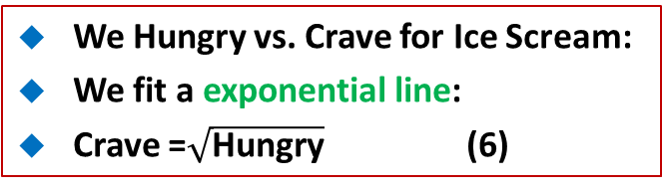
46.3 Complicate Chain Rule Relation
https://www.youtube.com/watch?v=wl1myxrtQHQ&list=PLblh5JKOoLUICTaGLRoHQDuF_7q2GfuJF&index=49
We hungry to Time since Last Snack.
We fit a exponential line:
Hungry = Time² + 1/2 (5)
We Hungry vs. Crave for Ice Scream:
We fit a exponential line:
Crave =$\sqrt{\text{Hungry}}$ (6)
Hungry
Crave for Ice Cream
Time Since Last Snack
Hunger

Slide 14
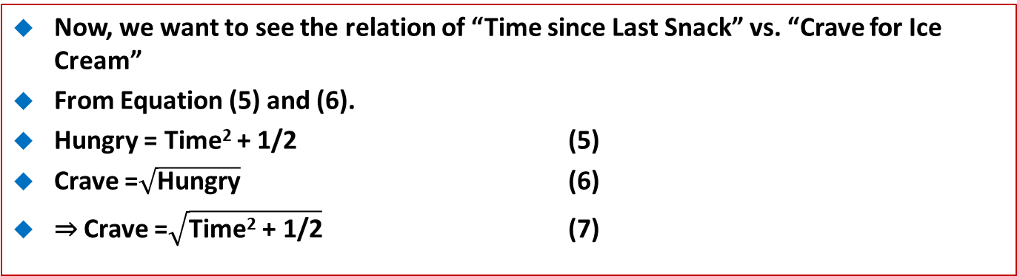
46.3 Complicate Chain Rule Relation
https://www.youtube.com/watch?v=wl1myxrtQHQ&list=PLblh5JKOoLUICTaGLRoHQDuF_7q2GfuJF&index=49
Now, we want to see the relation of “Time since Last Snack” vs. “Crave for Ice Cream”
From Equation (5) and (6).
Hungry = Time² + 1/2 (5)
Crave =$\sqrt{\text{Hungry}}$ (6)
⇒ Crave =$\sqrt{\text{Time}\text{2}\text{ + 1/2}}$ (7)
Hungry
Crave for Ice Cream
Time Since Last Snack
Hungry

Slide 15
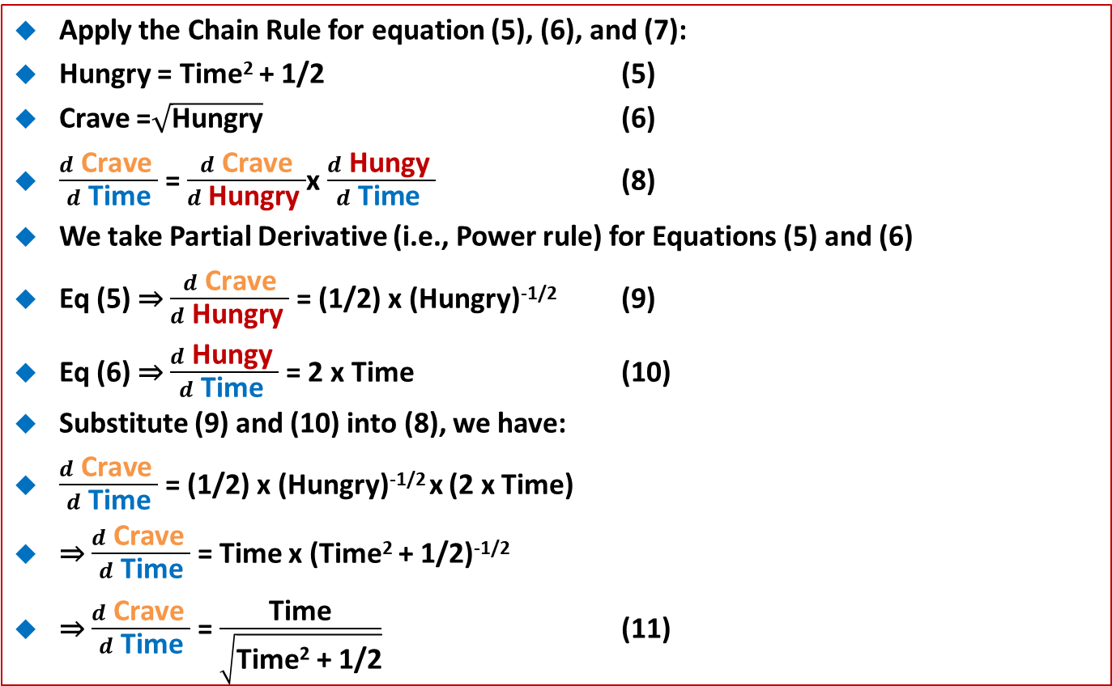
46.3 Complicate Chain Rule Relation
https://www.youtube.com/watch?v=wl1myxrtQHQ&list=PLblh5JKOoLUICTaGLRoHQDuF_7q2GfuJF&index=49
Apply the Chain Rule for equation (5), (6), and (7):
Hungry = Time² + 1/2 (5)
Crave =$\sqrt{\text{Hungry}}$ (6)
$\frac{d \text{Crave} }{d \text{Time}}$ = $\frac{d \text{Crave}}{d \text{H}\text{ungry} }$x $\frac{d \text{H}\text{ungy} }{d \text{Time} }$ (8)
We take Partial Derivative (i.e., Power rule) for Equations (5) and (6)
Eq (5) ⇒ $\frac{d \text{Crave}}{d \text{H}\text{ungry} }$ = (1/2) x (Hungry)^{-1/2} (9)
Eq (6) ⇒ $\frac{d \text{H}\text{ungy} }{d \text{Time} }$ = 2 x Time (10)
Substitute (9) and (10) into (8), we have:
$\frac{d \text{Crave} }{d \text{Time}}$ = (1/2) x (Hungry)^{-1/2} x (2 x Time)
⇒ $\frac{d \text{Crave} }{d \text{Time}}$ = Time x (Time² + 1/2)^{-1/2}
⇒ $\frac{d \text{Crave} }{d \text{Time}}$ = $\frac{\text{Time}}{\sqrt{\text{Time}\text{2}\text{ + 1/2}}}$ (11)

Slide 16
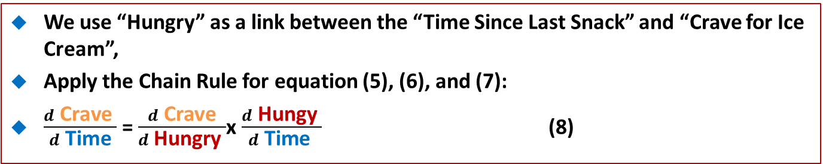
46.3 Complicate Chain Rule Relation
https://www.youtube.com/watch?v=wl1myxrtQHQ&list=PLblh5JKOoLUICTaGLRoHQDuF_7q2GfuJF&index=49
We use “Hungry” as a link between the “Time Since Last Snack” and “Crave for Ice Cream”,
Apply the Chain Rule for equation (5), (6), and (7):
$\frac{d \text{Crave} }{d \text{Time}}$ = $\frac{d \text{Crave}}{d \text{H}\text{ungry} }$x $\frac{d \text{H}\text{ungy} }{d \text{Time} }$ (8)
Hungry
Crave for Ice Cream
Hungry
Time Since Last Snack

Slide 17
46.4 Chain Rule to Sum of Squared

Slide 18
46.4 Chain Rule to Sum of Squared
https://www.youtube.com/watch?v=wl1myxrtQHQ&list=PLblh5JKOoLUICTaGLRoHQDuF_7q2GfuJF&index=49
Now, we apply the Chain Rule to SSR (Sum of Squared Residuals), this is very commonly used in Loss Function in Machine Learning.
Assume we have Weight vs. Height with measure data red dot.
We want to find the intercept of line with Slope = 1 and with the minimum SSR.
How to do that?
Height
Weight

Slide 19
46.4 Chain Rule to Sum of Squared
https://www.youtube.com/watch?v=wl1myxrtQHQ&list=PLblh5JKOoLUICTaGLRoHQDuF_7q2GfuJF&index=49
Assume we can only move the green line up and down.
The equation for the green line is:
Height = Intercept + (1 x Weight)
To keep simple, we keep the slope = 1.
Height
Weight

Slide 20
46.4 Chain Rule to Sum of Squared
https://www.youtube.com/watch?v=wl1myxrtQHQ&list=PLblh5JKOoLUICTaGLRoHQDuF_7q2GfuJF&index=49
Set the intercept to 0.
Height = 0 + (1 x Weight)
We have the predicted Height on with the weight.
And we can calculate the Residual, the difference between the Observed Height and the Predict Height.
Height
Weight

Slide 21
46.4 Chain Rule to Sum of Squared
https://www.youtube.com/watch?v=wl1myxrtQHQ&list=PLblh5JKOoLUICTaGLRoHQDuF_7q2GfuJF&index=49
We plot the intercept vs. Residual = (Observed – Predicted)
Residual = (Observed – Predicted)
Height
intercept
Weight

Slide 22
46.4 Chain Rule to Sum of Squared
https://www.youtube.com/watch?v=wl1myxrtQHQ&list=PLblh5JKOoLUICTaGLRoHQDuF_7q2GfuJF&index=49
We plot the intercept vs. Squared Residual
y = Residual²
= (Observed – Predicted)²
Residual = (Observed – Predicted)
Height
intercept
We plot the intercept vs. Squared Residual
Weight

Slide 23
46.4 Chain Rule to Sum of Squared
https://www.youtube.com/watch?v=wl1myxrtQHQ&list=PLblh5JKOoLUICTaGLRoHQDuF_7q2GfuJF&index=49
We can find the minimum Squared Residual = 0
y = Residual²
= (Observed – Predicted)²
Residual = (Observed – Predicted)
Height
intercept
Minimum Squared Residual = 0
Weight

Slide 24
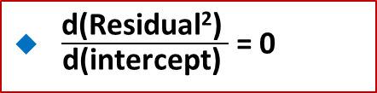
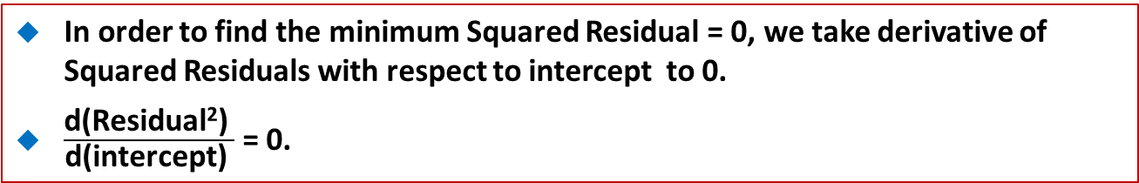
46.4 Chain Rule to Sum of Squared
https://www.youtube.com/watch?v=wl1myxrtQHQ&list=PLblh5JKOoLUICTaGLRoHQDuF_7q2GfuJF&index=49
In order to find the minimum Squared Residual = 0, we take derivative of Squared Residuals with respect to intercept to 0.
$\frac{\text{d}\text{(}\text{Residual}\text{2}\text{) }}{\text{d}\text{(}\text{intercept}\text{) }}$ = 0.
y = Residual²
= (Observed – Predicted)²
Residual = (Observed – Predicted)
Height
intercept
intercept
$\frac{\text{d}\text{(}\text{Residual}\text{2}\text{) }}{\text{d}\text{(}\text{intercept}\text{) }}$ = 0
Weight

Slide 25
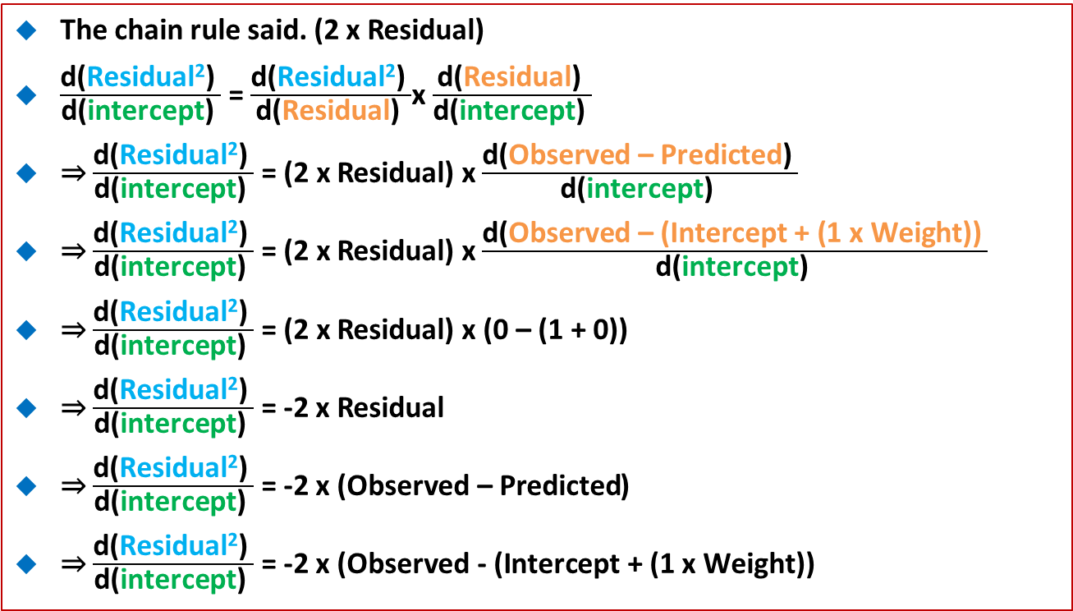
46.4 Chain Rule to Sum of Squared
https://www.youtube.com/watch?v=wl1myxrtQHQ&list=PLblh5JKOoLUICTaGLRoHQDuF_7q2GfuJF&index=49
The chain rule said. (2 x Residual)
$\frac{\text{d}\text{(}\text{Residual}\text{2}\text{) }}{\text{d}\text{(}\text{intercept}\text{) }}$ = $\frac{\text{d}\text{(}\text{Residual}\text{2}\text{) }}{\text{d}\text{(}\text{Residual}\text{) }}$x $\frac{\text{d}\text{(}\text{Residual}\text{) }}{\text{d}\text{(}\text{intercept}\text{) }}$
⇒ $\frac{\text{d}\text{(}\text{Residual}\text{2}\text{) }}{\text{d}\text{(}\text{intercept}\text{) }}$ = (2 x Residual) x $\frac{\text{d}\text{(}\text{Observed}\text{ – }\text{Predicted}\text{) }}{\text{d}\text{(}\text{intercept}\text{) }}$
⇒ $\frac{\text{d}\text{(}\text{Residual}\text{2}\text{) }}{\text{d}\text{(}\text{intercept}\text{) }}$ = (2 x Residual) x $\frac{\text{d}\text{(}\text{Observed}\text{ – (}\text{Intercept}\text{ + (1 }\text{x} \text{Weight}\text{)) }}{\text{d}\text{(}\text{intercept}\text{) }}$
⇒ $\frac{\text{d}\text{(}\text{Residual}\text{2}\text{) }}{\text{d}\text{(}\text{intercept}\text{) }}$ = (2 x Residual) x$\text{(0}\text{ – (1 + 0))}$
⇒ $\frac{\text{d}\text{(}\text{Residual}\text{2}\text{) }}{\text{d}\text{(}\text{intercept}\text{) }}$ = -2 x Residual
⇒ $\frac{\text{d}\text{(}\text{Residual}\text{2}\text{) }}{\text{d}\text{(}\text{intercept}\text{) }}$ = -2 x ($\text{Observed}\text{ – }\text{Predicted}$)
⇒ $\frac{\text{d}\text{(}\text{Residual}\text{2}\text{) }}{\text{d}\text{(}\text{intercept}\text{) }}$ = -2 x ($\text{Observed}\text{ - (}\text{Intercept}\text{ + (1 }\text{x} \text{Weight}\text{))}$
Plug in equation for residual

Slide 26
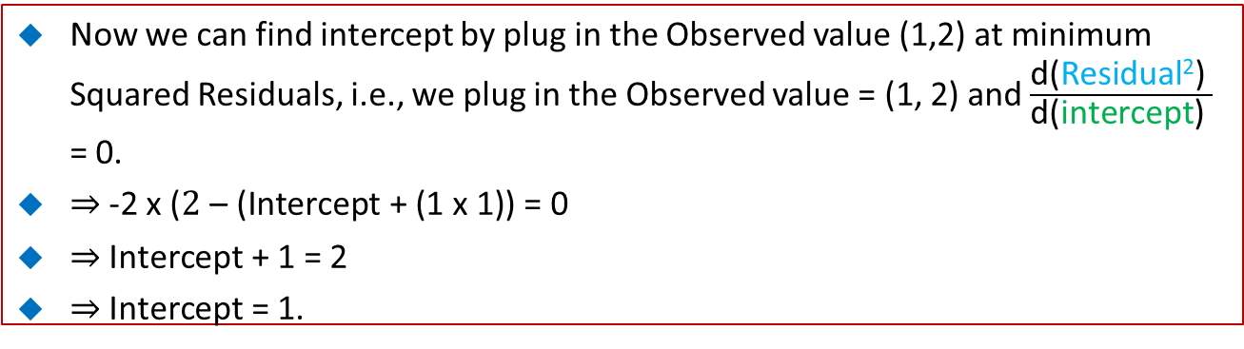
46.4 Chain Rule to Sum of Squared
https://www.youtube.com/watch?v=wl1myxrtQHQ&list=PLblh5JKOoLUICTaGLRoHQDuF_7q2GfuJF&index=49
Now we can find intercept by plug in the Observed value (1,2) at minimum Squared Residuals, i.e., we plug in the Observed value = (1, 2) and $\frac{\text{d}\text{(}\text{Residual}\text{2}\text{) }}{\text{d}\text{(}\text{intercept}\text{) }}$ = 0.
⇒ -2 x ($\text{2}\text{ –} \text{(}\text{Intercept}\text{ + (1 }\text{x}\text{ 1}\text{))}\text{ = 0}$
⇒ $\text{Intercept}\text{ + 1 = 2}$
⇒ $\text{Intercept}\text{ = 1.}$
Residual = (Observed – Predicted)
intercept
intercept
Weight

Slide 27
46.4 Chain Rule to Sum of Squared
https://www.youtube.com/watch?v=wl1myxrtQHQ&list=PLblh5JKOoLUICTaGLRoHQDuF_7q2GfuJF&index=49
When intercept = 1, we minimize the Squared Residual = 0.
Ans we have the best fitting line.
Residual = (Observed – Predicted)
intercept
intercept
Minimum Squared Residual = 0
Weight

Slide 28
46.5 Summary

Slide 29
46.5 Summary
https://www.youtube.com/watch?v=wl1myxrtQHQ&list=PLblh5JKOoLUICTaGLRoHQDuF_7q2GfuJF&index=49
Summary
We discuss Chain Rule and Partial Derivative (Power Rule) for variable relationship.
1) Partial Derivative of variable relation.
2) Loss function Use Chain Rule in Machine Learning.
3) Overall derivative can be split into several individual partial derivative by chain rule.
4) Apply power rule for each individual partial derivative.

Slide 30
46.5 Summary
https://www.youtube.com/watch?v=wl1myxrtQHQ&list=PLblh5JKOoLUICTaGLRoHQDuF_7q2GfuJF&index=49
Summary
5) Assume the measurement point to Residual (= Observed – predicted value) = 0.
6) The Overall partial Derivative = 0 at the minimum point.
Residual = (Observed – Predicted)
intercept
intercept
Minimum Squared Residual = 0
Weight

Slide 31
End of Chapter

