Slide 1

47 Gradient Descent
Peter H. Chen

Slide 2
47 Gradient Descent
https://www.youtube.com/watch?v=sDv4f4s2SB8&list=PLblh5JKOoLUICTaGLRoHQDuF_7q2GfuJF&index=50
In Machine Learning and Statistic, we find optimize solution for objective function.
When we fit a line with Linear Regression, we optimize the intercept and slope.
Height
Height = Intercept + slope x Weight
Weight

Slide 3
47 Gradient Descent
https://www.youtube.com/watch?v=sDv4f4s2SB8&list=PLblh5JKOoLUICTaGLRoHQDuF_7q2GfuJF&index=50
When we use Logistic Regression, we optimize a Squiggle (S-curve).
Is Obese
Squiggle
Is Normal
Weight

Slide 4
47 Gradient Descent
https://www.youtube.com/watch?v=sDv4f4s2SB8&list=PLblh5JKOoLUICTaGLRoHQDuF_7q2GfuJF&index=50
When we use t-SNE (Distributed Stochastic Neighbor Embedding), we optimize Clusters.
Clusters

Slide 5
47 Gradient Descent
https://www.youtube.com/watch?v=sDv4f4s2SB8&list=PLblh5JKOoLUICTaGLRoHQDuF_7q2GfuJF&index=50
These are few examples we optimize.
The Gradient Descent can optimize all of the followings (Linear Regression, Squiggle, and Clustering).
…and many more of the optimization problems in statistics, Data Science, and Machine Learning.

Slide 6
47.1 Simple Dataset

Slide 7
47.1 Simple Dataset
https://www.youtube.com/watch?v=sDv4f4s2SB8&list=PLblh5JKOoLUICTaGLRoHQDuF_7q2GfuJF&index=50
Start with Simple Data set.
We have slope 0.64 from least square.
Predicted Height = intercept + 0.64 x Weight
Height
Weight

Slide 8
47.1 Simple Dataset
https://www.youtube.com/watch?v=sDv4f4s2SB8&list=PLblh5JKOoLUICTaGLRoHQDuF_7q2GfuJF&index=50
Predicted Height = intercept + 0.64 x Weight
We move the line to find the Gradient Descent to find the optimal value for the intercept.
We can pick a initial random value for the intercept. We can start with intercept = 0.
Predicted Height = 0 + 0.64 x Weight
Height
Weight

Slide 9
47.2 Sum of Square residual Curve

Slide 10
47.2 Sum of Square residual Curve
https://www.youtube.com/watch?v=sDv4f4s2SB8&list=PLblh5JKOoLUICTaGLRoHQDuF_7q2GfuJF&index=50
We assume intercept = 0 and calculate the Sum of the Square Residuals.
Note: In Machine Learning lingo, the sum of the Squared Residuals is a type of Loss Function.
Sum of the Squared Residuals = 1.1² + 0.4² + 1.3² = 3.1
Sum of
Squared
Residuals
Height
Intercept = 0
Weight
0
1
2
Intercept

Slide 11
47.2 Sum of Square residual Curve
https://www.youtube.com/watch?v=sDv4f4s2SB8&list=PLblh5JKOoLUICTaGLRoHQDuF_7q2GfuJF&index=50
We have optimal solution by using Gradient Descent.
We start with random value.
When close to the optimal value, gradient descent getting slow.
Finally, Gradient Descent find the optimal point.
Sum of
Squared
Residuals
Height
Weight
0
1
2
Intercept

Slide 12
47.3 Find Minimum Point

Slide 13
47.3 Find Minimum Point
https://www.youtube.com/watch?v=sDv4f4s2SB8&list=PLblh5JKOoLUICTaGLRoHQDuF_7q2GfuJF&index=50
We have an equation for the curve and take partial derivative (slope = 0) of each individual point to get the optimal value.
Take derivative (loss function or sum of squared residuals) with chain rule for each individual points
When close to the optimal point, we take small step size.
Sum of
Squared
Residuals
Height
Slope = 0
Small Step when close to optimal point
0
1
Intercept
Weight
2

Slide 14
47.4 Take Partial Derivative

Slide 15
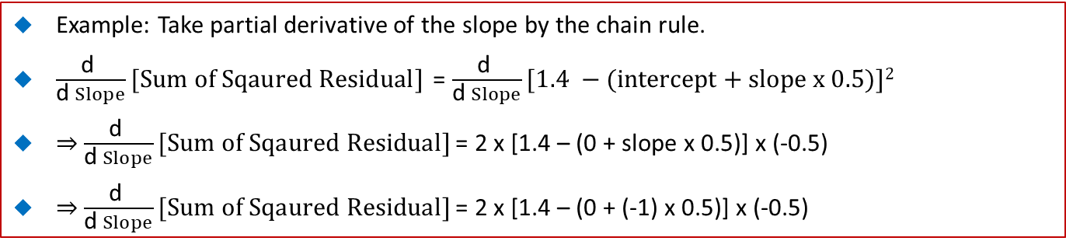
47.4 Take Partial Derivative
https://www.youtube.com/watch?v=sDv4f4s2SB8&list=PLblh5JKOoLUICTaGLRoHQDuF_7q2GfuJF&index=50
Example: Take partial derivative of the slope by the chain rule.
$\frac{\text{d} }{\text{d} Slope}[Sum of Sqaured Residual]$ = $\frac{\text{d} }{\text{d} Slope}[1.4 −(intercept+slope x 0.5)]2$
⇒ $\frac{\text{d} }{\text{d} Slope}[Sum of Sqaured Residual]$ = 2 x [1.4 – (0 + slope x 0.5)] x (-0.5)
⇒ $\frac{\text{d} }{\text{d} Slope}[Sum of Sqaured Residual]$ = 2 x [1.4 – (0 + (-1) x 0.5)] x (-0.5)
Sum of
Squared
Residuals
1.4
0
0.5
1
Intercept
2

Slide 16
47.5 Minimize Slope and Intercept

Slide 17
47.5 Minimize Slope and Intercept
https://www.youtube.com/watch?v=sDv4f4s2SB8&list=PLblh5JKOoLUICTaGLRoHQDuF_7q2GfuJF&index=50
In Gradient Descent, we have
Predicted Height = intercept + slope x Weight
Our goal is to find the optimal value for intercept and slope.
For example, If we start with intercept = 0 and slope = 1, then we can use weight to predict height.
Height
Predicted Height = Intercept + slope x Weight
Weight

Slide 18
47.5 Minimize Slope and Intercept
https://www.youtube.com/watch?v=sDv4f4s2SB8&list=PLblh5JKOoLUICTaGLRoHQDuF_7q2GfuJF&index=50
Then we can use sum of the squared residuals as the Loss Function to determine how well of the initial line fit the data.
Note: In Machine Learning ling, the Sum of the squared Residuals is a type of Loss Function.
  Sum of the squared residuals = (Observed Height – Predicted Height)²
To find the optimal value, we plug in the equation for the prediction.
  Sum of the squared residuals = (Observed Height – (Intercept + slope x Weight))²
Height
Predicted Height = Intercept + slope x Weight
Weight

Slide 19
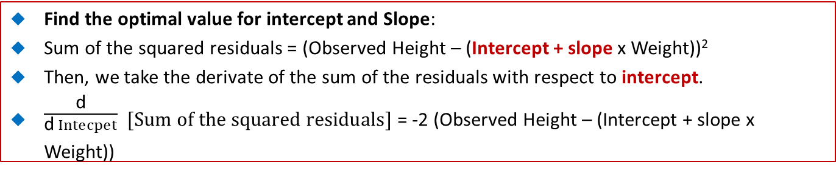
47.5 Minimize Slope and Intercept
https://www.youtube.com/watch?v=vMh0zPT0tLI&list=PLblh5JKOoLUICTaGLRoHQDuF_7q2GfuJF&index=48
Find the optimal value for intercept and Slope:
Sum of the squared residuals = (Observed Height – (Intercept + slope x Weight))²
Then, we take the derivate of the sum of the residuals with respect to intercept.
$\frac{\text{d}}{\text{d} Intecpet}$ $[Sum of the squared residuals]$ = -2 (Observed Height – (Intercept + slope x Weight))
Height
Predicted Height = Intercept + slope x Weight
Weight

Slide 20
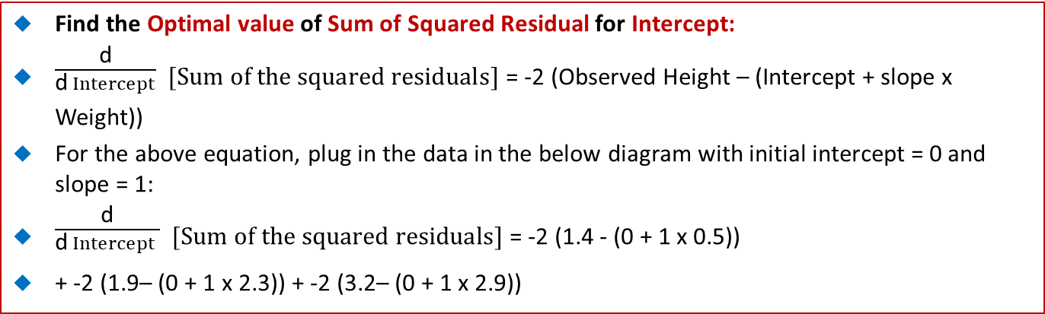
47.5 Minimize Slope and Intercept
https://www.youtube.com/watch?v=vMh0zPT0tLI&list=PLblh5JKOoLUICTaGLRoHQDuF_7q2GfuJF&index=48
Find the Optimal value of Sum of Squared Residual for Intercept:
$\frac{\text{d}}{\text{d} Intercept}$ $[Sum of the squared residuals]$ = -2 (Observed Height – (Intercept + slope x Weight))
For the above equation, plug in the data in the below diagram with initial intercept = 0 and slope = 1:
$\frac{\text{d}}{\text{d} Intercept }$ $[Sum of the squared residuals]$ = -2 (1.4 - (0 + 1 x 0.5))
+ -2 (1.9– (0 + 1 x 2.3)) + -2 (3.2– (0 + 1 x 2.9))
3.2
Height
Start with intercept = 0
1.9
1.4
Find the optimal value of Sum of Residual for Intercept
0.5
2.3
2.9
Weight

Slide 21
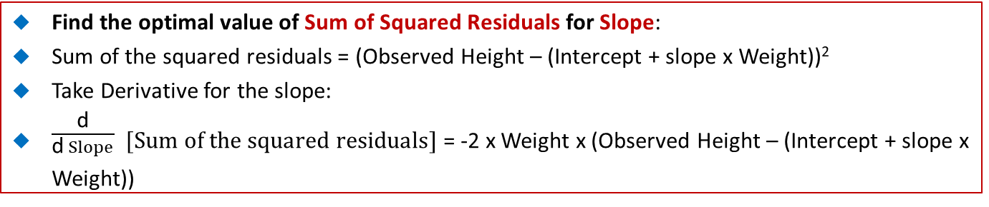
47.5 Minimize Slope and Intercept
https://www.youtube.com/watch?v=vMh0zPT0tLI&list=PLblh5JKOoLUICTaGLRoHQDuF_7q2GfuJF&index=48
Find the optimal value of Sum of Squared Residuals for Slope:
Sum of the squared residuals = (Observed Height – (Intercept + slope x Weight))²
Take Derivative for the slope:
$\frac{\text{d}}{\text{d} Slope}$ $[Sum of the squared residuals]$ = -2 x Weight x (Observed Height – (Intercept + slope x Weight))
Height
Weight

Slide 22
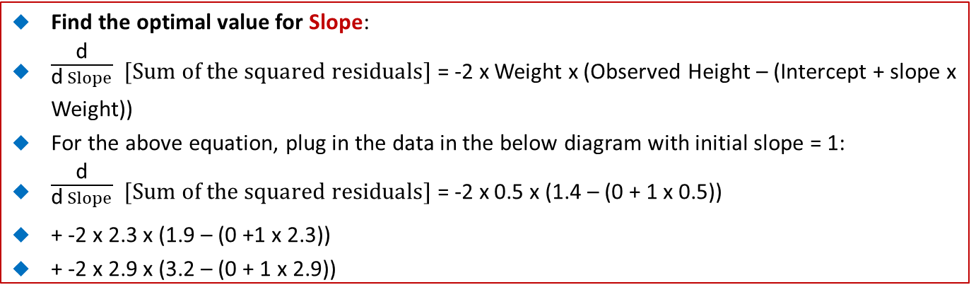
47.5 Minimize Slope and Intercept
https://www.youtube.com/watch?v=vMh0zPT0tLI&list=PLblh5JKOoLUICTaGLRoHQDuF_7q2GfuJF&index=48
Find the optimal value for Slope:
$\frac{\text{d}}{\text{d} Slope}$ $[Sum of the squared residuals]$ = -2 x Weight x (Observed Height – (Intercept + slope x Weight))
For the above equation, plug in the data in the below diagram with initial slope = 1:
$\frac{\text{d}}{\text{d} Slope}$ $[Sum of the squared residuals]$ = -2 x 0.5 x (1.4 – (0 + 1 x 0.5))
+ -2 x 2.3 x (1.9 – (0 +1 x 2.3))
+ -2 x 2.9 x (3.2 – (0 + 1 x 2.9))
3.2
Height
1.9
1.4
0.5
2.3
2.9
Weight

Slide 23
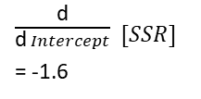
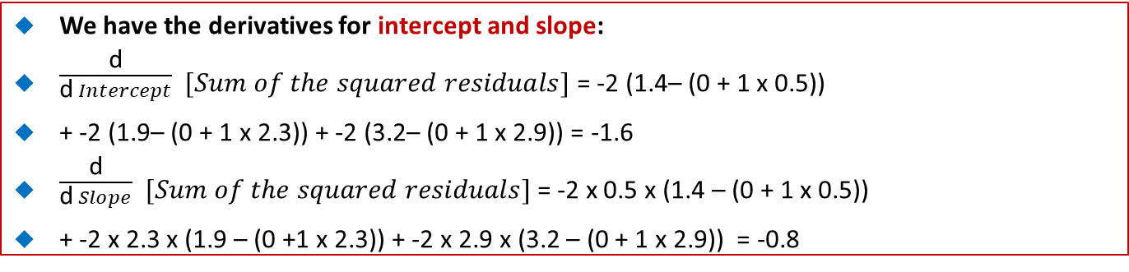
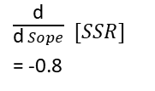
47.5 Minimize Slope and Intercept
https://www.youtube.com/watch?v=vMh0zPT0tLI&list=PLblh5JKOoLUICTaGLRoHQDuF_7q2GfuJF&index=48
We have the derivatives for intercept and slope:
$\frac{\text{d}}{\text{d} Intercept}$ $[Sum of the squared residuals]$ = -2 (1.4– (0 + 1 x 0.5))
+ -2 (1.9– (0 + 1 x 2.3)) + -2 (3.2– (0 + 1 x 2.9)) = -1.6
$\frac{\text{d}}{\text{d} Slope}$ $[Sum of the squared residuals]$ = -2 x 0.5 x (1.4 – (0 + 1 x 0.5))
+ -2 x 2.3 x (1.9 – (0 +1 x 2.3)) + -2 x 2.9 x (3.2 – (0 + 1 x 2.9)) = -0.8
3.2
$\frac{\text{d}}{\text{d} Sope}$ $[SSR]$
= -0.8
Height
$\frac{\text{d}}{\text{d} Intercept}$ $[SSR]$
= -1.6
1.9
1.4
SSR
SSR
2.9
0
0.5
1
2
0
2
4
0.5
2.3
Intercept
Slope
Weight

Slide 24
47.6 Calculate Step Size

Slide 25
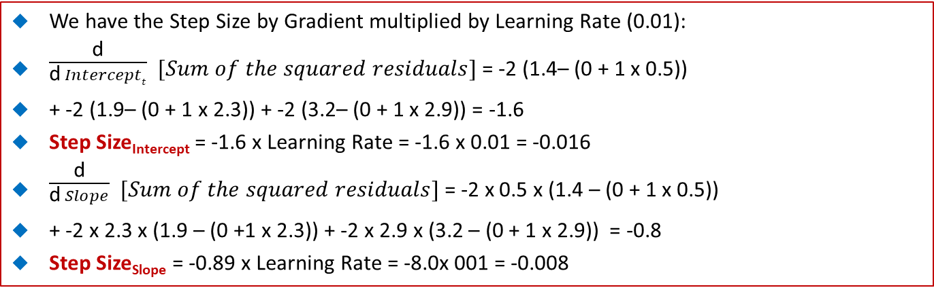
47.6 Calculate Step Size
https://www.youtube.com/watch?v=vMh0zPT0tLI&list=PLblh5JKOoLUICTaGLRoHQDuF_7q2GfuJF&index=48
We have the Step Size by Gradient multiplied by Learning Rate (0.01):
$\frac{\text{d}}{\text{d} Interceptt}$ $[Sum of the squared residuals]$ = -2 (1.4– (0 + 1 x 0.5))
+ -2 (1.9– (0 + 1 x 2.3)) + -2 (3.2– (0 + 1 x 2.9)) = -1.6
Step Size_{Intercept} = -1.6 x Learning Rate = -1.6 x 0.01 = -0.016
$\frac{\text{d}}{\text{d} Slope}$ $[Sum of the squared residuals]$ = -2 x 0.5 x (1.4 – (0 + 1 x 0.5))
+ -2 x 2.3 x (1.9 – (0 +1 x 2.3)) + -2 x 2.9 x (3.2 – (0 + 1 x 2.9)) = -0.8
Step Size_{Slope} = -0.89 x Learning Rate = -8.0x 001 = -0.008
3.2
Height
1.9
1.4
SSR
SSR
Step Size
Step Size
0.5
2.3
2.9
0
1
2
0
2
4
Intercept
Weight
Intercept
Slope

Slide 26
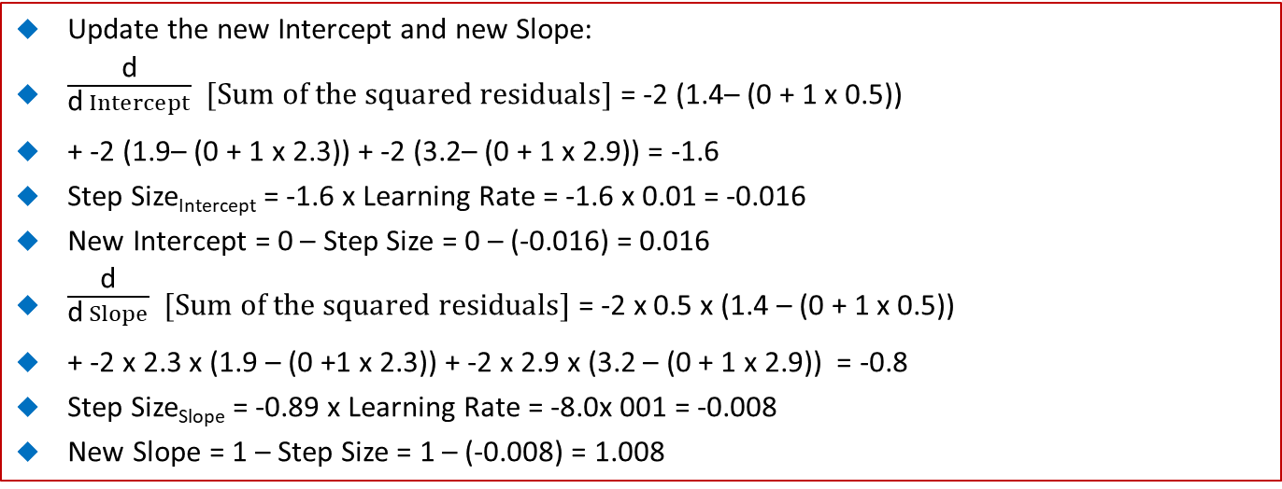
47.6 Calculate Step Size
https://www.youtube.com/watch?v=vMh0zPT0tLI&list=PLblh5JKOoLUICTaGLRoHQDuF_7q2GfuJF&index=48
Update the new Intercept and new Slope:
$\frac{\text{d}}{\text{d} Intercept}$ $[Sum of the squared residuals]$ = -2 (1.4– (0 + 1 x 0.5))
+ -2 (1.9– (0 + 1 x 2.3)) + -2 (3.2– (0 + 1 x 2.9)) = -1.6
Step Size_{Intercept} = -1.6 x Learning Rate = -1.6 x 0.01 = -0.016
New Intercept = 0 – Step Size = 0 – (-0.016) = 0.016
$\frac{\text{d}}{\text{d} Slope}$ $[Sum of the squared residuals]$ = -2 x 0.5 x (1.4 – (0 + 1 x 0.5))
+ -2 x 2.3 x (1.9 – (0 +1 x 2.3)) + -2 x 2.9 x (3.2 – (0 + 1 x 2.9)) = -0.8
Step Size_{Slope} = -0.89 x Learning Rate = -8.0x 001 = -0.008
New Slope = 1 – Step Size = 1 – (-0.008) = 1.008

Slide 27
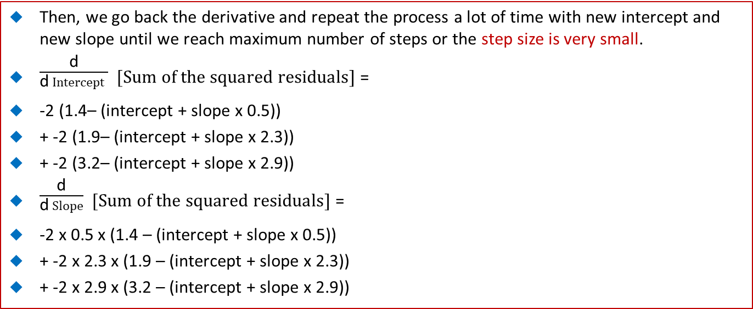
47.6 Calculate Step Size
https://www.youtube.com/watch?v=vMh0zPT0tLI&list=PLblh5JKOoLUICTaGLRoHQDuF_7q2GfuJF&index=48
Then, we go back the derivative and repeat the process a lot of time with new intercept and new slope until we reach maximum number of steps or the step size is very small.
$\frac{\text{d}}{\text{d} Intercept }$ $[Sum of the squared residuals]$ =
-2 (1.4– (intercept + slope x 0.5))
+ -2 (1.9– (intercept + slope x 2.3))
+ -2 (3.2– (intercept + slope x 2.9))
$\frac{\text{d}}{\text{d} Slope}$ $[Sum of the squared residuals]$ =
-2 x 0.5 x (1.4 – (intercept + slope x 0.5))
+ -2 x 2.3 x (1.9 – (intercept + slope x 2.3))
+ -2 x 2.9 x (3.2 – (intercept + slope x 2.9))

Slide 28
47.7 Gradient Descent Algorithm

Slide 29
47.7 Gradient Descent Algorithm
https://www.youtube.com/watch?v=sDv4f4s2SB8&list=PLblh5JKOoLUICTaGLRoHQDuF_7q2GfuJF&index=50
Gradient Descent Algorithm:
Step 1: Take derivative of the Loss Function (Sum of the Squared Residuals) for each parameter in Loss Function. In machine learning dialect, take Gradient of the Loss Function.
Step 2: Pick random values for the parameters.
Step 3. Plug the parameter values into the derivative (Gradient)
Step 4: Calculate the step size: Step size = Slope x Leaning Rate
Step 5: Calculate the New Parameters:
  New Parameter = Old Parameter - Step Size.
  If the step size is very step, then stop, else go back to Step 3
In our example, we only have very small data set.
In case, we have billions of point, we need Stochastic Gradient Descent which we randomly selected subset of the data at every step rather than the full dataset.
The Stochastic Gradient Descent reduces the time spent in calculating the derivatives of the Loss Function.

Slide 30
End of Chapter

