Slide 1

48 Stochastic Gradient Descent
Peter H. Chen

Slide 2
48 Stochastic Gradient Descent
https://www.youtube.com/watch?v=vMh0zPT0tLI&list=PLblh5JKOoLUICTaGLRoHQDuF_7q2GfuJF&index=51
We discuss the Stochastic Gradient Descent.
First, we review the Gradient Descent.

Slide 3
48.1 Gradient Descent Example

Slide 4
48.1 Gradient Descent Example
https://www.youtube.com/watch?v=vMh0zPT0tLI&list=PLblh5JKOoLUICTaGLRoHQDuF_7q2GfuJF&index=51
In Gradient Descent, we have
Predicted Height = intercept + slope x Weight
Our goal is to find the optimal value for intercept and slope.
For example, If we start with intercept = 0 and slope = 1, then we can use weight to predict height.
Height
Predicted Height = Intercept + slope x Weight
Weight

Slide 5
48.1 Gradient Descent Example
https://www.youtube.com/watch?v=vMh0zPT0tLI&list=PLblh5JKOoLUICTaGLRoHQDuF_7q2GfuJF&index=51
Then we can use sum of the squared residuals as the Loss Function to determine how well of the initial line fit the data.
In Machine Learning lingo, SSR (Sum of Squared Residual) means Loss Function.
  SSR (Sum of the squared residuals) = (Observed Height – Predicted Height)²
To find the optimal value, we plug in the equation for the prediction.
  SSR (Sum of the squared residuals) = (Observed Height – (Intercept + slope x Weight))²
Height
Predicted Height = Intercept + slope x Weight
Weight

Slide 6
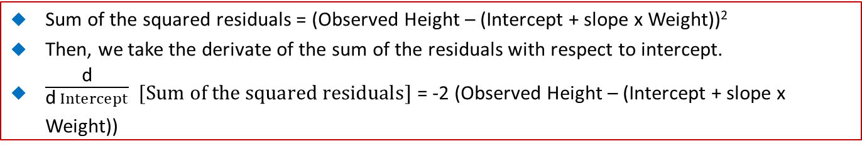
48.1 Gradient Descent Example
https://www.youtube.com/watch?v=vMh0zPT0tLI&list=PLblh5JKOoLUICTaGLRoHQDuF_7q2GfuJF&index=51
Sum of the squared residuals = (Observed Height – (Intercept + slope x Weight))²
Then, we take the derivate of the sum of the residuals with respect to intercept.
$\frac{\text{d}}{\text{d} Intercept}$ $[Sum of the squared residuals]$ = -2 (Observed Height – (Intercept + slope x Weight))
Height
Predicted Height = Intercept + slope x Weight
Weight

Slide 7
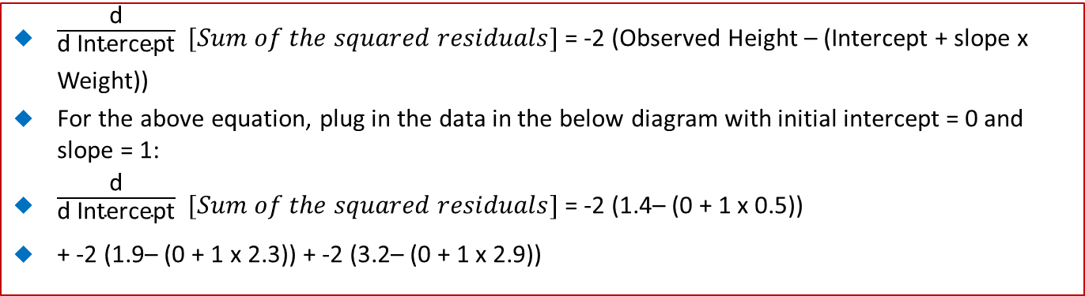
48.1 Gradient Descent Example
https://www.youtube.com/watch?v=vMh0zPT0tLI&list=PLblh5JKOoLUICTaGLRoHQDuF_7q2GfuJF&index=51
$\frac{\text{d}}{\text{d} \text{Intercept}}$ $[Sum of the squared residuals]$ = -2 (Observed Height – (Intercept + slope x Weight))
For the above equation, plug in the data in the below diagram with initial intercept = 0 and slope = 1:
$\frac{\text{d}}{\text{d} \text{Intercept}}$ $[Sum of the squared residuals]$ = -2 (1.4– (0 + 1 x 0.5))
+ -2 (1.9– (0 + 1 x 2.3)) + -2 (3.2– (0 + 1 x 2.9))
Height
3.2
1.9
1.4
0.5
2.3
2.9
Weight

Slide 8
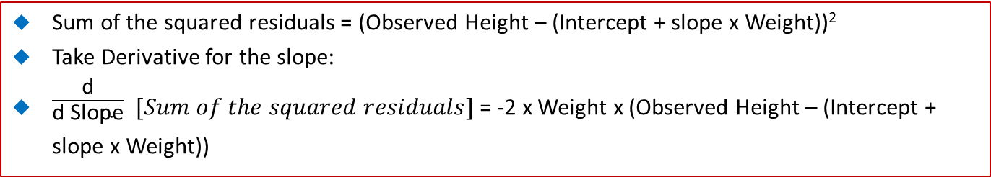
48.1 Gradient Descent Example
https://www.youtube.com/watch?v=vMh0zPT0tLI&list=PLblh5JKOoLUICTaGLRoHQDuF_7q2GfuJF&index=51
Sum of the squared residuals = (Observed Height – (Intercept + slope x Weight))²
Take Derivative for the slope:
$\frac{\text{d}}{\text{d} \text{Slope}}$ $[Sum of the squared residuals]$ = -2 x Weight x (Observed Height – (Intercept + slope x Weight))
Height
Weight

Slide 9
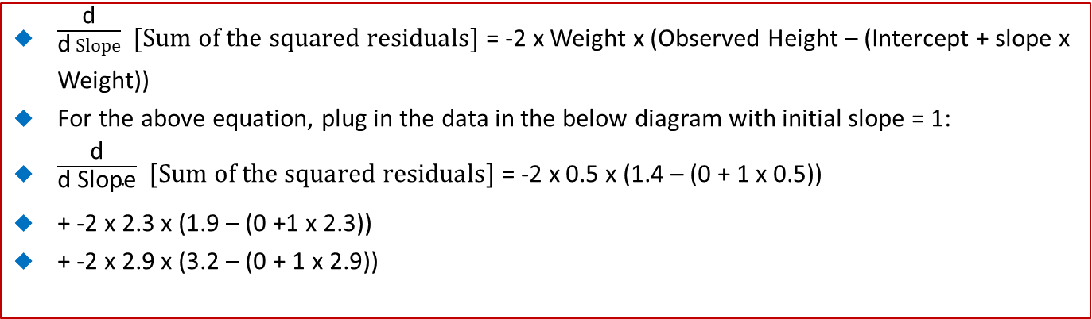
48.1 Gradient Descent Example
https://www.youtube.com/watch?v=vMh0zPT0tLI&list=PLblh5JKOoLUICTaGLRoHQDuF_7q2GfuJF&index=51
$\frac{\text{d}}{\text{d} Slope}$ $[Sum of the squared residuals]$ = -2 x Weight x (Observed Height – (Intercept + slope x Weight))
For the above equation, plug in the data in the below diagram with initial slope = 1:
$\frac{\text{d}}{\text{d} \text{Slope}}$ $[Sum of the squared residuals]$ = -2 x 0.5 x (1.4 – (0 + 1 x 0.5))
+ -2 x 2.3 x (1.9 – (0 +1 x 2.3))
+ -2 x 2.9 x (3.2 – (0 + 1 x 2.9))
3.2
Height
1.9
1.4
0.5
2.3
2.9
Weight

Slide 10
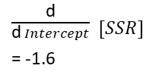
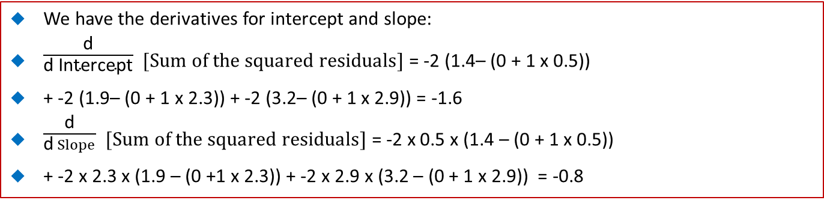
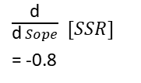
48.1 Gradient Descent Example
https://www.youtube.com/watch?v=vMh0zPT0tLI&list=PLblh5JKOoLUICTaGLRoHQDuF_7q2GfuJF&index=51
We have the derivatives for intercept and slope:
$\frac{\text{d}}{\text{d} \text{Intercept}}$ $[Sum of the squared residuals]$ = -2 (1.4– (0 + 1 x 0.5))
+ -2 (1.9– (0 + 1 x 2.3)) + -2 (3.2– (0 + 1 x 2.9)) = -1.6
$\frac{\text{d}}{\text{d} Slope}$ $[Sum of the squared residuals]$ = -2 x 0.5 x (1.4 – (0 + 1 x 0.5))
+ -2 x 2.3 x (1.9 – (0 +1 x 2.3)) + -2 x 2.9 x (3.2 – (0 + 1 x 2.9)) = -0.8
3.2
$\frac{\text{d}}{\text{d} Sope}$ $[SSR]$
= -0.8
Height
$\frac{\text{d}}{\text{d} Intercept}$ $[SSR]$
= -1.6
1.9
1.4
SSR
SSR
0.5
2.3
0
0.5
1
2
0
2
4
2.9
Slope
Intercept

Slide 11
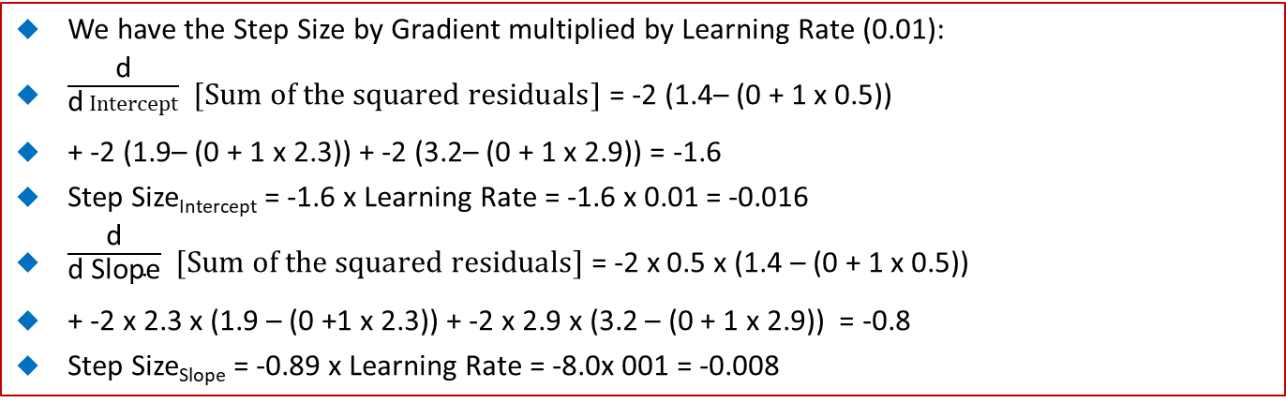
48.1 Gradient Descent Example
https://www.youtube.com/watch?v=vMh0zPT0tLI&list=PLblh5JKOoLUICTaGLRoHQDuF_7q2GfuJF&index=51
We have the Step Size by Gradient multiplied by Learning Rate (0.01):
$\frac{\text{d}}{\text{d} Intercept}$ $[Sum of the squared residuals]$ = -2 (1.4– (0 + 1 x 0.5))
+ -2 (1.9– (0 + 1 x 2.3)) + -2 (3.2– (0 + 1 x 2.9)) = -1.6
Step Size_{Intercept} = -1.6 x Learning Rate = -1.6 x 0.01 = -0.016
$\frac{\text{d}}{\text{d} \text{Slope}}$ $[Sum of the squared residuals]$ = -2 x 0.5 x (1.4 – (0 + 1 x 0.5))
+ -2 x 2.3 x (1.9 – (0 +1 x 2.3)) + -2 x 2.9 x (3.2 – (0 + 1 x 2.9)) = -0.8
Step Size_{Slope} = -0.89 x Learning Rate = -8.0x 001 = -0.008
3.2
Height
1.9
1.4
SSR
SSR
Step Size
Step Size
0.5
2.3
2.9
0
1
2
0
2
4

Slide 12
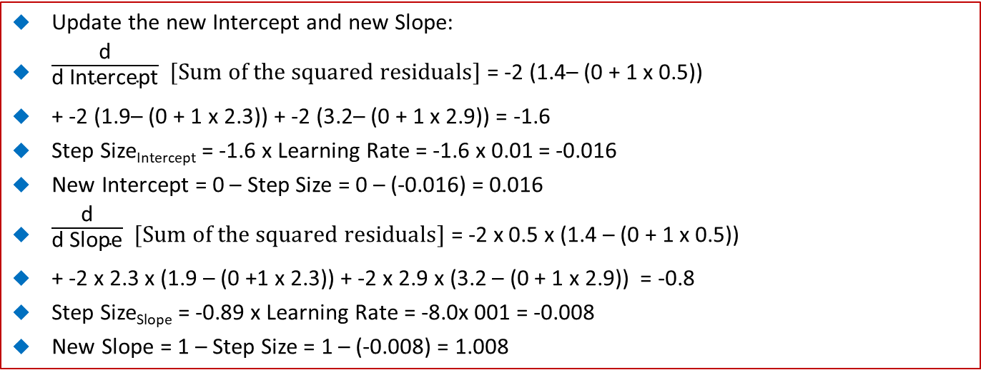
48.1 Gradient Descent Example
https://www.youtube.com/watch?v=vMh0zPT0tLI&list=PLblh5JKOoLUICTaGLRoHQDuF_7q2GfuJF&index=51
Update the new Intercept and new Slope:
$\frac{\text{d}}{\text{d} \text{Intercept}}$ $[Sum of the squared residuals]$ = -2 (1.4– (0 + 1 x 0.5))
+ -2 (1.9– (0 + 1 x 2.3)) + -2 (3.2– (0 + 1 x 2.9)) = -1.6
Step Size_{Intercept} = -1.6 x Learning Rate = -1.6 x 0.01 = -0.016
New Intercept = 0 – Step Size = 0 – (-0.016) = 0.016
$\frac{\text{d}}{\text{d} \text{Slope}}$ $[Sum of the squared residuals]$ = -2 x 0.5 x (1.4 – (0 + 1 x 0.5))
+ -2 x 2.3 x (1.9 – (0 +1 x 2.3)) + -2 x 2.9 x (3.2 – (0 + 1 x 2.9)) = -0.8
Step Size_{Slope} = -0.89 x Learning Rate = -8.0x 001 = -0.008
New Slope = 1 – Step Size = 1 – (-0.008) = 1.008

Slide 13
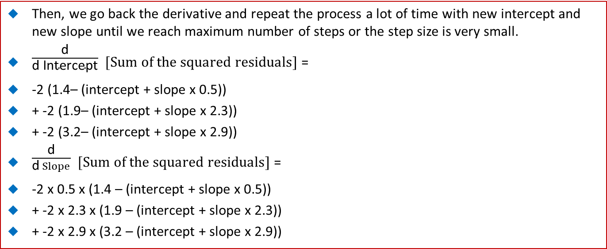
48.1 Gradient Descent Example
https://www.youtube.com/watch?v=vMh0zPT0tLI&list=PLblh5JKOoLUICTaGLRoHQDuF_7q2GfuJF&index=51
Then, we go back the derivative and repeat the process a lot of time with new intercept and new slope until we reach maximum number of steps or the step size is very small.
$\frac{\text{d}}{\text{d} \text{Intercept}}$ $[Sum of the squared residuals]$ =
-2 (1.4– (intercept + slope x 0.5))
+ -2 (1.9– (intercept + slope x 2.3))
+ -2 (3.2– (intercept + slope x 2.9))
$\frac{\text{d}}{\text{d} Slope}$ $[Sum of the squared residuals]$ =
-2 x 0.5 x (1.4 – (intercept + slope x 0.5))
+ -2 x 2.3 x (1.9 – (intercept + slope x 2.3))
+ -2 x 2.9 x (3.2 – (intercept + slope x 2.9))

Slide 14
48.2 Stochastic Gradient Descent

Slide 15
48.2 Stochastic Gradient Descent
https://www.youtube.com/watch?v=vMh0zPT0tLI&list=PLblh5JKOoLUICTaGLRoHQDuF_7q2GfuJF&index=51
In this example, we use two parameters: intercept and slope
Predicted Height = intercept + slope x weight
Height
Weight

Slide 16
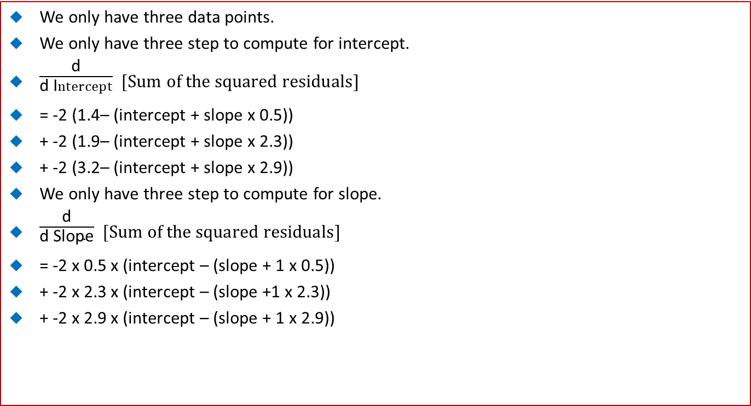
48.2 Stochastic Gradient Descent
https://www.youtube.com/watch?v=vMh0zPT0tLI&list=PLblh5JKOoLUICTaGLRoHQDuF_7q2GfuJF&index=51
We only have three data points.
We only have three step to compute for intercept.
$\frac{\text{d}}{\text{d} \text{I}ntercept}$ $[Sum of the squared residuals]$
= -2 (1.4– (intercept + slope x 0.5))
+ -2 (1.9– (intercept + slope x 2.3))
+ -2 (3.2– (intercept + slope x 2.9))
We only have three step to compute for slope.
$\frac{\text{d}}{\text{d} \text{Slope}}$ $[Sum of the squared residuals]$
= -2 x 0.5 x (intercept – (slope + 1 x 0.5))
+ -2 x 2.3 x (intercept – (slope +1 x 2.3))
+ -2 x 2.9 x (intercept – (slope + 1 x 2.9))

Slide 17
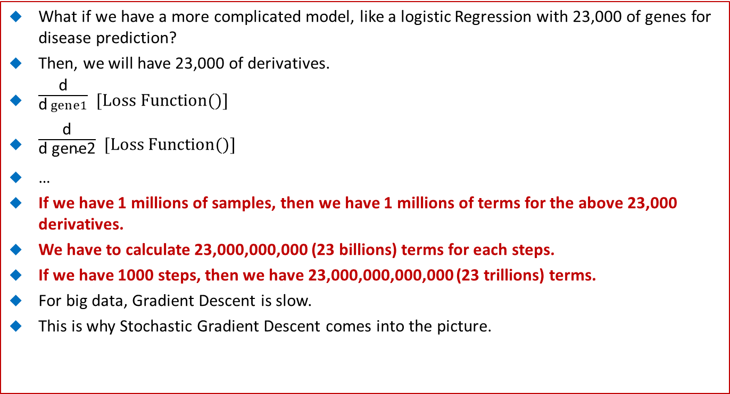
48.2 Stochastic Gradient Descent
https://www.youtube.com/watch?v=vMh0zPT0tLI&list=PLblh5JKOoLUICTaGLRoHQDuF_7q2GfuJF&index=51
What if we have a more complicated model, like a logistic Regression with 23,000 of genes for disease prediction?
Then, we will have 23,000 of derivatives.
$\frac{\text{d}}{\text{d} gene1}$ $[Loss Function()]$
$\frac{\text{d}}{\text{d} \text{gene}\text{2}}$ $[Loss Function()]$
…
If we have 1 millions of samples, then we have 1 millions of terms for the above 23,000 derivatives.
We have to calculate 23,000,000,000 (23 billions) terms for each steps.
If we have 1000 steps, then we have 23,000,000,000,000 (23 trillions) terms.
For big data, Gradient Descent is slow.
This is why Stochastic Gradient Descent comes into the picture.

Slide 18
48.3 Random Select Data

Slide 19
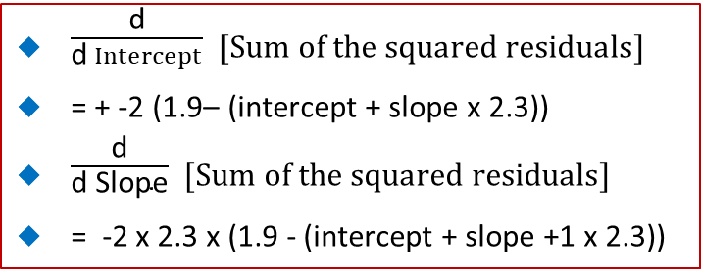
48.3 Random Select Data
https://www.youtube.com/watch?v=vMh0zPT0tLI&list=PLblh5JKOoLUICTaGLRoHQDuF_7q2GfuJF&index=51
Stochastic Gradient Descent will randomly pick one sample for each step.
Just use that sample to calculate the derivatives.
$\frac{\text{d}}{\text{d} Intercept}$ $[Sum of the squared residuals]$
= + -2 (1.9– (intercept + slope x 2.3))
$\frac{\text{d}}{\text{d} \text{Slope}}$ $[Sum of the squared residuals]$
= -2 x 2.3 x (1.9 - (intercept + slope +1 x 2.3))
Height
In this simple example, we have three sample, the Stochastic Gradient Descent will reduce the number of terms by a factor of 3.
If we have 1,000,000 samples, we will reduce a factor of 1,000,000.
…so Stochastic Gradient is pretty cool.
Weight

Slide 20
48.3 Random Select Data
https://www.youtube.com/watch?v=vMh0zPT0tLI&list=PLblh5JKOoLUICTaGLRoHQDuF_7q2GfuJF&index=51
Stochastic Gradient Descent is especially useful when there are redundancies in the data.
For example, we have 12 data, but there is a lot of redundancies in the three clusters.
Height
Weight

Slide 21
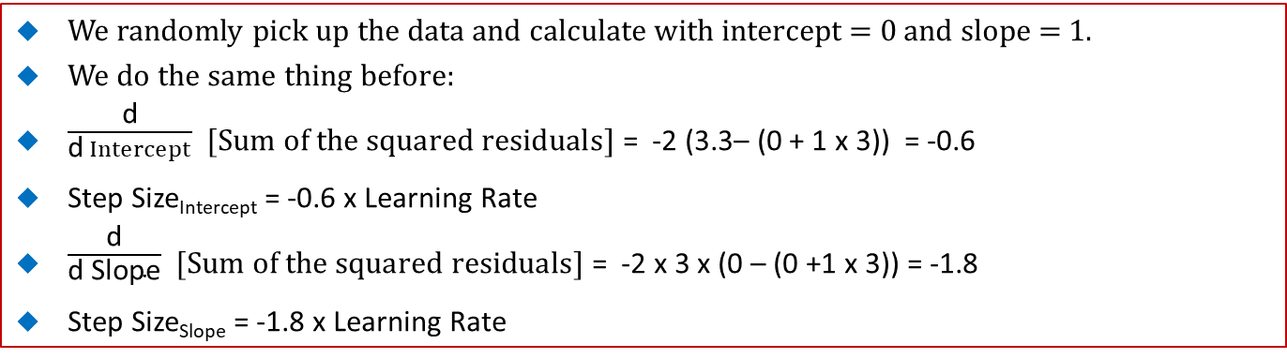
48.3 Random Select Data
https://www.youtube.com/watch?v=vMh0zPT0tLI&list=PLblh5JKOoLUICTaGLRoHQDuF_7q2GfuJF&index=51
We randomly pick up the data and calculate with intercept = 0 and slope = 1.
We do the same thing before:
$\frac{\text{d}}{\text{d} Intercept}$ $[Sum of the squared residuals]$ = -2 (3.3– (0 + 1 x 3)) = -0.6
Step Size_{Intercept} = -0.6 x Learning Rate
$\frac{\text{d}}{\text{d} \text{Slope}}$ $[Sum of the squared residuals]$ = -2 x 3 x (0 – (0 +1 x 3)) = -1.8
Step Size_{Slope} = -1.8 x Learning Rate
Height
Weight

Slide 22
48.3 Random Select Data
https://www.youtube.com/watch?v=vMh0zPT0tLI&list=PLblh5JKOoLUICTaGLRoHQDuF_7q2GfuJF&index=51
Step Size_{Intercept} = -0.6 x Learning Rate
Step Size_{Slope} = -1.8 x Learning Rate
Just like the Regular Gradient Descent, for the general strategy, the Learning Rate is to start with relative large and make smaller with each step.
The Stochastic Gradient Descent will take care of the Learning Rate for you by default.
Height
Weight

Slide 23
48.3 Random Select Data
https://www.youtube.com/watch?v=vMh0zPT0tLI&list=PLblh5JKOoLUICTaGLRoHQDuF_7q2GfuJF&index=51
Terminology: Schedule
What is Schedule?
The ways the Learning Rate started from relatively large and end with relatively small is called schedule.
If you fail to converge in the Stochastic Gradient Descent, try set the Learning Rate to 0.01.
Height
Weight

Slide 24
48.3 Random Select Data
https://www.youtube.com/watch?v=vMh0zPT0tLI&list=PLblh5JKOoLUICTaGLRoHQDuF_7q2GfuJF&index=51
Step Size_{Intercept} = -0.6 x Learning Rate = -0.6 x 0.01 = -0.006
Step Size_{Slope} = -1.8 x Learning Rate = -1.8 x 0.01 = -0.018
New Intercept = 0 - Step Size_{Intercept} = 0 - -0.006 = 0.006
New Slope = 1 - Step Size_{Intercept} = 1 - -0.018 = 1.018
Height
Weight

Slide 25
48.3 Random Select Data
https://www.youtube.com/watch?v=vMh0zPT0tLI&list=PLblh5JKOoLUICTaGLRoHQDuF_7q2GfuJF&index=51
The New Parameter give us the new line.
Then, we randomly pick up another point.
Then, we repeat a bunch of time with different intercept and slope.
…
Height
Weight

Slide 26
48.3 Random Select Data
https://www.youtube.com/watch?v=vMh0zPT0tLI&list=PLblh5JKOoLUICTaGLRoHQDuF_7q2GfuJF&index=51
Finally, we get intercept 0.85 and slope = 0.67.
Height
Weight

Slide 27
48.4 Mini-Batch

Slide 28
48.4 Mini-Batch
https://www.youtube.com/watch?v=vMh0zPT0tLI&list=PLblh5JKOoLUICTaGLRoHQDuF_7q2GfuJF&index=51
What is Mini-Batch?
The strict definition of Stochastic Gradient Descent is to only use 1 sample per step.
Stochastic Gradient Descent: 1 point per step
Height
Weight

Slide 29
48.4 Mini-Batch
https://www.youtube.com/watch?v=vMh0zPT0tLI&list=PLblh5JKOoLUICTaGLRoHQDuF_7q2GfuJF&index=51
Note:
However, it is more common to select a small subset of data or mini-batch for each step.
For example, we can use three samples per step instead of just one.
Using min-batch, we pass in the number of the parameter for each step.
Mini-Batch Stochastic Gradient Descent: several points (specify in passing parameters) per step
Height
Weight

Slide 30
48.4 Mini-Batch
https://www.youtube.com/watch?v=vMh0zPT0tLI&list=PLblh5JKOoLUICTaGLRoHQDuF_7q2GfuJF&index=51
Accuracy comparison of one point (Stochastic Gradient Descent) and 3 points (mini-batch Stochastic Gradient Descent) of In this example,
The least square estimates, give up the gold standard intercept = 0.87 and slope = 0.69.
If we use 3 samples per step and ended up with the intercept = 0.85 and slope = 0.68.
If we use 1 sample per step, we get the answer intercept = 0.85 and slope = 0.67.
Height
Weight

Slide 31
48.5 New Data

Slide 32
48.5 New Data
https://www.youtube.com/watch?v=vMh0zPT0tLI&list=PLblh5JKOoLUICTaGLRoHQDuF_7q2GfuJF&index=51
For the New Arrival Data, the Stochastic Gradient Descent can easily adjust for the parameter estimates without having to start over from the scratch.
In other words, we do not need to go back to initial guess for intercept = 0 and slope = 1 and redo everything.
Note: For new point, we start from intercept = 0 and slope = 1. For all old points, we do not re-start again.
In stead, we pick up the right where we leave off and continue to take one more step using the new sample.
Height
Weight

Slide 33
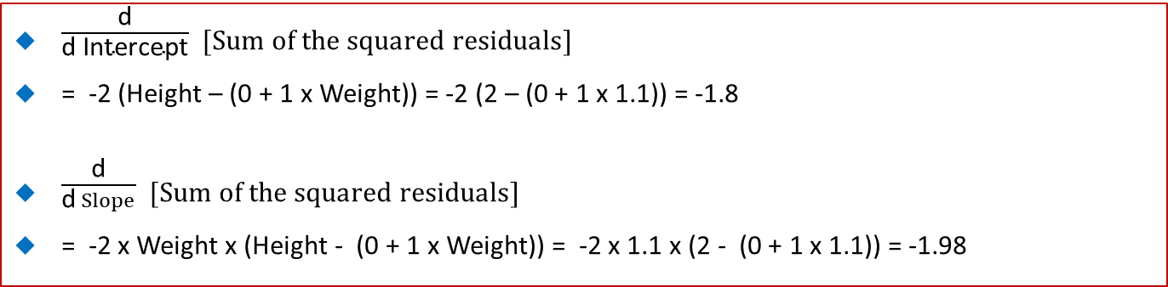
48.5 New Data
https://www.youtube.com/watch?v=vMh0zPT0tLI&list=PLblh5JKOoLUICTaGLRoHQDuF_7q2GfuJF&index=51
$\frac{\text{d}}{\text{d} \text{Intercept}}$ $[Sum of the squared residuals]$
= -2 (Height – (0 + 1 x Weight)) = -2 (2 – (0 + 1 x 1.1)) = -1.8
$\frac{\text{d}}{\text{d} Slope}$ $[Sum of the squared residuals]$
= -2 x Weight x (Height - (0 + 1 x Weight)) = -2 x 1.1 x (2 - (0 + 1 x 1.1)) = -1.98
Height
Weight

Slide 34
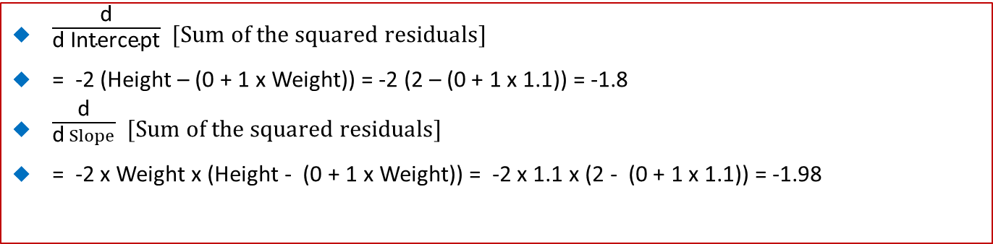
48.5 New Data
https://www.youtube.com/watch?v=vMh0zPT0tLI&list=PLblh5JKOoLUICTaGLRoHQDuF_7q2GfuJF&index=51
$\frac{\text{d}}{\text{d} \text{Intercept}}$ $[Sum of the squared residuals]$
= -2 (Height – (0 + 1 x Weight)) = -2 (2 – (0 + 1 x 1.1)) = -1.8
$\frac{\text{d}}{\text{d} Slope}$ $[Sum of the squared residuals]$
= -2 x Weight x (Height - (0 + 1 x Weight)) = -2 x 1.1 x (2 - (0 + 1 x 1.1)) = -1.98
Height
Weight

Slide 35
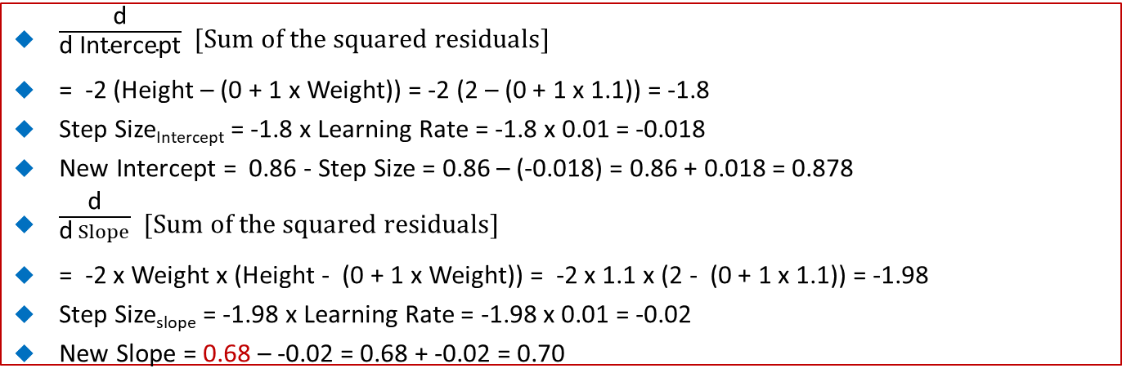
48.5 New Data
https://www.youtube.com/watch?v=vMh0zPT0tLI&list=PLblh5JKOoLUICTaGLRoHQDuF_7q2GfuJF&index=51
$\frac{\text{d}}{\text{d} \text{Intercept}}$ $[Sum of the squared residuals]$
= -2 (Height – (0 + 1 x Weight)) = -2 (2 – (0 + 1 x 1.1)) = -1.8
Step Size_{Intercept} = -1.8 x Learning Rate = -1.8 x 0.01 = -0.018
New Intercept = 0.86 - Step Size = 0.86 – (-0.018) = 0.86 + 0.018 = 0.878
$\frac{\text{d}}{\text{d} Slope}$ $[Sum of the squared residuals]$
= -2 x Weight x (Height - (0 + 1 x Weight)) = -2 x 1.1 x (2 - (0 + 1 x 1.1)) = -1.98
Step Size_{slope} = -1.98 x Learning Rate = -1.98 x 0.01 = -0.02
New Slope = 0.68 – -0.02 = 0.68 + -0.02 = 0.70

Slide 36
48.7 Summary

Slide 37
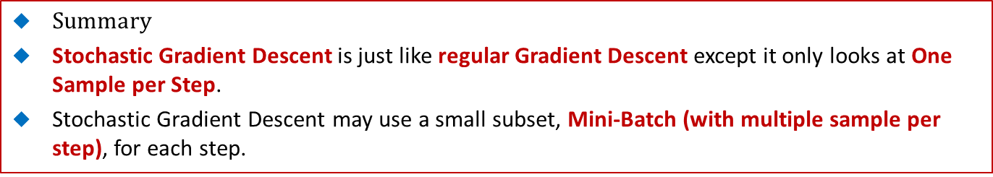
48.6 Summary
https://www.youtube.com/watch?v=vMh0zPT0tLI&list=PLblh5JKOoLUICTaGLRoHQDuF_7q2GfuJF&index=51
$Summary$
Stochastic Gradient Descent is just like regular Gradient Descent except it only looks at One Sample per Step.
Stochastic Gradient Descent may use a small subset, Mini-Batch (with multiple sample per step), for each step.
One Sample per Step
Mini-Batch per Step
Height
Height
Weight
Weight

Slide 38
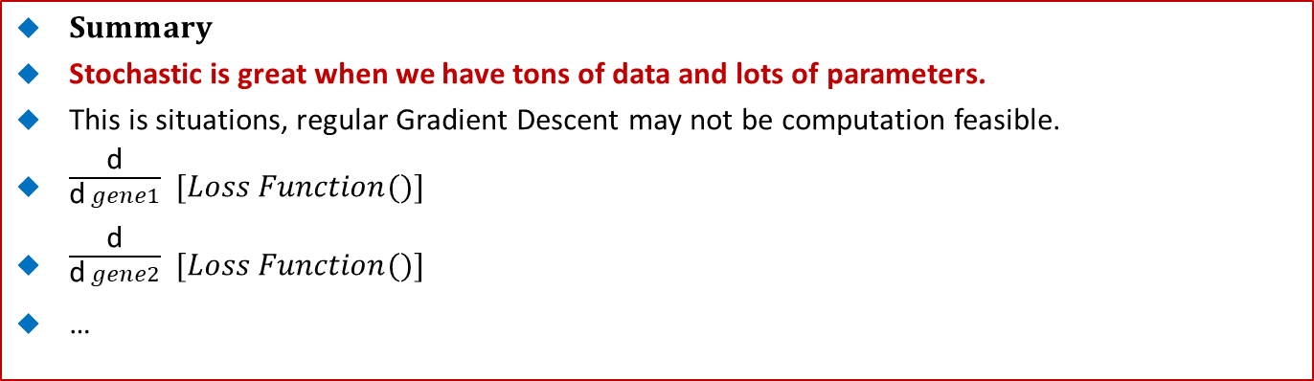
48.6 Summary
https://www.youtube.com/watch?v=vMh0zPT0tLI&list=PLblh5JKOoLUICTaGLRoHQDuF_7q2GfuJF&index=51
$Summary$
Stochastic is great when we have tons of data and lots of parameters.
This is situations, regular Gradient Descent may not be computation feasible.
$\frac{\text{d}}{\text{d} gene1}$ $[Loss Function()]$
$\frac{\text{d}}{\text{d} gene2}$ $[Loss Function()]$
…

Slide 39
48.7 Summary
https://www.youtube.com/watch?v=vMh0zPT0tLI&list=PLblh5JKOoLUICTaGLRoHQDuF_7q2GfuJF&index=51
The Stochastic is update the parameters when the new data shows up.
Height
Weight

Slide 40
End of Chapter

