Slide 1
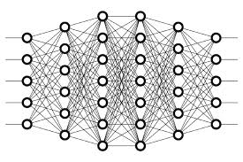
5 Activation Function
Peter H. Chen

Slide 2
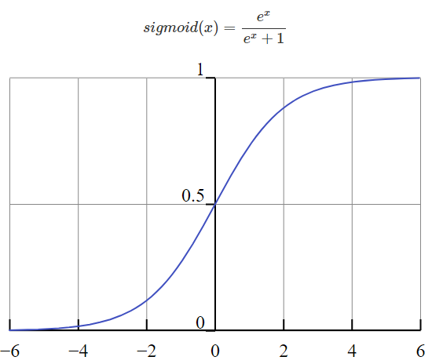
5 Activation Function
https://www.youtube.com/watch?v=m0pIlLfpXWE&list=PLZbbT5o_s2xq7LwI2y8_QtvuXZedL6tQU&index=5
Activation Function
In an artificial neural network, an activation function is a function that maps a node's inputs to its corresponding output.
node output = activation(weighted sum of inputs)
Sigmoid Activation Function

Slide 3
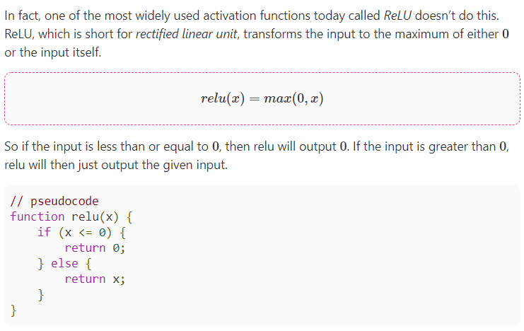
5 Activation Function
https://www.youtube.com/watch?v=m0pIlLfpXWE&list=PLZbbT5o_s2xq7LwI2y8_QtvuXZedL6tQU&index=5
Activation Function
Relu Activation Function: Output is between 0 and infinity

Slide 4
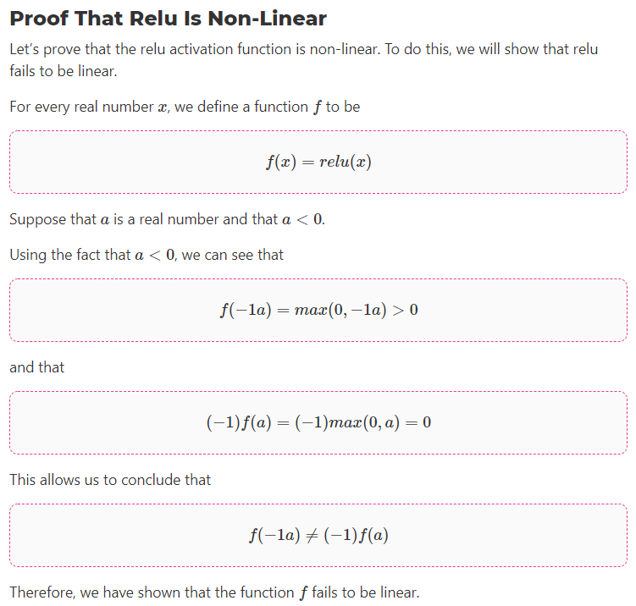
5 Activation Function
https://www.youtube.com/watch?v=m0pIlLfpXWE&list=PLZbbT5o_s2xq7LwI2y8_QtvuXZedL6tQU&index=5
Activation Function

Slide 5
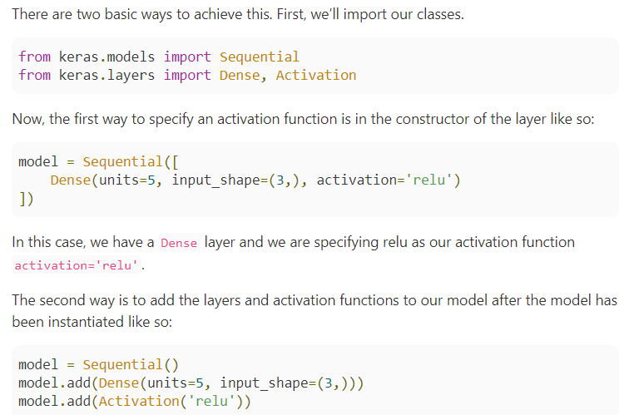
5 Activation Function
https://www.youtube.com/watch?v=m0pIlLfpXWE&list=PLZbbT5o_s2xq7LwI2y8_QtvuXZedL6tQU&index=5
Activation Function
Activation Functions In Code With Keras

Slide 6
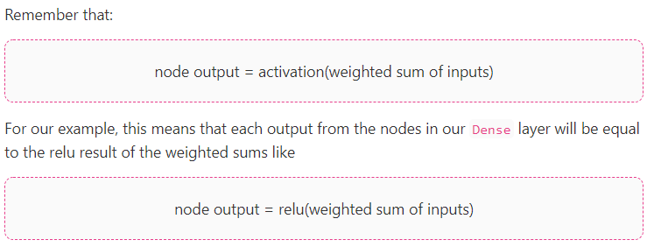
5 Activation Function
https://www.youtube.com/watch?v=m0pIlLfpXWE&list=PLZbbT5o_s2xq7LwI2y8_QtvuXZedL6tQU&index=5
Activation Function

Slide 7
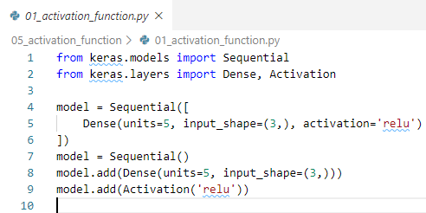
5 Activation Function
https://www.youtube.com/watch?v=m0pIlLfpXWE&list=PLZbbT5o_s2xq7LwI2y8_QtvuXZedL6tQU&index=5
Activation Function
In an artificial neural network, the activation function of a neuron defines the output of that neuron given a set of inputs.
Biologically inspired by activity in our brains, where different neurons fire, or are activated, by different stimuli.

Slide 8
5.1 Quiz

Slide 9
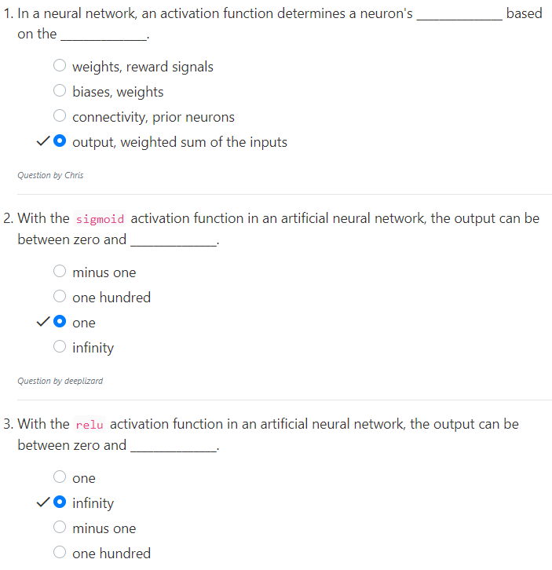
5.1 Quiz
https://www.youtube.com/watch?v=m0pIlLfpXWE&list=PLZbbT5o_s2xq7LwI2y8_QtvuXZedL6tQU&index=5
Quiz

Slide 10
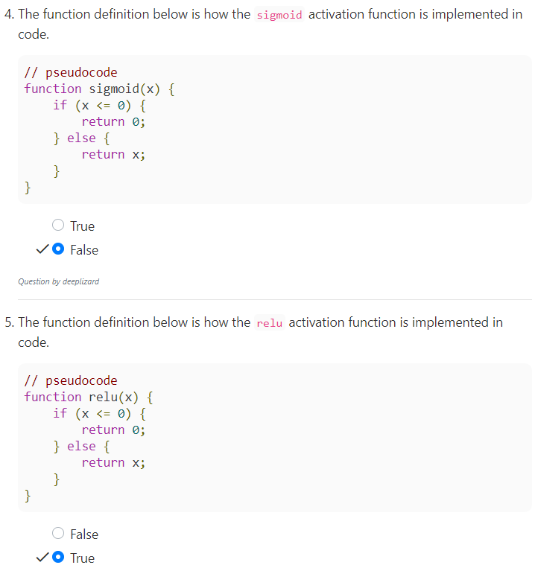
5.1 Quiz
https://www.youtube.com/watch?v=m0pIlLfpXWE&list=PLZbbT5o_s2xq7LwI2y8_QtvuXZedL6tQU&index=5
Quiz
This is relu, not sigmoid

Slide 11
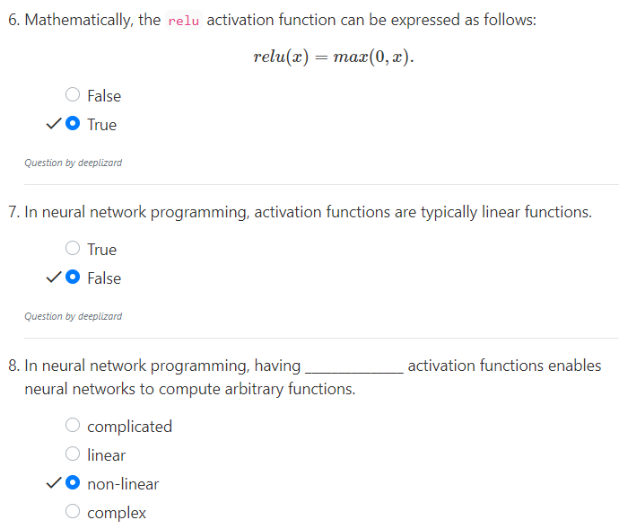
5.1 Quiz
https://www.youtube.com/watch?v=m0pIlLfpXWE&list=PLZbbT5o_s2xq7LwI2y8_QtvuXZedL6tQU&index=5
Quiz

Slide 12
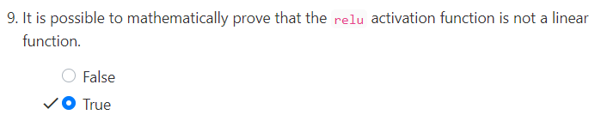
5.1 Quiz
https://www.youtube.com/watch?v=m0pIlLfpXWE&list=PLZbbT5o_s2xq7LwI2y8_QtvuXZedL6tQU&index=5
Quiz

Slide 13
End of Chapter

