Slide 1
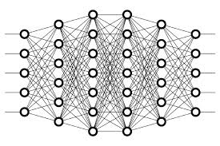
10 Train, Validate, and Test
Peter H. Chen

Slide 2
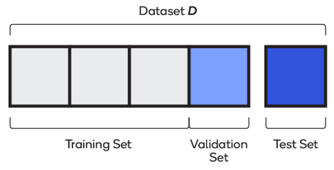
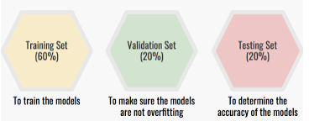
10 Train, Validate, and Test
https://www.youtube.com/watch?v=Zi-0rlM4RDs&list=PLZbbT5o_s2xq7LwI2y8_QtvuXZedL6tQU&index=10
Train, Validate, Test
For training and testing purposes for our model, we should have our data broken down into three distinct datasets. These datasets will consist of the following:
Training set
Validation set
Test set
60%
20%
20%

Slide 3
10 Train, Validate, and Test
https://www.youtube.com/watch?v=Zi-0rlM4RDs&list=PLZbbT5o_s2xq7LwI2y8_QtvuXZedL6tQU&index=10
Test Set
The test set is a set of data that is used to test the model after the model has already been trained. The test set is separate from both the training set and validation set.
After our model has been trained and validated using our training and validation sets, we will then use our model to predict the output of the unlabeled data in the test set.
One major difference between the test set and the two other sets (training and validation sets) is that the test set should not be labeled.
The training set and validation set have to be labeled so that we can see the metrics given during training, like the loss and the accuracy from each epoch.
Quiz 1:
The test set differs from the training and validation sets by being passed to the model after training with no labels.

Slide 4
10 Train, Validate, and Test
https://www.youtube.com/watch?v=Zi-0rlM4RDs&list=PLZbbT5o_s2xq7LwI2y8_QtvuXZedL6tQU&index=10
Validation Set
The validation set is a set of data, separate from the training set, that is used to validate our model during training.
This validation process helps give information that may assist us with adjusting our hyperparameters.
Recall how we just mentioned that with each epoch during training, the model will be trained on the data in the training set.
One of the major reasons we need a validation set is to ensure that our model is not overfitting to the data in the training set.
During training, if we’re also validating the model on the validation set and see that the results it’s giving for the validation data are just as good as the results it’s giving for the training data, then we can be more confident that our model is not overfitting.
The validation set allows us to see how well the model is generalizing during training.
If the results on the training data are really good, but the results (loss function) on the validation data are lagging behind, then our model is overfitting.

Slide 5
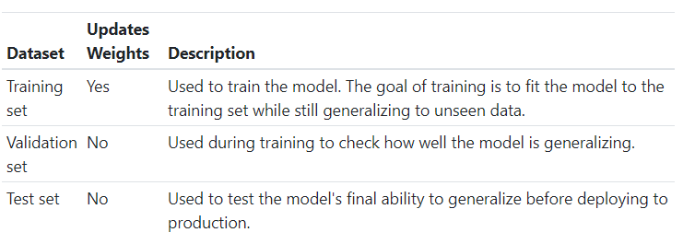
10 Train, Validate, and Test
https://www.youtube.com/watch?v=Zi-0rlM4RDs&list=PLZbbT5o_s2xq7LwI2y8_QtvuXZedL6tQU&index=10
Deep Learning Datasets In Summary

Slide 6
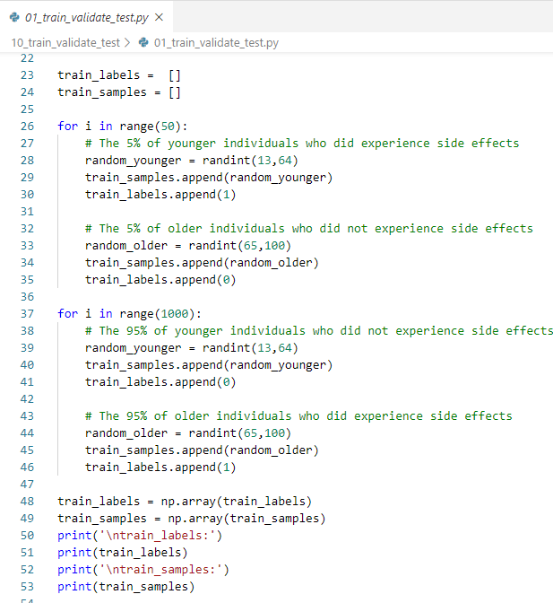
10 Train, Validate, and Test
https://www.youtube.com/watch?v=Zi-0rlM4RDs&list=PLZbbT5o_s2xq7LwI2y8_QtvuXZedL6tQU&index=10
Keras Code

Slide 7
10.1 Quiz

Slide 8
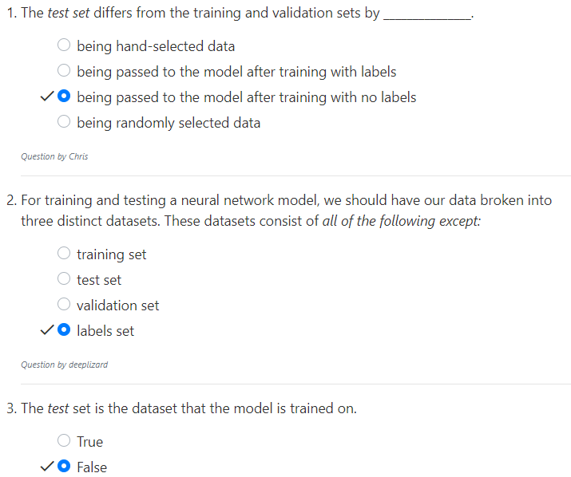
10.1 Quiz
https://www.youtube.com/watch?v=jWT-AX9677k&list=PLZbbT5o_s2xq7LwI2y8_QtvuXZedL6tQU&index=9
Quiz

Slide 9
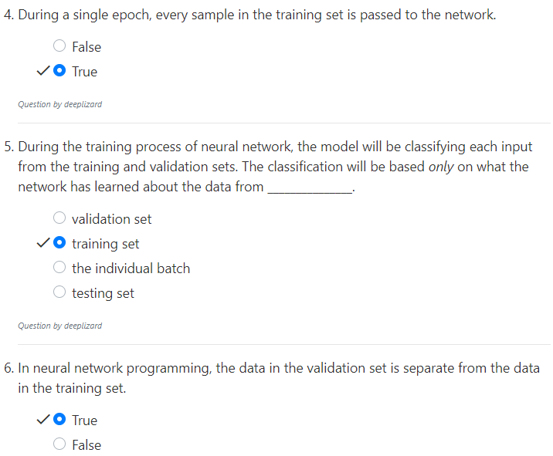
10.1 Quiz
https://www.youtube.com/watch?v=jWT-AX9677k&list=PLZbbT5o_s2xq7LwI2y8_QtvuXZedL6tQU&index=9
Quiz

Slide 10
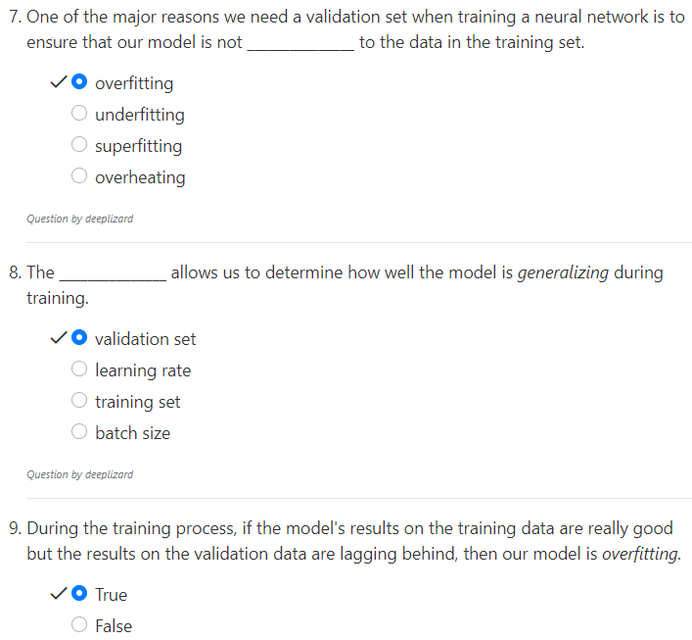
10.1 Quiz
https://www.youtube.com/watch?v=jWT-AX9677k&list=PLZbbT5o_s2xq7LwI2y8_QtvuXZedL6tQU&index=9
Quiz

Slide 11
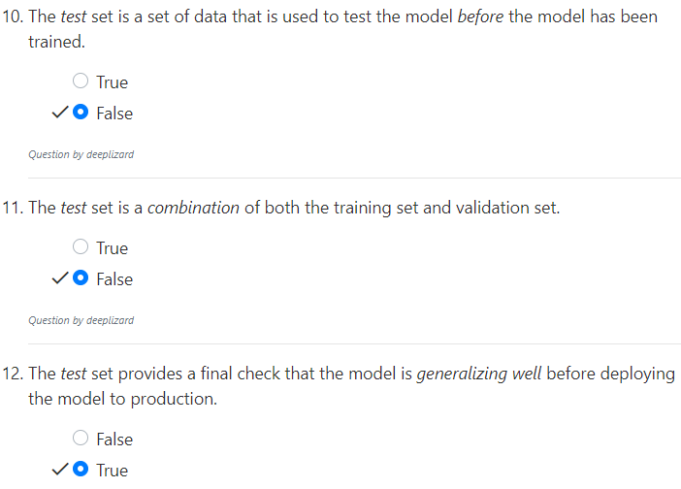
10.1 Quiz
https://www.youtube.com/watch?v=jWT-AX9677k&list=PLZbbT5o_s2xq7LwI2y8_QtvuXZedL6tQU&index=9
Quiz

Slide 12
End of Chapter

