Slide 1
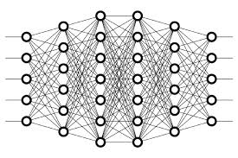
14 Supervised Learning
Peter H. Chen

Slide 2
14 Supervised Learning
https://www.youtube.com/watch?v=Quh6x4kG6VY&list=PLZbbT5o_s2xq7LwI2y8_QtvuXZedL6tQU&index=14
Supervised Learning
Each time we mentioned the process of training a model or the learning process that the model, we actually implicitly talking about supervised learning.
Labeled Data
Supervised learning occurs when the data in our training set is labeled.
Labels are used to supervise or guide the learning process.
Recall from our discussion on training, validation, and testing sets, we explained that both the training data and validation data are labeled when passed to the model.
This is the case for supervised learning.
With supervised learning, each piece of data passed to the model during training is a pair that consists of the input object, or sample, along with the corresponding label or output value.

Slide 3
14 Supervised Learning
https://www.youtube.com/watch?v=Quh6x4kG6VY&list=PLZbbT5o_s2xq7LwI2y8_QtvuXZedL6tQU&index=14
Supervised Learning
Each time we mentioned the process of training a model or the learning process that the model, we actually implicitly talking about supervised learning.
Labeled Data
Supervised learning occurs when the data in our training set is labeled.
Labels are used to supervise or guide the learning process.
Recall from our discussion on training, validation, and testing sets, we explained that both the training data and validation data are labeled when passed to the model.
This is the case for supervised learning.
With supervised learning, each piece of data passed to the model during training is a pair that consists of the input object, or sample, along with the corresponding label or output value.

Slide 4
14 Supervised Learning
https://www.youtube.com/watch?v=Quh6x4kG6VY&list=PLZbbT5o_s2xq7LwI2y8_QtvuXZedL6tQU&index=14
Labeled Data
Essentially, with supervised learning, the model is learning how to create a mapping from given inputs to particular outputs based on what it’s learning from the labeled training data.
For example, say we’re training a model to classify different types of reptiles based on images of reptiles.
Now during training, we pass in an image of a lizard.
Since we’re doing supervised learning, we’ll also be supplying our model with the label for this image, which in this case is simply just lizard.
Based on what we saw in our discussiom on training, we know that the model will then classify the output of this image, and then determine the error for that image by looking at the difference between the value it predicted and the actual label for the image.

Slide 5
14 Supervised Learning
https://www.youtube.com/watch?v=Quh6x4kG6VY&list=PLZbbT5o_s2xq7LwI2y8_QtvuXZedL6tQU&index=14
Labels Are Numeric
To do this, the labels need to be encoded into something numeric.
In this case, the label of lizard may be encoded as 0, whereas the label of turtle may be encoded as 1.
After this, we go through this process of determining the error or loss for all of the data in our training set for as many epochs as we specify.
Remember, during this training, the objective of the model is to minimize the loss, so when we deploy our model and use it to predict on data it wasn’t trained on, it will be making these predictions based on the labeled data that it did see during training.
If we didn’t supply our labels to the model, though, then what’s the alternative?
Well, as opposed to supervised learning, we could instead use something called unsupervised learning.
We could also use another technique called semi-supervised learning. We’ll be covering each of these topics in future posts.

Slide 6
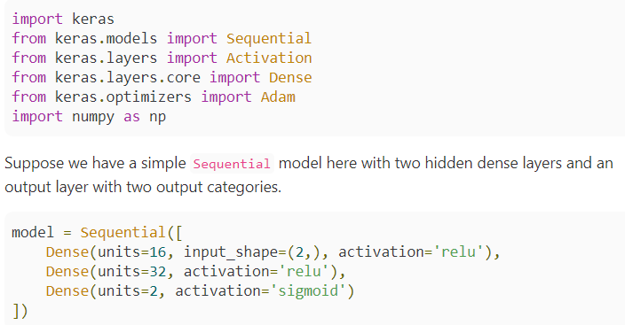
14 Supervised Learning
https://www.youtube.com/watch?v=Quh6x4kG6VY&list=PLZbbT5o_s2xq7LwI2y8_QtvuXZedL6tQU&index=14
Label with Keras

Slide 7
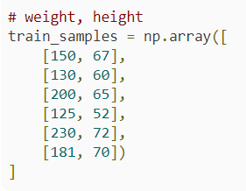
14 Supervised Learning
https://www.youtube.com/watch?v=Quh6x4kG6VY&list=PLZbbT5o_s2xq7LwI2y8_QtvuXZedL6tQU&index=14
Label with Keras
After compiling our model, we’ve have an example here of some training data that is completely made up for illustration purposes.
The actual training data is stored in the train_samples variable.
Here, we have a list of pairs, and each of these pairs is an individual sample, and a sample is the weight and height of a person.
The first element in each pair is the weight measured in pounds, and the second element is the height measured in inches.

Slide 8

14 Supervised Learning
https://www.youtube.com/watch?v=Quh6x4kG6VY&list=PLZbbT5o_s2xq7LwI2y8_QtvuXZedL6tQU&index=14
Label with Keras
Next, we have our labels stored in this train_labels variable.
Here, a 0 represents a male, and a 1 represents a female.

Slide 9
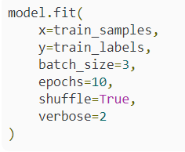
14 Supervised Learning
https://www.youtube.com/watch?v=Quh6x4kG6VY&list=PLZbbT5o_s2xq7LwI2y8_QtvuXZedL6tQU&index=14
Label with Keras
The position of each of these labels corresponds to the positions of each sample in our train_samples variable.
For example, this first 1 here, which represents a female, is the label for the first element in the train_samples array.
This second 1 in train_labels corresponds to the second sample in train_samples, and so on.
Now, when we go to train our model, we call model.fit() as we’ve discussed in previous posts, and the first parameter here specified by x is going to be our train_samples variable, and the second parameter, specified by y, is going to be the corresponding train_labels.

Slide 10
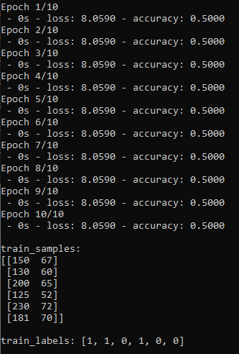
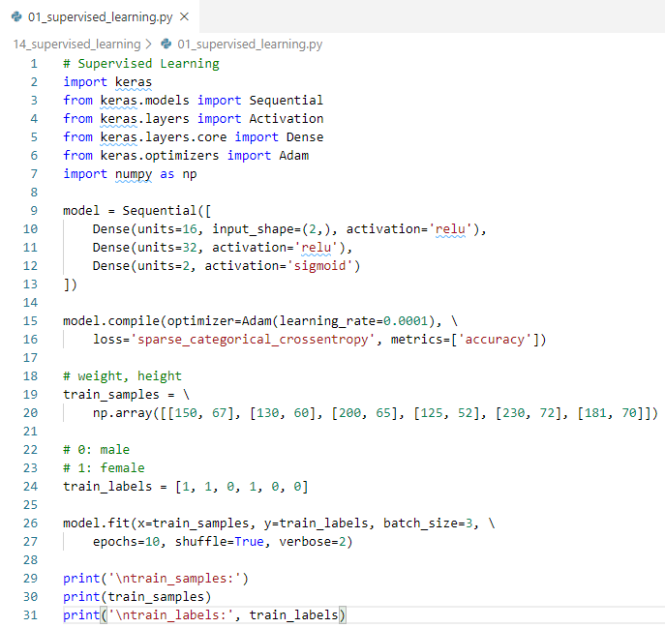
14 Supervised Learning
https://www.youtube.com/watch?v=Quh6x4kG6VY&list=PLZbbT5o_s2xq7LwI2y8_QtvuXZedL6tQU&index=14
Supervised Learning Keras Code:

Slide 11
14.1 Quiz

Slide 12
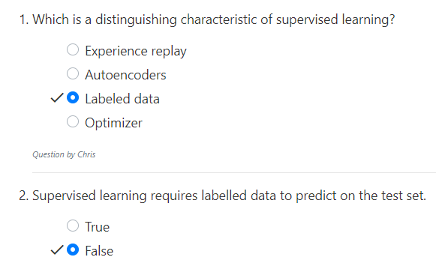
14.1 Quiz
https://www.youtube.com/watch?v=Quh6x4kG6VY&list=PLZbbT5o_s2xq7LwI2y8_QtvuXZedL6tQU&index=14
Quiz
Labelled data is on the training set.
Test set does not need labelled data

Slide 13
End of Chapter

