Slide 1
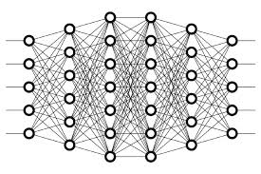
11 Prediction
Peter H. Chen

Slide 2
11 Prediction
https://www.youtube.com/watch?v=Z0KVRdE_a7Q&list=PLZbbT5o_s2xq7LwI2y8_QtvuXZedL6tQU&index=11
Prediction
When we do the prediction, we pass our test data to the model, we do not pass the corresponding labels. So, the model is not aware of the labels for the test set at all.

Slide 3
11 Prediction
https://www.youtube.com/watch?v=Z0KVRdE_a7Q&list=PLZbbT5o_s2xq7LwI2y8_QtvuXZedL6tQU&index=11
Passing Samples With No Labels
For predicting, essentially what we’re doing is passing our unlabeled test data to the model and having the model predict on what it thinks about each sample in our test data.
These predictions are occurring based on what the model learned during training.
Predictions are based on what the model learned during training.

Slide 4
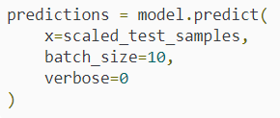
11 Prediction
https://www.youtube.com/watch?v=Z0KVRdE_a7Q&list=PLZbbT5o_s2xq7LwI2y8_QtvuXZedL6tQU&index=11
Keras
The first item we have here is a variable we’ve called predictions.
We’re assuming that we already have our model built and trained. Our model in this example is the object called model. We’re setting predictions equal to model.predict().
This predict() function is what we call to actually have the model make predictions. To the predict() function, we’re passing the variable called scaled_test_samples. This is the variable that’s holding our test data.
We set our batch_size here arbitrarily to 10. We set the verbosity, which is how much we want to see printed to the screen when we run these predictions, to 0 here to show nothing.

Slide 5
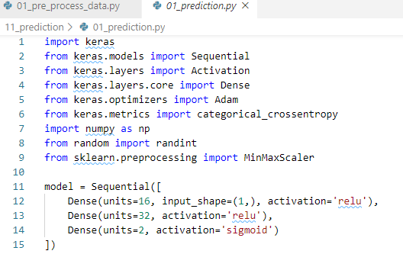
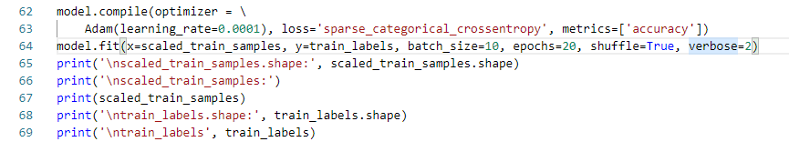
11 Prediction
https://www.youtube.com/watch?v=Z0KVRdE_a7Q&list=PLZbbT5o_s2xq7LwI2y8_QtvuXZedL6tQU&index=11
Keras Code:

Slide 6
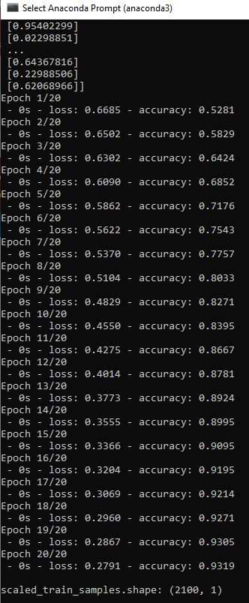
11 Prediction
https://www.youtube.com/watch?v=Z0KVRdE_a7Q&list=PLZbbT5o_s2xq7LwI2y8_QtvuXZedL6tQU&index=11
Keras Code:
Result

Slide 7
11.1 Quiz

Slide 8
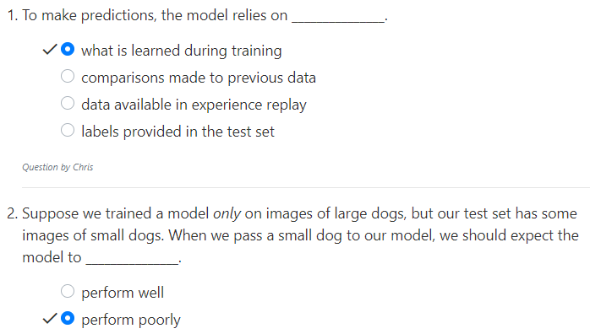
11.1 Quiz
https://www.youtube.com/watch?v=jWT-AX9677k&list=PLZbbT5o_s2xq7LwI2y8_QtvuXZedL6tQU&index=9
Quiz

Slide 9
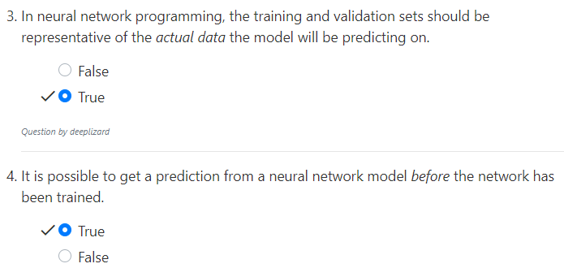
11.1 Quiz
https://www.youtube.com/watch?v=jWT-AX9677k&list=PLZbbT5o_s2xq7LwI2y8_QtvuXZedL6tQU&index=9
Quiz

Slide 10
End of Chapter

