Slide 1
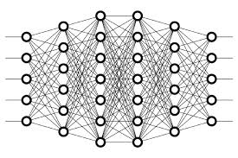
1 Deep Learning
Peter H. Chen

Slide 2
1 Deep Learning
https://www.youtube.com/watch?v=GCFmqet--Lc&list=PLZbbT5o_s2xrwRnXk_yCPtnqqo4_u2YGL&index=2
Difference of Machine Learning and traditional Programming
Example: Analyzing the sentiment (feeling) of a popular media outlet and classifying that sentiment as positive or negative
Traditional programming approach
The algorithm may first look for particular words associated with a negative or positive sentiment.
With conditional statements, the algorithm would classify articles as positive or negative based on the words that it knows are positive or negative.
Machine learning approach
The algorithm would analyze large amounts of given media data and learn the features that classify what a negative article looks like versus a positive article.
With what it's learned, the algorithm could then classify new articles as positive or negative

Slide 3
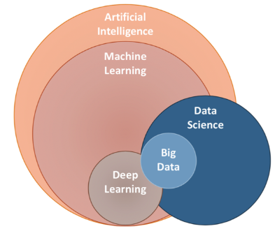
1 Deep Learning
https://www.youtube.com/watch?v=GCFmqet--Lc&list=PLZbbT5o_s2xrwRnXk_yCPtnqqo4_u2YGL&index=2
Relation of Deep Learning:
Relationship of Artificial Intelligence, Machine Learning, Deep Learning, Data Science, and Big Data.

Slide 4
1 Deep Learning
https://www.youtube.com/watch?v=GCFmqet--Lc&list=PLZbbT5o_s2xrwRnXk_yCPtnqqo4_u2YGL&index=2
Deep Learning Definition:
Deep learning is a subfield of machine learning that uses algorithms inspired by the structure and function of the brain’s neural networks.
As a subfield of machine learning (ML), deep learning (DL) also uses algorithms to analyze data, learn from that data, and then make a determination or prediction about new data.
Deep Learning includes two types of leaning:
Supervised learning occurs when your deep learning model learns and makes inferences from data that has already been labeled.
Unsupervised learning occurs when the model learns and makes inferences from unlabeled data.
The Labeled is for training and validated vs. Unlabeled is used for testing or prediction
Example: Classify images of cats and dogs

Slide 5
1 Deep Learning
https://www.youtube.com/watch?v=GCFmqet--Lc&list=PLZbbT5o_s2xrwRnXk_yCPtnqqo4_u2YGL&index=2
Artificial Neural Networks
Artificial neural networks are deep learning models that are based on the structure of the brain's neural networks.
Artificial neural networks are used interchangeably with the terms:
neural net
Net
Model

Slide 6
1 Deep Learning
https://www.youtube.com/watch?v=GCFmqet--Lc&list=PLZbbT5o_s2xrwRnXk_yCPtnqqo4_u2YGL&index=2
Artificial Neural Network
Artificial neural networks are computing systems that are inspired by the brain’s neural networks.
These networks are based on a collection of connected units called artificial neurons, or neurons.
Each connection between neurons can transmit a signal from one neuron to another.
The receiving neuron processes the signal and signals downstream neurons connected to it.
Neurons are organized in layers.
Input layer
Hidden layers
Output layer

Slide 7
1 Deep Learning
https://www.youtube.com/watch?v=GCFmqet--Lc&list=PLZbbT5o_s2xrwRnXk_yCPtnqqo4_u2YGL&index=2
Install Tensorflow
https://www.tutorialspoint.com/tensorflow/tensorflow_installation.htm
We need to create a totally clean enviornemnt for tensorflow and GPU.
> conda create --name tf python=3.7
> cond activate tf
(tf) > pip install tensorflow
(tf) > pip install scikit-learn # for sklearn
> conda deactivate
We will use the environment in this discussion.
How to remove the conda envoriment?
> conda remove tf # remove environemt

Slide 8
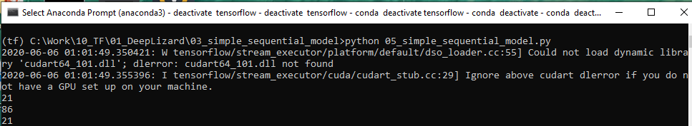
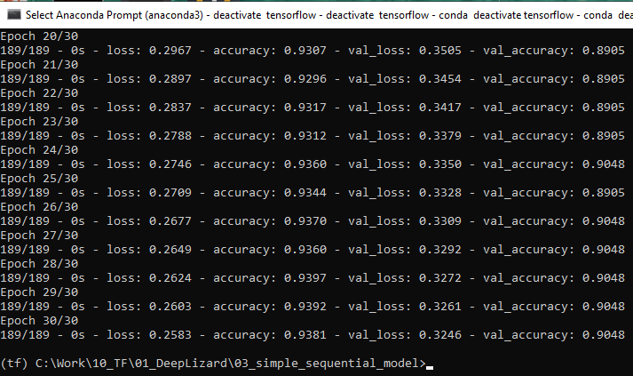
2 Get Started with Tensorflow
conda create --name tensorflow python = 3.5
https://www.youtube.com/watch?v=GCFmqet--Lc&list=PLZbbT5o_s2xrwRnXk_yCPtnqqo4_u2YGL&index=2
Install Tensorflow
https://www.tutorialspoint.com/tensorflow/tensorflow_installation.htm
> pyhton 05_simple_sequential_model.py

Slide 9
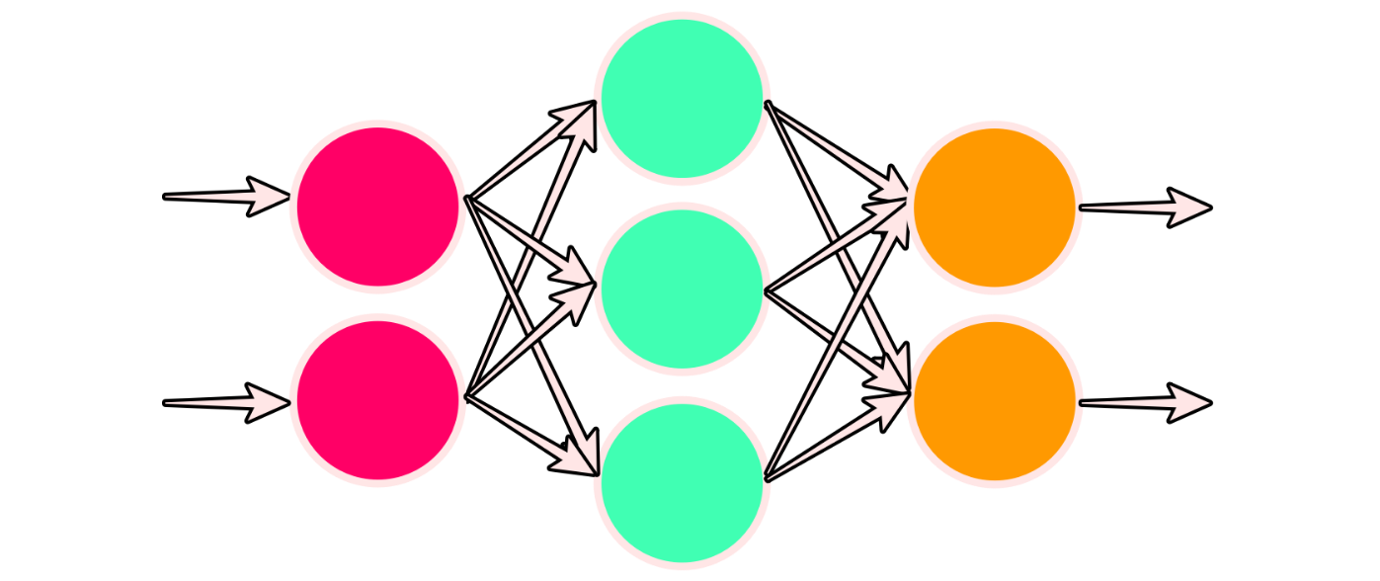
1 Deep Learning
https://www.youtube.com/watch?v=gZmobeGL0Yg&list=PLZbbT5o_s2xq7LwI2y8_QtvuXZedL6tQU
Deep Learning
We discussed Deep Learning Fundamentals: ANN (Artificial Neural Network), Activation function, back-propagation, CNN (Convolutional Neural Network), Data Augmentation, Transfer Learning, and etc.
Deep Learning is implemented with Kera, a neural network API.

Slide 10
1 Deep Learning
https://www.youtube.com/watch?v=gZmobeGL0Yg&list=PLZbbT5o_s2xq7LwI2y8_QtvuXZedL6tQU
Outline
PART 1: INTRO TO DEEP LEARNING
Section 1: Artificial neural network basics
Intro to machine learning
Intro to deep Learning
Neural network architecture
Training neural networks
Loss and learning rate
Section 2: Data topics for deep learning
Data sets for deep learning
Predicting with neural networks
Over and under fitting data
Supervised, unsupervised, and semi-supervised learning
Data augmentation
One-hot encoding
PART 2: INTERMEDIATE DEEP LEARNING TOPICS
Section 1: Convolutional Neural Networks (CNNs)
What are CNNs?
Visualizing convolutional filters
Zero padding
Max pooling
Section 2: Backpropagation
Backprop intuition
Mathematics of backprop
Vanishing and exploding gradient
Weight initialization
Section 3: Additional deep learning concepts
Bias terms in neural networks
Learnable parameters
Regularization
Batches and batch size
Fine-tuning and transfer learning
Batch normalization

Slide 11
1 Deep Learning
https://www.youtube.com/watch?v=gZmobeGL0Yg&list=PLZbbT5o_s2xq7LwI2y8_QtvuXZedL6tQU
What Is Machine Learning?
Machine learning is the practice of using algorithms to analyze data, learn from that data, and then make a determination or prediction about new data.
from the definition of machine learning that we just gave, the focus is on the “learn from that data” part of the definition.

Slide 12
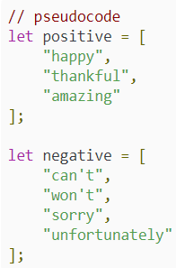
1 Deep Learning
https://www.youtube.com/watch?v=gZmobeGL0Yg&list=PLZbbT5o_s2xq7LwI2y8_QtvuXZedL6tQU
Machine Learning Vs. Traditional Programming
Example: Analyzing the sentiment (sentire: feeling, personal feeling) of a popular media outlet and classifying that sentiment as positive or negative.
Traditional Programming Approach
The algorithm may first look for particular words associated with a negative or positive sentiment.
With conditional statements, the algorithm would classify articles as positive or negative based on the words that it knows are positive or negative.

Slide 13
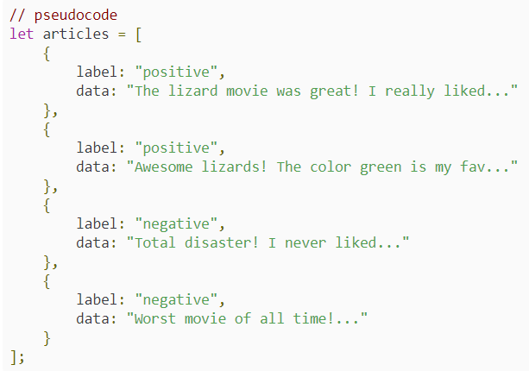
1 Deep Learning
https://www.youtube.com/watch?v=gZmobeGL0Yg&list=PLZbbT5o_s2xq7LwI2y8_QtvuXZedL6tQU
Machine Learning Approach
The algorithm analyzes given media data and learns the features that classify what a negative article looks like versus a positive article.
With what it has learned, the algorithm can then classify new articles as positive or negative.
As a machine learning programmer in this case, you won't be explicitly specifying the words for the algorithm to recognize.
Instead, the algorithm will “learn” that certain words are positive or negative based on labels given to each article it examines.

Slide 14
1 Quiz

Slide 15
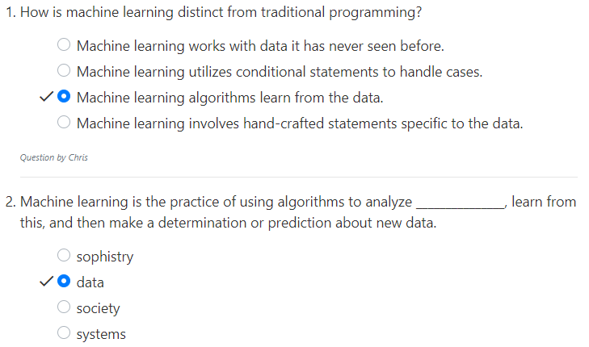
1 Quiz
https://www.youtube.com/watch?v=gZmobeGL0Yg&list=PLZbbT5o_s2xq7LwI2y8_QtvuXZedL6tQU
Quiz

Slide 16
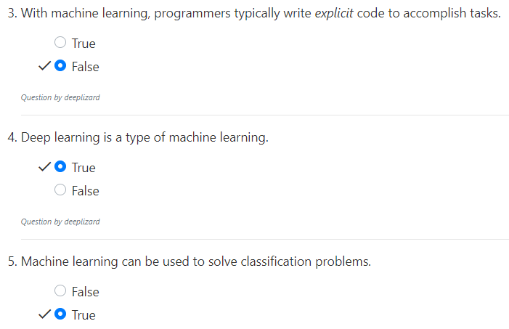
1 Quiz
https://www.youtube.com/watch?v=gZmobeGL0Yg&list=PLZbbT5o_s2xq7LwI2y8_QtvuXZedL6tQU
Quiz

Slide 17
1 Quiz
https://www.youtube.com/watch?v=gZmobeGL0Yg&list=PLZbbT5o_s2xq7LwI2y8_QtvuXZedL6tQU
Quiz
https://github.com/h5py/h5py/issues/853
6. When you run encounter h5py and hdf5 conflict error and cannot resolve the issues.
What is the easiest way to solve the problem?
Assume your existed environment is tfold
A). Create a totally clean enviornemnt for tensorflow and GPU.
> conda create --name tf python=3.7
> cond activate tf
(tf) > pip install tensorflow
B). Remove the environment and install new tensorflow
(tfold) > conda remove tfold
(tfold) > pip install tensorflow
C). Uninstall the trensorflow and reinstall the tensorflow.
(tfold) > conda remove tf # remove environemt
(tfold) > pip uninstall tensorflow
(tfold) > pip install tensorflow
D). Uninstall the hdf5 and reinstall the hdf5.
(tfold) > conda remove tf # remove environemt
(tfold) > pip uninstall hdf5
(tfold) > pip install hdf5
Ans: A).
Note:
After run tensorflow for long time, the dependencies may be totally screw up.
B) remove does not guraneteed the dependencies is clean up.
A) Recreate the new environment is the easiest way.

Slide 18
End of Chapter

