Slide 1
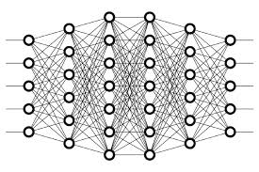
3 ANN Model
Peter H. Chen

Slide 2
3 ANN Explanation
https://www.youtube.com/watch?v=hfK_dvC-avg&list=PLZbbT5o_s2xq7LwI2y8_QtvuXZedL6tQU&index=3
What Is An Artificial Neural Network?
An artificial neural network is a computing system that is comprised of a collection of connected units called neurons that are organized into what we call layers.
At the highest level, there are three types of layers in every ANN:
Input layer
Hidden layers
Output layer

Slide 3
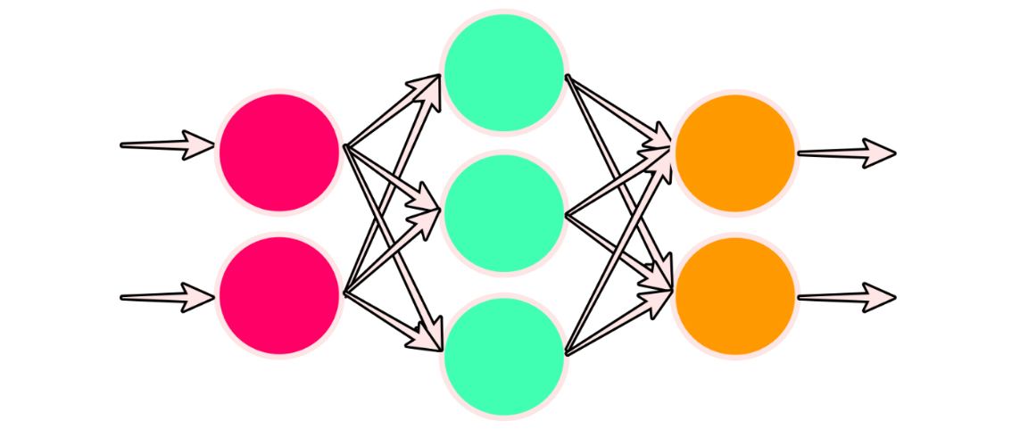
3 ANN Explanation
https://www.youtube.com/watch?v=hfK_dvC-avg&list=PLZbbT5o_s2xq7LwI2y8_QtvuXZedL6tQU&index=3
What Is An Artificial Neural Network?
Number of nodes in each layer:
Input layer (left): 2 nodes
Hidden layer (middle): 3 nodes
Output layer (right): 2 nodes

Slide 4
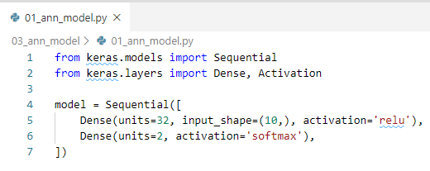
3 ANN Explanation
https://www.youtube.com/watch?v=hfK_dvC-avg&list=PLZbbT5o_s2xq7LwI2y8_QtvuXZedL6tQU&index=3
Keras Sequential Model
The Keras is a Sequential model with a linear stack of layers.

Slide 5
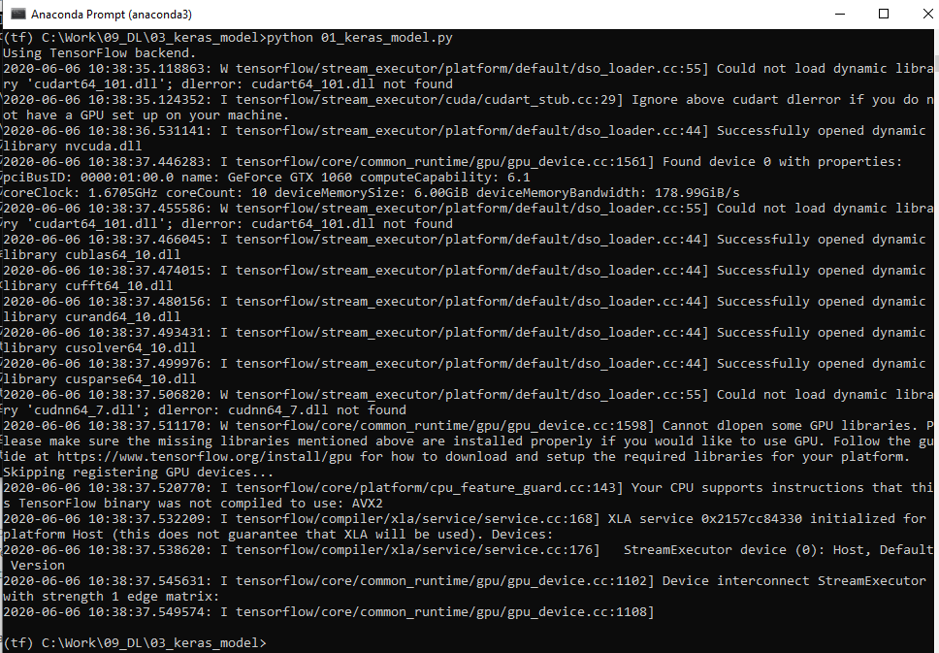
3 ANN Explanation
https://www.youtube.com/watch?v=hfK_dvC-avg&list=PLZbbT5o_s2xq7LwI2y8_QtvuXZedL6tQU&index=3
Keras Sequential Model
> conda activate tf
> pip install keras
> python 01_keras_model.py

Slide 6
3.1 Quiz

Slide 7
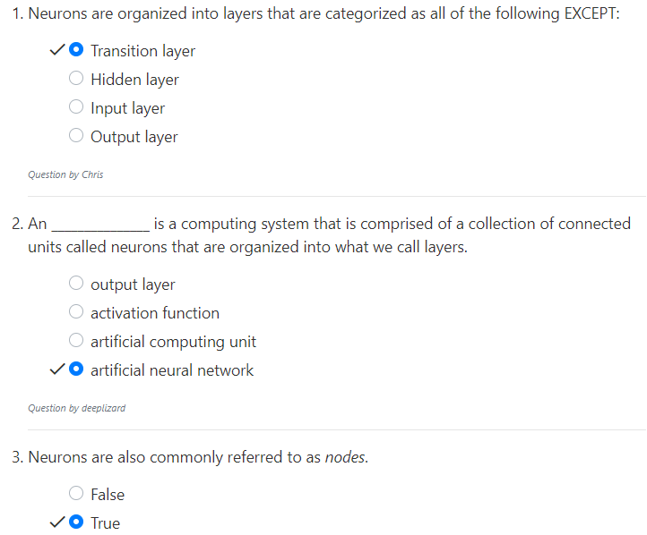
3.1 Quiz
https://www.youtube.com/watch?v=hfK_dvC-avg&list=PLZbbT5o_s2xq7LwI2y8_QtvuXZedL6tQU&index=3
Quiz

Slide 8
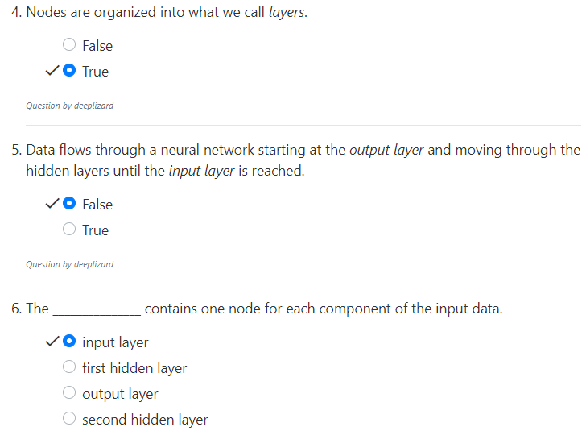
3.1 Quiz
https://www.youtube.com/watch?v=hfK_dvC-avg&list=PLZbbT5o_s2xq7LwI2y8_QtvuXZedL6tQU&index=3
Quiz

Slide 9
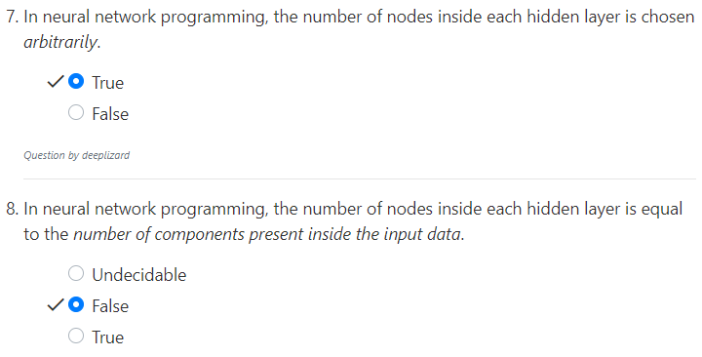
3.1 Quiz
https://www.youtube.com/watch?v=hfK_dvC-avg&list=PLZbbT5o_s2xq7LwI2y8_QtvuXZedL6tQU&index=3
Quiz

Slide 10
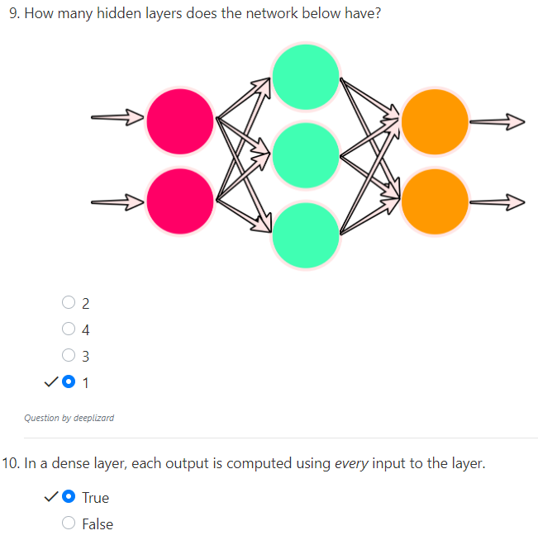
3.1 Quiz
https://www.youtube.com/watch?v=hfK_dvC-avg&list=PLZbbT5o_s2xq7LwI2y8_QtvuXZedL6tQU&index=3
Quiz

Slide 11
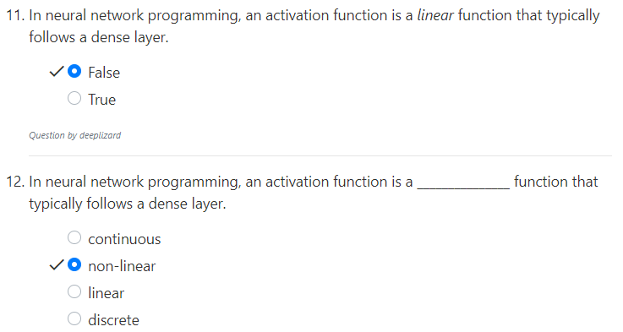
3.1 Quiz
https://www.youtube.com/watch?v=hfK_dvC-avg&list=PLZbbT5o_s2xq7LwI2y8_QtvuXZedL6tQU&index=3
Quiz

Slide 12
End of Chapter

