Slide 1
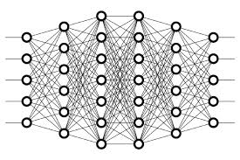
4 ANN Layer
Peter H. Chen

Slide 2
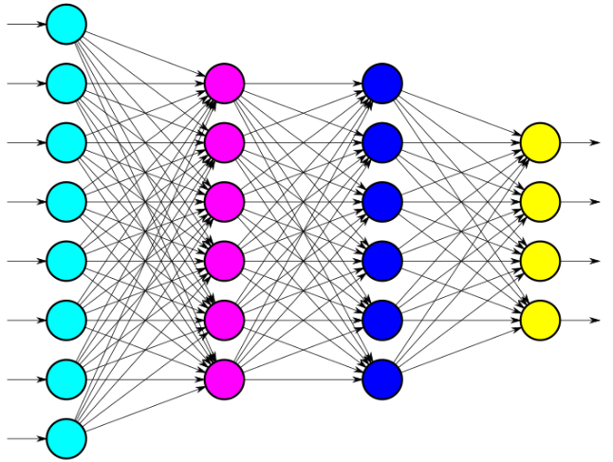
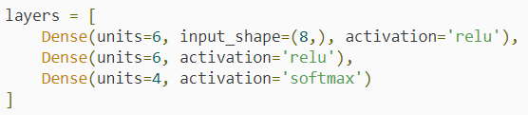
4 ANN Layer
https://www.youtube.com/watch?v=FK77zZxaBoI&list=PLZbbT5o_s2xq7LwI2y8_QtvuXZedL6tQU&index=4
Layers Explanation
Defining The Neural Network In Code With Keras

Slide 3
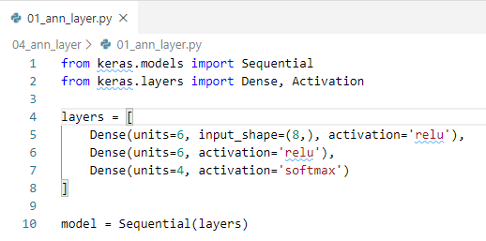
4 ANN Layer
https://www.youtube.com/watch?v=FK77zZxaBoI&list=PLZbbT5o_s2xq7LwI2y8_QtvuXZedL6tQU&index=4
Layers Explanation
> python 01_ann_layer.py

Slide 4
4.1 Quiz

Slide 5
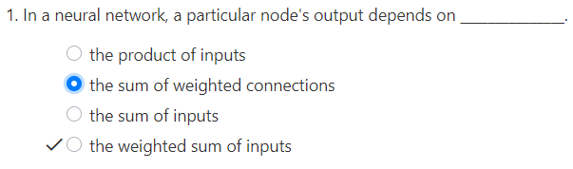
4.1 Quiz
https://www.youtube.com/watch?v=FK77zZxaBoI&list=PLZbbT5o_s2xq7LwI2y8_QtvuXZedL6tQU&index=4
Quiz

Slide 6
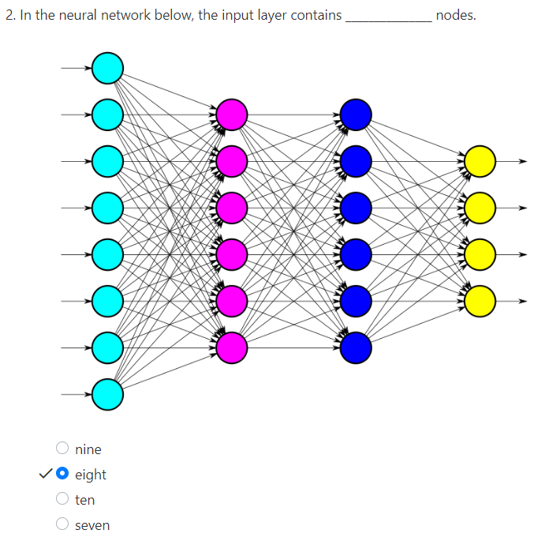
4.1 Quiz
https://www.youtube.com/watch?v=FK77zZxaBoI&list=PLZbbT5o_s2xq7LwI2y8_QtvuXZedL6tQU&index=4
Quiz

Slide 7
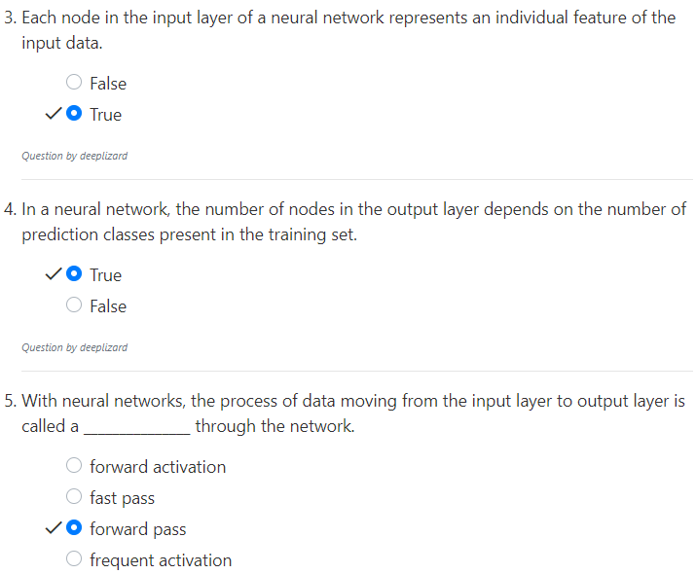
4.1 Quiz
https://www.youtube.com/watch?v=FK77zZxaBoI&list=PLZbbT5o_s2xq7LwI2y8_QtvuXZedL6tQU&index=4
Quiz

Slide 8
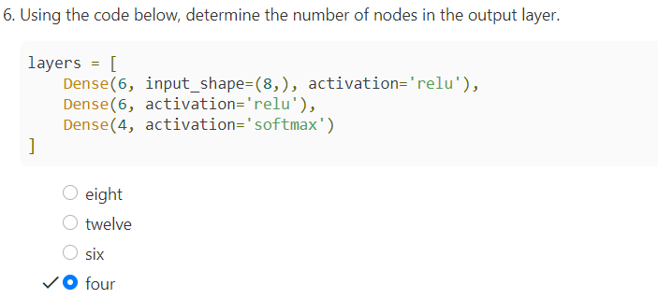
4.1 Quiz
https://www.youtube.com/watch?v=FK77zZxaBoI&list=PLZbbT5o_s2xq7LwI2y8_QtvuXZedL6tQU&index=4
Quiz

Slide 9
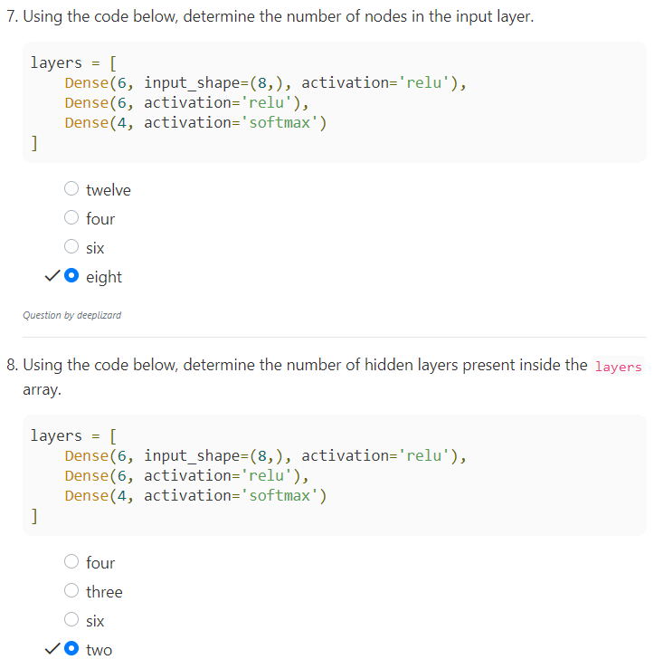
4.1 Quiz
https://www.youtube.com/watch?v=FK77zZxaBoI&list=PLZbbT5o_s2xq7LwI2y8_QtvuXZedL6tQU&index=4
Quiz

Slide 10
End of Chapter

