Slide 1
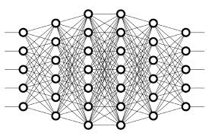
36 Batch Normalization
Peter H. Chen

Slide 2

36 Batch Normalization
https://www.youtube.com/watch?v=dXB-KQYkzNU&list=PLZbbT5o_s2xq7LwI2y8_QtvuXZedL6tQU&index=36
What Is Batch Normalization?
Before we discuss batch normalization, we discuss what is Regular Normalization (or Normalization) techniques.
What Is Regular Normalization?
When we train a neural network, we want to normalize or standardize our data in some way ahead of time as part of the pre-processing step.
This is the step where we prepare our data to get it ready for training.
Normalization and standardization have the same objective of transforming the data to put all the data points on the same scale.

Slide 3
36 Batch Normalization
https://www.youtube.com/watch?v=dXB-KQYkzNU&list=PLZbbT5o_s2xq7LwI2y8_QtvuXZedL6tQU&index=36
A typical normalization process consists of scaling numerical data down to be on a scale from zero to one, and a typical standardization process consists of subtracting the mean of the dataset from each data point, and then dividing that difference by the data set’s standard deviation.
This forces the standardized data to take on a mean of zero and a standard deviation of one.
In practice, this standardization process is often just referred to as normalization as well.

Slide 4
36 Batch Normalization
https://www.youtube.com/watch?v=dXB-KQYkzNU&list=PLZbbT5o_s2xq7LwI2y8_QtvuXZedL6tQU&index=36
Why Use Normalization Techniques?
Normalization boils down to putting our data on some type of known or standard scale.
Why do we do this?
If we do not normalize our data in some way, we may have some numerical data points in our data set that might be very high (Overflow), and other that might be very low (Underflow).
What data need to be Normalized?
Weight Data and Trainable Data (Hyperparameter) need to be normalized.
The large weight will then cause the output from its corresponding neuron to be extremely large, and this imbalance will, again, continue to cascade through the network, causing instability. This is where batch normalization comes into play.

Slide 5
36 Batch Normalization
https://www.youtube.com/watch?v=dXB-KQYkzNU&list=PLZbbT5o_s2xq7LwI2y8_QtvuXZedL6tQU&index=36
Applying Batch Norm To A Layer
Batch norm is applied to layers that we choose within our network.
Batch normalization is applied to layers.
When applying batch norm to a layer, the first thing batch norm does is normalize the output from the activation function.
The output from a layer is passed to an activation function, which transforms the output in some way depending on the function itself, before being passed to the next layer as input.
After normalizing the output from the activation function, batch norm multiplies this normalized output by some arbitrary parameter and then adds another arbitrary parameter to this resulting product.

Slide 6
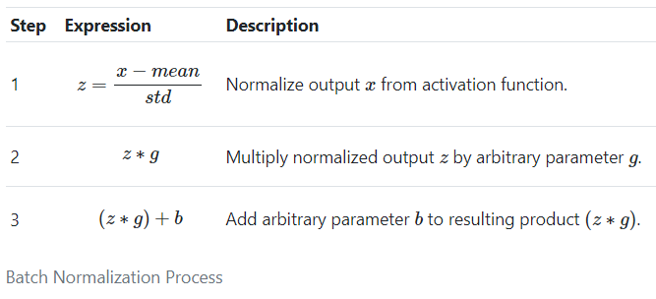
36 Batch Normalization
https://www.youtube.com/watch?v=dXB-KQYkzNU&list=PLZbbT5o_s2xq7LwI2y8_QtvuXZedL6tQU&index=36
Batch Normalization Process

Slide 7
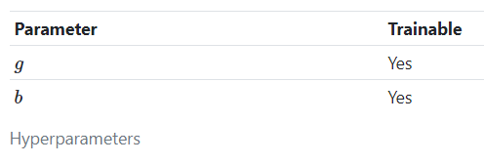
36 Batch Normalization
https://www.youtube.com/watch?v=dXB-KQYkzNU&list=PLZbbT5o_s2xq7LwI2y8_QtvuXZedL6tQU&index=36
Trainable Parameters
This calculation with the two arbitrary parameters sets a new standard deviation and mean for the data.
The two arbitrarily set parameters, g and b are trainable, meaning that they will be become learned and optimized during the training process.

Slide 8
36 Batch Normalization
https://www.youtube.com/watch?v=dXB-KQYkzNU&list=PLZbbT5o_s2xq7LwI2y8_QtvuXZedL6tQU&index=36
Trainable Parameters
This process makes it so that the weights within the network don’t become imbalanced with extremely high or low values since the normalization is included in the gradient process.
This addition of batch norm to our model can greatly increase the speed in which training occurs and reduce the ability of outlying large weights to over-influence the training process.

Slide 9
36 Batch Normalization
https://www.youtube.com/watch?v=dXB-KQYkzNU&list=PLZbbT5o_s2xq7LwI2y8_QtvuXZedL6tQU&index=36
Normalizing Per Batch
Everything we just mentioned about the batch normalization process occurs on a per-batch basis, hence the name batch norm.
These batches are determined by the batch size we set when we train our model. If we’re not yet familiar with training batches or batch size, check out this post on the topic.

Slide 10
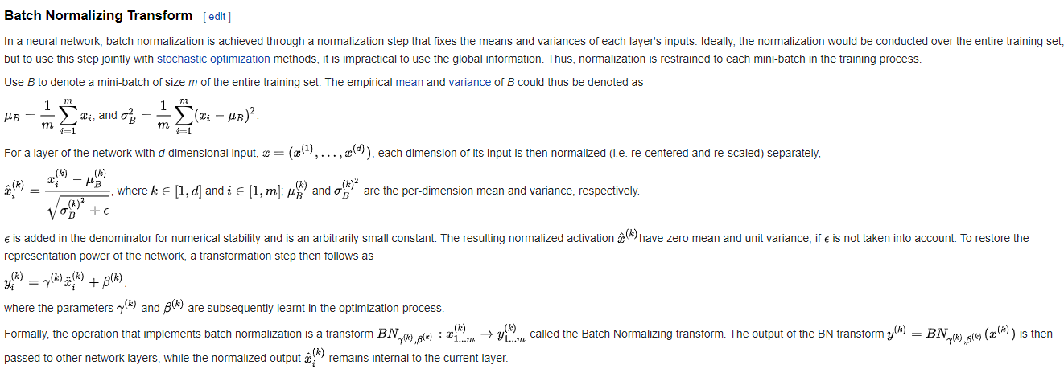
36 Batch Normalization
https://www.youtube.com/watch?v=dXB-KQYkzNU&list=PLZbbT5o_s2xq7LwI2y8_QtvuXZedL6tQU&index=36
Normalizing Per Batch
https://en.wikipedia.org/wiki/Batch_normalization

Slide 11
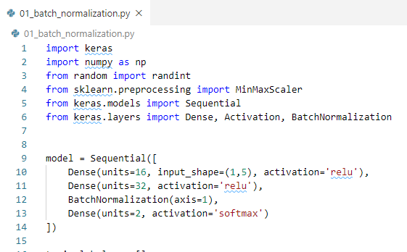
36 Batch Normalization
https://www.youtube.com/watch?v=dXB-KQYkzNU&list=PLZbbT5o_s2xq7LwI2y8_QtvuXZedL6tQU&index=36
Keras Code:

Slide 12
29.1 Quiz

Slide 13
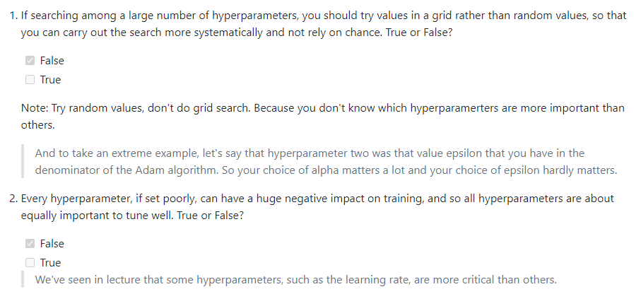
29.1 Quiz
https://www.youtube.com/watch?v=dXB-KQYkzNU&list=PLZbbT5o_s2xq7LwI2y8_QtvuXZedL6tQU&index=36
Quiz:
https://github.com/Kulbear/deep-learning-coursera/blob/master/Improving%20Deep%20Neural%20Networks%20Hyperparameter%20tuning%2C%20Regularization%20and%20Optimization/Week%203%20Quiz%20-%20Hyperparameter%20tuning%2C%20Batch%20Normalization%2C%20Programming%20Frameworks.md

Slide 14
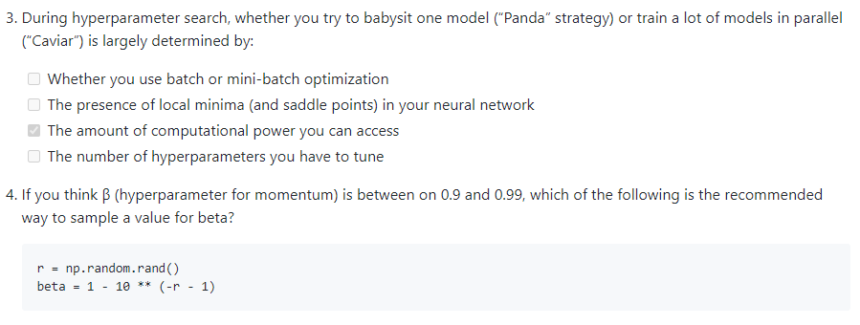
29.1 Quiz
https://www.youtube.com/watch?v=dXB-KQYkzNU&list=PLZbbT5o_s2xq7LwI2y8_QtvuXZedL6tQU&index=36
Quiz:
https://github.com/Kulbear/deep-learning-coursera/blob/master/Improving%20Deep%20Neural%20Networks%20Hyperparameter%20tuning%2C%20Regularization%20and%20Optimization/Week%203%20Quiz%20-%20Hyperparameter%20tuning%2C%20Batch%20Normalization%2C%20Programming%20Frameworks.md

Slide 15
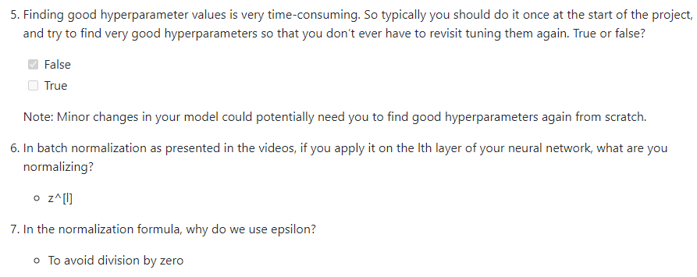
29.1 Quiz
https://www.youtube.com/watch?v=dXB-KQYkzNU&list=PLZbbT5o_s2xq7LwI2y8_QtvuXZedL6tQU&index=36
Quiz:
https://github.com/Kulbear/deep-learning-coursera/blob/master/Improving%20Deep%20Neural%20Networks%20Hyperparameter%20tuning%2C%20Regularization%20and%20Optimization/Week%203%20Quiz%20-%20Hyperparameter%20tuning%2C%20Batch%20Normalization%2C%20Programming%20Frameworks.md

Slide 16
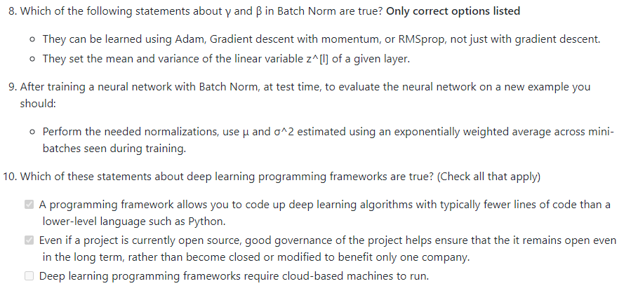
29.1 Quiz
https://www.youtube.com/watch?v=dXB-KQYkzNU&list=PLZbbT5o_s2xq7LwI2y8_QtvuXZedL6tQU&index=36
Quiz:
https://github.com/Kulbear/deep-learning-coursera/blob/master/Improving%20Deep%20Neural%20Networks%20Hyperparameter%20tuning%2C%20Regularization%20and%20Optimization/Week%203%20Quiz%20-%20Hyperparameter%20tuning%2C%20Batch%20Normalization%2C%20Programming%20Frameworks.md

Slide 17
End of Chapter

