Slide 1
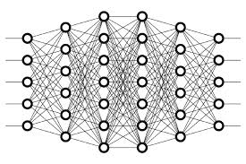
6 Training
Peter H. Chen

Slide 2
6 Training
https://www.youtube.com/watch?v=sZAlS3_dnk0&list=PLZbbT5o_s2xq7LwI2y8_QtvuXZedL6tQU&index=6
Training
Deep Learning uses model to solve an optimization problem
Optimizing weights
with Stochastic Gradient Descent (SGD)
Objective: Minimize the loss function
The model needs data to train the weights in neural network.

Slide 3

6 Training
https://www.youtube.com/watch?v=sZAlS3_dnk0&list=PLZbbT5o_s2xq7LwI2y8_QtvuXZedL6tQU&index=6
Training
When we train a model, we’re basically trying to solve an optimization problem. We’re trying to optimize the weights within the model.
Our task is to find the weights that most accurately map our input data to the correct output class.
This mapping is what the network must learn.
During training, these weights are iteratively updated and moved towards their optimal values.

Slide 4
6 Training
https://www.youtube.com/watch?v=sZAlS3_dnk0&list=PLZbbT5o_s2xq7LwI2y8_QtvuXZedL6tQU&index=6
Optimization Algorithm
The weights are optimized using what we call an optimization algorithm. The optimization process depends on the chosen optimization algorithm.
We also use the term optimizer to refer to the chosen algorithm.
The most widely known optimizer is called stochastic gradient descent, or more simply, SGD.
When we have any optimization problem, we must have an optimization objective, so now let’s consider what SGD’s objective is in optimizing the model’s weights.

Slide 5
6 Training
https://www.youtube.com/watch?v=sZAlS3_dnk0&list=PLZbbT5o_s2xq7LwI2y8_QtvuXZedL6tQU&index=6
Loss Function
One common loss function is mean squared error (MSE), but there are several loss functions that we could use in its place.
As deep learning practitioners, it's our job to decide which loss function to use.

Slide 6
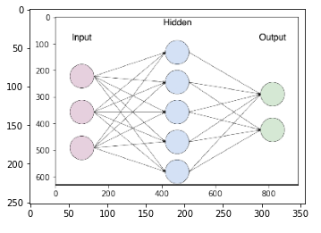
6 Training
https://www.youtube.com/watch?v=sZAlS3_dnk0&list=PLZbbT5o_s2xq7LwI2y8_QtvuXZedL6tQU&index=6
Pre-Process Data for Training
Example data:
An experimental drug was tested on individuals from ages 13 to 100.
The trial had 2100 participants. Half were under 65 years old, half were over 65 years old.
95% of patients 65 or older experienced side effects.
95% of patients under 65 experienced no side effects.

Slide 7
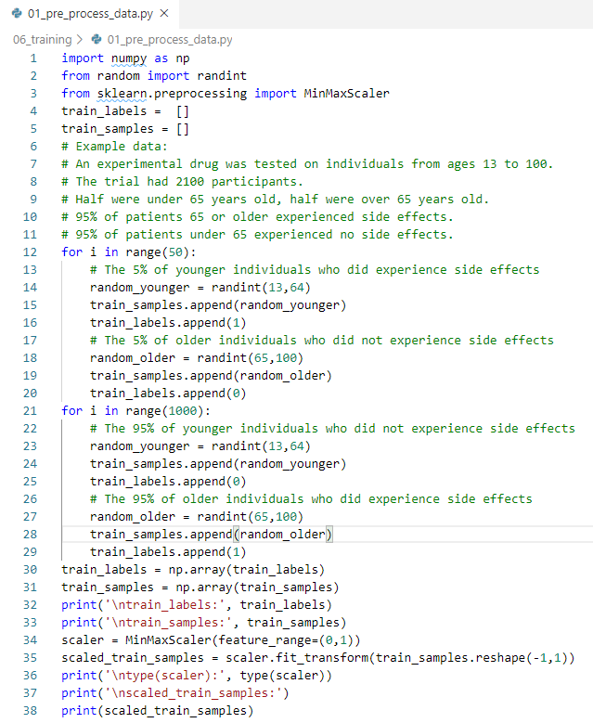
6 Training
https://www.youtube.com/watch?v=sZAlS3_dnk0&list=PLZbbT5o_s2xq7LwI2y8_QtvuXZedL6tQU&index=6
Pre-Process Data for Training
Code:

Slide 8
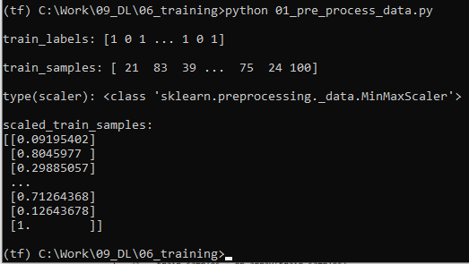
6 Training
https://www.youtube.com/watch?v=sZAlS3_dnk0&list=PLZbbT5o_s2xq7LwI2y8_QtvuXZedL6tQU&index=6
Pre-Process Data for Training
Result:

Slide 9
6.1 Quiz

Slide 10
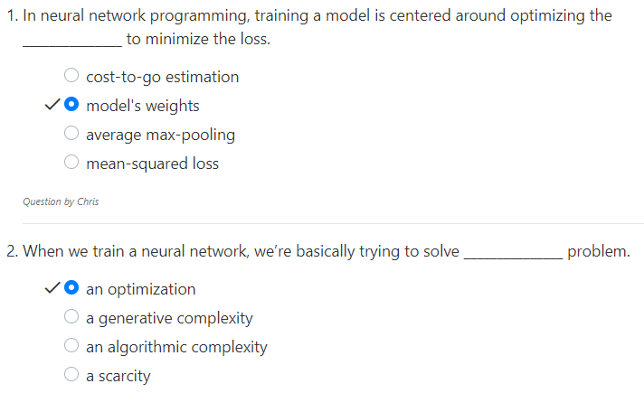
6.1 Quiz
https://www.youtube.com/watch?v=sZAlS3_dnk0&list=PLZbbT5o_s2xq7LwI2y8_QtvuXZedL6tQU&index=6
Quiz

Slide 11
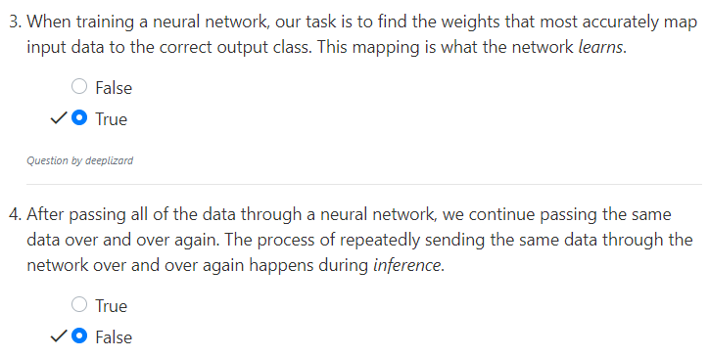
6.1 Quiz
https://www.youtube.com/watch?v=sZAlS3_dnk0&list=PLZbbT5o_s2xq7LwI2y8_QtvuXZedL6tQU&index=6
Quiz
During training, these weights are iteratively updated and moved towards their optimal values.

Slide 12
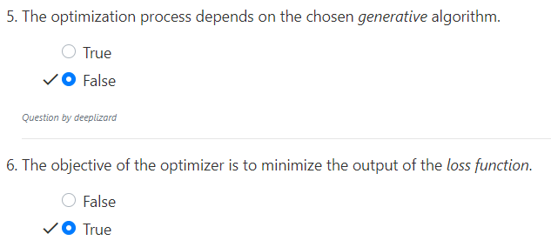
6.1 Quiz
https://www.youtube.com/watch?v=sZAlS3_dnk0&list=PLZbbT5o_s2xq7LwI2y8_QtvuXZedL6tQU&index=6
Quiz
The optimization process depends on the chosen optimization algorithm.
We also use the term optimizer to refer to the chosen algorithm.
The most widely known optimizer is called stochastic gradient descent, or more simply, SGD.

Slide 13
End of Chapter

