Slide 1
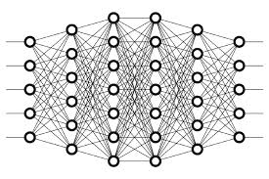
7 Learning
Peter H. Chen

Slide 2
7 Learning
https://www.youtube.com/watch?v=_N5kpSMDf4o&list=PLZbbT5o_s2xq7LwI2y8_QtvuXZedL6tQU&index=7
Learning
An epoch refers to a single pass of the entire dataset to the network during training.
Gradient Of The Loss Function
After the loss is calculated, the gradient of this loss function is computed with respect to each of the weights within the network.
Note, gradient is just a word for the derivative of a function of several variables.
After we have calculated the loss of a single output, we calculate the gradient of that loss with respect to our single chosen weight. This calculation is done using a technique called backpropagation.

Slide 3
7 Learning
https://www.youtube.com/watch?v=_N5kpSMDf4o&list=PLZbbT5o_s2xq7LwI2y8_QtvuXZedL6tQU&index=7
Learning Rate
We then multiply the gradient value by something called a learning rate.
A learning rate is a small number usually ranging between 0.01 and 0.0001, but the actual value can vary.
The learning rate tells us how large of a step we should take in the direction of the minimum.
Updating The Weights
new weight = old weight - (learning rate * gradient)

Slide 4
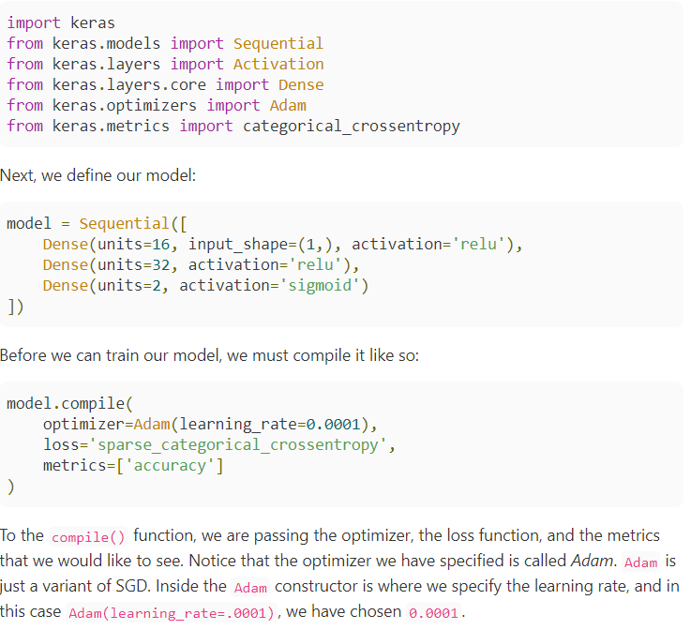
7 Learning
https://www.youtube.com/watch?v=_N5kpSMDf4o&list=PLZbbT5o_s2xq7LwI2y8_QtvuXZedL6tQU&index=7
Keras

Slide 5
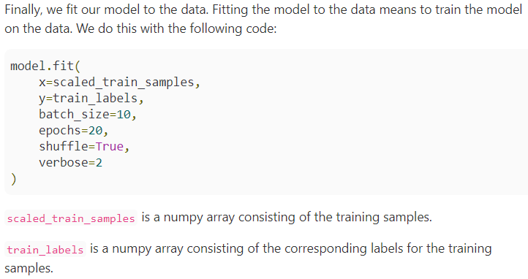
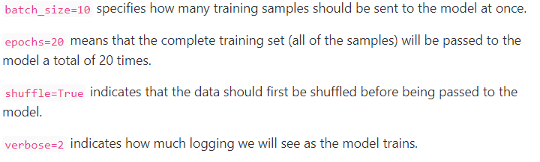
7 Learning
https://www.youtube.com/watch?v=_N5kpSMDf4o&list=PLZbbT5o_s2xq7LwI2y8_QtvuXZedL6tQU&index=7
Keras

Slide 6
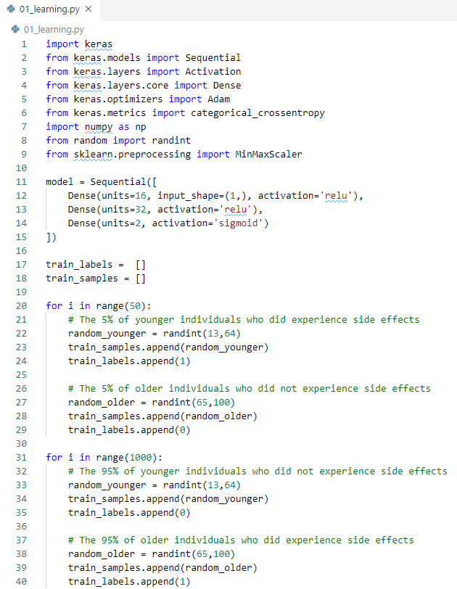
7 Learning
https://www.youtube.com/watch?v=_N5kpSMDf4o&list=PLZbbT5o_s2xq7LwI2y8_QtvuXZedL6tQU&index=7
Code:

Slide 7
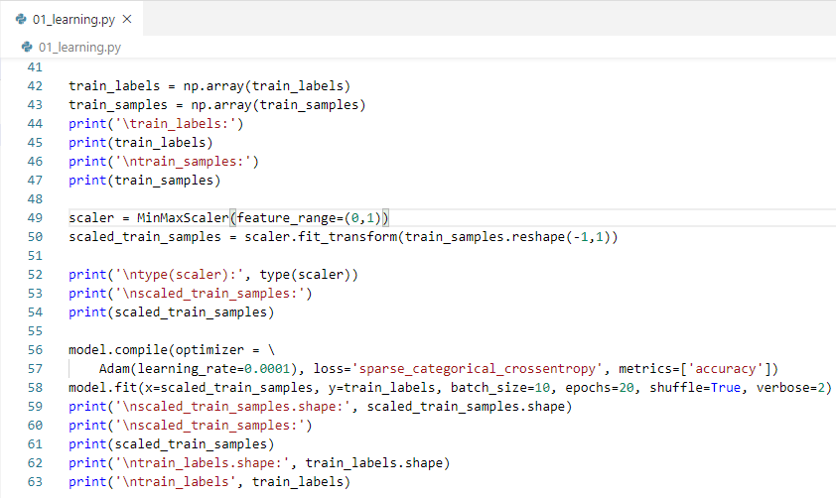
7 Learning
https://www.youtube.com/watch?v=_N5kpSMDf4o&list=PLZbbT5o_s2xq7LwI2y8_QtvuXZedL6tQU&index=7
Code:

Slide 8
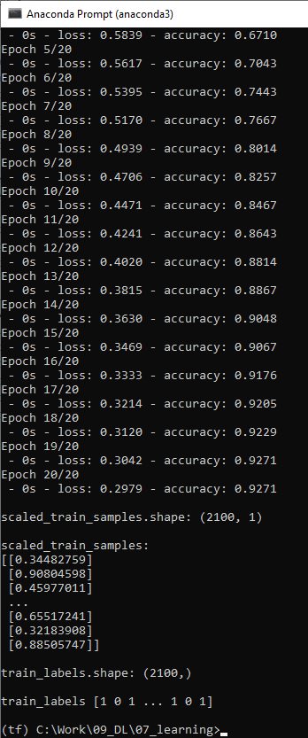
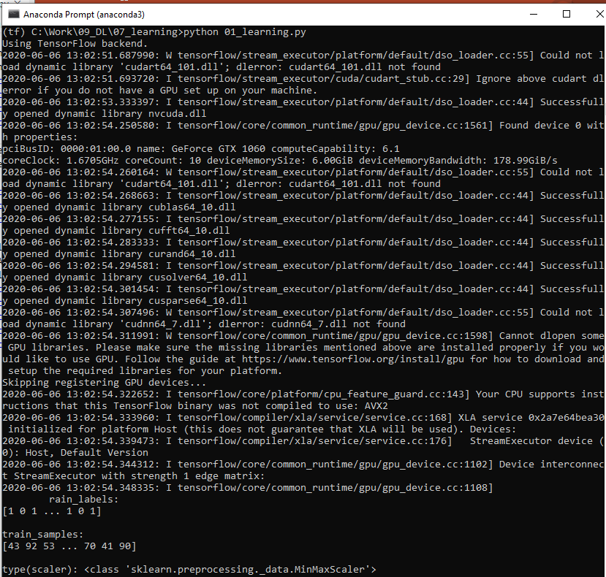
7 Learning
https://www.youtube.com/watch?v=_N5kpSMDf4o&list=PLZbbT5o_s2xq7LwI2y8_QtvuXZedL6tQU&index=7
Result:

Slide 9
7.1 Quiz

Slide 10
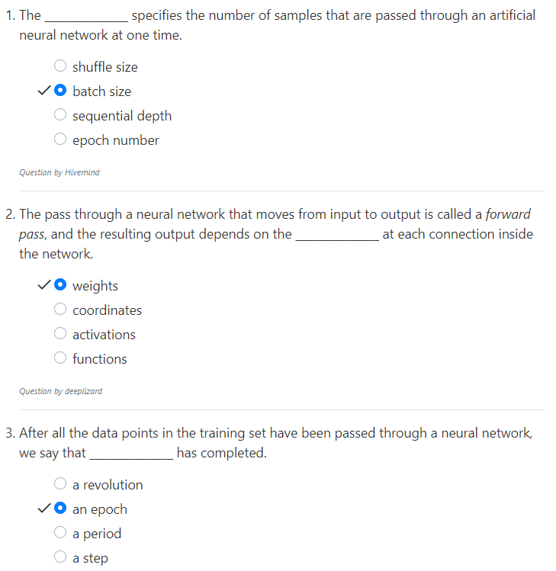
7.1 Quiz
https://www.youtube.com/watch?v=_N5kpSMDf4o&list=PLZbbT5o_s2xq7LwI2y8_QtvuXZedL6tQU&index=7
Quiz

Slide 11
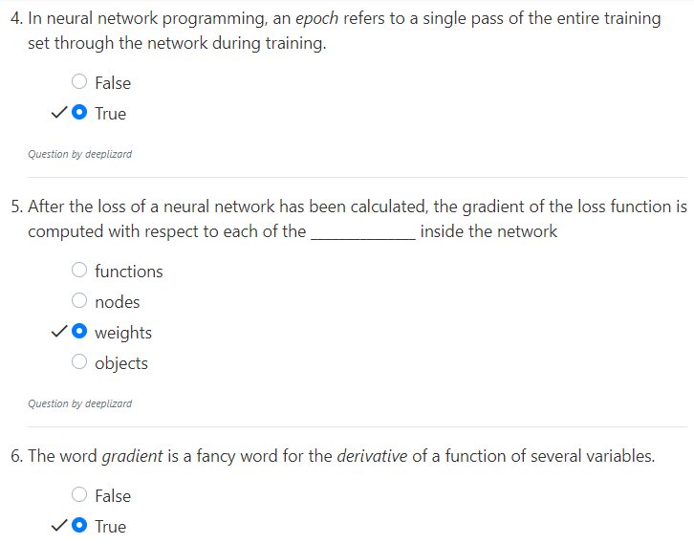
7.1 Quiz
https://www.youtube.com/watch?v=_N5kpSMDf4o&list=PLZbbT5o_s2xq7LwI2y8_QtvuXZedL6tQU&index=7
Quiz

Slide 12
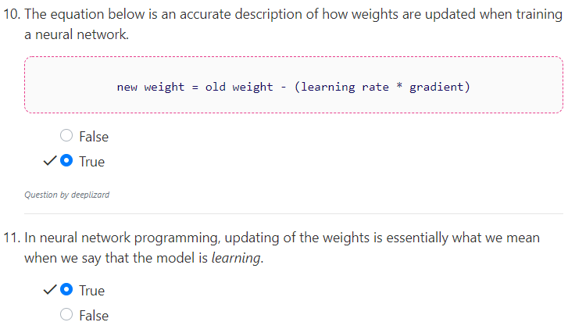
7.1 Quiz
https://www.youtube.com/watch?v=_N5kpSMDf4o&list=PLZbbT5o_s2xq7LwI2y8_QtvuXZedL6tQU&index=7
Quiz

Slide 13
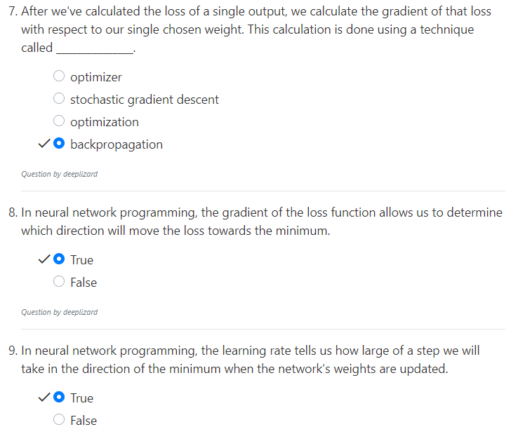
7.1 Quiz
https://www.youtube.com/watch?v=_N5kpSMDf4o&list=PLZbbT5o_s2xq7LwI2y8_QtvuXZedL6tQU&index=7
Quiz

Slide 14
End of Chapter

