Slide 1
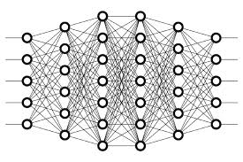
2 Deep Learning Explanation
Peter H. Chen

Slide 2
2 Deep Learning Explanation
https://www.youtube.com/watch?v=gZmobeGL0Yg&list=PLZbbT5o_s2xq7LwI2y8_QtvuXZedL6tQU
Deep Learning Explanation
Deep learning is a sub-field of machine learning that uses algorithms inspired by the structure and function of the brain's neural networks
The neural networks that we use in deep learning aren't actual biological neural networks though. They simply share some characteristics with biological neural networks, and for this reason, we call them artificial neural networks (ANNs).
We often also use other terms to refer to ANNs. In the field of deep learning, the term artificial neural network (ANN) is used interchangeably with the following:
net
neural net
model

Slide 3
2 Deep Learning Explanation
https://www.youtube.com/watch?v=gZmobeGL0Yg&list=PLZbbT5o_s2xq7LwI2y8_QtvuXZedL6tQU
What Does Deep Mean In Deep Learning?
To understand the term deep in deep learning, we need to first understand how ANNs are structured. Once we know this, we will be able to see that deep learning uses a specific type of ANN that we call a deep net or deep artificial neural network.
In the next post on artificial neural networks, we'll learn how ANNs are structured, and this will give us the knowledge we need to understand how an ANN becomes a deep ANN.
For now, here is what you need to know:
ANNs are built using what we call neurons.
Neurons in an ANN are organized into what we call layers.
Layers within an ANN (all but the input and output layers) are called hidden layers.
If an ANN has more than one hidden layer, the ANN is said to be a deep ANN.
In summary, deep learning uses ANNs that have multiple hidden layers. Keep this in mind as we move forward in this series, and it will become more clear as we continue our journey through deep learning.

Slide 4
2.1 Quiz

Slide 5
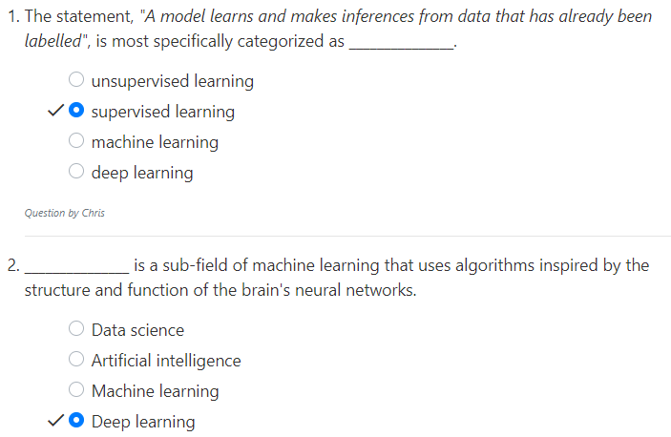
2.1 Quiz
https://www.youtube.com/watch?v=gZmobeGL0Yg&list=PLZbbT5o_s2xq7LwI2y8_QtvuXZedL6tQU
Quiz

Slide 6
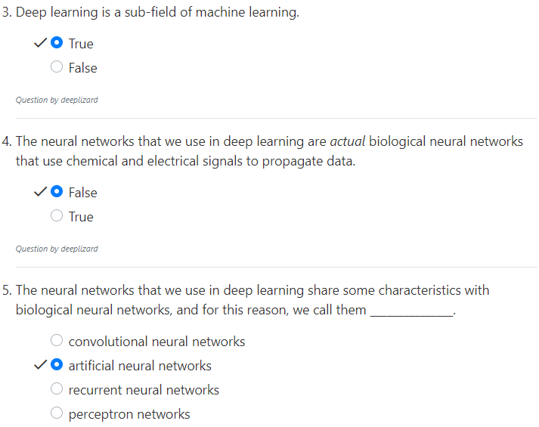
2.1 Quiz
https://www.youtube.com/watch?v=gZmobeGL0Yg&list=PLZbbT5o_s2xq7LwI2y8_QtvuXZedL6tQU
Quiz

Slide 7
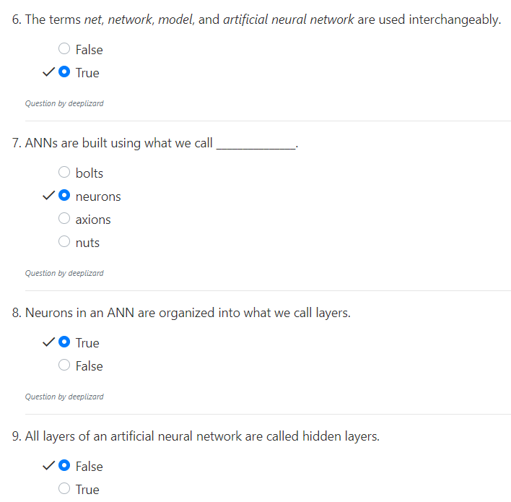
2.1 Quiz
https://www.youtube.com/watch?v=gZmobeGL0Yg&list=PLZbbT5o_s2xq7LwI2y8_QtvuXZedL6tQU
Quiz

Slide 8
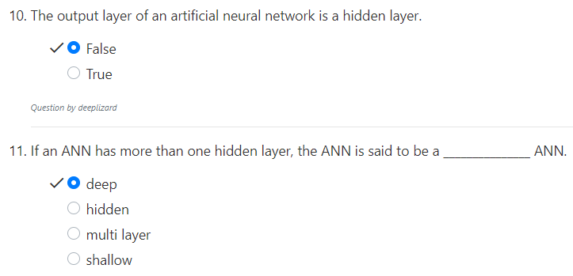
2.1 Quiz
https://www.youtube.com/watch?v=gZmobeGL0Yg&list=PLZbbT5o_s2xq7LwI2y8_QtvuXZedL6tQU
Quiz

Slide 9
End of Chapter

