Slide 1
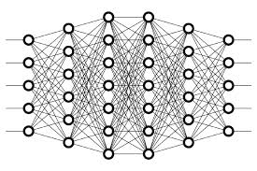
4 Layers Explanation
Peter H. Chen

Slide 2
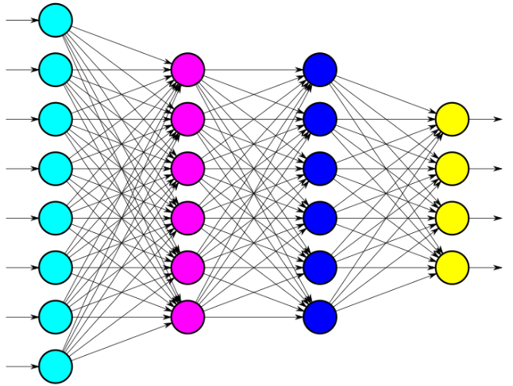
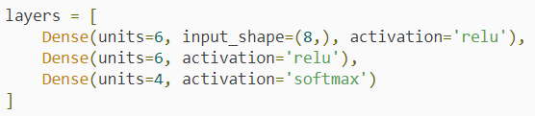
4 Layers Explanation
https://www.youtube.com/watch?v=FK77zZxaBoI&list=PLZbbT5o_s2xq7LwI2y8_QtvuXZedL6tQU&index=4
Layers Explanation
Defining The Neural Network In Code With Keras

Slide 3
4.1 Quiz

Slide 4
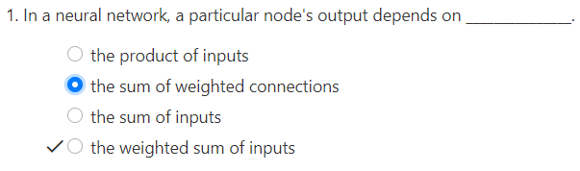
4.1 Quiz
https://www.youtube.com/watch?v=FK77zZxaBoI&list=PLZbbT5o_s2xq7LwI2y8_QtvuXZedL6tQU&index=4
Quiz

Slide 5
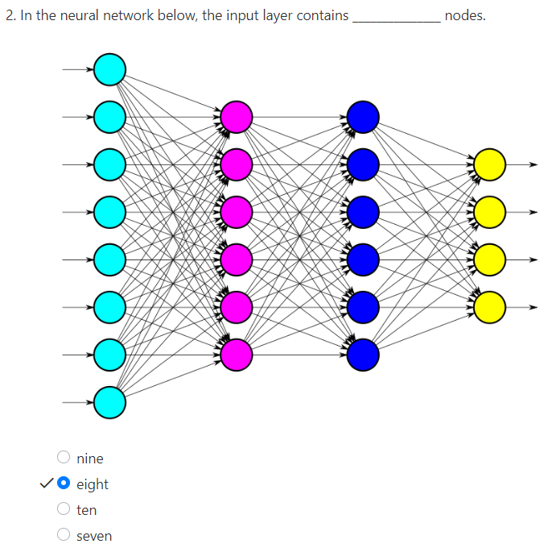
4.1 Quiz
https://www.youtube.com/watch?v=FK77zZxaBoI&list=PLZbbT5o_s2xq7LwI2y8_QtvuXZedL6tQU&index=4
Quiz

Slide 6
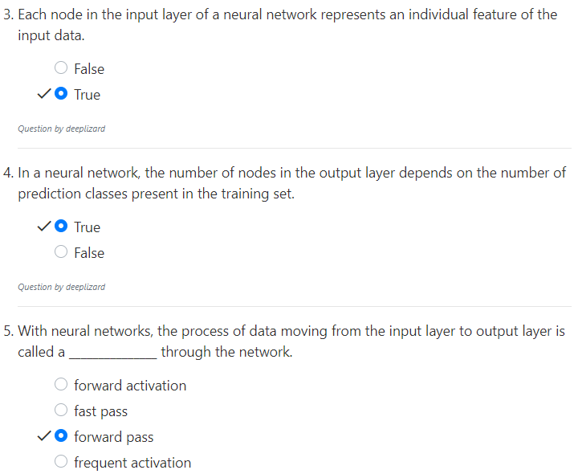
4.1 Quiz
https://www.youtube.com/watch?v=FK77zZxaBoI&list=PLZbbT5o_s2xq7LwI2y8_QtvuXZedL6tQU&index=4
Quiz

Slide 7
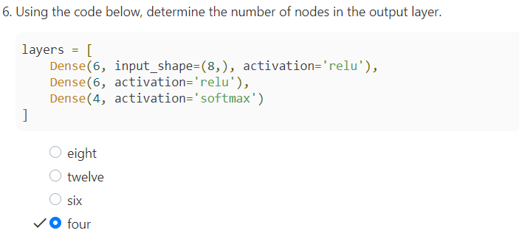
4.1 Quiz
https://www.youtube.com/watch?v=FK77zZxaBoI&list=PLZbbT5o_s2xq7LwI2y8_QtvuXZedL6tQU&index=4
Quiz

Slide 8
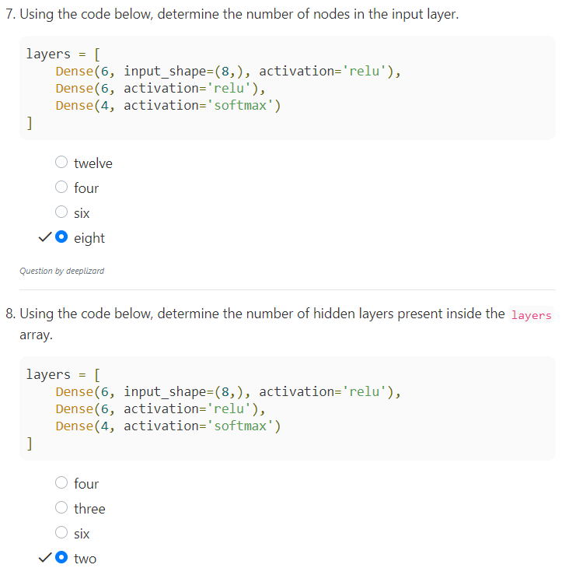
4.1 Quiz
https://www.youtube.com/watch?v=FK77zZxaBoI&list=PLZbbT5o_s2xq7LwI2y8_QtvuXZedL6tQU&index=4
Quiz

Slide 9
End of Chapter

