Slide 1
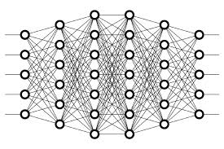
8 Loss Function
Peter H. Chen

Slide 2
8 Loss Function
https://www.youtube.com/watch?v=Skc8nqJirJg&list=PLZbbT5o_s2xq7LwI2y8_QtvuXZedL6tQU&index=8
Loss Function
Suppose our model is classifying images of cats and dogs, and assume that the label for cat is 0 and the label for dog is 1.
cat: 0
dog: 1
Now suppose we pass an image of a cat to the model, and the provided output is 0.25. In this case, the difference between the model’s prediction and the true label is 0.25 - 0.00 = 0.25. This difference is also called the error.
error = 0.25 - 0.00 = 0.25

Slide 3
8 Loss Function
https://www.youtube.com/watch?v=Skc8nqJirJg&list=PLZbbT5o_s2xq7LwI2y8_QtvuXZedL6tQU&index=8
Mean Squared Error (MSE)
For a single sample, with MSE, we first calculate the difference (the error) between the provided output prediction and the label. We then square this error. For a single input, this is all we do.
MSE (input) = (output - label)(output - label)

Slide 4
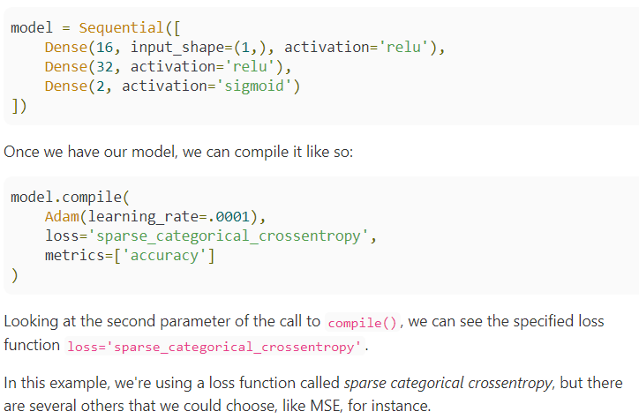
8 Loss Function
https://www.youtube.com/watch?v=Skc8nqJirJg&list=PLZbbT5o_s2xq7LwI2y8_QtvuXZedL6tQU&index=8
Keras

Slide 5
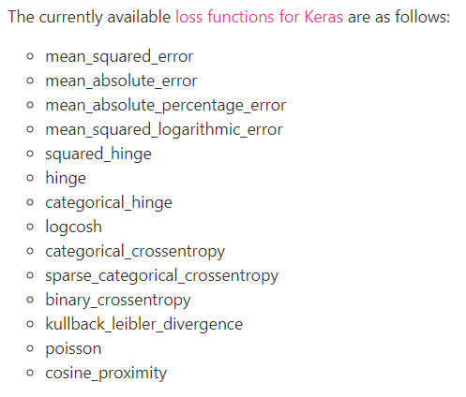
8 Loss Function
https://www.youtube.com/watch?v=Skc8nqJirJg&list=PLZbbT5o_s2xq7LwI2y8_QtvuXZedL6tQU&index=8
Keras

Slide 6
8.1 Quiz

Slide 7
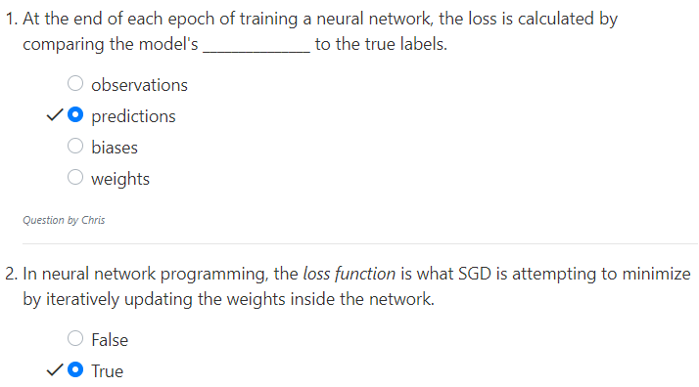
8.1 Quiz
https://www.youtube.com/watch?v=Skc8nqJirJg&list=PLZbbT5o_s2xq7LwI2y8_QtvuXZedL6tQU&index=8
Quiz

Slide 8
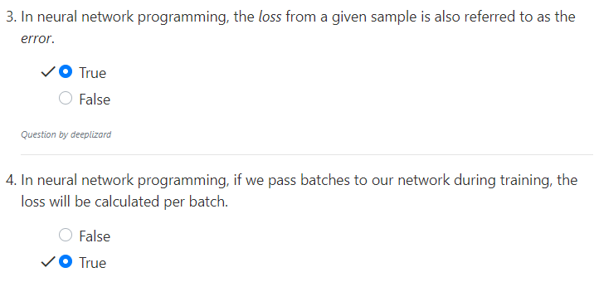
8.1 Quiz
https://www.youtube.com/watch?v=Skc8nqJirJg&list=PLZbbT5o_s2xq7LwI2y8_QtvuXZedL6tQU&index=8
Quiz

Slide 9
End of Chapter

