Slide 1
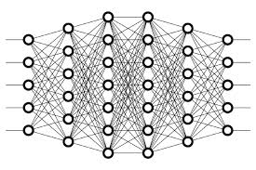
9 Learning Rate
Peter H. Chen

Slide 2
9 Learning Rate
https://www.youtube.com/watch?v=jWT-AX9677k&list=PLZbbT5o_s2xq7LwI2y8_QtvuXZedL6tQU&index=9
Learning Rate
The gradients will then get multiplied by the learning rate.
gradients * learning rate
This learning rate is a small number usually ranging between 0.01 and 0.0001, but the actual value can vary, and any value we get for the gradient is going to become pretty small once we multiply it by the learning rate.

Slide 3
9 Learning Rate
https://www.youtube.com/watch?v=jWT-AX9677k&list=PLZbbT5o_s2xq7LwI2y8_QtvuXZedL6tQU&index=9
Updating The Network's Weights
Alright, so we get the value of this product for each gradient multiplied by the learning rate, and we then take each of these values and update the respective weights by subtracting this value from them.
new weight = old weight - (learning rate * gradient)
The value we choose for the learning rate is going to require some testing.
The learning rate is a hyperparameters.
We have to test and tune learning rate (hyperparameters) with each model before we know exactly where we want to set it, but as mentioned earlier, a typical guideline is to set it somewhere between 0.01 and 0.0001.

Slide 4
9 Learning Rate
https://www.youtube.com/watch?v=jWT-AX9677k&list=PLZbbT5o_s2xq7LwI2y8_QtvuXZedL6tQU&index=9
Keras
model = Sequential([
Dense(units=16, input_shape=(1,), activation='relu’),
Dense(units=32, activation='relu', kernel_regularizer=regularizers.l2(0.01)),
Dense(units=2, activation='sigmoid’)
])
model.compile(optimizer=
Adam(learning_rate=0.0001),
loss='sparse_categorical_crossentropy’,
metrics=['accuracy’]
)

Slide 5
9 Learning Rate
https://www.youtube.com/watch?v=jWT-AX9677k&list=PLZbbT5o_s2xq7LwI2y8_QtvuXZedL6tQU&index=9
Keras
With the line where we’re compiling our model, we can see that the first parameter we’re specifying is our optimizer. In this case, we’re using Adam as the optimizer for this model.
Now to our optimizer, we can optionally pass our learning rate by specifying the lr parameter.
We can see that here we’re specifying 0.0001 as the learning rate.
In a code implementation, the object that typically needs to have the learning rate is the optimizer.

Slide 6
9.1 Quiz

Slide 7
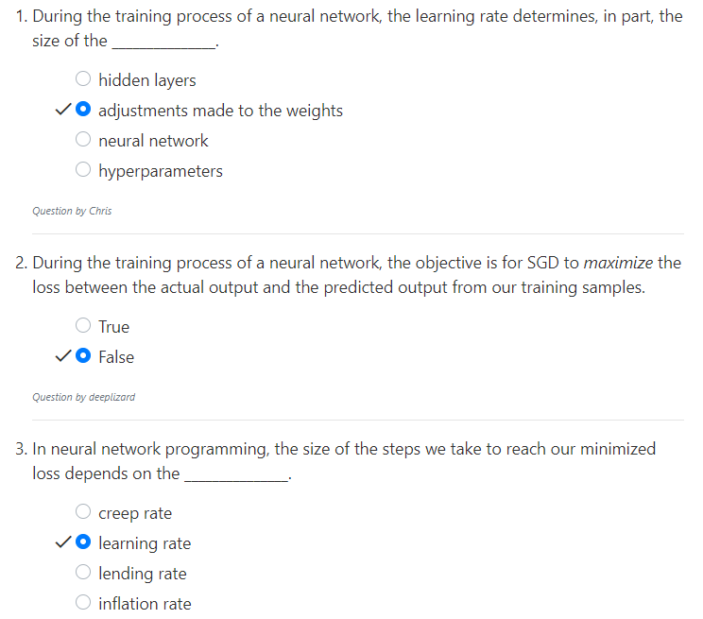
9.1 Quiz
https://www.youtube.com/watch?v=jWT-AX9677k&list=PLZbbT5o_s2xq7LwI2y8_QtvuXZedL6tQU&index=9
Quiz

Slide 8
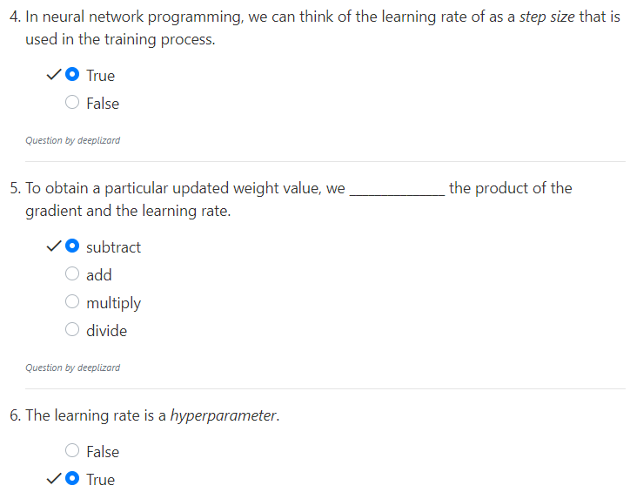
9.1 Quiz
https://www.youtube.com/watch?v=jWT-AX9677k&list=PLZbbT5o_s2xq7LwI2y8_QtvuXZedL6tQU&index=9
Quiz

Slide 9
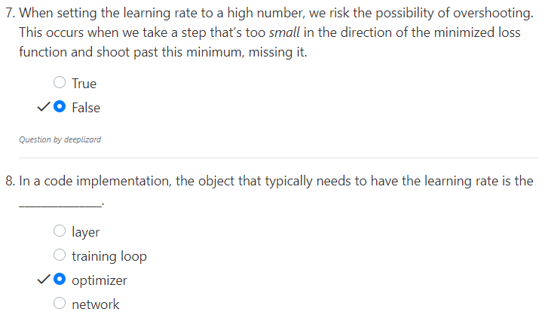
9.1 Quiz
https://www.youtube.com/watch?v=jWT-AX9677k&list=PLZbbT5o_s2xq7LwI2y8_QtvuXZedL6tQU&index=9
Quiz

Slide 10
End of Chapter

