Slide 1
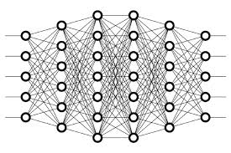
12 Overfit
Peter H. Chen

Slide 2
12 Overfit
https://www.youtube.com/watch?v=DEMmkFC6IGM&list=PLZbbT5o_s2xq7LwI2y8_QtvuXZedL6tQU&index=12
How to Spot Overfit
We can tell if the model is overfitting based on the metrics that are given for our training data and validation data during training.
We previously saw that when we specify a validation set during training, we get metrics for the validation accuracy and loss, as well as the training accuracy and loss.
If the validation metrics are considerably worse than the training metrics, then that is indication that our model is overfitting.
We can also get an idea that our model is overfitting if during training, the model’s metrics were good, but when we use the model to predict on test data, it doesn't accurately classify the data in the test set.
The concept of overfitting boils down to the fact that the model is unable to generalize well.
It has learned the features of the training set extremely well, but if we give the model any data that slightly deviates from the exact data used during training, it’s unable to generalize and accurately predict the output.

Slide 3
12 Overfit
https://www.youtube.com/watch?v=DEMmkFC6IGM&list=PLZbbT5o_s2xq7LwI2y8_QtvuXZedL6tQU&index=12
Reducing Overfitting
Overfitting is a common issue. How can we reduce it? Let's look at some techniques.
Adding More Data To The Training Set
The easiest thing we can do, as long as we have access to it, is to add more data. The more data we can train our model on, the more it will be able to learn from the training set. Also, with more data, we’re hoping to be adding more diversity to the training set as well.
For example, if we train a model to classify whether an image is an image of a dog or cat, and the model has only seen images of larger dogs, like Labs, Golden Retrievers, and Boxers, then in practice if it sees a Pomeranian, it may not do so well at recognizing that a Pomeranian is a dog.
If we add more data to this model to encompass more breeds, then our training data will become more diverse, and the model will be less likely to overfit.

Slide 4
12 Overfit
https://www.youtube.com/watch?v=DEMmkFC6IGM&list=PLZbbT5o_s2xq7LwI2y8_QtvuXZedL6tQU&index=12
Data Augmentation (Data Expansion)
Another technique we can deploy to reduce overfitting is to use data augmentation.
This is the process of creating additional augmented data by reasonably modifying the data in our training set. For image data, for example, we can do these modifications by:
Cropping (clip or trim)
Rotating
Flipping
Zooming
The general idea of data augmentation allows us to add more data to our training set that is similar to the data that we already have, but is just reasonably modified to some degree so that it’s not the exact same.
For example, if most of our dog images were dogs facing to the left, then it would be a reasonable modification to add augmented flipped images so that our training set would also have dogs that faced to the right.

Slide 5
12 Overfit
https://www.youtube.com/watch?v=DEMmkFC6IGM&list=PLZbbT5o_s2xq7LwI2y8_QtvuXZedL6tQU&index=12
Reduce The Complexity Of The Model
Something else we can do to reduce overfitting is to reduce the complexity of our model.
We could reduce complexity by making simple changes, like removing some layers from the model, or reducing the number of neurons in the layers.
This may help our model generalize better to data it hasn’t seen before.
Dropout (Throw Away)
The last tip we'll cover for reducing overfitting is to use something called dropout.
The general idea behind dropout is that, if you add it to a model, it will randomly ignore some subset of nodes in a given layer during training, i.e., it drops out the nodes from the layer.
This will prevent these dropped out nodes from participating in producing a prediction on the data.

Slide 6
12.1 Quiz

Slide 7
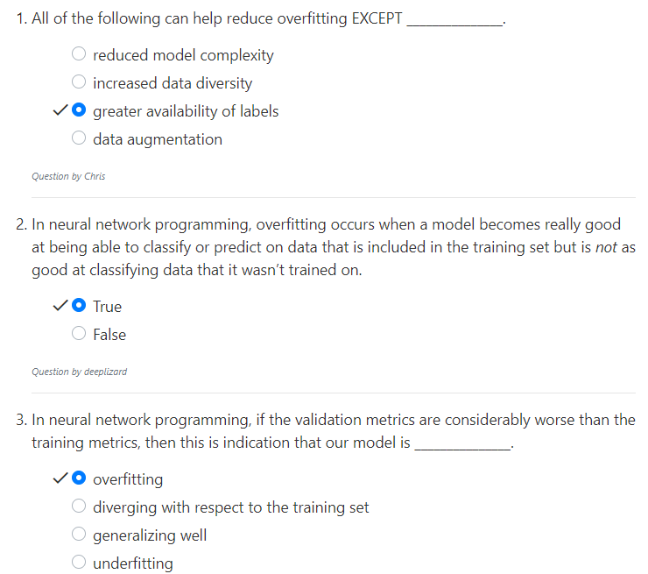
12.1 Quiz
https://www.youtube.com/watch?v=DEMmkFC6IGM&list=PLZbbT5o_s2xq7LwI2y8_QtvuXZedL6tQU&index=12
Quiz

Slide 8
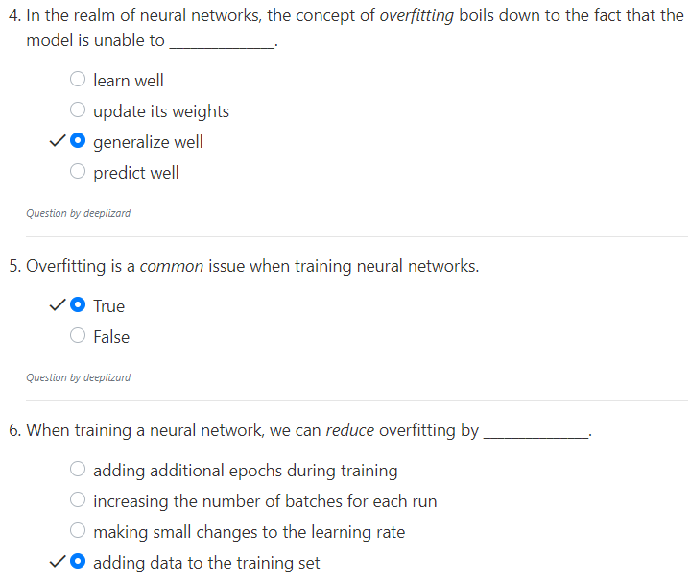
12.1 Quiz
https://www.youtube.com/watch?v=DEMmkFC6IGM&list=PLZbbT5o_s2xq7LwI2y8_QtvuXZedL6tQU&index=12
Quiz
Data Augmentation (Data Expansion)
Cropping (clip or trim)
Rotating
Flipping
Zooming

Slide 9
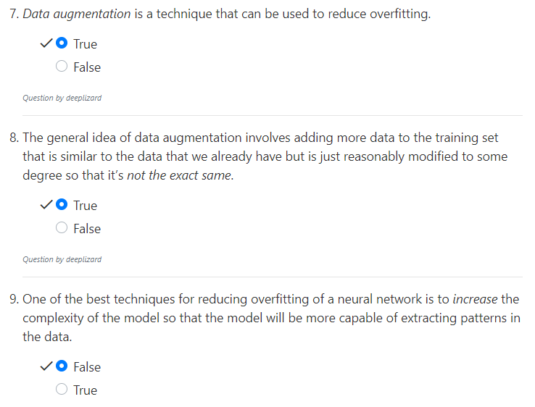
12.1 Quiz
https://www.youtube.com/watch?v=DEMmkFC6IGM&list=PLZbbT5o_s2xq7LwI2y8_QtvuXZedL6tQU&index=12
Quiz

Slide 10
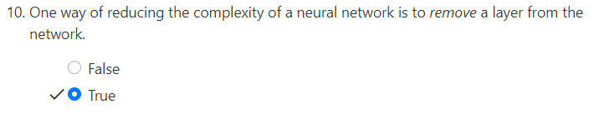
12.1 Quiz
https://www.youtube.com/watch?v=DEMmkFC6IGM&list=PLZbbT5o_s2xq7LwI2y8_QtvuXZedL6tQU&index=12
Quiz

Slide 11
End of Chapter

