Slide 1
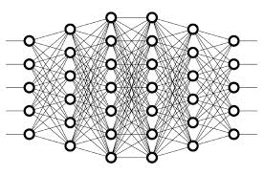
22 Max Pooling
Peter H. Chen

Slide 2
22 Max Pooling
https://www.youtube.com/watch?v=ZjM_XQa5s6s&list=PLZbbT5o_s2xq7LwI2y8_QtvuXZedL6tQU&index=22
Max Pooling
Why do we need Max Pooling?
Introducing Max Pooling
Max pooling is a type of operation that is typically added to CNNs following individual convolutional layers.
When added to a model, max pooling reduces the dimensionality of images by reducing the number of pixels in the output from the previous convolutional layer.

Slide 3
22 Max Pooling
https://www.youtube.com/watch?v=ZjM_XQa5s6s&list=PLZbbT5o_s2xq7LwI2y8_QtvuXZedL6tQU&index=22
Example Using A Sample From The MNIST Dataset
We discussed CNN that each convolutional layer has some number of filters that we define with a specified dimension and that these filters convolve our image input channels.
When a filter convolves a given input, it then gives us an output.
This output is a matrix of pixels with the values that were computed during the convolutions that occurred on our image. We call these output channels.
We’re going to be using the same image of a seven that we used in our previous post on CNNs.
Recall, we have a matrix of the pixel values from an image of a 7 from the MNIST data set.

Slide 4
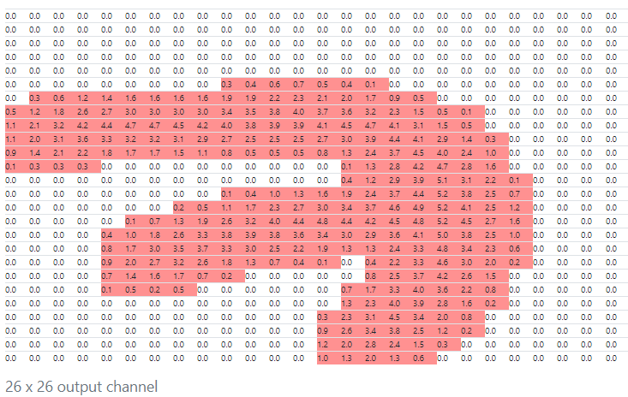
22 Max Pooling
https://www.youtube.com/watch?v=ZjM_XQa5s6s&list=PLZbbT5o_s2xq7LwI2y8_QtvuXZedL6tQU&index=22
Example Using A Sample From The MNIST Dataset
We used a 3 x 3 filter to produce the output channel below:

Slide 5
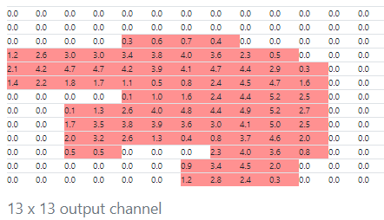
22 Max Pooling
https://www.youtube.com/watch?v=ZjM_XQa5s6s&list=PLZbbT5o_s2xq7LwI2y8_QtvuXZedL6tQU&index=22
Example Using A Sample From The MNIST Dataset
As mentioned earlier, max pooling is added after a convolutional layer.
This is the output from the convolution operation and is the input to the max pooling operation.
After the max pooling operation, we have the following output channel:

Slide 6
22 Max Pooling
https://www.youtube.com/watch?v=ZjM_XQa5s6s&list=PLZbbT5o_s2xq7LwI2y8_QtvuXZedL6tQU&index=22
Example Using A Sample From The MNIST Dataset
Max pooling works like this. We define some n x n region as a corresponding filter for the max pooling operation. We’re going to use 2 x 2 in this example.
We define a stride, which determines how many pixels we want our filter to move as it slides across the image.
Stride determines how many units the filter slides.
On the convolutional output, and we take the first 2 x 2 region and calculate the max value from each value in the 2 x 2 block. This value is stored in the output channel, which makes up the full output from this max pooling operation.
We move over by the number of pixels that we defined our stride size to be. We’re using 2 here, so we just slide over by 2, then do the same thing. We calculate the max value in the next 2 x 2 block, store it in the output, and then, go on our way sliding over by 2 again.

Slide 7
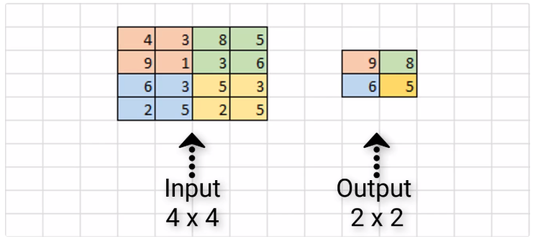
22 Max Pooling
https://www.youtube.com/watch?v=ZjM_XQa5s6s&list=PLZbbT5o_s2xq7LwI2y8_QtvuXZedL6tQU&index=22
Scaled Down Example
Suppose we have the following:

Slide 8
22 Max Pooling
https://www.youtube.com/watch?v=ZjM_XQa5s6s&list=PLZbbT5o_s2xq7LwI2y8_QtvuXZedL6tQU&index=22
Scaled Down Example
We have some sample input of size 4 x 4, and we’re assuming that we have a 2 x 2 filter size with a stride of 2 to do max pooling on this input channel.
Our first 2 x 2 region is in orange, and we can see the max value of this region is 9, and so we store that over in the output channel.

Slide 9
22 Max Pooling
https://www.youtube.com/watch?v=ZjM_XQa5s6s&list=PLZbbT5o_s2xq7LwI2y8_QtvuXZedL6tQU&index=22
Scaled Down Example
Next, we slide over by 2 pixels, and we see the max value in the green region is 8. As a result, we store the value over in the output channel.
Since we’ve reached the edge, we now move back over to the far left, and go down by 2 pixels. Here, the max value in the blue region is 6, and we store that here in our output channel.
Finally, we move to the right by 2, and see the max value of the yellow region is 5. We store this value in our output channel.
This completes the process of max pooling on this sample 4 x 4 input channel, and the resulting output channel is this 2 x 2 block. As a result, we can see that our input dimensions were again reduced by a factor of two.
Alright, we know what max pooling is and how it works, so let’s discuss why would we want to add this to our network?

Slide 10
22 Max Pooling
https://www.youtube.com/watch?v=ZjM_XQa5s6s&list=PLZbbT5o_s2xq7LwI2y8_QtvuXZedL6tQU&index=22
Why Use Max Pooling?
There are a couple of reasons why adding max pooling to our network may be helpful.
Reducing Computational Load
Since max pooling is reducing the resolution of the given output of a convolutional layer, the network will be looking at larger areas of the image at a time going forward, which reduces the amount of parameters in the network and consequently reduces computational load.

Slide 11
22 Max Pooling
https://www.youtube.com/watch?v=ZjM_XQa5s6s&list=PLZbbT5o_s2xq7LwI2y8_QtvuXZedL6tQU&index=22
Average Pooling
For example, average pooling is another type of pooling, and that’s where you take the average value from each region rather than the max.
Currently max pooling is used vastly more than average pooling, but I did just want to mention that point. Alright, now let’s jump over to Keras and see how this is done in code.

Slide 12
22 Max Pooling
https://www.youtube.com/watch?v=ZjM_XQa5s6s&list=PLZbbT5o_s2xq7LwI2y8_QtvuXZedL6tQU&index=22
Reducing Overfitting
Additionally, max pooling may also help to reduce overfitting. The intuition for why max pooling works is that, for a particular image, our network will be looking to extract some particular features.
Maybe, it’s trying to identify numbers from the MNIST dataset, and so it’s looking for edges, and curves, and circles, and such. From the output of the convolutional layer, we can think of the higher valued pixels as being the ones that are the most activated.
With max pooling, as we’re going over each region from the convolutional output, we’re able to pick out the most activated pixels and preserve these high values going forward while discarding the lower valued pixels that are not as activated.
Just to mention quickly before going forward, there are other types of pooling that follow the exact same process we’ve just gone through, except for that it does some other operation on the regions rather than finding the max value.

Slide 13
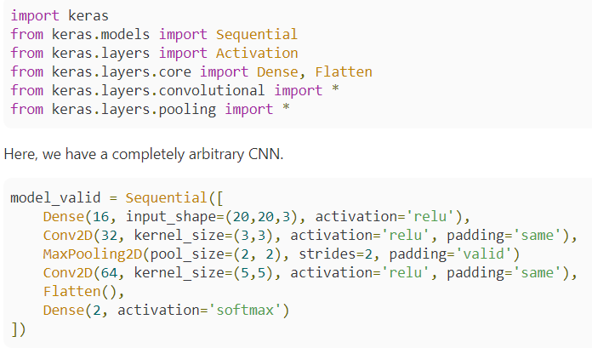
22 Max Pooling
https://www.youtube.com/watch?v=ZjM_XQa5s6s&list=PLZbbT5o_s2xq7LwI2y8_QtvuXZedL6tQU&index=22
Keras Code

Slide 14
22 Max Pooling
https://www.youtube.com/watch?v=ZjM_XQa5s6s&list=PLZbbT5o_s2xq7LwI2y8_QtvuXZedL6tQU&index=22
Keras Code
It has an input layer that accepts input of 20 x 20 x 3 dimensions, then a dense layer followed by a convolutional layer followed by a max pooling layer, and then one more convolutional layer, which is finally followed by an output layer.
Following the first convolutional layer, we specify max pooling. Since the convolutional layers are 2d here, We're using the MaxPooling2D layer from Keras, but Keras also has 1d and 3d max pooling layers as well.
The first parameter we’re specifying is the pool_size. This is the size of what we were calling a filter before, and in our example, we used a 2 x 2 filter.
The next parameter is strides. Again, in our earlier examples, we used 2 as well, so that’s what we've specified here. The last parameter that we have specified is the padding parameter. If you’re unsure what padding or zero-padding is in regards to CNNs, be sure to check out the earlier post that explains the concept.

Slide 15
22 Max Pooling
https://www.youtube.com/watch?v=ZjM_XQa5s6s&list=PLZbbT5o_s2xq7LwI2y8_QtvuXZedL6tQU&index=22
Keras Code
Recall from that post, we discussed how valid padding means to use no padding, that’s what we’ve specified here, and actually I don’t think it’s a common practice at all to use padding on max pooling layers.
But while we’re on the subject of padding, I wanted to point something else out, which is that for the two convolutional layers, we’ve specified same padding so that the input is padded such that the output of the convolutional layers will be the same size as the input.
If we go ahead and look at a summary of our model, we can see that the dimensions from the output of our first layer are 20 x 20, which matches the original input size. The dimensions of the output from our first convolutional layer maintain the same 20 x 20 values because we’re using same padding on that layer.

Slide 16
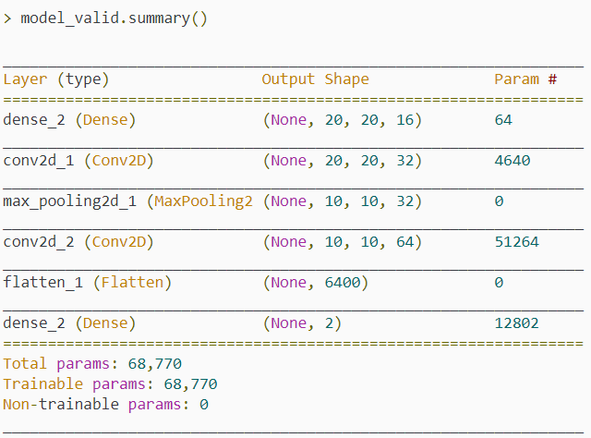
22 Max Pooling
https://www.youtube.com/watch?v=ZjM_XQa5s6s&list=PLZbbT5o_s2xq7LwI2y8_QtvuXZedL6tQU&index=22
Keras Code

Slide 17
22 Max Pooling
https://www.youtube.com/watch?v=ZjM_XQa5s6s&list=PLZbbT5o_s2xq7LwI2y8_QtvuXZedL6tQU&index=22
Keras Code
Once we go down to the max pooling layer, we see the value of the dimensions has been cut in half to become 10 x 10. This is because, as we saw with our earlier examples, a filter of size 2 x 2 along with a stride of 2 for our max pooling layer will reduce the dimensions of our input by a factor of two, so that’s exactly what we see here.
Lastly, this max pooling layer is followed by one last convolutional layer that is using same padding, so we can see that the output shape for this last layer maintains the 10 x 10 dimensions from the previous max pooling layer.

Slide 18
22.1 Quiz

Slide 19
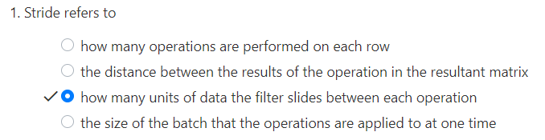
22.1 Quiz
https://www.youtube.com/watch?v=ZjM_XQa5s6s&list=PLZbbT5o_s2xq7LwI2y8_QtvuXZedL6tQU&index=22
Quiz

Slide 20
End of Chapter

