Slide 1
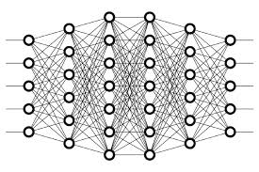
24 Backpropagation Math Notation
Peter H. Chen

Slide 2
24 Backpropagation Math Notation
https://www.youtube.com/watch?v=2mSysRx-1c0&list=PLZbbT5o_s2xq7LwI2y8_QtvuXZedL6tQU&index=24
Backpropagation in Mathematical Notation
What is math in Backpropagation?
Recapping Backpropagation
After we forward propagate our data through our network, the network gives an output for that data.
The loss is then calculated for that predicted output based on what the true value of the original data is.
Stochastic gradient descent, or SGD, has the objective to minimize this loss.
To do this, it calculates the derivative of the loss with respect to each of the weights in the network. It then uses this derivative to update the weights.
When SGD calculates the derivative, it’s doing this using backpropagation.
Essentially, SGD is using backprop as a tool to calculate the derivative, or the gradient, of the loss function.

Slide 3
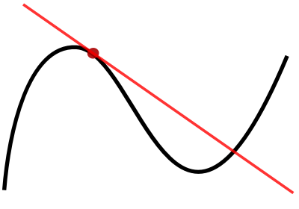
24 Backpropagation Math Notation
https://www.youtube.com/watch?v=2mSysRx-1c0&list=PLZbbT5o_s2xq7LwI2y8_QtvuXZedL6tQU&index=24
Backpropagation Mathematical Notation
As discussed, we’re going to start out by going over the definitions and notation that we’ll be using going forward to do our calculations.

Slide 4
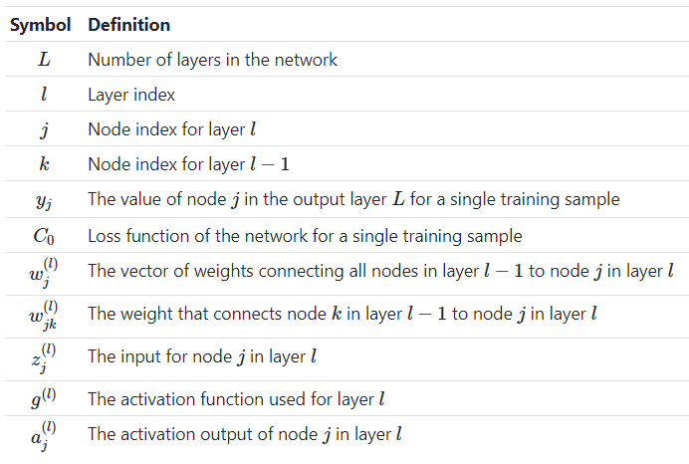
24 Backpropagation Math Notation
https://www.youtube.com/watch?v=2mSysRx-1c0&list=PLZbbT5o_s2xq7LwI2y8_QtvuXZedL6tQU&index=24
This table describes the notation we’ll be using throughout this process.

Slide 5
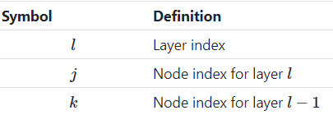
24 Backpropagation Math Notation
https://www.youtube.com/watch?v=2mSysRx-1c0&list=PLZbbT5o_s2xq7LwI2y8_QtvuXZedL6tQU&index=24
Importance Of Indices
Recall at the top of the table, we covered the notation that we’d be using to index the layers and nodes within our network. All further definitions then depended on these indices.

Slide 6

24 Backpropagation Math Notation
https://www.youtube.com/watch?v=2mSysRx-1c0&list=PLZbbT5o_s2xq7LwI2y8_QtvuXZedL6tQU&index=24
We saw that, for each of the terms we introduced, we have either a subscript or a superscript, or both.
Sometimes, our subscript even had two terms, as we saw when we defined the weight between two nodes.
These indices we’re using everywhere may make the terms look a little intimidating and overly bulky.
That’s why I want to focus on this topic further here.
It turns out that if we use these indices properly and we understand their purpose, it’s going to make our lives a lot easier going forward when working with these terms and will reduce any ambiguity or confusion, rather than induce it.

Slide 7

24 Backpropagation Math Notation
https://www.youtube.com/watch?v=2mSysRx-1c0&list=PLZbbT5o_s2xq7LwI2y8_QtvuXZedL6tQU&index=24
In code, when we run loops, like a for loop or a while loop that, the data that the loop is iterating over is an indexed sequence of data.
Indexed data allows the code to understand where to start, where to end, and where it is, at any given point in time, within the loop itself.
This idea of keeping track of where we are during an iteration over a sequence is precisely why keeping track of which layer, which node, which weight, or really, which anything that we introduced here, is important.
In the math in the upcoming post, we’ll be seeing a lot of iteration, particularly via summation, where summation is simply the addition of a sequence of numbers. A summation is just the process of iterating over a sequence of values and summing them.

Slide 8

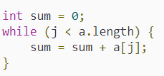
24 Backpropagation Math Notation
https://www.youtube.com/watch?v=2mSysRx-1c0&list=PLZbbT5o_s2xq7LwI2y8_QtvuXZedL6tQU&index=24
Math example:
Suppose that (an)(an) is a sequence of numbers. The sum of this sequence is given by:
Code example:
Suppose that a = [1,2,3,4] is a sequence of numbers. The sum is given by:

Slide 9
24 Backpropagation Math Notation
https://www.youtube.com/watch?v=2mSysRx-1c0&list=PLZbbT5o_s2xq7LwI2y8_QtvuXZedL6tQU&index=24
Aside from iteration, any time we choose a specific item to work with, like a particular layer, node, or weight, the indexing that we introduced here is what will allow us to properly reference this particular item that we’ve chosen to focus on.
As it turns out, backpropagation itself is an iterative process, iterating backwards through each layer, calculating the derivative of the loss function with respect to each weight for each layer.
Given this, it should be clear why these indices are required in order to make sense of the math going forward. Hopefully, rather than causing confusion within our notation, these indices can instead become intuition for when we think about doing anything iterative over our network.

Slide 10
24.1 Quiz

Slide 11
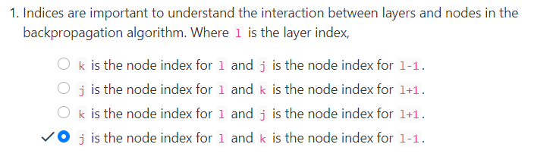
24.1 Quiz
https://www.youtube.com/watch?v=2mSysRx-1c0&list=PLZbbT5o_s2xq7LwI2y8_QtvuXZedL6tQU&index=24
Quiz

Slide 12
End of Chapter

