Slide 1
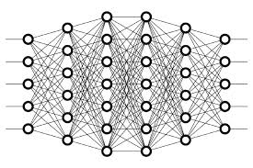
25 Backpropagation Math Observation
Peter H. Chen

Slide 2
25 Backpropagation Math Observation
https://www.youtube.com/watch?v=G5b4jRBKNxw&t=3s
Backpropagation in Mathematical Observation
What is math observation in Backpropagation?
The Path Forward
In our last discussion, we focused on the mathematical notation and definitions that we would be using going forward to show how backpropagation mathematically works to calculate the gradient of the loss function.
We’ll observe what method we’ll be using to differentiate the loss function via backpropagation. Alright, let’s begin.

Slide 3


25 Backpropagation Math Observation
https://www.youtube.com/watch?v=G5b4jRBKNxw&t=3s
Loss C₀
Observe the expression
is the squared difference of the activation output and the desired output for node j in the output layer L.
This can be interpreted as the loss for node j in layer L.
Therefore, to calculate the total loss, we should sum this squared difference for each node j in the output layer L.
This is expressed as

Slide 4


25 Backpropagation Math Observation
https://www.youtube.com/watch?v=G5b4jRBKNxw&t=3s
Input z_{j}^{(l)}
We know that the input for node j in layer l is the weighted sum of the activation outputs from the previous layer l−1.
An individual term from the sum looks like this:
So, the input for a given node j in layer l is expressed as:

Slide 5

25 Backpropagation Math Observation
https://www.youtube.com/watch?v=G5b4jRBKNxw&t=3s
Activation Output a_{j}^{(l)}
We know that the activation output of a given node j in layer l is the result of passing the input, z_{j}^{(l)}, to whatever activation function we choose to use g^{(l)}.
Therefore, the activation output of node j in layer l is expressed as

Slide 6
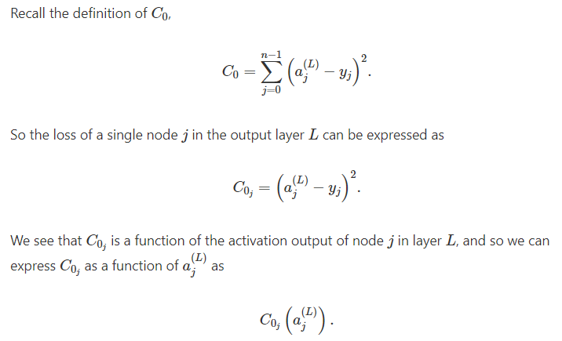
25 Backpropagation Math Observation
https://www.youtube.com/watch?v=G5b4jRBKNxw&t=3s
Expressing C₀ As A Composition Of Functions

Slide 7
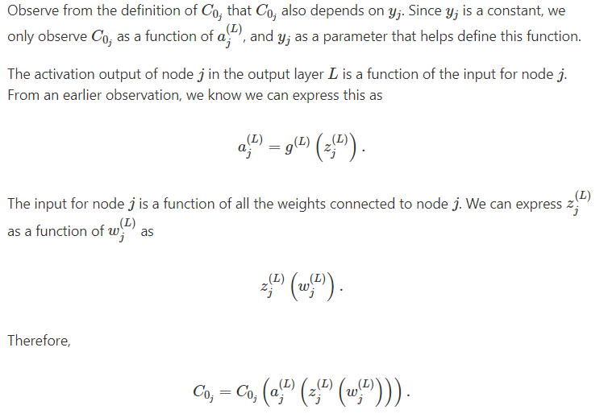
25 Backpropagation Math Observation
https://www.youtube.com/watch?v=G5b4jRBKNxw&t=3s
Expressing C₀ As A Composition Of Functions

Slide 8
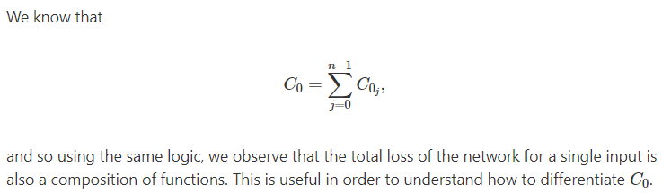
25 Backpropagation Math Observation
https://www.youtube.com/watch?v=G5b4jRBKNxw&t=3s
Given this, we can see that C₀ is a composition of functions.
To differentiate a composition of functions, we use the chain rule.

Slide 9
25.1 Quiz

Slide 10
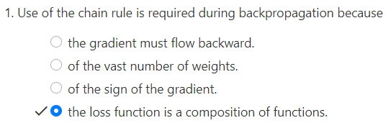
25.1 Quiz
https://www.youtube.com/watch?v=G5b4jRBKNxw&t=3s
Quiz

Slide 11
End of Chapter

