Slide 1
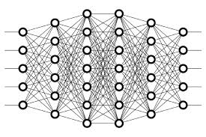
26 Backpropagation: Calculate Gradient
Peter H. Chen

Slide 2
26 Backpropagation: Calculate Gradient
https://www.youtube.com/watch?v=Zr5viAZGndE&list=PLZbbT5o_s2xq7LwI2y8_QtvuXZedL6tQU&index=26
Backpropagation: Calculate Gradient
We discuss Calculate Gradient in Backpropagation.
The Path Forward
Derivative Of The Loss Function With Respect To The Weights
Let's look at a single weight that connects node 2 in layer L−1 to node 1 in layer L.
This weight is denoted as

Slide 3
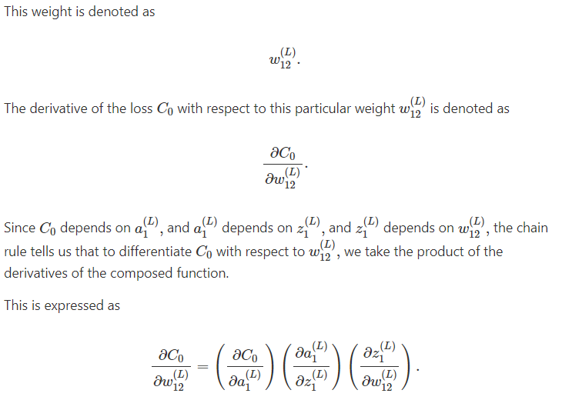
26 Backpropagation: Calculate Gradient
https://www.youtube.com/watch?v=Zr5viAZGndE&list=PLZbbT5o_s2xq7LwI2y8_QtvuXZedL6tQU&index=26
The Path Forward

Slide 4
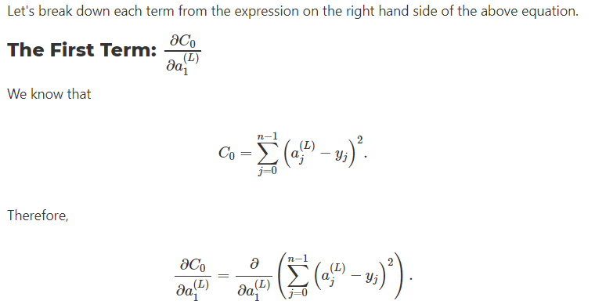
26 Backpropagation: Calculate Gradient
https://www.youtube.com/watch?v=Zr5viAZGndE&list=PLZbbT5o_s2xq7LwI2y8_QtvuXZedL6tQU&index=26
The Path Forward

Slide 5
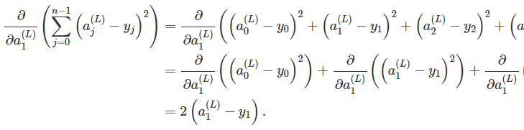
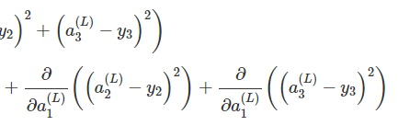
26 Backpropagation: Calculate Gradient
https://www.youtube.com/watch?v=Zr5viAZGndE&list=PLZbbT5o_s2xq7LwI2y8_QtvuXZedL6tQU&index=26
Expanding the sum, we see:
Observe that the loss from the network for a single input sample will respond to a small change in the activation output from node 1 in layer L by an amount equal to two times the difference of the activation output a1 for node 1 and the desired output y1 for node 1.

Slide 6
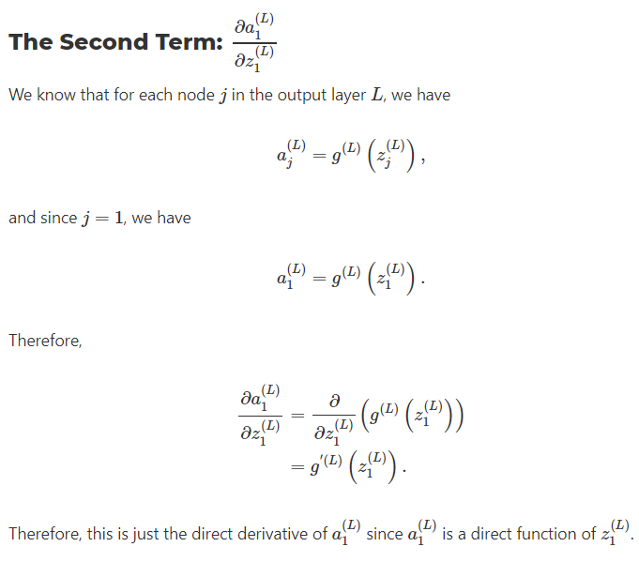
26 Backpropagation: Calculate Gradient
https://www.youtube.com/watch?v=Zr5viAZGndE&list=PLZbbT5o_s2xq7LwI2y8_QtvuXZedL6tQU&index=26
The second term:

Slide 7
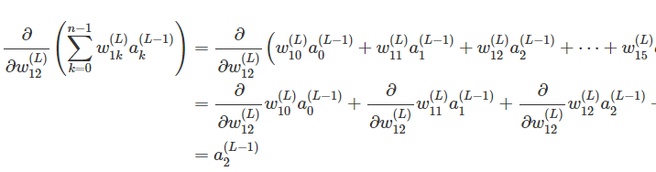
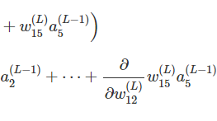
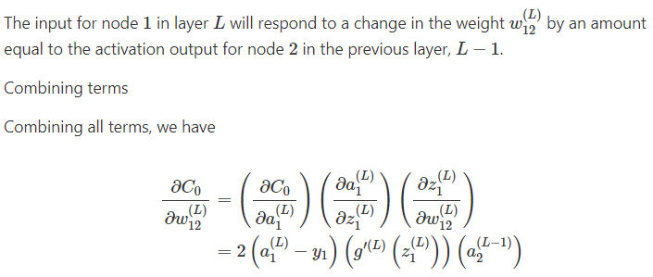
26 Backpropagation: Calculate Gradient
https://www.youtube.com/watch?v=Zr5viAZGndE&list=PLZbbT5o_s2xq7LwI2y8_QtvuXZedL6tQU&index=26
Expand the sum, we have:

Slide 8
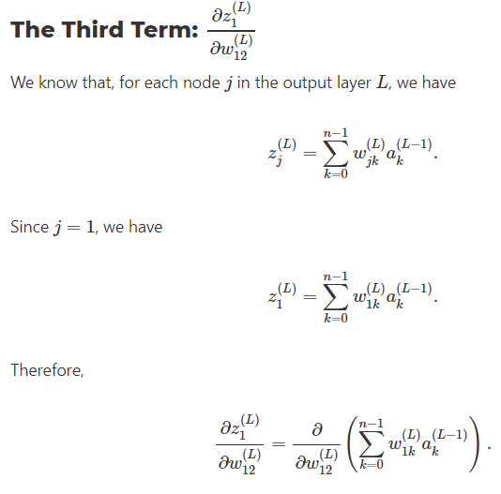
26 Backpropagation: Calculate Gradient
https://www.youtube.com/watch?v=Zr5viAZGndE&list=PLZbbT5o_s2xq7LwI2y8_QtvuXZedL6tQU&index=26
The third term:

Slide 9

26 Backpropagation: Calculate Gradient
https://www.youtube.com/watch?v=Zr5viAZGndE&list=PLZbbT5o_s2xq7LwI2y8_QtvuXZedL6tQU&index=26
We Conclude
We've seen how to calculate the derivative of the loss with respect to one individual weight for one individual training sample.
To calculate the derivative of the loss with respect to this same particular weight, w₁₂, for all n training samples, we calculate the average derivative of the loss function over all n training samples.
This can be expressed as
We would then do this same process for each weight in the network to calculate the derivative of C with respect to each weight.

Slide 10
26.1 Quiz

Slide 11
26.1 Quiz
https://www.youtube.com/watch?v=Zr5viAZGndE&list=PLZbbT5o_s2xq7LwI2y8_QtvuXZedL6tQU&index=26
Quiz: None

Slide 12
End of Chapter

