Slide 1
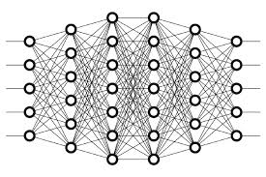
27 Backpropagation: Back
Peter H. Chen

Slide 2
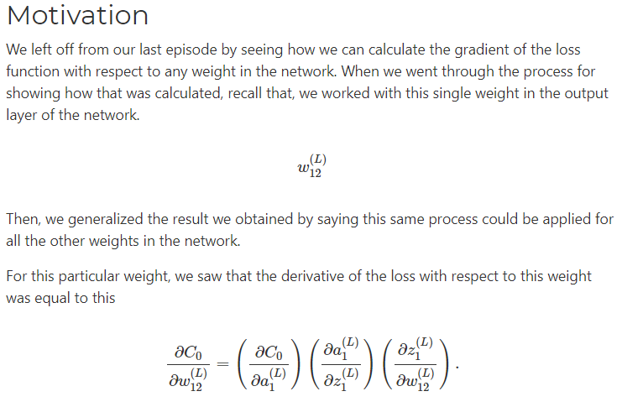
27 Backpropagation: Back
https://www.youtube.com/watch?v=xClK__CqZnQ&list=PLZbbT5o_s2xq7LwI2y8_QtvuXZedL6tQU&index=27
Backpropagation: Back
We discuss what to put in Backpropagation.

Slide 3
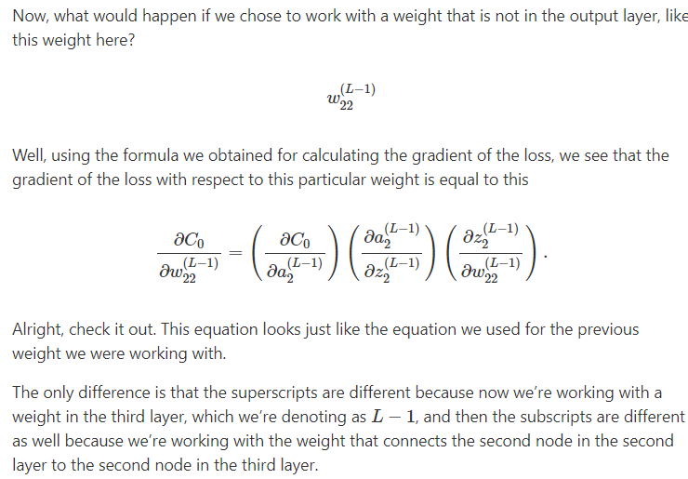
27 Backpropagation: Back
https://www.youtube.com/watch?v=xClK__CqZnQ&list=PLZbbT5o_s2xq7LwI2y8_QtvuXZedL6tQU&index=27
Backpropagation: Back

Slide 4
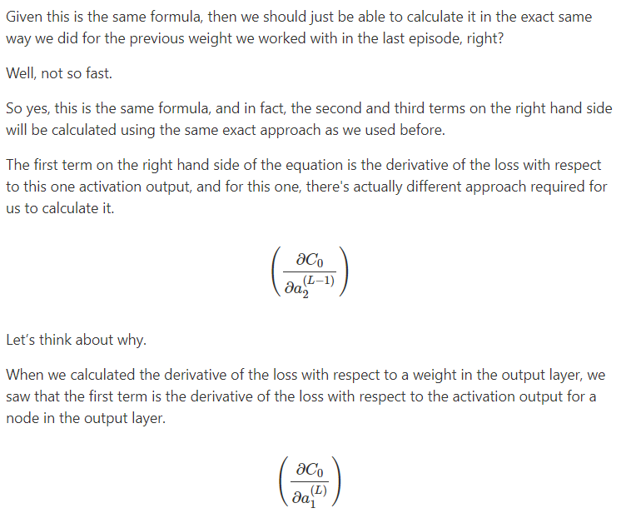
27 Backpropagation: Back
https://www.youtube.com/watch?v=xClK__CqZnQ&list=PLZbbT5o_s2xq7LwI2y8_QtvuXZedL6tQU&index=27
Backpropagation: Back

Slide 5
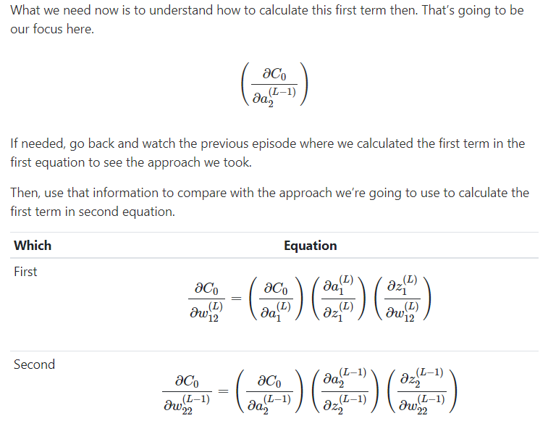
27 Backpropagation: Back
https://www.youtube.com/watch?v=xClK__CqZnQ&list=PLZbbT5o_s2xq7LwI2y8_QtvuXZedL6tQU&index=27
Backpropagation: Back

Slide 6
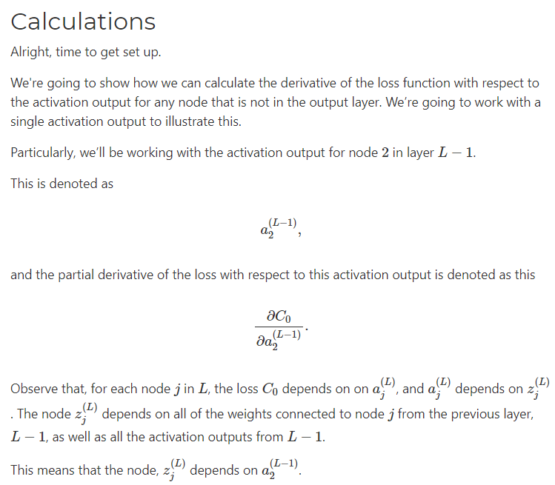
27 Backpropagation: Back
https://www.youtube.com/watch?v=xClK__CqZnQ&list=PLZbbT5o_s2xq7LwI2y8_QtvuXZedL6tQU&index=27
Backpropagation: Back

Slide 7
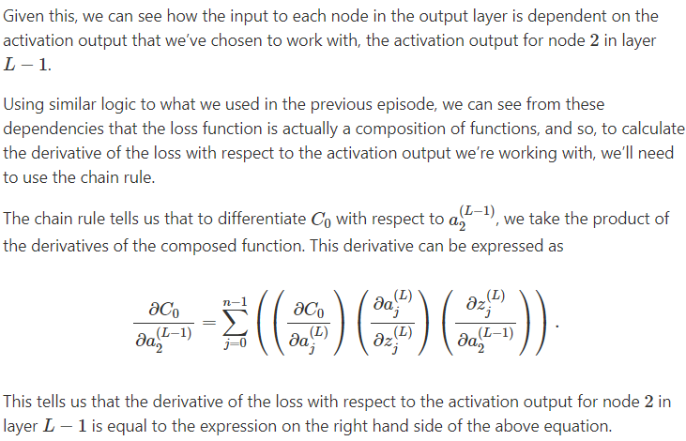
27 Backpropagation: Back
https://www.youtube.com/watch?v=xClK__CqZnQ&list=PLZbbT5o_s2xq7LwI2y8_QtvuXZedL6tQU&index=27
Backpropagation: Back

Slide 8
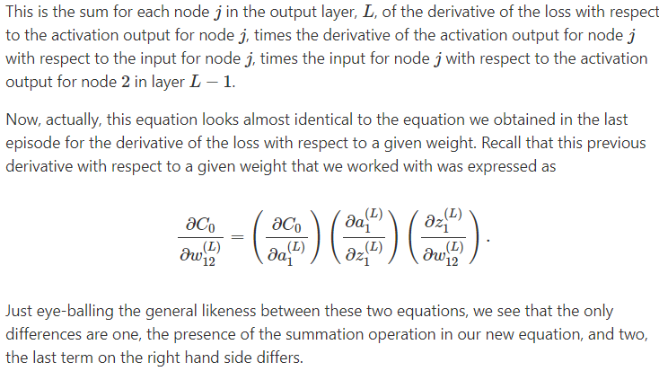
27 Backpropagation: Back
https://www.youtube.com/watch?v=xClK__CqZnQ&list=PLZbbT5o_s2xq7LwI2y8_QtvuXZedL6tQU&index=27
Backpropagation: Back

Slide 9
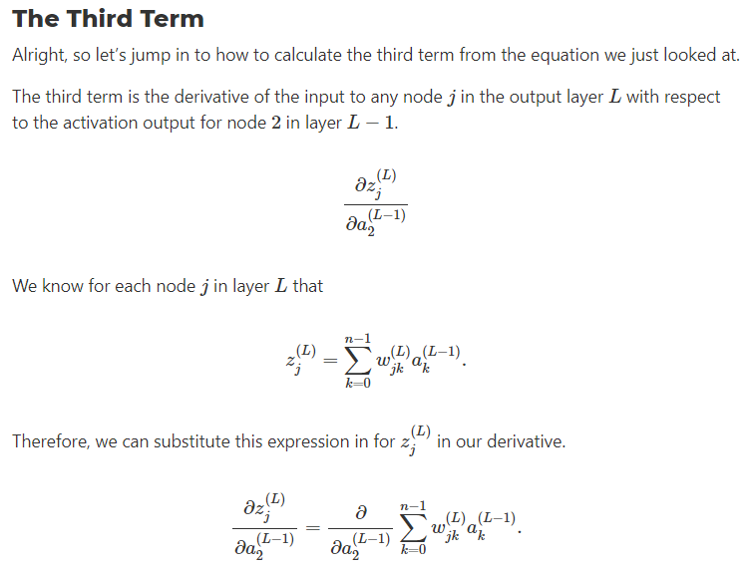
27 Backpropagation: Back
https://www.youtube.com/watch?v=xClK__CqZnQ&list=PLZbbT5o_s2xq7LwI2y8_QtvuXZedL6tQU&index=27
Backpropagation: Back

Slide 10
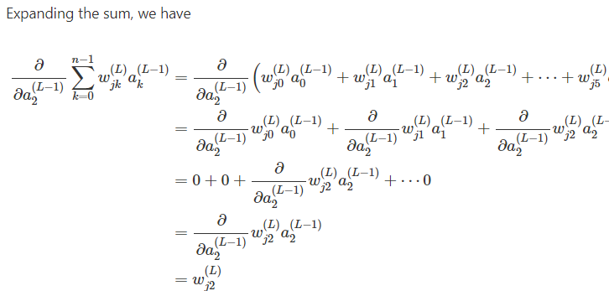
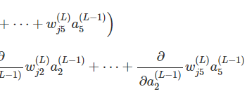
27 Backpropagation: Back
https://www.youtube.com/watch?v=xClK__CqZnQ&list=PLZbbT5o_s2xq7LwI2y8_QtvuXZedL6tQU&index=27
Backpropagation: Back

Slide 11
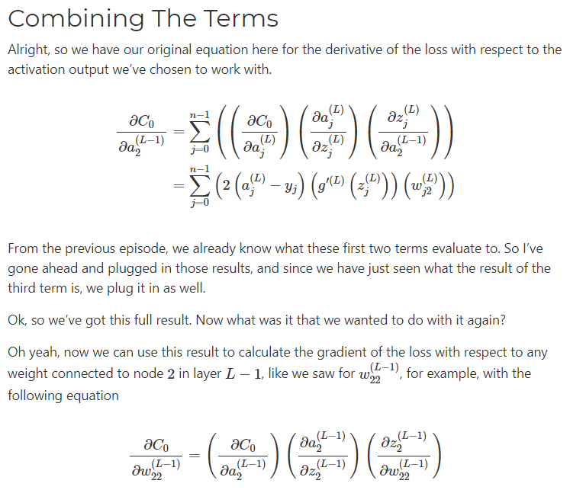
27 Backpropagation: Back
https://www.youtube.com/watch?v=xClK__CqZnQ&list=PLZbbT5o_s2xq7LwI2y8_QtvuXZedL6tQU&index=27
Backpropagation: Back

Slide 12
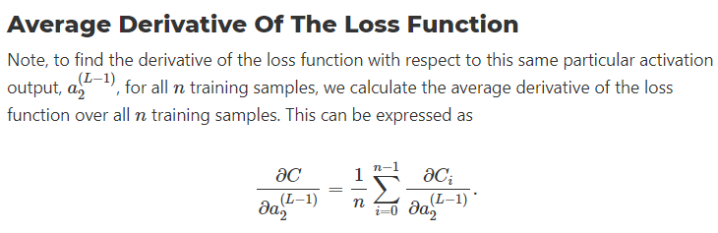
27 Backpropagation: Back
https://www.youtube.com/watch?v=xClK__CqZnQ&list=PLZbbT5o_s2xq7LwI2y8_QtvuXZedL6tQU&index=27
Backpropagation: Back

Slide 13
27.1 Quiz

Slide 14
27.1 Quiz
https://www.youtube.com/watch?v=xClK__CqZnQ&list=PLZbbT5o_s2xq7LwI2y8_QtvuXZedL6tQU&index=27
Quiz: None

Slide 15
End of Chapter

