Slide 1
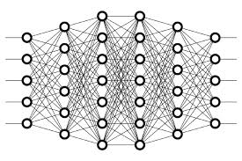
28 Small Gradient
Peter H. Chen

Slide 2
28 Small Gradient
https://www.youtube.com/watch?v=qO_NLVjD6zE&list=PLZbbT5o_s2xq7LwI2y8_QtvuXZedL6tQU&index=28
Gradient
What Is The Vanishing Gradient Problem?
In general, the vanishing gradient problem is a problem that causes major difficulty when training a neural network. More specifically, this is a problem that involves weights in earlier layers of the network.
Recall that, during training, stochastic gradient descent (or SGD) works to calculate the gradient of the loss with respect to weights in the network.
Now, sometimes the gradient with respect to weights in earlier layers of the network becomes really small, like vanishingly small.
Hence, vanishing gradient.
Ok, what’s the big deal with a small gradient?

Slide 3
28 Small Gradient
https://www.youtube.com/watch?v=qO_NLVjD6zE&list=PLZbbT5o_s2xq7LwI2y8_QtvuXZedL6tQU&index=28
Small Gradients
Well, once SGD calculates the gradient with respect to a particular weight, it uses this value to update that weight, and the weight gets updated in some way that is proportional to the gradient.
If the gradient is vanishingly small, then this update is, in turn, going to be vanishingly small as well.
Therefore, if this newly updated value of the weight has just barely moved from its original value, then it’s not really doing much for the network.
This change is not going to carry through the network very well to help to reduce the loss because it has barely changed at all from where it was before the update occurred.
As a result, this weight becomes kind of stuck, never really updating enough to even get close to its optimal value which has implications for the remainder of the network to the right of this one weight and impairs the ability of the network to learn well.

Slide 4
28 Small Gradient
https://www.youtube.com/watch?v=qO_NLVjD6zE&list=PLZbbT5o_s2xq7LwI2y8_QtvuXZedL6tQU&index=28
Small Gradients
This is the problem, and now that we know what this problem is, how exactly does this problem occur?
Well, we know from what we learned about backpropagation that the gradient of the loss with respect to any given weight is going to be the product of some derivatives that depend on components that reside later in the network.
Given this, we can deduce that the earlier in the network a weight lives, the more terms will be needed in the product we just mentioned to get the gradient of the loss with respect to this weight.
The key now is to understand what happens if the terms in this product, or at least some of them, are small? And by small, we mean less than one, small.
Well, the product of a bunch of numbers less than one is going to give us an even smaller number, right?

Slide 5
28 Small Gradient
https://www.youtube.com/watch?v=qO_NLVjD6zE&list=PLZbbT5o_s2xq7LwI2y8_QtvuXZedL6tQU&index=28
Stuck Weights
Now, we can think about if the gradient that we obtain with respect to this weight is already really small, i.e., vanishing, then by the time we multiply it by the learning rate, the product is going to be even smaller, and so when we subtract this teeny tiny number from the weight, it’s just barely going to move the weight at all.
Essentially, the weight gets into this kind of stuck state.
Not moving, not learning, and therefore not really helping to meet the overall objective of minimizing the loss of the network.
We can see why earlier weights are subject to this problem. Because, as we said, the earlier in the network the weight resides, the more terms are going to be included in the product to calculate the gradient.

Slide 6
28 Small Gradient
https://www.youtube.com/watch?v=qO_NLVjD6zE&list=PLZbbT5o_s2xq7LwI2y8_QtvuXZedL6tQU&index=28
Exploding Gradient
Now let’s talk about this problem in the opposite direction. Not a gradient that vanishes, but rather, a gradient that explodes.
Think about the conversation we just had about how the vanishing gradient problem occurs with weights early in the network due to a product of, at least some, relatively small values.
Now think about calculating the gradient with respect to the same weight, but instead of really small terms, what if they were large? And by large, we mean greater than one.
Well, if we multiply a bunch of terms together that are all greater than one, we’re going to get something greater than one, and perhaps even a lot greater than one.
The same argument holds here that we discussed about the vanishing gradient, where, the earlier in the network a weight lives, the more terms will be needed in the product we just mentioned.
As a result, we can see that the more of these larger valued terms we have being multiplied together, the larger the gradient is going to be, thus essentially exploding in size.

Slide 7
28.1 Quiz

Slide 8
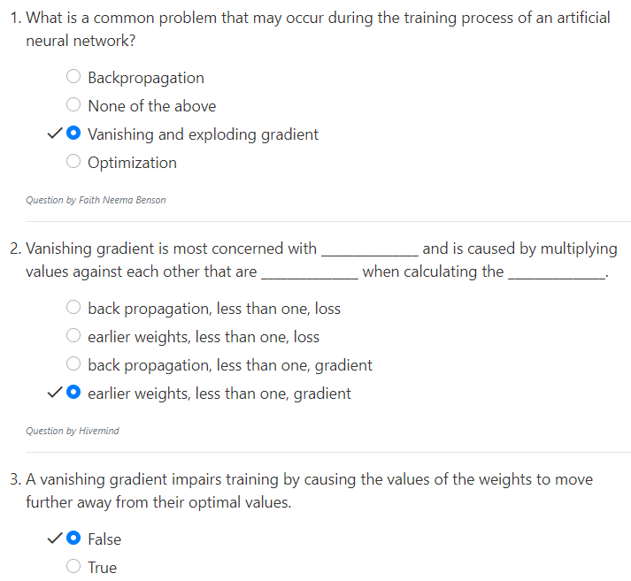
28.1 Quiz
https://www.youtube.com/watch?v=qO_NLVjD6zE&list=PLZbbT5o_s2xq7LwI2y8_QtvuXZedL6tQU&index=28
Quiz:

Slide 9
End of Chapter

