Slide 1
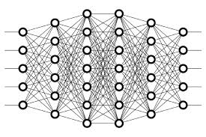
29 Initialized Weight
Peter H. Chen

Slide 2
29 Initialized Weight
https://www.youtube.com/watch?v=8krd5qKVw-Q&list=PLZbbT5o_s2xq7LwI2y8_QtvuXZedL6tQU&index=29
Random Initialization Weight
Suppose that our neural network’s input layer has 250 nodes, and for simplicity, suppose that the value of each of these 250 nodes is 1.
Now, let’s focus only on the weights that connect the input layer to a single node in the first hidden layer. In total, there will be 250 weights connecting this node in our first hidden layer to all the nodes in the input layer.
Now, each of these weights were randomly generated and normally distributed with a mean of 0 and a standard deviation of 1.
So, what does this mean for the weighted sum, z, that this node accepts as input?

Slide 3
29 Initialized Weight
https://www.youtube.com/watch?v=8krd5qKVw-Q&list=PLZbbT5o_s2xq7LwI2y8_QtvuXZedL6tQU&index=29
Problems With Random Initialization
If the desired output from our activation function is on the opposite side from where it saturated, then during training, when SGD updates the weights in attempts to influence the activation output, it will only make very small changes in the value of this activation output, barely even incrementally moving it in the right direction.
Thus, the network’s ability to learn becomes hindered, and training is stuck running in this slow and inefficient state.

Slide 4
29 Initialized Weight
https://www.youtube.com/watch?v=8krd5qKVw-Q&list=PLZbbT5o_s2xq7LwI2y8_QtvuXZedL6tQU&index=29
Xavier Initialization
In hindsight, we should be able to look back at the problems we've discussed and trace them back to being caused by the weighted sum taking on a variance that is decently larger, or smaller, than 1. So to tackle this problem, what we can do is force this variance to be smaller.
How do we do this?
Well, since the variance of the input for a given node is determined by the variance of the weights connected to this node from the previous layer, we need to shrink the variance of these weights, which will shrink the variance of the weighted sum.
Some researchers identified a value for the variance of the weights that seems to work pretty well to mitigate the earlier problems we discussed. The value for the variance of the weights connected to a given node is 1/n, where nn is the number of weights connected to this node from the previous layer.
So, rather than the distribution of these weights be centered around 0 with a variance of 1, which is what we had earlier, they are now still centered around 0, but with a significantly smaller variance, 1/n.

Slide 5
29 Initialized Weight
https://www.youtube.com/watch?v=8krd5qKVw-Q&list=PLZbbT5o_s2xq7LwI2y8_QtvuXZedL6tQU&index=29
Xavier Initialization
It turns out that, to get these weights to have this variance of 1/n1, what we do is, after randomly generating the weights centered around 00 with variance 1, we multiply each of them by √1/n. Doing this causes the variance of these weights to shift from 11 to 1/n1.
This type of initialization is referred to as Xavier initialization and also Glorot initialization.

Slide 6
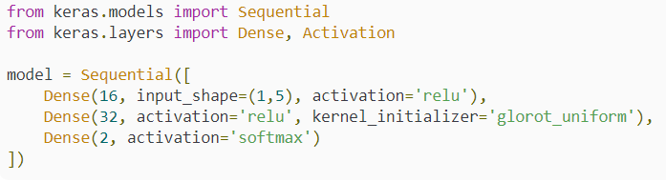
29 Initialized Weight
https://www.youtube.com/watch?v=8krd5qKVw-Q&list=PLZbbT5o_s2xq7LwI2y8_QtvuXZedL6tQU&index=29
Kera Code: Weight Initialization

Slide 7
29.1 Quiz

Slide 8
29.1 Quiz
https://www.youtube.com/watch?v=8krd5qKVw-Q&list=PLZbbT5o_s2xq7LwI2y8_QtvuXZedL6tQU&index=29
Quiz: None

Slide 9
End of Chapter

