Slide 1
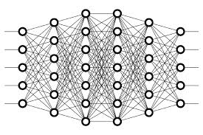
30 Bias
Peter H. Chen

Slide 2
30 Bias
https://www.youtube.com/watch?v=HetFihsXSys&list=PLZbbT5o_s2xq7LwI2y8_QtvuXZedL6tQU&index=30
What Is Bias?
So, what is bias in an artificial neural network?
Well, first, when we talk about bias, we’re talking about it on a per-neuron basis. We can think of each neuron as having its own bias term, and so the entire network will be made up of multiple biases.
Now, the values assigned to these biases are learnable, just like the weights. Just how stochastic gradient descent learns and updates the weights via backpropagation during training, SGD is also learning and updating the biases as well.

Slide 3
29.1 Quiz

Slide 4
29.1 Quiz
https://www.youtube.com/watch?v=HetFihsXSys&list=PLZbbT5o_s2xq7LwI2y8_QtvuXZedL6tQU&index=30
Quiz: None

Slide 5
End of Chapter

