Slide 1
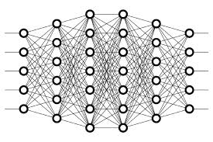
33 Regularization
Peter H. Chen

Slide 2
33 Regularization
https://www.youtube.com/watch?v=iuJgyiS7BKM&list=PLZbbT5o_s2xq7LwI2y8_QtvuXZedL6tQU&index=33
What Is Regularization?
In the last discussion on overfitting, we introduced the drop out.
The drop out is a kind of regularization technique.
In general, the regularization is q technique that help reduce overfitting or reduce variance in the network by penalizing for complexity.
Some kind of complexities may make our model unlikely to generalize well, even the model fit the training data.
Regularization is a technique that helps reduce overfitting or reduce variance in our network by penalizing for complexity.

Slide 3


33 Regularization
https://www.youtube.com/watch?v=iuJgyiS7BKM&list=PLZbbT5o_s2xq7LwI2y8_QtvuXZedL6tQU&index=33
L2 Regularization
The most common regularization technique is called L2 regularization.
We know that regularization basically involves adding a term to our loss function that penalizes for large weights.
L2 Regularization Term
With L2 regularization, the term we’re adding to the loss is the sum of the squared norms of the weight matrices.
multiplied by a small constant

Slide 4

33 Regularization
https://www.youtube.com/watch?v=iuJgyiS7BKM&list=PLZbbT5o_s2xq7LwI2y8_QtvuXZedL6tQU&index=33
L2 Regularization
If λ is large, then this term, , will continue to stay relatively large, and if we’re multiplying that by the sum of the squared norms, then the product may be relatively large depending on how large our weights are.
This means that our model is incentivized to make the weights small so that the value of this entire function stays relatively small in order to minimize loss.

Slide 5
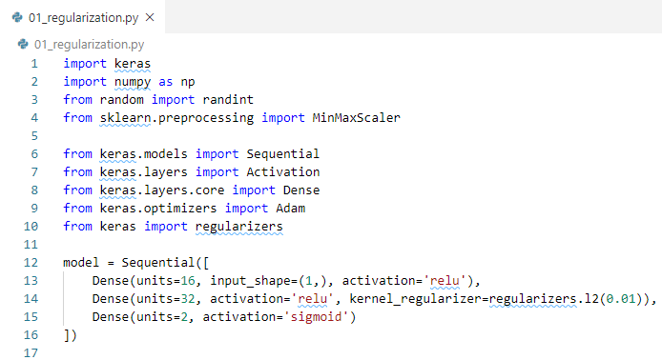
33 Regularization
https://www.youtube.com/watch?v=iuJgyiS7BKM&list=PLZbbT5o_s2xq7LwI2y8_QtvuXZedL6tQU&index=33
Keras Code:

Slide 6
29.1 Quiz

Slide 7
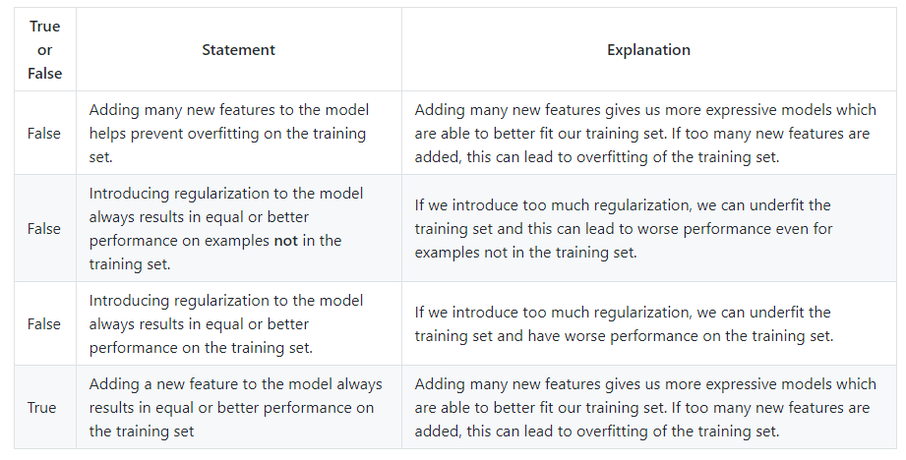
29.1 Quiz
https://www.youtube.com/watch?v=HetFihsXSys&list=PLZbbT5o_s2xq7LwI2y8_QtvuXZedL6tQU&index=30
Quiz:
https://gist.github.com/mGalarnyk/9cdfce29e9172745d0ff2d3f19130d6c
Question 1: regularization increase training accuracy but reduce performance.

Slide 8
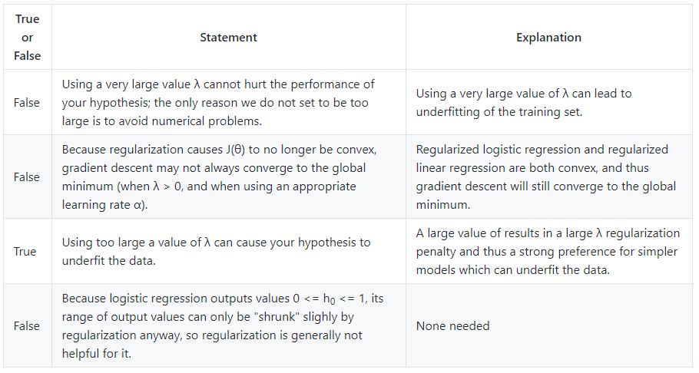
29.1 Quiz
https://www.youtube.com/watch?v=HetFihsXSys&list=PLZbbT5o_s2xq7LwI2y8_QtvuXZedL6tQU&index=30
Quiz:
https://gist.github.com/mGalarnyk/9cdfce29e9172745d0ff2d3f19130d6c
Question 3: regularization with Lambda.

Slide 9
End of Chapter

