Slide 1

5 Setup Minikube
Peter H. Chen

Slide 2
5 Setup Minikube
https://kubernetes.io/docs/tasks/tools/install-minikube/
Setup Minikube
https://www.youtube.com/watch?v=ppgrKs1FNJE

Slide 3
5.1 Setup Minikube

Slide 4

5.1 Setup Minikube
https://kubernetes.io/docs/tasks/tools/install-minikube/
https://kubernetes.io/docs/tasks/tools/install-minikube/
> systeminfo
https://www.youtube.com/watch?v=ppgrKs1FNJE
Download minkube-wndow-amd64.exe and rename it to minikube.exe and put it under C:\Windows\system32 folder.
Download kubectl and put under C:\Windows\system32 folder
Verify the environment variable PATH to have C:\Windows\system32
Verify the minikube version
> minikube version

Slide 5
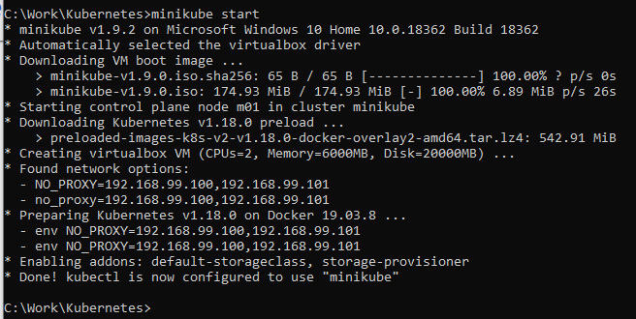
5.1 Install Minikube
https://kubernetes.io/docs/tasks/tools/install-minikube/
https://www.youtube.com/watch?v=ppgrKs1FNJE
Start the minikube
> minibube start
Minikube is on Window 10 Home Edition.
By default, minikube select the VirtualBox Driver for installing minikube version.
It starts downloading the minikube ISO from the Google Storage.

Slide 6
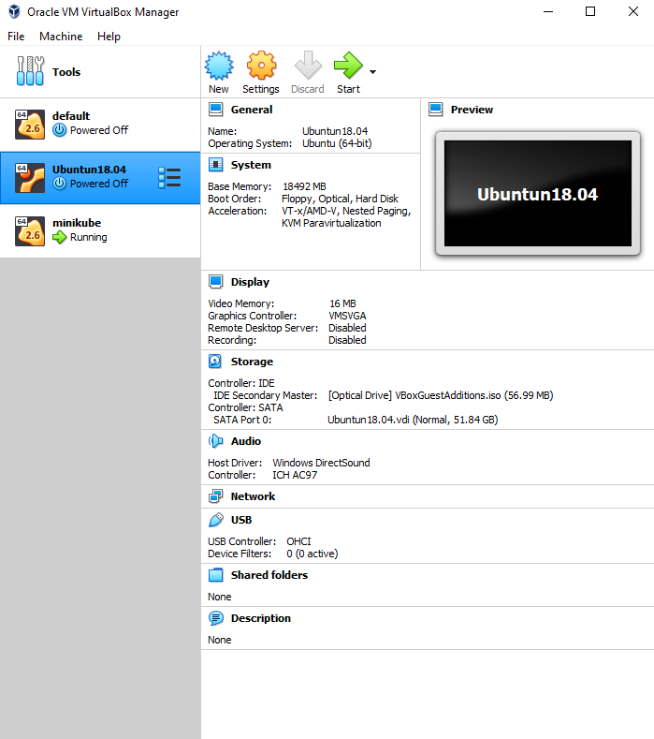
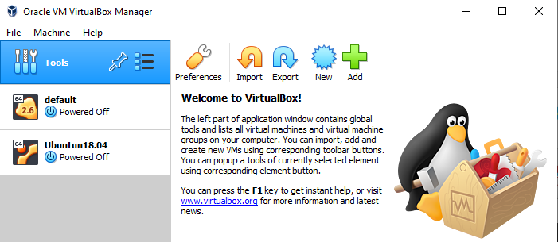

5.1 Install Minikube
https://kubernetes.io/docs/tasks/tools/install-minikube/
https://www.youtube.com/watch?v=ppgrKs1FNJE
Once the download is completed.
Open the virualBox. It starts a new minikube VM in VirutalBox.
Minikube is ready to use.

Slide 7
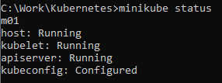

5.1 Setup Minikube
https://kubernetes.io/docs/tasks/tools/install-minikube/
https://kubernetes.io/docs/tasks/tools/install-minikube/
Confirmed the installation
> minikube status
Stop minikube
> stop minikube

Slide 8
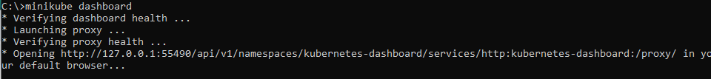
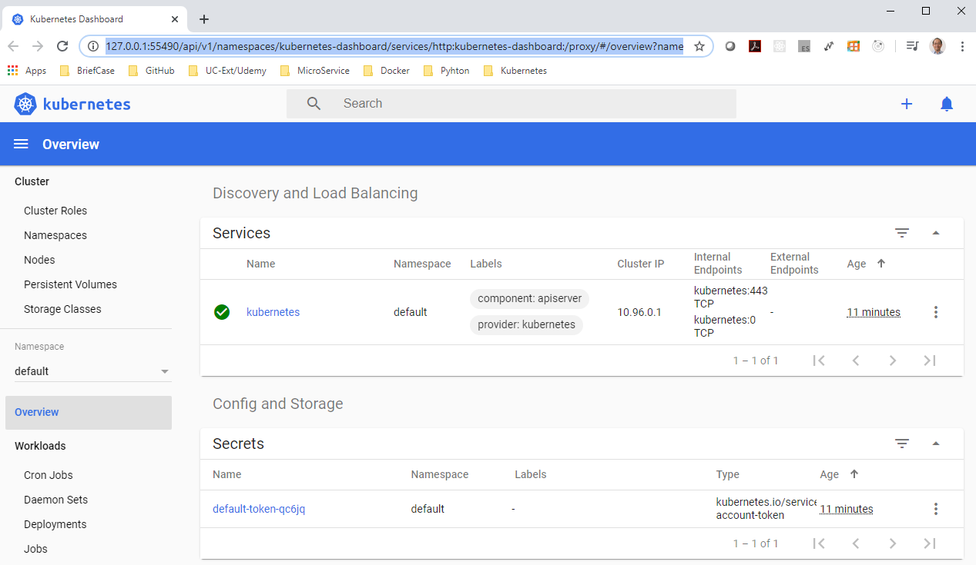
5.1 Setup Minikube
https://kubernetes.io/docs/tasks/tools/install-minikube/
https://www.youtube.com/watch?v=ppgrKs1FNJE
We can access the minikube Graphical User Interface
> minikube dashboard

Slide 9
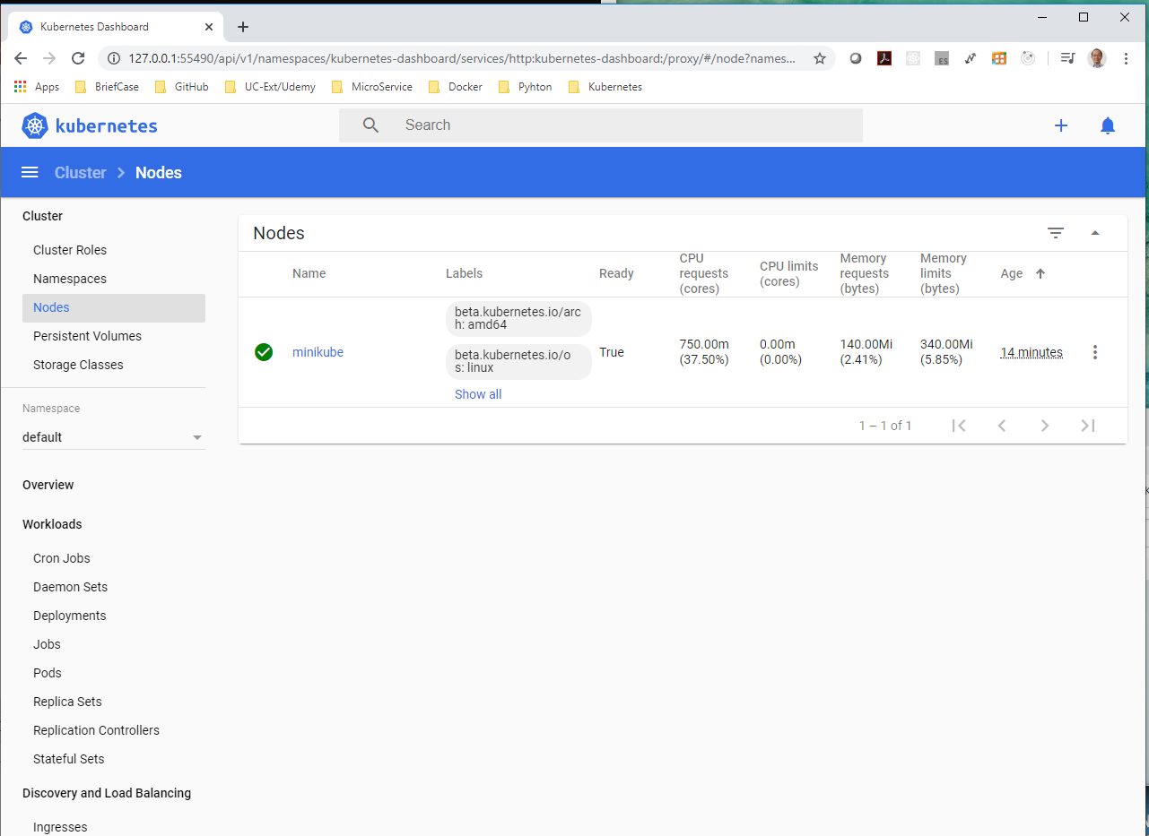
5.1 Setup Minikube
https://kubernetes.io/docs/tasks/tools/install-minikube/
https://www.youtube.com/watch?v=ppgrKs1FNJE
Click the “Node” Option to verify the node status.

Slide 10
End of Chapter

