Slide 1

5 Setup
Peter H. Chen

Slide 2
5 Setup
https://www.youtube.com/watch?v=r0uRLhrzbtU&list=PL2We04F3Y_43dAehLMT5GxJhtk3mJtkl5&index=1
Kubernetes
Since Docker for Windows need the Professional/Enterprise Edition and not free and Docker Toolbox for Windows Home Edition is hard to host Web Browser, we need to use Native Linux OS for Docker and Kubernetes.

Slide 3
5.1 Install VirtualBox and Ubuntu

Slide 4
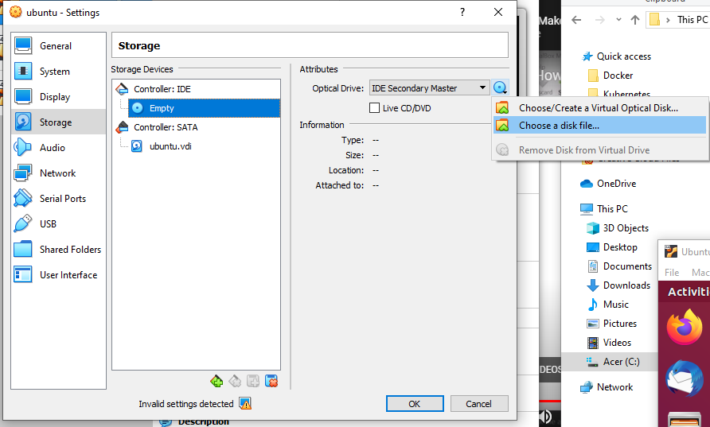
5.1 Install VirtualBox and Ubuntu
https://www.youtube.com/watch?v=r0uRLhrzbtU&list=PL2We04F3Y_43dAehLMT5GxJhtk3mJtkl5&index=1
Install VirtualBox and Ubuntu:
5. Download Ubuntu Linux iso image file from Ubuntu web site (It takes an hour to download)
2. Install VirtualBox from Oracle VirtualBox.
3. After ViRight Mouse Select the VirutalMachine: Settings > Select Storage > Select Controller: Empty, Optical Drive: Click CD logo and select the downloaded Ububtu iso image to install.

Slide 5
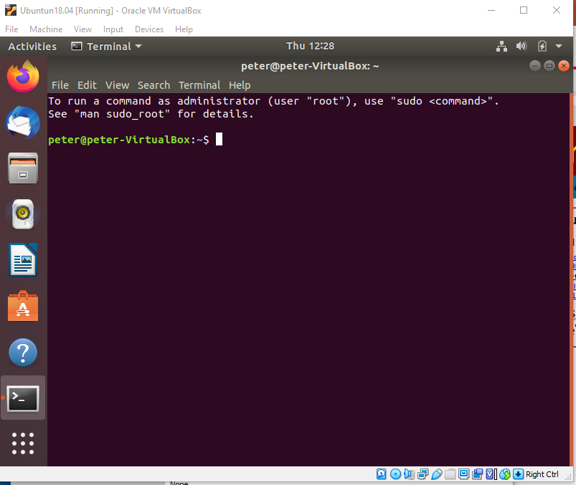
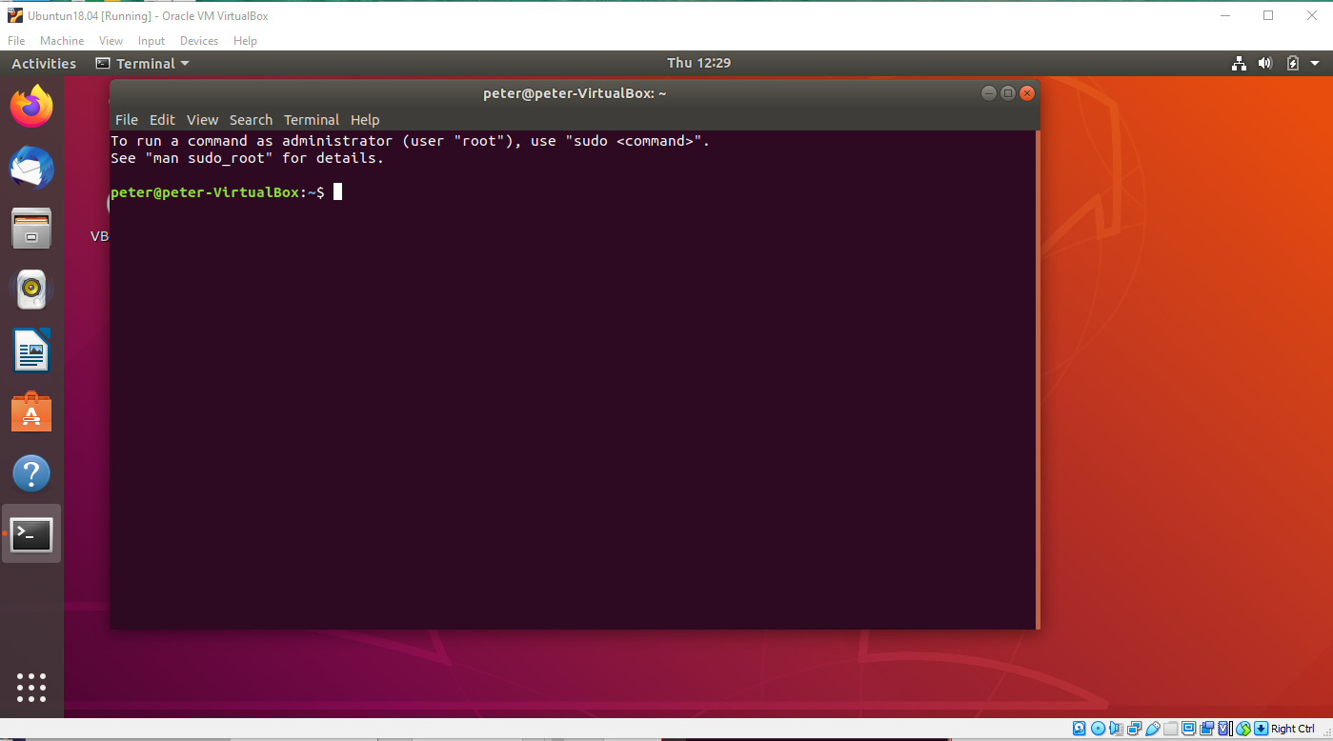
5.1 Install VirtualBox and Ubuntu
https://www.youtube.com/watch?v=r0uRLhrzbtU&list=PL2We04F3Y_43dAehLMT5GxJhtk3mJtkl5&index=1
Enlarge Ubuntu Screen size:
The default Ubuntu on VirtualBox Screen size is small. We need to enlarge
https://www.google.com/search?rlz=1C1KDEC_enUS826US826&sxsrf=ALeKk03Mlk6YL-1Iqw_32Y2637xuu4HbFw%3A1587668498563&ei=EuahXreFItPH-gTdibawCQ&q=how+to+enlarge+display+Ubuntu+in+virutalbox&oq=how+to+enlarge+display+Ubuntu+in+virutalbox&gs_lcp=CgZwc3ktYWIQAzoECAAQRzoHCCMQsAIQJzoICAAQCBANEB46BAghEApQlUJYymZgy2hoAXACeACAAXSIAZEHkgEDMy42mAEAoAEBqgEHZ3dzLXdpeg&sclient=psy-ab&ved=0ahUKEwi31oKHnv_oAhXTo54KHd2EDZYQ4dUDCAw&uact=5#kpvalbx=_MOahXt_KB8LK-gTWs63YCA26
Device > Inser Guest CD Image …: Select “C:\Program Files\Oracle\VirtualBox\VBoxGuestAddition”
Enlarge Screen Size

Slide 6
5.2 Install Docker

Slide 7
5.2 Install Docker
https://www.youtube.com/watch?v=r0uRLhrzbtU&list=PL2We04F3Y_43dAehLMT5GxJhtk3mJtkl5&index=1
Install Docker

Slide 8
5.3 Install Kubernetes

Slide 9
5.3 Install Kubernetes
https://www.youtube.com/watch?v=r0uRLhrzbtU&list=PL2We04F3Y_43dAehLMT5GxJhtk3mJtkl5&index=1
Install Kubernetes

Slide 10
End of Chapter

