Slide 1
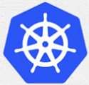
6 Hello World
Peter H. Chen

Slide 2
6 Hello World
https://kubernetes.io/docs/tutorials/hello-minikube/
Deploy Hello World

Slide 3
6.1 Create Server.js and Dockerfile

Slide 4
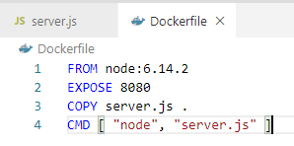
6.1 Create Server.js and Dockerfile
https://kubernetes.io/docs/tutorials/hello-minikube/
Create Dockerfile

Slide 5
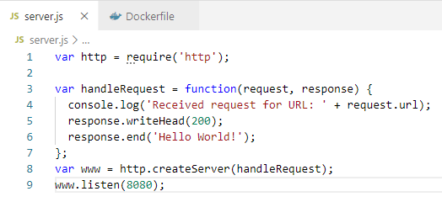
6.1 Create Server.js and Dockerfile
https://kubernetes.io/docs/tutorials/hello-minikube/
Create Server.js

Slide 6
6.2 Create Minikube Cluster

Slide 7
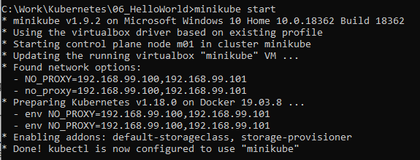
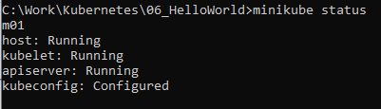
6.2 Create Minikube Cluster
https://kubernetes.io/docs/tutorials/hello-minikube/
> minikube start
> minikube status

Slide 8
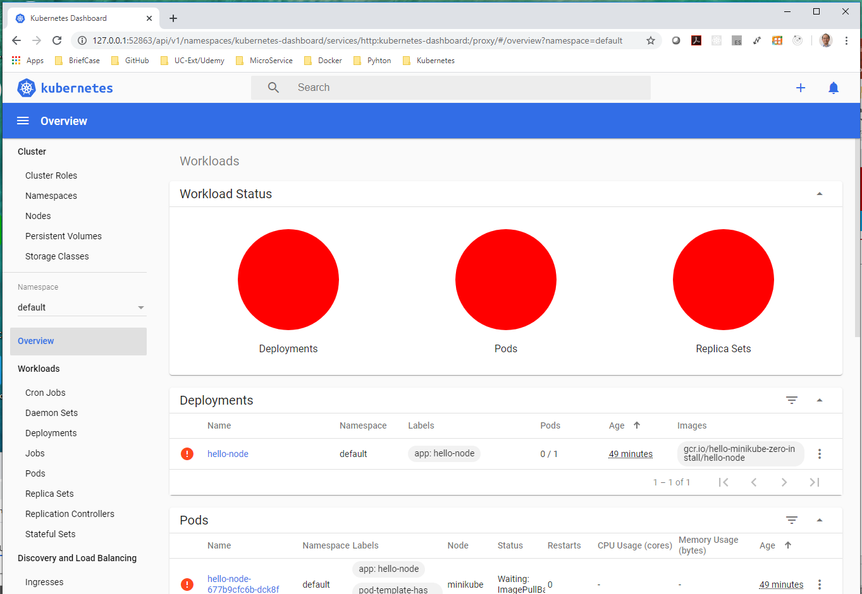
6.3 Create Deployment
https://kubernetes.io/docs/tutorials/hello-minikube/
> minikube dashboard

Slide 9
6.4 Create a Deployment

Slide 10

6.3 Create Deployment
https://kubernetes.io/docs/tutorials/hello-minikube/
A Kubernetes Pod is a group of one or more Containers, tied together for the purpose of administration and networking.
In this discussion, the Pod has only one container.
The Kubernetes Deployment Master Node checks on the health of client node (your app node) and restart the Pod container if it is terminated.
The Kubernetes Deployment is the recommended way to manage the creation and scaling of Pods.
Pod
Master Node
Client App Node

Slide 11
6.3 Create Deployment
https://kubernetes.io/docs/tutorials/hello-minikube/
Create Deployment
Use the kubectl create command to create a Deployment that manages a Pod. The Pod runs a Container based on the provided Docker image. It uses the Dockerfile in the current directory to create the image.
> kubectl create deployment hello-node --image=gcr.io/hello-minikube-zero-install/hello-node

Slide 12


6.3 Create Deployment
https://kubernetes.io/docs/tutorials/hello-minikube/
Create Deployment
View the Deployment:
> Kubectl get deployments
View the Pods:
> Kubectl get pods

Slide 13
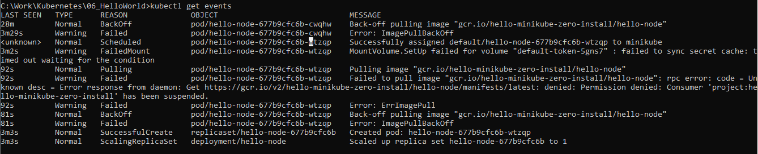
6.3 Create Deployment
https://kubernetes.io/docs/tutorials/hello-minikube/
Create Deployment
View Cluster events
> kubectl get events

Slide 14
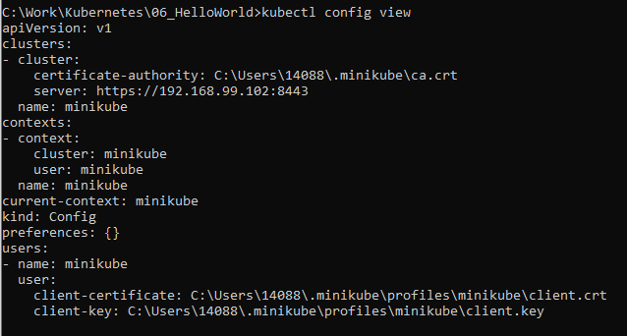
6.3 Create Deployment
https://kubernetes.io/docs/tutorials/hello-minikube/
Create Deployment
View kubectl configuration
> kubectl config view

Slide 15
6.4 Create a Service

Slide 16
6.4 Create a Service
https://kubernetes.io/docs/tutorials/hello-minikube/
Create a Service
By default, the Pod is only is only accessible by its internal IP address within the Kubernetes cluster.
To make the hello-node Container accessible from outside the Kubernetes virtual network, we have to expose the Pod as a Kubernetes Service
Kubernetes Cluster
Pod
Master Node
Client App Node

Slide 17
6.4 Create a Service
https://kubernetes.io/docs/tutorials/hello-minikube/
Create a Service
Expose the Pod to the public internet using the kubectl expose command:
> kubectl expose deployment hello-node --type=LoadBalancer --port=8080
The --type=LoadBalancer flag indicates that you want to expose your Service outside of the cluster.

Slide 18
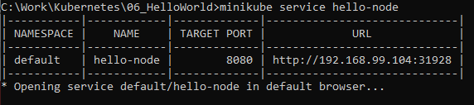
6.4 Create a Service
https://kubernetes.io/docs/tutorials/hello-minikube/
Create a Service
Run the following command:
> minikube service hello-node

Slide 19
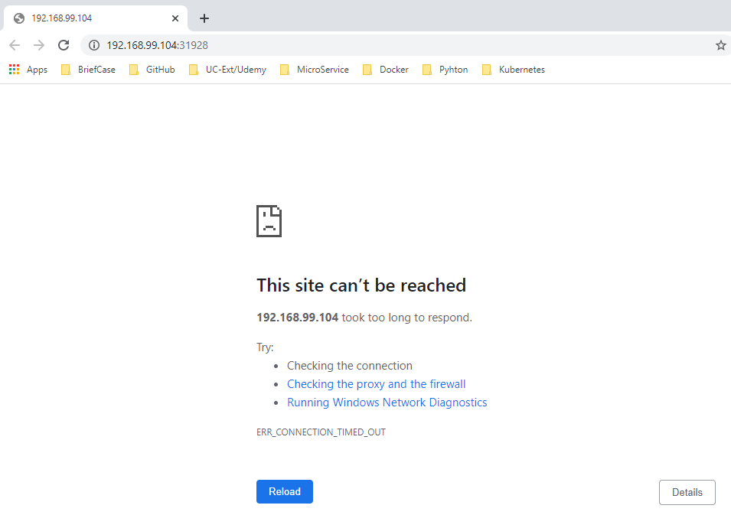
6.4 Create a Service
https://kubernetes.io/docs/tutorials/hello-minikube/
Create a Service
This site can’t be reached

Slide 20

6.4 Create a Service
https://kubernetes.io/docs/tutorials/hello-minikube/
Create a Service
View the Service you just created.
> kubectl get services
On cloud providers that support load balancers, an external IP address would be provisioned to access the Service.
On Minikube, the LoadBalancer type makes the Service accessible through the minikube service command.
Note the 5 digit port number displayed opposite to 8080 in services output. This port number is randomly generated and it can be different for you. Type your number in the port number text box, then click Display Port. Using the example from earlier, you would type 30369.
This opens up a browser window that serves your app and shows the “Hello World” message.

Slide 21
6.5 Enable Addons

Slide 22
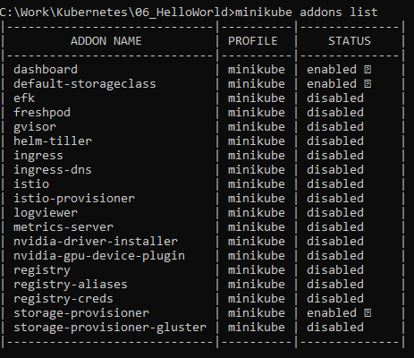
6.5 Enable Addons
https://kubernetes.io/docs/tutorials/hello-minikube/
Enable Addons
List the currently supported addons:>
> minkkube addons list

Slide 23
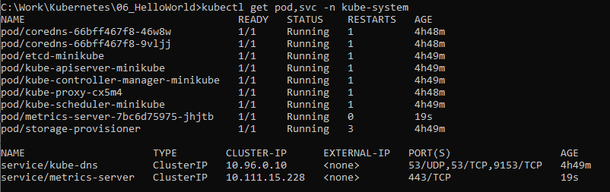
6.5 Enable Addons
https://kubernetes.io/docs/tutorials/hello-minikube/
Enable Addons
Enable an addon, for example, metrics-server
> minikube addons enable metrics-server
View the Pod and Service you just created
> kubectl get pod,svc -n kube-system

Slide 24
6.5 Enable Addons
https://kubernetes.io/docs/tutorials/hello-minikube/
Enable Addons
DisAable metrics-server
> minikube addons disable metrics-server

Slide 25
6.6 Cleanup

Slide 26
End of Chapter

