Slide 1

5 Setup Minikube
Peter H. Chen

Slide 2
5 Setup Minikube
https://kubernetes.io/docs/tasks/tools/install-minikube/
Setup Minikube

Slide 3
5.1 Install Minikube

Slide 4
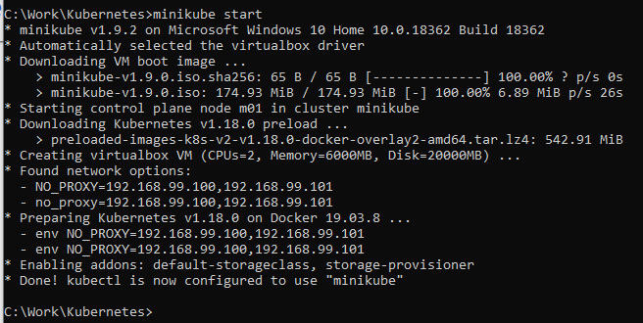
5.1 Install Minikube
https://kubernetes.io/docs/tasks/tools/install-minikube/
https://kubernetes.io/docs/tasks/tools/install-minikube/
> systeminfo
Download minkube-wndow-amd64.exe and rename it to minikube.exe

Slide 5
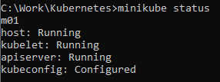

5.1 Install Minikube
https://kubernetes.io/docs/tasks/tools/install-minikube/
https://kubernetes.io/docs/tasks/tools/install-minikube/
Confirmed the installation
> minikube status
Stop minikube
> stop minikube

Slide 6
End of Chapter

