Slide 1
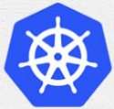
4 Kubernetes Architecture
Peter H. Chen

Slide 2
4 Kubernetes Architecture
https://www.youtube.com/watch?v=8C_SCDbUJTg&list=PL2We04F3Y_43dAehLMT5GxJhtk3mJtkl5&index=4
Kubernetes (or K8s) Architecture
Cluster Architecture
Basic ECTD
ECTD in Kubernetes
Kube API Server
Controller Managers
Kube schedule
Kubelet
Kube Proxy

Slide 3
4.1 Kubernetes Cluster

Slide 4
4.1 Kubernetes Cluster
https://www.youtube.com/watch?v=8C_SCDbUJTg&list=PL2We04F3Y_43dAehLMT5GxJhtk3mJtkl5&index=4
Purpose of Kubernetes
The purpose of Kubernetes is to host your applications in the form of containers in an automated fashion So that you can easily deploy as many instances of your application as required and easily enable communication between different services within your applications.

Slide 5
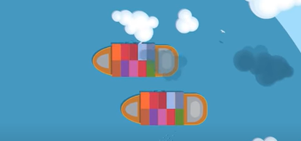
4.1 Kubernetes Cluster
https://www.youtube.com/watch?v=8C_SCDbUJTg&list=PL2We04F3Y_43dAehLMT5GxJhtk3mJtkl5&index=4
Cargo Ships
There are many thing involved to work together to make this possible.
We will use the ships as the example to understand the Kubernetes.
We have two kinds of ships:
The cargo ships that does the actual work of carrying containers across the sea

Slide 6
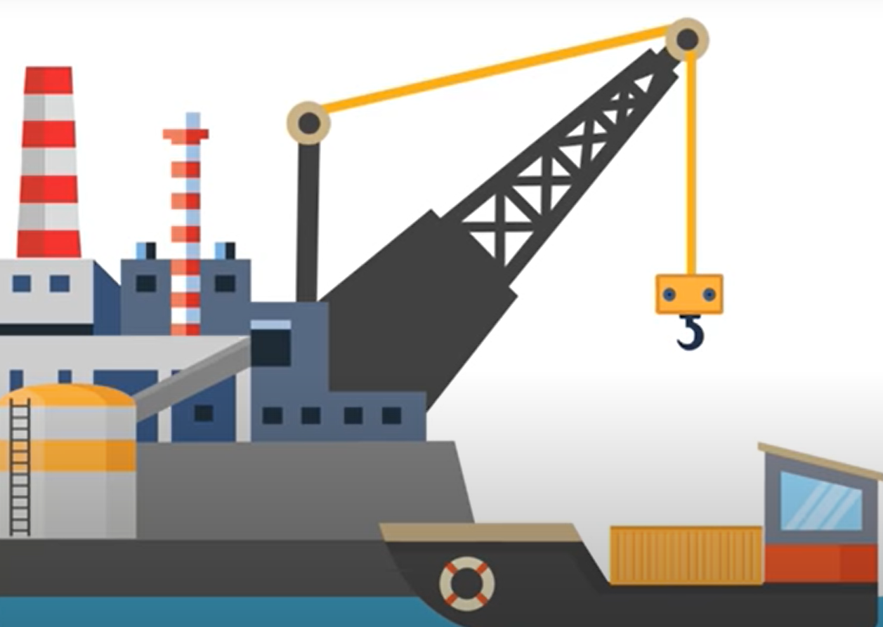
4.1 Kubernetes Cluster
https://www.youtube.com/watch?v=8C_SCDbUJTg&list=PL2We04F3Y_43dAehLMT5GxJhtk3mJtkl5&index=4
Control Ships
The control ships that are responsible for monitoring and managing the cargo ship.

Slide 7
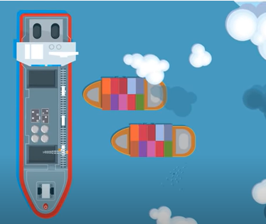
4.1 Kubernetes Cluster
https://www.youtube.com/watch?v=8C_SCDbUJTg&list=PL2We04F3Y_43dAehLMT5GxJhtk3mJtkl5&index=4
Control Ship and Cargo Ship
The Kubernetes cluster consists of a set of nodes which is physical or virtual on cloud that host applications in the form of containers. These relate to cargo ships in this analogy.

Slide 8
4.2 Worker Nodes

Slide 9
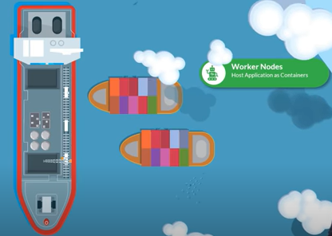
4.2 Worker Nodes
https://www.youtube.com/watch?v=8C_SCDbUJTg&list=PL2We04F3Y_43dAehLMT5GxJhtk3mJtkl5&index=4
Purpose of Kubernetes
The worker nodes in this cluster are ships that can load the containers.
The workers need to load the containers on the ships.
The workers not only load the container, but also need to plan how to load, identify the right ships, store information about the ships, monitor and track the location of containers, manage the whole loading processes, and etc.
This task is done by control ships that hosts different offices and departments, which provide the monitoring equipment, communication equipment, cranes for moving container between ships, and etc.
The control ships related to master node in the Kubernetes cluster.
Worker Nodes:
Host Application Containers

Slide 10
4.3 Master Nodes

Slide 11
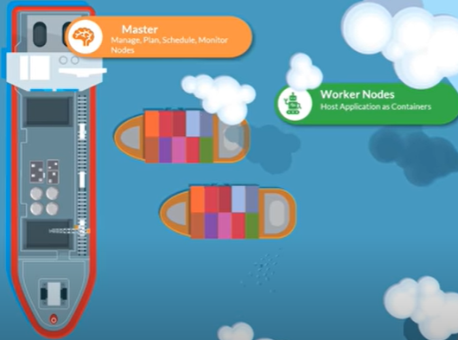
4.3 Master Nodes
https://www.youtube.com/watch?v=8C_SCDbUJTg&list=PL2We04F3Y_43dAehLMT5GxJhtk3mJtkl5&index=4
Master Nodes
The master node is responsible for managing the Kubernetes cluster, storing information regarding the different nodes, planning which container goes where, monitoring the nodes, and etc.
The master node does all of these using a set of components together known as the control plane components (or Control-plane node).
We will look at each of these components.
Master Nodes:
Manage, Plan, Schedule, Monitor Nodes
Worker Nodes:
Host Application Containers

Slide 12
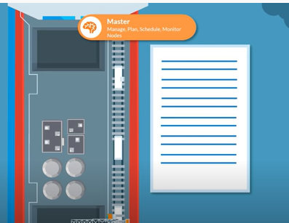
4.3 Master Nodes
https://www.youtube.com/watch?v=8C_SCDbUJTg&list=PL2We04F3Y_43dAehLMT5GxJhtk3mJtkl5&index=4
Master Nodes
Now, there are many containers being loaded and unloaded from the ships on a daily basis. SO you need to maintain information about the different ship.
What containers is on which ship and what time it was loaded, and etc.
All of these are stored in a highly available key
Master Nodes:
Manage, Plan, Schedule, Monitor Nodes

Slide 13
4.4 ECTD Cluster

Slide 14
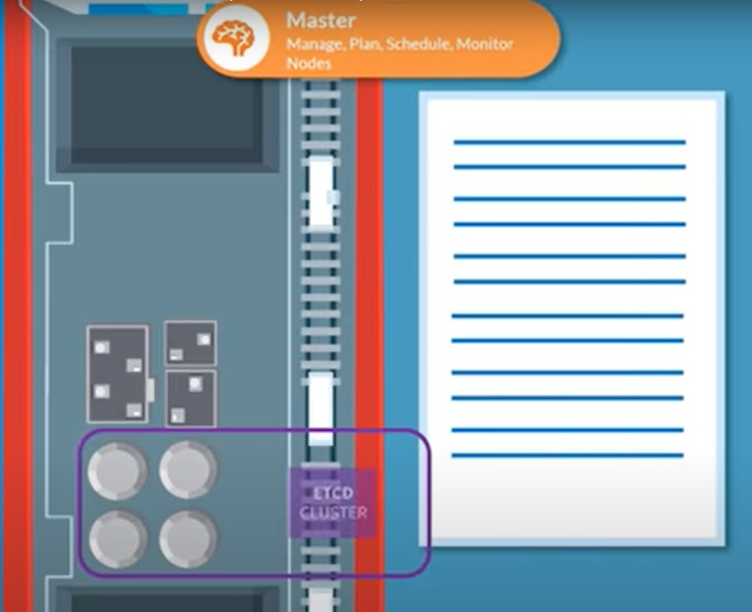
4.4 ECTD Cluster
https://www.youtube.com/watch?v=8C_SCDbUJTg&list=PL2We04F3Y_43dAehLMT5GxJhtk3mJtkl5&index=4
ECTD Cluster
All of these information are stored in a highly available key-value store called etcd.
The etcd is a database that stores information in a key-value format.
We will look more into what etcd cluster actually is, what data is stored in and how it stores the data in.
Master Nodes:
Manage, Plan, Schedule, Monitor Nodes
ETCD
Cluster

Slide 15
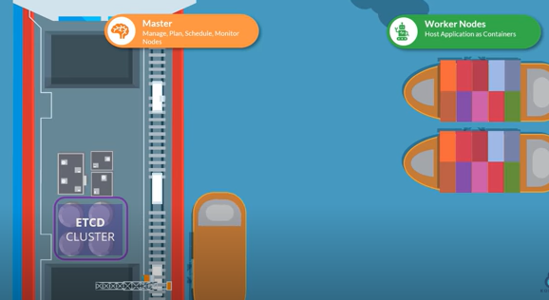
4.4 ECTD Cluster
https://www.youtube.com/watch?v=8C_SCDbUJTg&list=PL2We04F3Y_43dAehLMT5GxJhtk3mJtkl5&index=4
ECTD Cluster
When ships arrive, you load containers on them using cranes.
The cranes identify the containers that need to be placed on ship.
Master Nodes:
Manage, Plan, Schedule, Monitor Nodes
Worker Nodes:
Host Application Containers
ETCD
Cluster

Slide 16
4.5 Kube Scheduler

Slide 17
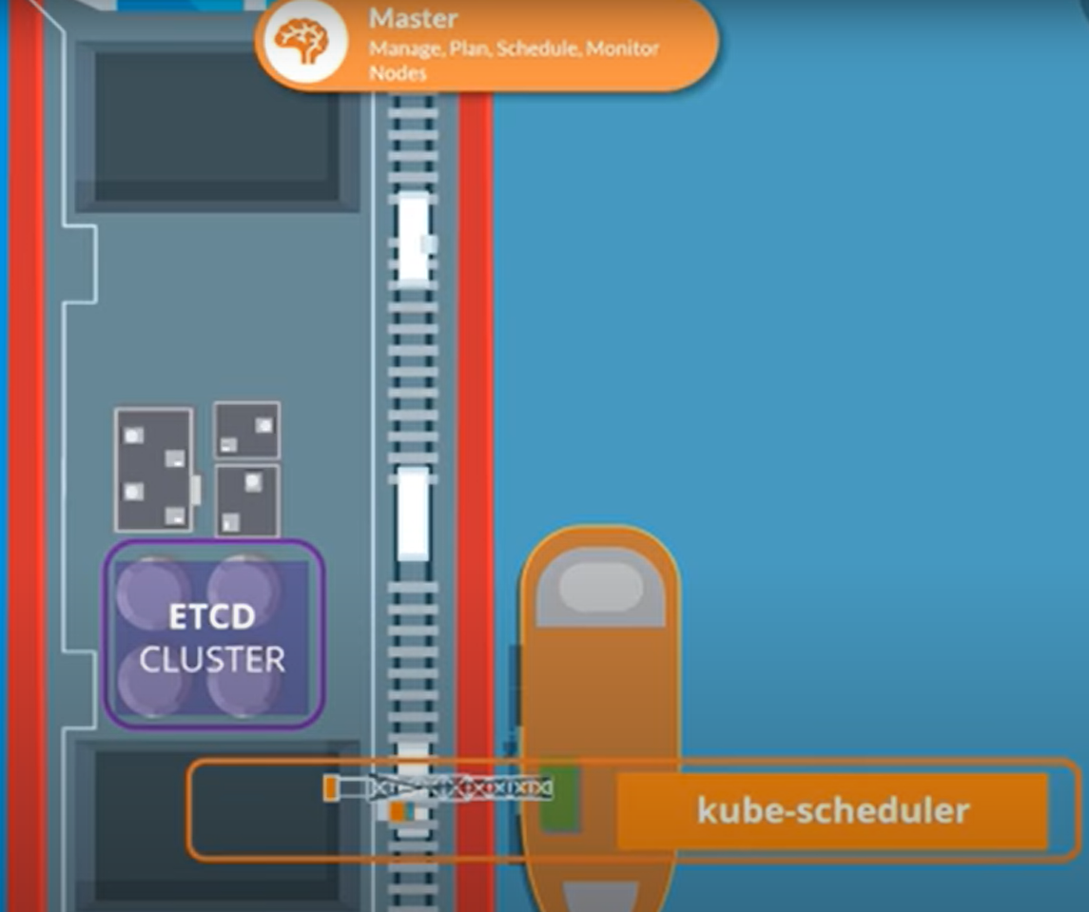
4.5 Kube Scheduler
https://www.youtube.com/watch?v=8C_SCDbUJTg&list=PL2We04F3Y_43dAehLMT5GxJhtk3mJtkl5&index=4
Kube Scheduler
It identifies the right ship based on its size, its capacity, the number of containers already on the ship and any other conditions, such as, the destination of the ship, the type of containers that it is allowed to carry, and etc.
Those are schedulers in a Kubernetes cluster.
The scheduler identifies the right node to place on a container based on containers resource requirements, the worker nodes capacity, or any other policies or constraints, such as, toleramce or affinity rules that around them.
Master Nodes:
Manage, Plan, Schedule, Monitor Nodes
ETCD
Cluster
Kube-scheduler

Slide 18
4.5 Kube Scheduler
https://www.youtube.com/watch?v=8C_SCDbUJTg&list=PL2We04F3Y_43dAehLMT5GxJhtk3mJtkl5&index=4
Kube Scheduler
There are different offices in the Dock that are assigned to special tasks or departments, for example, the operation team takes care of ship handling, traffic control, and etc.
The offices deals with issues related to damages, the routes to different ships, and etc.
The cargo team take care of containers when containers are damaged or destroyed. They make sure new containers are made available.
We have these service offices that take care of IT and communications between different ships.

Slide 19
4.6 Node Controller

Slide 20
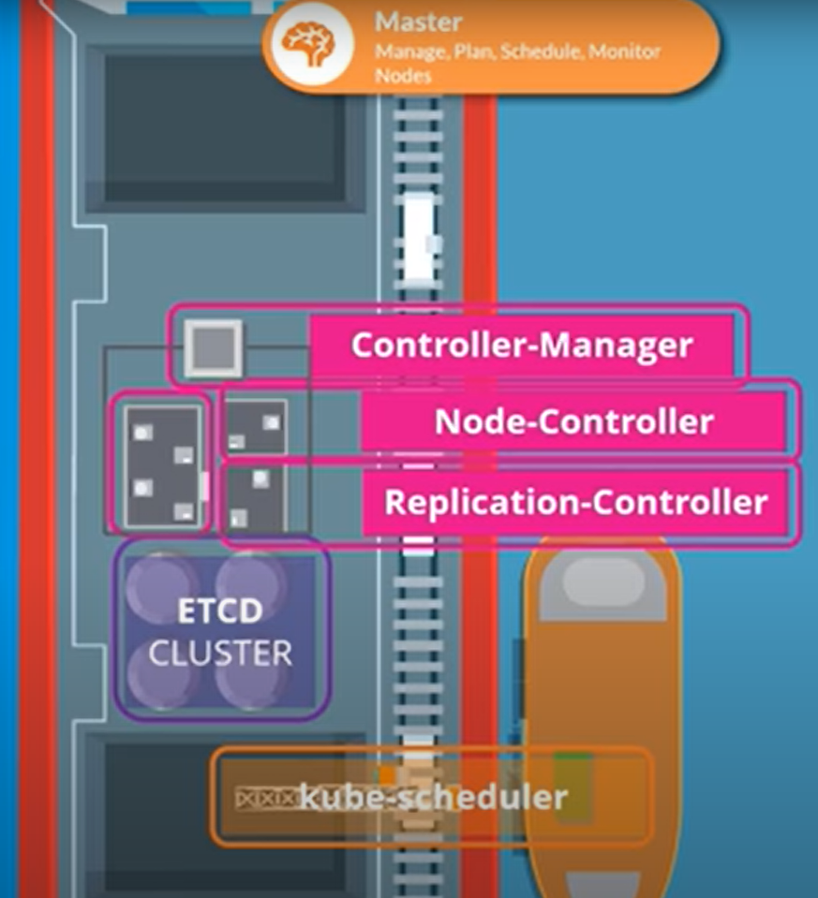
4.6 Node Controller
https://www.youtube.com/watch?v=8C_SCDbUJTg&list=PL2We04F3Y_43dAehLMT5GxJhtk3mJtkl5&index=4
Node Controller
Similarly, in Kubernetes, we have controller available that take care of different areas.
Master Nodes:
Manage, Plan, Schedule, Monitor Nodes
The node-controller takes care of nodes. They are responsible for onboarding new nodes to the cluster, handling situations where nodes become unavailable or get destroyed.
The replication-controller ensures the desired number of containers are running at all time in your repetition.
Controller-Manager
Node-Controller
Replication-Controller
ETCD
Cluster
Kube-scheduler

Slide 21
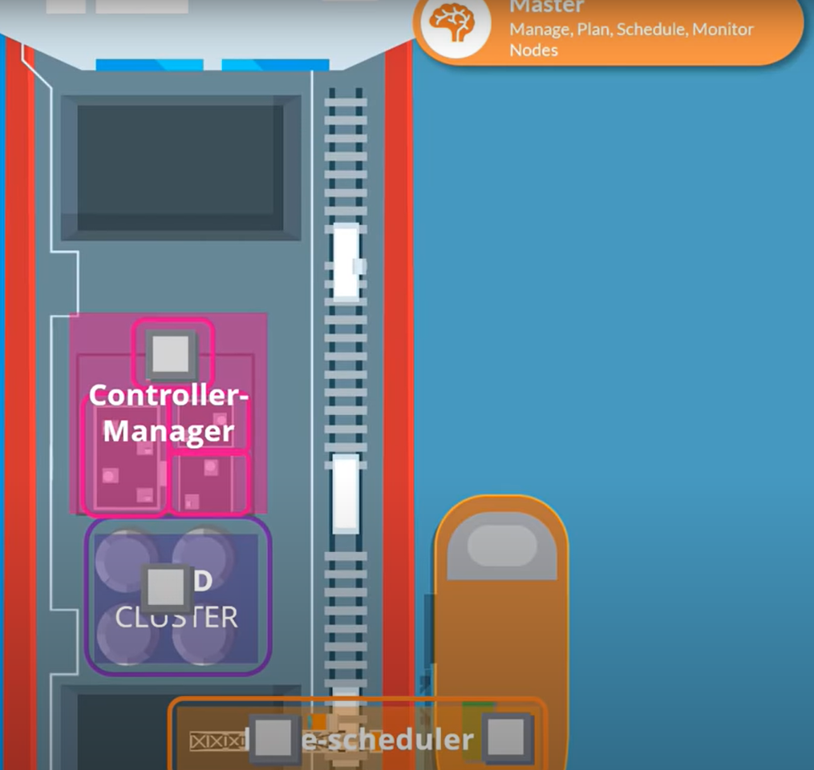
4.6 Node Controller
https://www.youtube.com/watch?v=8C_SCDbUJTg&list=PL2We04F3Y_43dAehLMT5GxJhtk3mJtkl5&index=4
Node Controller
We have seen different components like different offices, the different ships, the datastore, the cranes.
Master Nodes:
Manage, Plan, Schedule, Monitor Nodes
Controller-Manager
ETCD
Cluster
Kube-scheduler

Slide 22
4.7 Kube API Controller (Orchestrator)

Slide 23
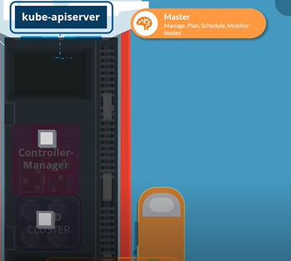
4.7 Kube API Controller (Orchestrator)
https://www.youtube.com/watch?v=8C_SCDbUJTg&list=PL2We04F3Y_43dAehLMT5GxJhtk3mJtkl5&index=4
Kube API Controller
How do these communicate with each others?
How does one office reach the other office who manages them all at a high level.
The kube-apiserver is the primary management component of Kubernetes.
The kube-apiserver is responsible for orchestrating all operation within the cluster.
Kube-apiserver
Master Nodes:
Manage, Plan, Schedule, Monitor Nodes
Controller-Manager
ETCD
Cluster

Slide 24
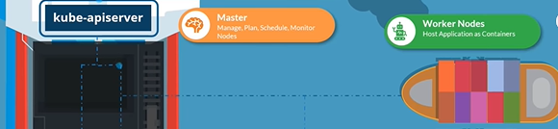
4.7 Kube API Controller (Orchestrator)
https://www.youtube.com/watch?v=8C_SCDbUJTg&list=PL2We04F3Y_43dAehLMT5GxJhtk3mJtkl5&index=4
Kube API Controller
It exposes the Kubernetes API which is used by external users to perform management operations on the cluster as well as various controllers to monitor the state of the cluster and make necessary changes as required and by the worker nodes to communicate with the server.
Now, we are working with containers here.
Containers are everywhere.
We need everything to be container compatible.
We application are in the form of containers. The different components that form entire management system on the master node could be hosted in the form of containers.
Kube-apiserver
Master Nodes:
Manage, Plan, Schedule, Monitor Nodes
Worker Nodes:
Host Application Containers

Slide 25
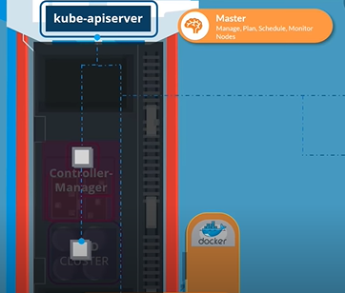
4.7 Kube API Controller (Orchestrator)
https://www.youtube.com/watch?v=8C_SCDbUJTg&list=PL2We04F3Y_43dAehLMT5GxJhtk3mJtkl5&index=4
Kube API Controller
The DNS service, networking solution can all be in the form of containers.
So, we need these software that can run containers and that is the container runtime engine, a popular one is docker.
We need docker or its supported equivalent.
Installed all the nodes in the cluster, including the Master nodes.
Kube-apiserver
Master Nodes:
Manage, Plan, Schedule, Monitor Nodes

Slide 26
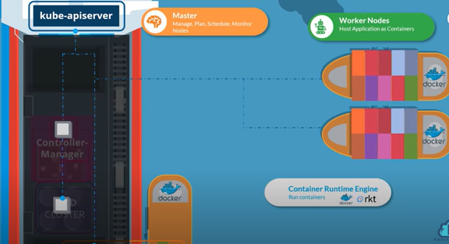
4.7 Kube API Controller (Orchestrator)
https://www.youtube.com/watch?v=8C_SCDbUJTg&list=PL2We04F3Y_43dAehLMT5GxJhtk3mJtkl5&index=4
Kube API Controller
If you wish to host the control plane components as containers.
Now, it does not have to be docker.
Kubernetes support other runtime engine as well, like container d or rocket.
Kube-apiserver
Master Nodes:
Manage, Plan, Schedule, Monitor Nodes
Worker Nodes:
Host Application Containers

Slide 27
4.8 Kubelet (Cargo Captain)

Slide 28
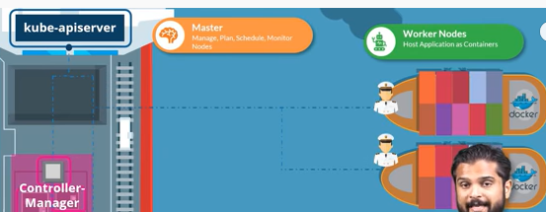


4.8 Kubelet (Cargo Captain)
https://www.youtube.com/watch?v=8C_SCDbUJTg&list=PL2We04F3Y_43dAehLMT5GxJhtk3mJtkl5&index=4
Communication
Now, we focus on Cargo ship.
Every Cargo ship has a Captain.
Captain is responsibility for managing all activities on these ships.
The Captain is responsible for releasing with Master ship starting with letting the master ship know that they are interested in joining the group, receiving information about the containers to be loaded on the ship and loading the appropriate containers as required, sending reports back to the master about the status of this ship and the status of the containers on the ship, and etc.
Kube-apiserver
Master Nodes:
Manage, Plan, Schedule, Monitor Nodes
Worker Nodes:
Host Application Containers
Controller-Manager

Slide 29
4.8 Kubelet (Cargo Captain)
https://www.youtube.com/watch?v=8C_SCDbUJTg&list=PL2We04F3Y_43dAehLMT5GxJhtk3mJtkl5&index=4
Communication
Now, the Captain of the ship is the in Kubelet in Kubernetes.
Kubelet is an agent that runs on each node in a cluster.
Kubelet listen the instruction from the Kube-apiserver and deploy or destroy the containers (app running images) on the nodes (ships) as required.
The Kube-apiserver periodically fetches status reports from the Kuberlet to monitor the status of nodes and containers on them.
Kube-apiserver
Master Nodes:
Manage, Plan, Schedule, Monitor Nodes
Worker Nodes:
Host Application Containers
Kubelet
Kubelet
Controller-Manager
Kubelet

Slide 30
4.8 Kubelet (Cargo Captain)
https://www.youtube.com/watch?v=8C_SCDbUJTg&list=PL2We04F3Y_43dAehLMT5GxJhtk3mJtkl5&index=4
Purpose of Kubernetes
The Kubelet was more of a Captain on the ship that manages containers on the ship.
The application running on the worker nodes need to be able to communicate with each other, for example, you may have a web server run in one container on one of the nodes and the database server running on another container on another node.
Kube-apiserver
Master Nodes:
Manage, Plan, Schedule, Monitor Nodes
Worker Nodes:
Host Application Containers
Kubelet
Kubelet
Controller-Manager
Kubelet

Slide 31
4.9 Kube-Proxy

Slide 32
4.9 Kube-Proxy
https://www.youtube.com/watch?v=8C_SCDbUJTg&list=PL2We04F3Y_43dAehLMT5GxJhtk3mJtkl5&index=4
Purpose of Kubernetes
How would the web server reach a database server on the other node?
Communication between worker nodes are enabled by another component known as the Kube-Proxy service.
The Kube-Proxy service ensures that the necessary rules are in place on the worker nodes to allow the containers running on them to reach each others.
Kube-apiserver
Master Nodes:
Manage, Plan, Schedule, Monitor Nodes
Worker Nodes:
Host Application Containers
Kubelet
Kubelet
Kube-Proxy
Controller-Manager
Kubelet

Slide 33
4.10 Summary

Slide 34
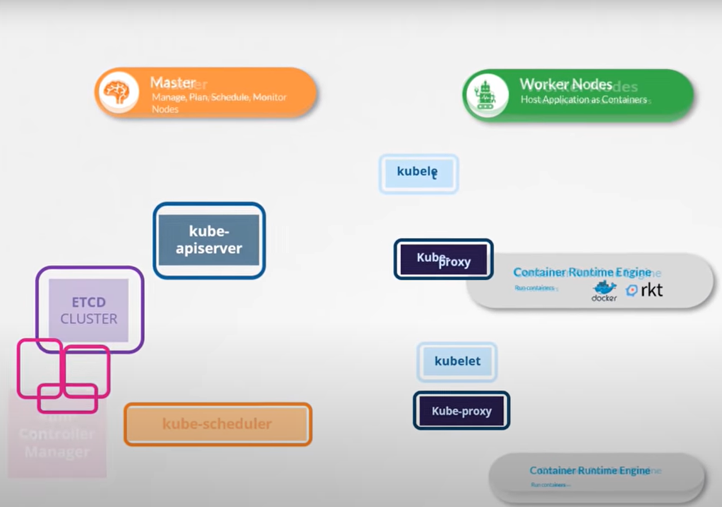
4.10 Summary
https://www.youtube.com/watch?v=8C_SCDbUJTg&list=PL2We04F3Y_43dAehLMT5GxJhtk3mJtkl5&index=4
Summary of Kubernetes Architecture
We have Master and worker nodes.
On the Master, We have the ECTD Cluster which store information about the cluster. We have the Kube-scheduler that is responsible for scheduling applications or container on nodes.
We have different controllers that take care of different functions: we have node-controller or replication-controller, and etc.
We have Kube-apiserver that is responsible for orchestrating all operations within the cluster.
Master Nodes:
Manage, Plan, Schedule, Monitor Nodes
Worker Nodes:
Host Application Containers
Kubelet
Kube-apiserver
Kube-Proxy
ETCD
Cluster
Kubelet
Controller-Manager
Kube-scheduler
Kube-Proxy

Slide 35
4.10 Summary
https://www.youtube.com/watch?v=8C_SCDbUJTg&list=PL2We04F3Y_43dAehLMT5GxJhtk3mJtkl5&index=4
Summary of Kubernetes Architecture
On the worker nodes, we have the Kubelet that listens for the instruction from the Kube-apiserver and Kubelet manages the containers (running app image) and the Kube-proxy that help enable the communication between services (between the nodes) within the cluster.
That is high level overview of various components.
Master Nodes:
Manage, Plan, Schedule, Monitor Nodes
Worker Nodes:
Host Application Containers
Kubelet
Kube-apiserver
Kube-Proxy
ETCD
Cluster
Kubelet
Controller-Manager
Kube-scheduler
Kube-Proxy

Slide 36
End of Chapter

