Slide 1
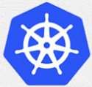
6 Implement Nginx
Peter H. Chen

Slide 2

6 Minikube Nginx
https://rominirani.com/tutorial-getting-started-with-kubernetes-on-your-windows-laptop-with-minikube-3269b54a226
We discuss and implement an app nginx (or containers Ngnix) in Kubernetes.
Kubernetes
Server
Client
App nginx
(or Container nginx)
Pod
Master Node
Client App Node

Slide 3
6.1 Minikube
Peter H. Chen

Slide 4
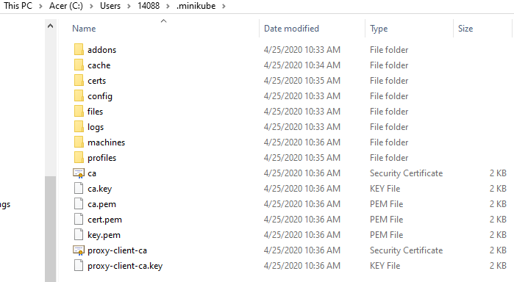
6.1 Minikube
https://rominirani.com/tutorial-getting-started-with-kubernetes-on-your-windows-laptop-with-minikube-3269b54a226
> minikube start
After this command, the .minikube folder is created in the “c:\users\username”, for example, c:\users\14088\.minikube)

Slide 5
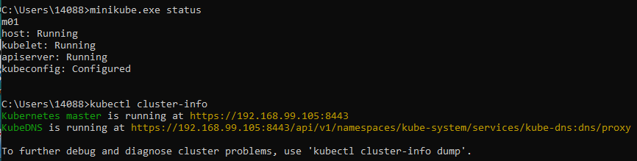
6.1 Minikube
https://kubernetes.io/docs/tutorials/hello-minikube/
> minikube start
> minikube status
> minkkube cluster-info

Slide 6
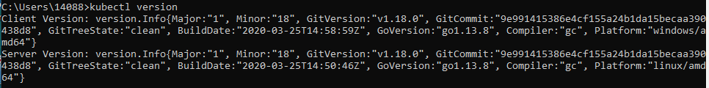

6.1 Minikube
https://kubernetes.io/docs/tutorials/hello-minikube/
> kubectl version
> kubectl ip

Slide 7
6.2 Minikube Dashboard

Slide 8
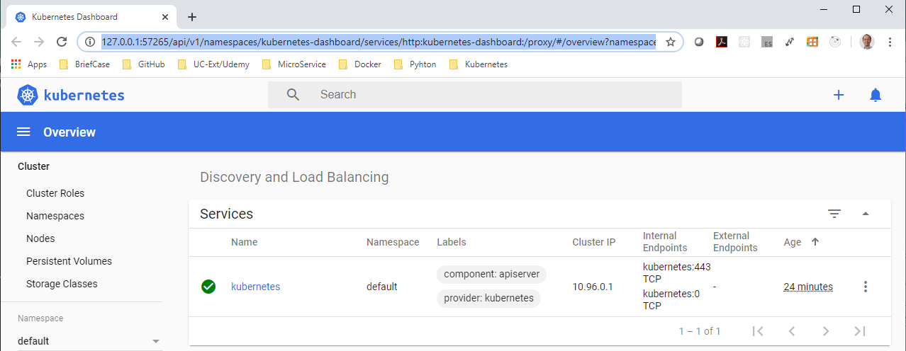
6.2 Minikube Dashboard
https://kubernetes.io/docs/tutorials/hello-minikube/
> minikube dashboard
There is nothing (no application) is deployed.

Slide 9
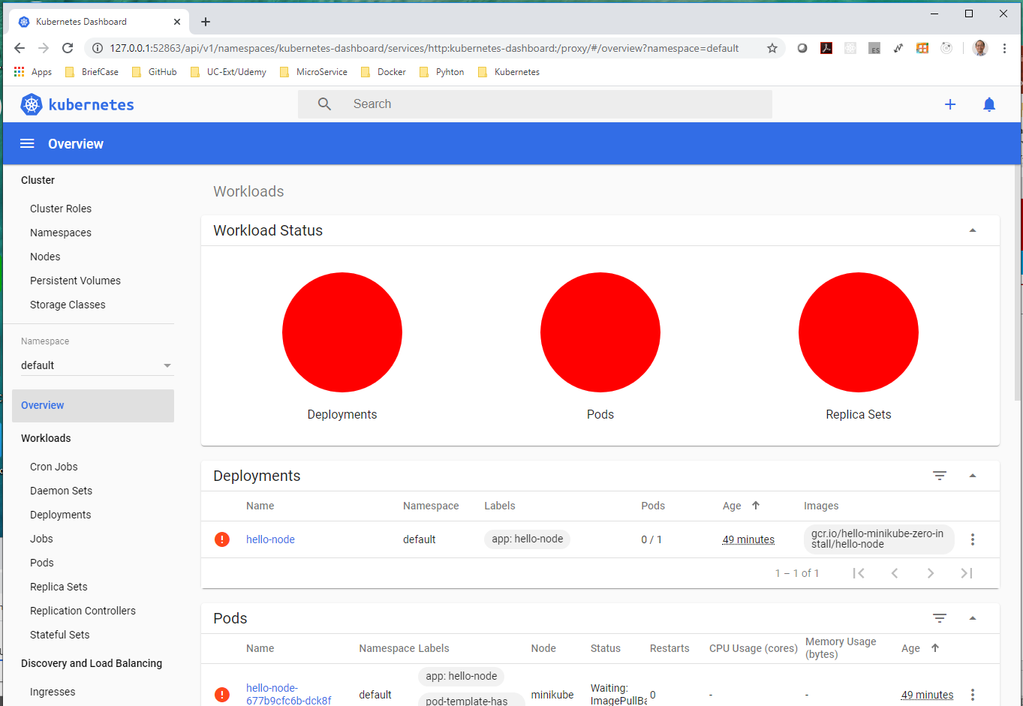
6.2 Minikube Dashboard
https://kubernetes.io/docs/tutorials/hello-minikube/
> minikube dashboard

Slide 10

6.2 Minikube Dashboard
https://kubernetes.io/docs/tutorials/hello-minikube/
Start dashboard without the GUI
> kubectl dashboard --url=true

Slide 11

6.2 Minikube Dashboard
https://kubernetes.io/docs/tutorials/hello-minikube/
Use kubectl CLI to get a list of nodes.
> kubectl get nodes

Slide 12

6.2 Minikube Dashboard
https://kubernetes.io/docs/tutorials/hello-minikube/
Switch context “minikube”
> kubectl config use-context minikube

Slide 13
6.3 Run Workload

Slide 14
6.3 Run Workload
https://kubernetes.io/docs/tutorials/hello-minikube/
> kubectl.exe run hello-nginx --image=nginx --port=80

Slide 15

6.3 Run Workload
https://kubernetes.io/docs/tutorials/hello-minikube/
Create container “hello-nginx” with image ngnix
> kubectl.exe run hello-nginx --image=nginx --port=80
Investigate pods
> kubectl.exe get pods

Slide 16
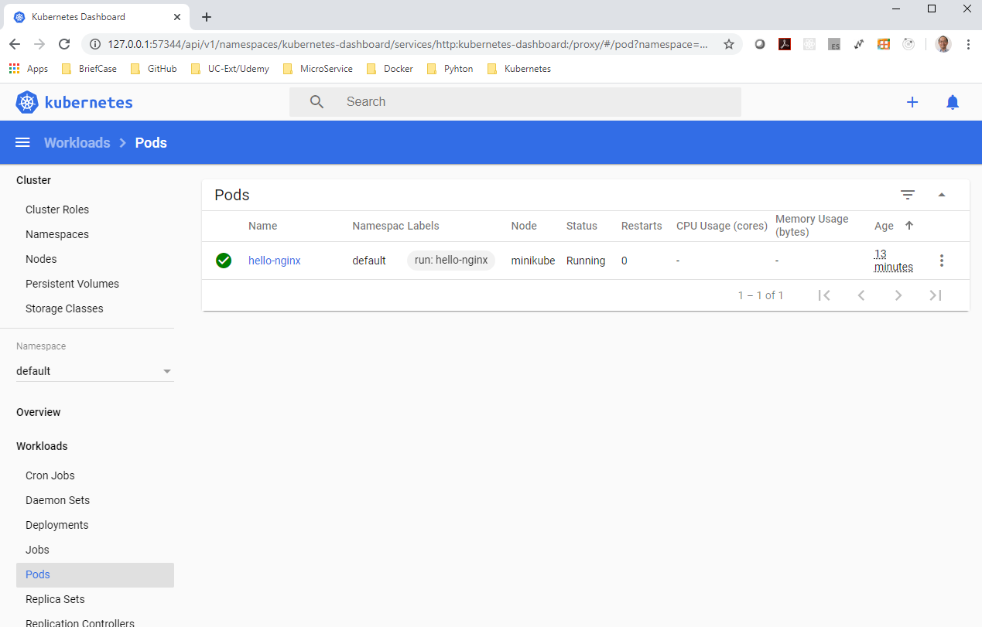
6.3 Run Workload
https://kubernetes.io/docs/tutorials/hello-minikube/
Check dashboard. There is a pod running.

Slide 17
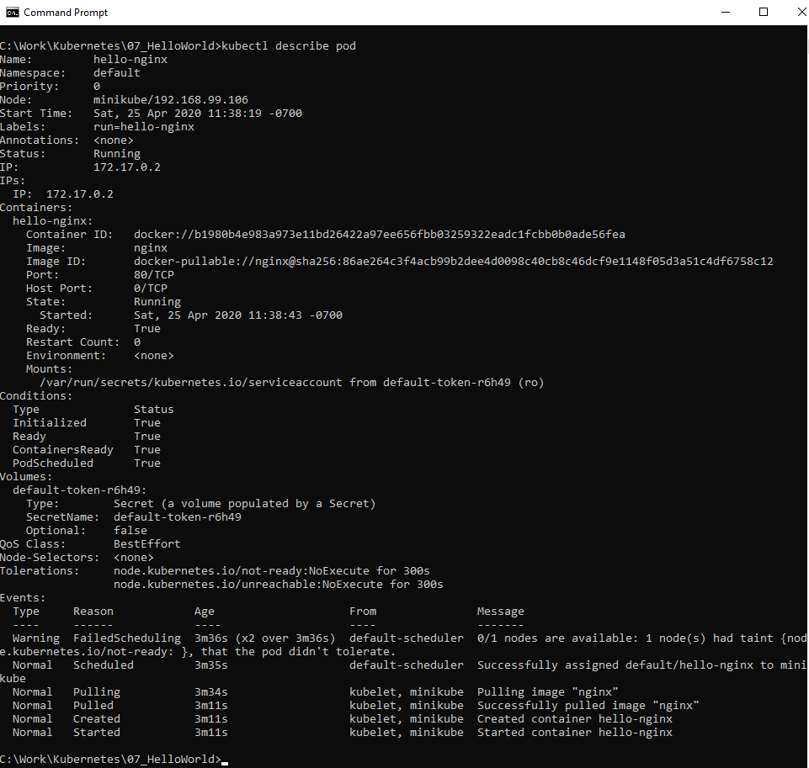
6.3 Run Workload
https://kubernetes.io/docs/tutorials/hello-minikube/
> kubectl describe pod

Slide 18
6.4 Create Deployment

Slide 19
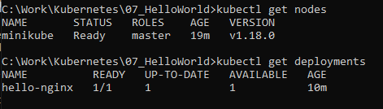
6.4 Create Deployment
https://kubernetes.io/docs/tutorials/hello-minikube/
> kubectl creare deployment hello-nginx –image=nginx
Check nodes and deployment:
> kubectl get nodes
> kubectl get deployments

Slide 20
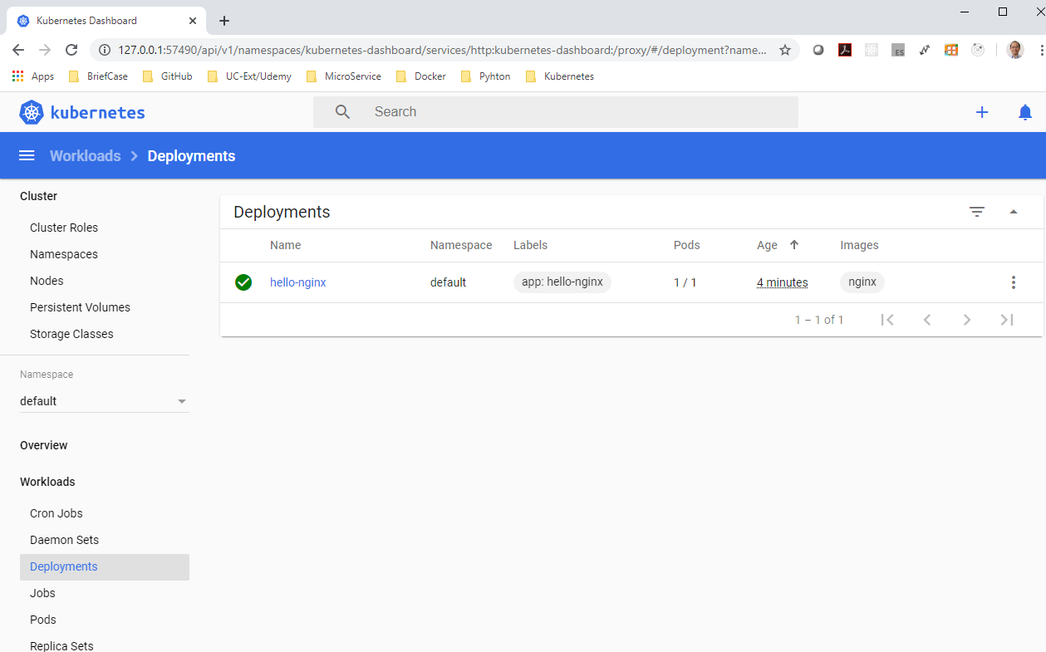
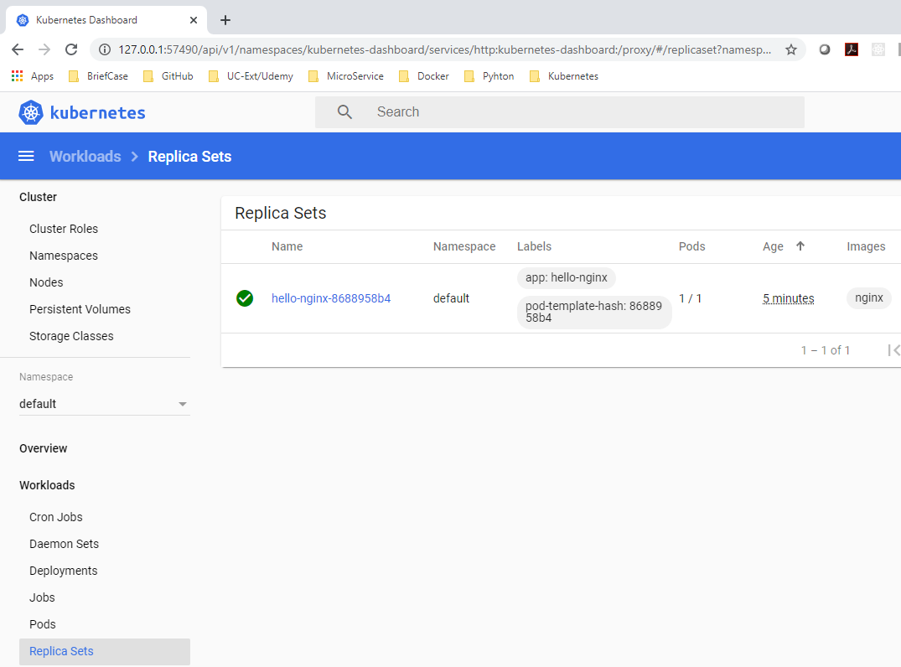
6.4 Create Deployment
https://kubernetes.io/docs/tutorials/hello-minikube/
Check dashboard

Slide 21
6.5 Create Service

Slide 22

6.5 Create Service
https://kubernetes.io/docs/tutorials/hello-minikube/
Create a Service
> kubectl expose deployment hello-ngnix –type=NodePort –port=80
Check Service on Dashboard
> kubectl get services
There are two services: Master kubernetes and client hello-ngnix

Slide 23
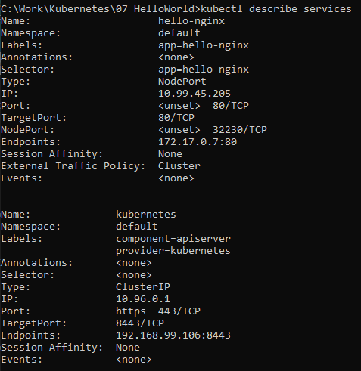
6.5 Create Service
https://kubernetes.io/docs/tutorials/hello-minikube/
Check Service details
> kubectl describe services

Slide 24
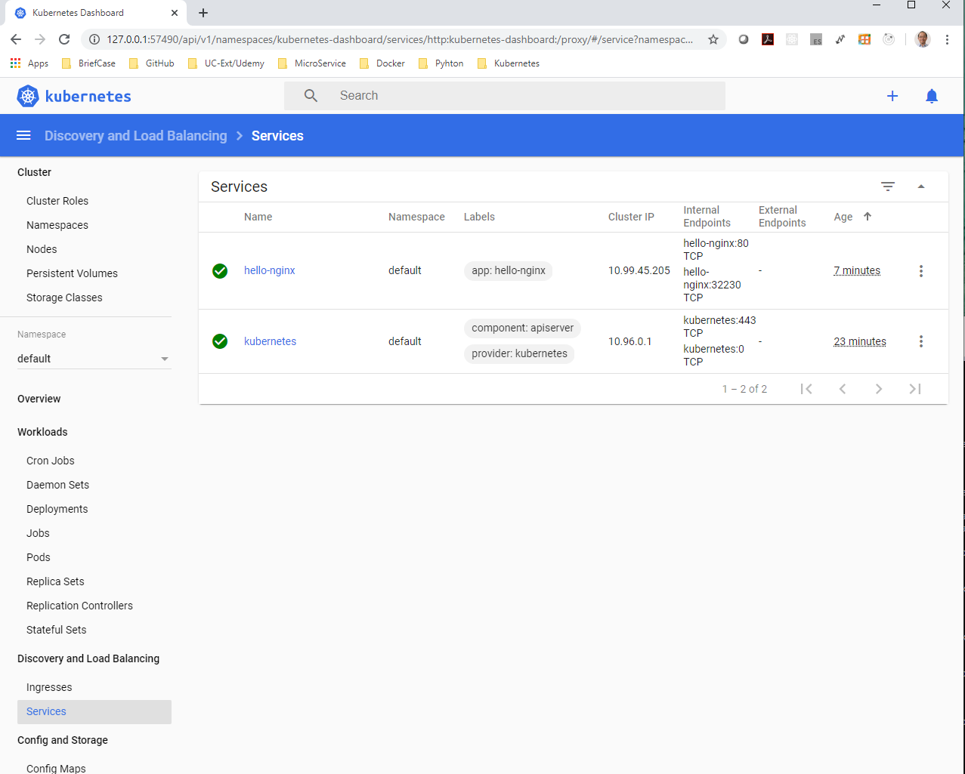
6.5 Create Service
https://kubernetes.io/docs/tutorials/hello-minikube/
Verify two services (Master kubernetes and client hello-ngnix ) on Dashboard

Slide 25
6.6 Display App on Browser

Slide 26
6.6 Display App on Browser
https://kubernetes.io/docs/tutorials/hello-minikube/
Check service IP and port information without browser
> minikube service --url=true hello-nginx
>> http://192/168.99.106:32230

Slide 27
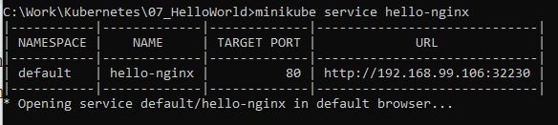
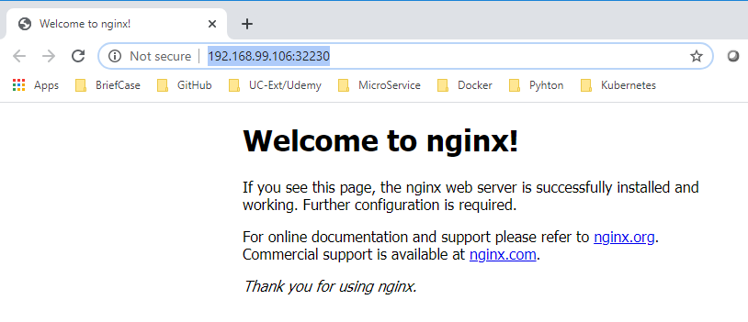
6.6 Display App on Browser
https://kubernetes.io/docs/tutorials/hello-minikube/
Bring up browser
> minikube service hello-nginx

Slide 28
End of Chapter

