Slide 1

2 Create Django Project
Peter H. Chen

Slide 2
2 Create Django Project
https://www.youtube.com/watch?v=0t_o6bTIKRk&list=PLTgRMOcmRb3Oxj1oKJYsW2-JjRjtlFvoQ&index=2
Create a Django Project
Create the Flight Scheduler application (a Django app)
Install the Django REST Framework (DRF)
Set and Test REST APIs.

Slide 3
2.1 Django Project

Slide 4
2.1 Django Project
https://www.youtube.com/watch?v=0t_o6bTIKRk&list=PLTgRMOcmRb3Oxj1oKJYsW2-JjRjtlFvoQ&index=2
Django Project
A Django project is a
Collection of configurations
Modules
Apps
May contain many apps
An apps is a simple independent Web Application (Example: Webblog, Poll, Calendar, Web weather, and etc.).
An Apps can be contained in many projects.
If you familiar with Angular, ReactJS, and other frameworks, an App can be thought of as a component that makes things easier to understand.

Slide 5
2.1 Django Project
https://www.youtube.com/watch?v=0t_o6bTIKRk&list=PLTgRMOcmRb3Oxj1oKJYsW2-JjRjtlFvoQ&index=2
Django Project
If we have project A and this project contains two apps: App1 and App2.
The Project B can have the App1 from project A and have its own App3.
The Project C can have App2 from Project A and App3 from Project B.
You can see the Logic here. An App is an independent components or applications that can be used again in other projects.
Project A
Project B
Project C
App1
App1
App2
App2
App3
App3

Slide 6
2.1 Django Project
https://www.youtube.com/watch?v=0t_o6bTIKRk&list=PLTgRMOcmRb3Oxj1oKJYsW2-JjRjtlFvoQ&index=2
Anatomy of Django Project
We see the common items:
Manage.py is a module. Every python file is a module. It is a alias to the Django admin command utility file that performs many of the command line tasks, like creating applications, manage interacting with databases, and etc.
You also see a file called db.sqlite3. This is a database file. This is a default database used by Django when you create a Django Project. You can always change to a different system or a different file but db.sqlite3 is a default after you run the Django application.
Manage.py
db.sqlite3
venv
…

Slide 7
2.1 Django Project
https://www.youtube.com/watch?v=0t_o6bTIKRk&list=PLTgRMOcmRb3Oxj1oKJYsW2-JjRjtlFvoQ&index=2
Anatomy of Django Project
The venv is a virtual environment. This venv contains all the Django package and other third party packages and applications in this folder.
This is where all the files are stored.
You may contain other files and folders, such as, static folders and etc.
The my_project itself is the Django Project folder. This project folder contains some really important files. One of these are __init__.py.
My_project
__init__.py
db.sqlite3
Manage.py
venv
…

Slide 8
2.1 Django Project
https://www.youtube.com/watch?v=0t_o6bTIKRk&list=PLTgRMOcmRb3Oxj1oKJYsW2-JjRjtlFvoQ&index=2
Anatomy of Django Project
The __init__.py is a special file that tell Python that this folder is a package. Without __init__.py file, folder will not be able to distinguish.
Make sure __init__.py is in the folder even __init__.py it is empty.
We also have a settings.py file. The settings.py is just a configuration file to configure your project. It is really important.
My_project
__init__.py
settings.py
db.sqlite3
Manage.py
venv
…

Slide 9
2.1 Django Project
https://www.youtube.com/watch?v=0t_o6bTIKRk&list=PLTgRMOcmRb3Oxj1oKJYsW2-JjRjtlFvoQ&index=2
Anatomy of Django Project
We have urls.py this called root url. All your root URL patterns will be defined in this file. In your application, they have their own urls.py file too. That is the way you should be built.
Each application should have their own urls and no matter what, They still going to be linked to this root url.
My_project
__init__.py
settings.py
db.sqlite3
Manage.py
urls.py
venv
…

Slide 10
2.1 Django Project
https://www.youtube.com/watch?v=0t_o6bTIKRk&list=PLTgRMOcmRb3Oxj1oKJYsW2-JjRjtlFvoQ&index=2
Anatomy of Django Project
You can see wsgi.py. WSGI is the webserver gateway interface. WSGI is the interface that talks to Django and Python will built upon this interface or specification for web development. That is also needed.
My_project
__init__.py
settings.py
db.sqlite3
Manage.py
urls.py
wsgi.py
venv
…

Slide 11
2.1 Django Project
https://www.youtube.com/watch?v=0t_o6bTIKRk&list=PLTgRMOcmRb3Oxj1oKJYsW2-JjRjtlFvoQ&index=2
Anatomy of Django Project
Then, we also see these apps: app_1, app_2, …, and app_n.
These apps do not need to be contained within the project folder.
These apps can be outside the folder too.
My_project
__init__.py
settings.py
db.sqlite3
Manage.py
urls.py
wsgi.py
venv
app_1
app_n
…
app_2

Slide 12
2.2 Create a Django Project

Slide 13
2.2 Create a Django Project
https://www.youtube.com/watch?v=0t_o6bTIKRk&list=PLTgRMOcmRb3Oxj1oKJYsW2-JjRjtlFvoQ&index=2
Create a Django Project
To create a Django Project is really simple.
Use Django admin to create Django projects and apps
> django-admin startproject my_project
> django_admin startproject my_project
An instance of Django consisting of collection of settings: Database, configuration, Django-specific options, and app-specific setting

Slide 14
2.2 Create a Django Project
https://www.youtube.com/watch?v=0t_o6bTIKRk&list=PLTgRMOcmRb3Oxj1oKJYsW2-JjRjtlFvoQ&index=2
Create a Django Project
When you create the Django project, use the python convection, all lowercases.
Try not to use name with “Django” or “python” to conflict with python package names.
> django_admin startproject my_project
An instance of Django consisting of collection of settings: Database, configuration, Django-specific options, and app-specific setting

Slide 15
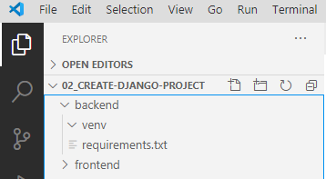
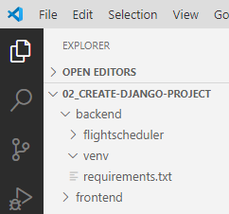
2.2 Create a Django Project
https://www.youtube.com/watch?v=0t_o6bTIKRk&list=PLTgRMOcmRb3Oxj1oKJYsW2-JjRjtlFvoQ&index=2
Create a Django Project
Inside working folder 02_create-django-project, we have folders of backend and frontend.
Inside the backend folder, we create the project flightscheduler
(tf) backend > django-admin startproject flightscheduler

Slide 16
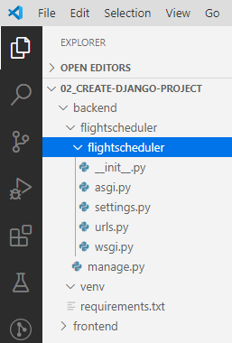
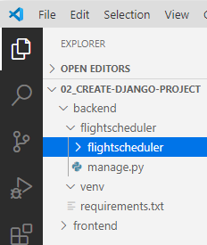
2.2 Create a Django Project
https://www.youtube.com/watch?v=0t_o6bTIKRk&list=PLTgRMOcmRb3Oxj1oKJYsW2-JjRjtlFvoQ&index=2
Create a Django Project
There are two folders (outside and inside) with the same name “flightscheduler”. You can rename the outside folder to other name, the keep the inside folder name “flightschduler” and do not change the name of inside folder.
The outside folder has manage.py file.

Slide 17
2.2 Create a Django Project
https://www.youtube.com/watch?v=0t_o6bTIKRk&list=PLTgRMOcmRb3Oxj1oKJYsW2-JjRjtlFvoQ&index=2
Create a Django Project
Inside folder flightschedule is the package. You can tell this the the package because it has the __init__.py.
The __init__.py is nothing there but it is required.

Slide 18
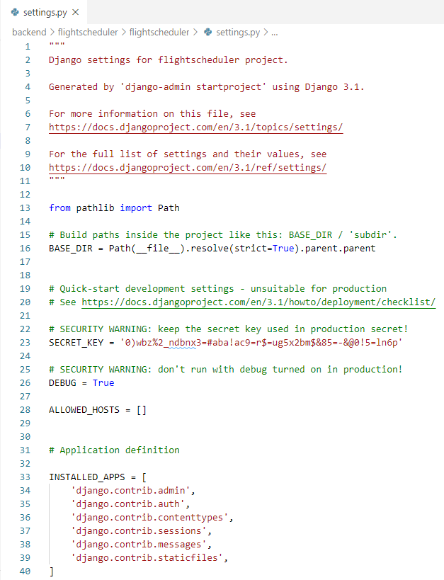
2.2 Create a Django Project
https://www.youtube.com/watch?v=0t_o6bTIKRk&list=PLTgRMOcmRb3Oxj1oKJYsW2-JjRjtlFvoQ&index=2
Create a Django Project
We have the settings.py.

Slide 19
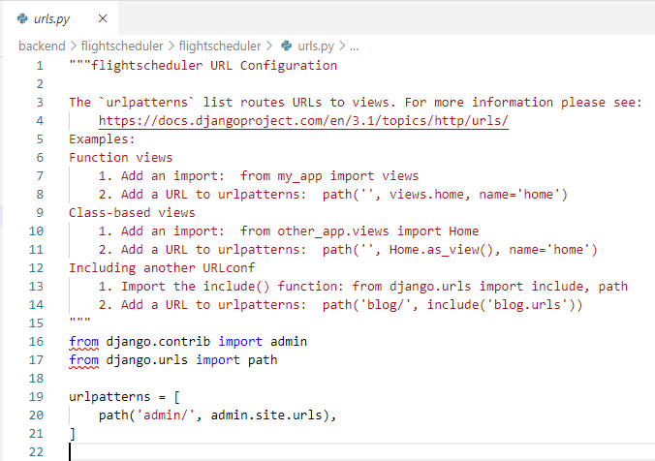
2.2 Create a Django Project
https://www.youtube.com/watch?v=0t_o6bTIKRk&list=PLTgRMOcmRb3Oxj1oKJYsW2-JjRjtlFvoQ&index=2
Create a Django Project
We have the urls.py for the root url.

Slide 20
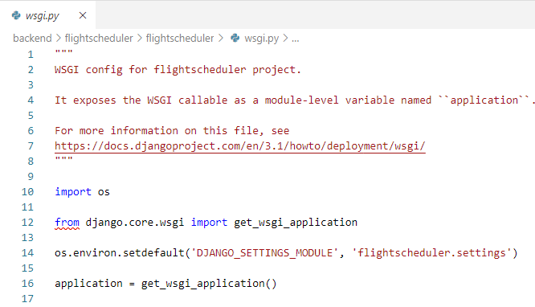
2.2 Create a Django Project
https://www.youtube.com/watch?v=0t_o6bTIKRk&list=PLTgRMOcmRb3Oxj1oKJYsW2-JjRjtlFvoQ&index=2
Create a Django Project
We have the wsgi.py for web server gate interface for the project.

Slide 21

2.2 Create a Django Project
https://www.youtube.com/watch?v=0t_o6bTIKRk&list=PLTgRMOcmRb3Oxj1oKJYsW2-JjRjtlFvoQ&index=2
Create a Django Project
We do not see the database yet because we have not run the program yet.
Now, we want to the app and see the database.
(tf) > cd flightschedule
You can see the manage.py

Slide 22
2.3 Run Django Project

Slide 23
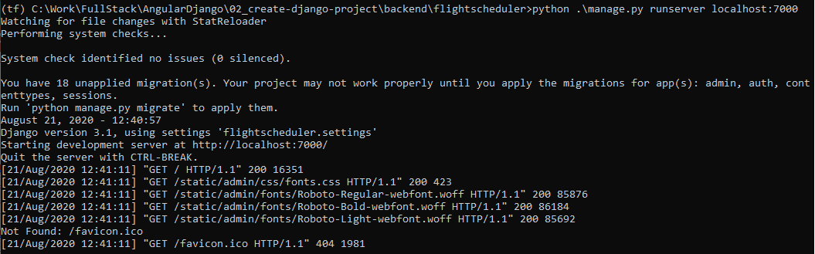
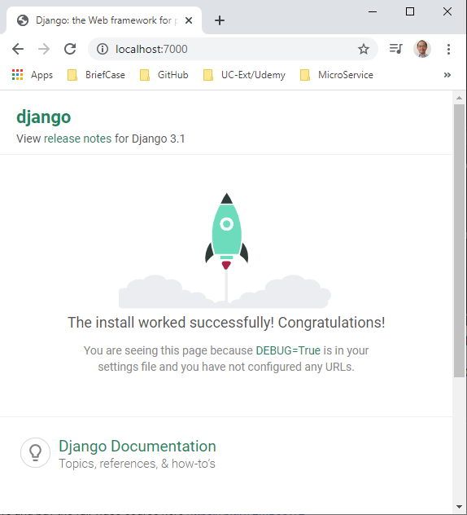
2.3 Run Django Project
https://www.youtube.com/watch?v=0t_o6bTIKRk&list=PLTgRMOcmRb3Oxj1oKJYsW2-JjRjtlFvoQ&index=2
Run Django Project
(tf) ..\backend\flighscheduler > python .\manage.py runserver localhost:7000
Open chrome
> localhost:7000

Slide 24
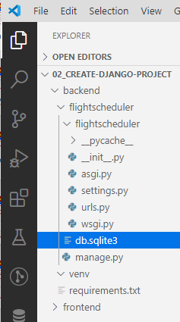
2.3 Run Django Project
https://www.youtube.com/watch?v=0t_o6bTIKRk&list=PLTgRMOcmRb3Oxj1oKJYsW2-JjRjtlFvoQ&index=2
Run Django Project
After run, we will see the database name “db.sqlite3” I the fightscheduler folder.

Slide 25
2.4 Aanaconda3 Environment

Slide 26
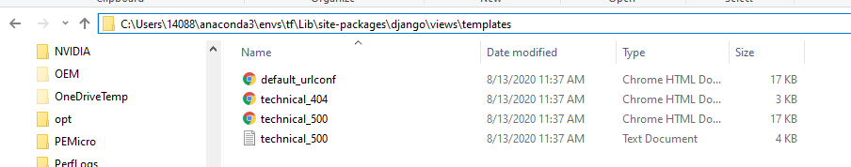
2.4 Aanaconda3 Environment
https://www.youtube.com/watch?v=0t_o6bTIKRk&list=PLTgRMOcmRb3Oxj1oKJYsW2-JjRjtlFvoQ&index=2
Anaconda3 Environment
Under C:\Users\<your-name>\anaconda3\envs\<your-environment>
for example, in my case, my user name is “14088” and environment is “tf”,
(tf) C:\Users\14088\anaconda3\envs\tf\Lib\site-packages\django\views\templates

Slide 27
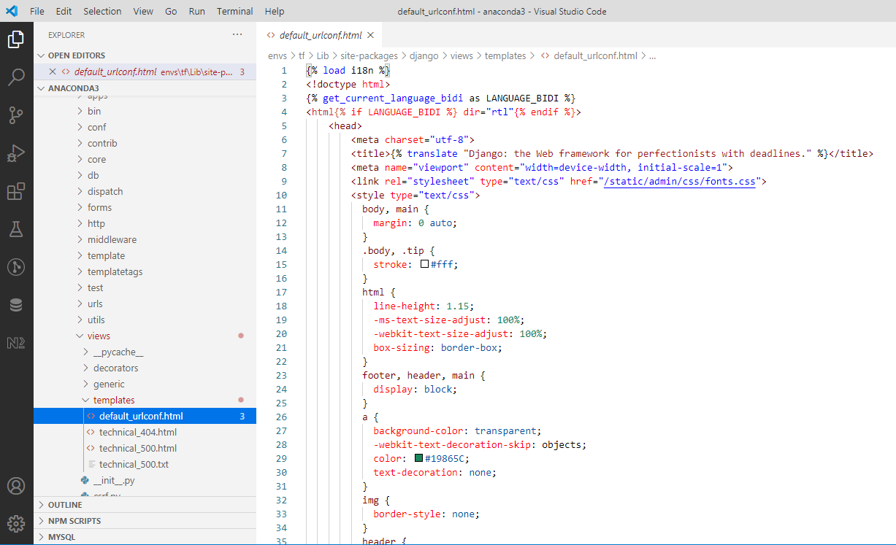
2.4 Aanaconda3 Environment
https://www.youtube.com/watch?v=0t_o6bTIKRk&list=PLTgRMOcmRb3Oxj1oKJYsW2-JjRjtlFvoQ&index=2
Anaconda3 Environment
The file envs\tf\Lib\site-packages\django\views\templates\default_urlconf.html is the file for url configuration.
This is the file that generates the view you see in the web browser.
This is a default template you see out there.
So this the content what Django load now.

Slide 28
2.5 Alternate Port Number

Slide 29
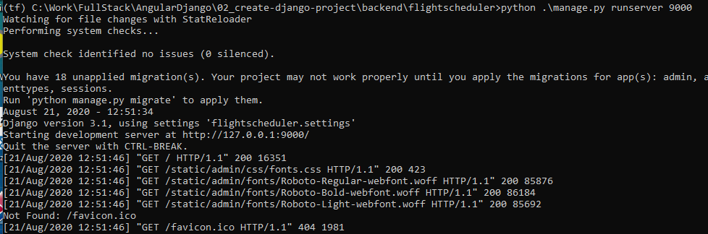
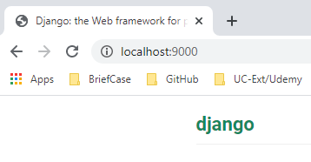
2.5 Alternate Port Number
https://www.youtube.com/watch?v=0t_o6bTIKRk&list=PLTgRMOcmRb3Oxj1oKJYsW2-JjRjtlFvoQ&index=2
Alternate Port Number
Next, we can use other port number, such as, port 9000
> python .\manage.py runserver 9000
This 9000 is on command line is temporary.

Slide 30
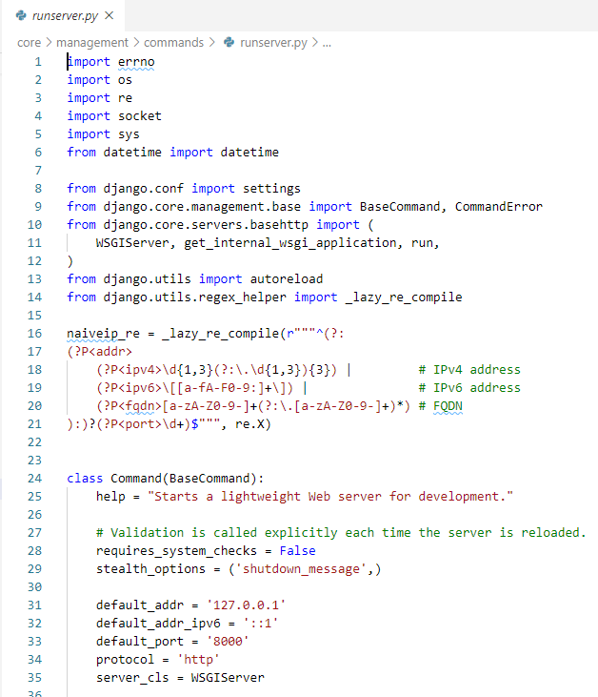
2.5 Alternate Port Number
https://www.youtube.com/watch?v=0t_o6bTIKRk&list=PLTgRMOcmRb3Oxj1oKJYsW2-JjRjtlFvoQ&index=2
Alternate Port Number
If we want the permanent change the port number, we can go to
(tf) C:\Users\14088\anaconda3\envs\tf\Lib\site-packages\django\core\management\commands\runserver.py
Here, we can change the default_port =“8000’
To whatever you want, e.g., 9000.
This is not recommended. We should leave port number 8000 there.
We can use command line to temporary change to 9000 if we want to change the port number.
We also can use manage.py to change to port number.

Slide 31
2.6 Change Port Number

Slide 32
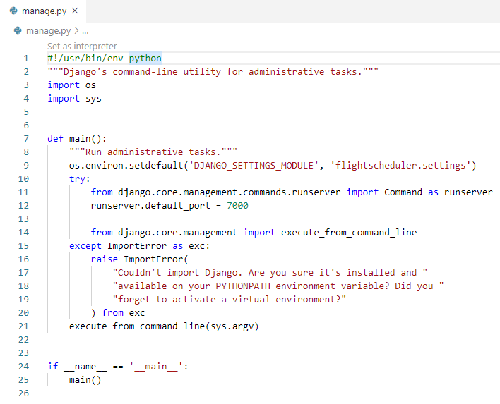
2.6 Change Port Number
https://www.youtube.com/watch?v=0t_o6bTIKRk&list=PLTgRMOcmRb3Oxj1oKJYsW2-JjRjtlFvoQ&index=2
Change Port Number
The permanent way to change port number is to change in the manage.py as below.

Slide 33
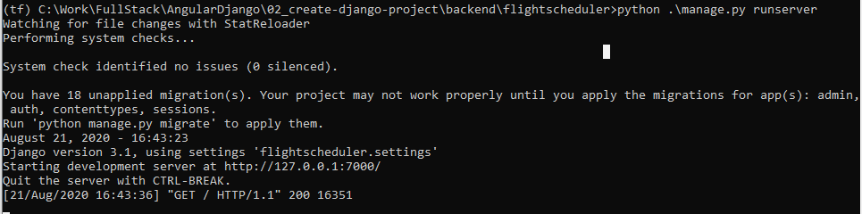
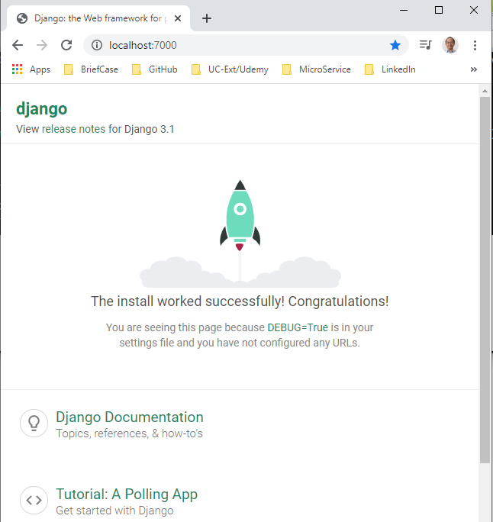
2.6 Change Port Number
https://www.youtube.com/watch?v=0t_o6bTIKRk&list=PLTgRMOcmRb3Oxj1oKJYsW2-JjRjtlFvoQ&index=2
Change Port Number
> python .\manage.py runserver

Slide 34
2.7 Keep Default Port Number

Slide 35
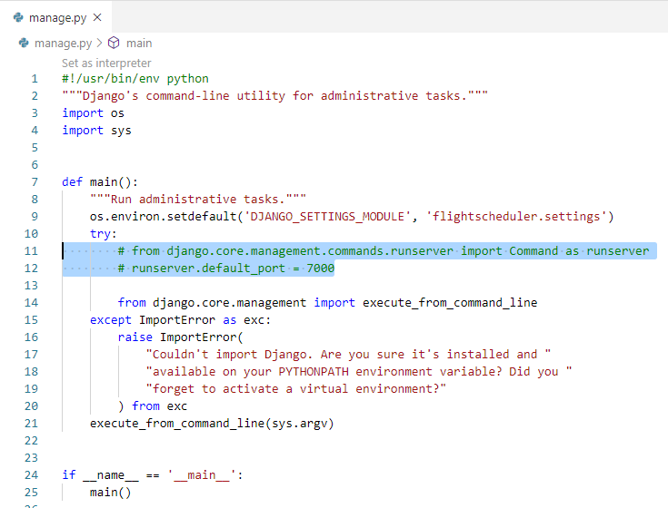
2.7 Keep Default Port Number
https://www.youtube.com/watch?v=0t_o6bTIKRk&list=PLTgRMOcmRb3Oxj1oKJYsW2-JjRjtlFvoQ&index=2
Change Port Number
We comment out the change port number and keep the default.

Slide 36
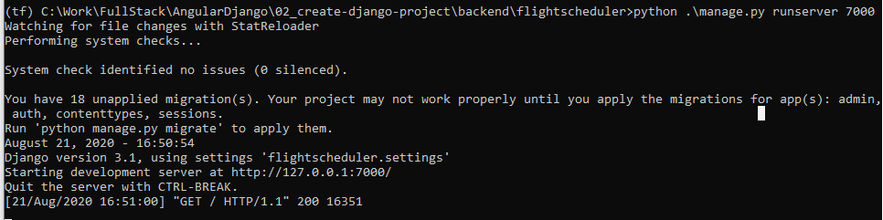
2.6 Change Port Number
https://www.youtube.com/watch?v=0t_o6bTIKRk&list=PLTgRMOcmRb3Oxj1oKJYsW2-JjRjtlFvoQ&index=2
Change Port Number
> python .\manage.py runserver 7000

Slide 37
End of Chapter

