Slide 1

3 Database
Peter H. Chen

Slide 2
3 Database
https://www.youtube.com/watch?v=cVJXLzZc8L4&list=PLTgRMOcmRb3Oxj1oKJYsW2-JjRjtlFvoQ&index=3
Working with Database
Select a database system
Create Data Models
Create a Serializer Class for serialize data
Load Data into the database
Create Views and APIs
Add Cross-Origin Resource Sharing (CORS) headers to allow access to API.
We see database table, DDL, Query schema by the following:
1. Install and Use command based SQLite utility (dbsghell, sqlite3, sqldiff)
2. Install and use SQLiteStudio for GUI based

Slide 3
3.1 Select a Database System

Slide 4
3.1 Select a Database System
https://www.youtube.com/watch?v=cVJXLzZc8L4&list=PLTgRMOcmRb3Oxj1oKJYsW2-JjRjtlFvoQ&index=3
Select a Database System
Django engines support the following database system without install any additional drivers.
SQLite3
postgreSQL
MySQL
Oracle
For other database system, we can get the instructions from the Django official web site.
Django creates a SQLite for our application by default configuration.
SQLite is also included in Python. We will use SQLite3 for our application.
We test database connection using dbshell command utility. We have to test our database through the dbshell command.
Use SQLite studio for managing SQL database.
Download from: https://sqlitestudio.pl

Slide 5
3.2 Install SQLite Utitlity

Slide 6
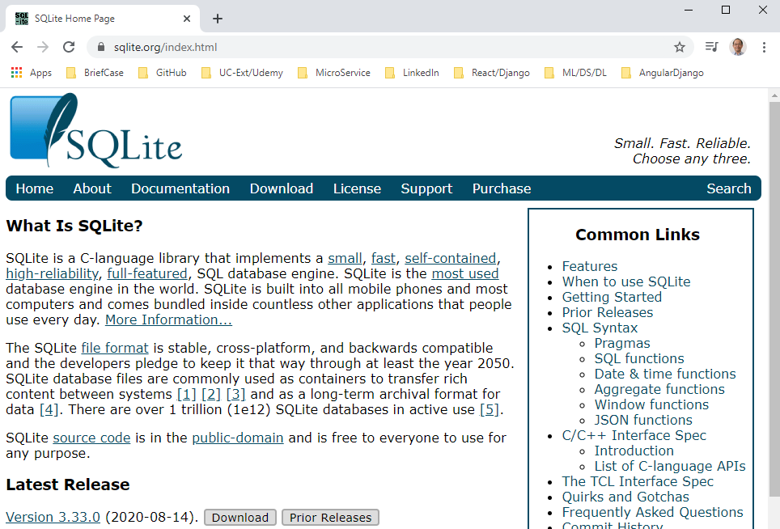
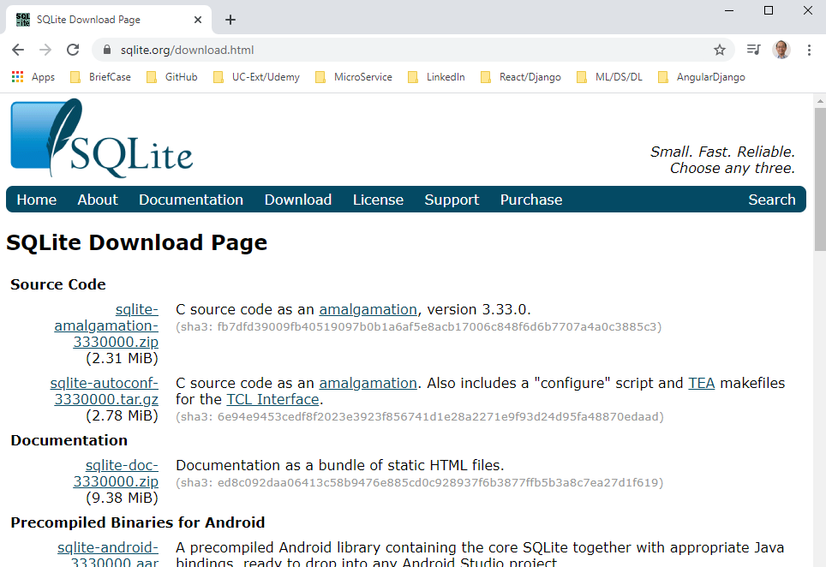
3.2 Install SQLite Utitlity
https://www.youtube.com/watch?v=cVJXLzZc8L4&list=PLTgRMOcmRb3Oxj1oKJYsW2-JjRjtlFvoQ&index=3
Select a Database System
Download utility file: https:www.sqlite.org

Slide 7
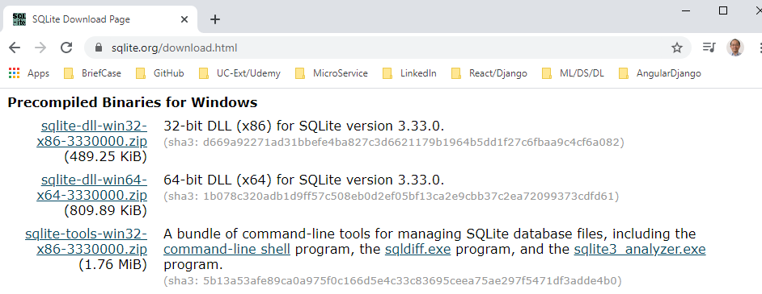
3.2 Install SQLite Utitlity
https://www.youtube.com/watch?v=cVJXLzZc8L4&list=PLTgRMOcmRb3Oxj1oKJYsW2-JjRjtlFvoQ&index=3
Select a Database System
Download sqlite-tools-win32-x86-333000.zip which includes command-line shell, sqldiff.exe, and sqlite3_analyzer.exe. These are for command shell, SQL diff, and SQL lite analyzer.
Put them to whatever we can access.

Slide 8
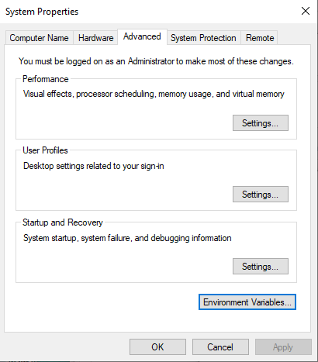
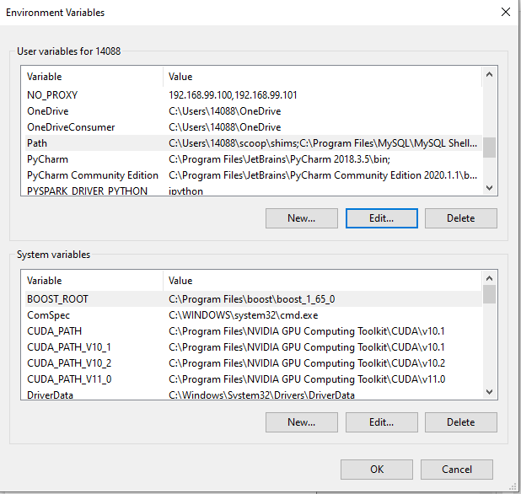
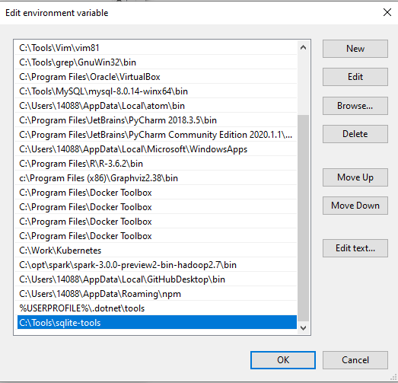
3.2 Install SQLite Utitlity
https://www.youtube.com/watch?v=cVJXLzZc8L4&list=PLTgRMOcmRb3Oxj1oKJYsW2-JjRjtlFvoQ&index=3
Select a Database System
Put the SQLite utility under path “C:\Tools\sqlite-tools”

Slide 9
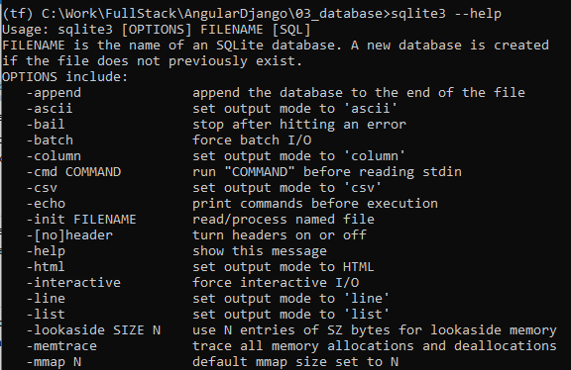
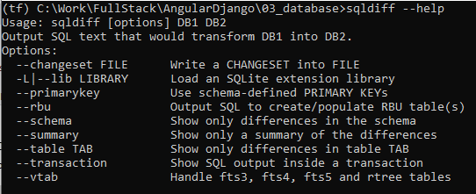
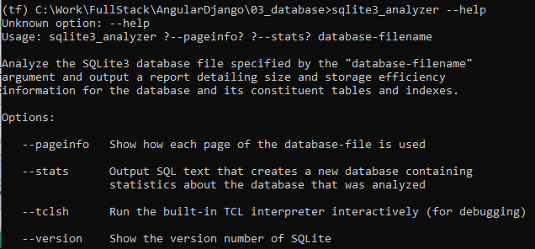
3.2 Install SQLite Utitlity
https://www.youtube.com/watch?v=cVJXLzZc8L4&list=PLTgRMOcmRb3Oxj1oKJYsW2-JjRjtlFvoQ&index=3
Select a Database System
Check sqlite3, sqldiff, and sqlite3_analyzer.
> sqlite3 –help
> sqldiff –help
> sqlite3_analyzer --help

Slide 10
3.3 Install SQLite Studio

Slide 11
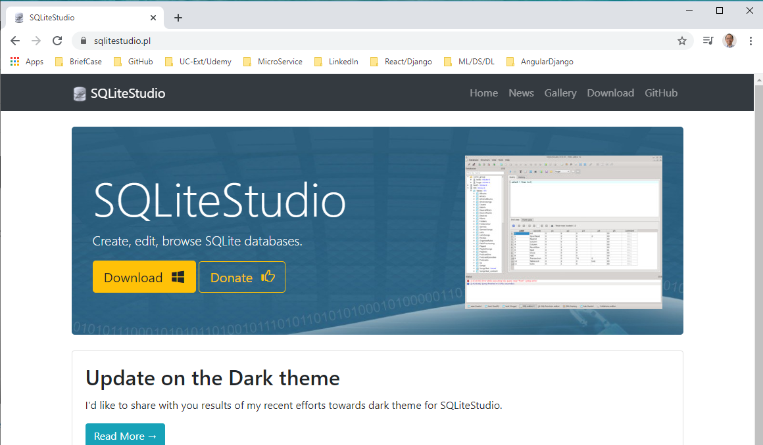
3.3 Install SQLite Studio
https://www.youtube.com/watch?v=cVJXLzZc8L4&list=PLTgRMOcmRb3Oxj1oKJYsW2-JjRjtlFvoQ&index=3
Select a Database System
Download from: https://sqlitestudio.pl

Slide 12
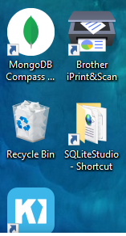
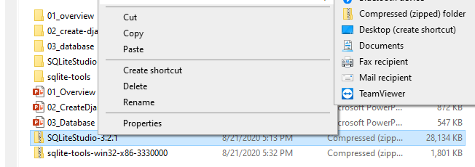
3.3 Install SQLite Studio
https://www.youtube.com/watch?v=cVJXLzZc8L4&list=PLTgRMOcmRb3Oxj1oKJYsW2-JjRjtlFvoQ&index=3
Select a Database System
Next is to install SQLite studio. This allows you to manage the database.
Download it and send to the desktop.

Slide 13
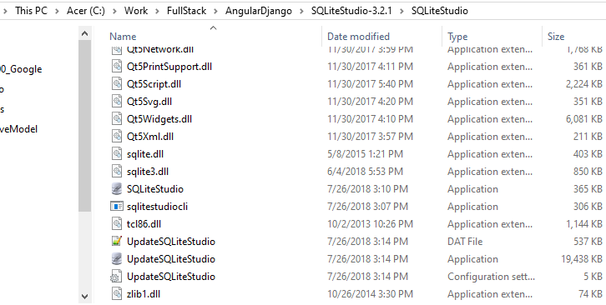
3.3 Install SQLite Studio
https://www.youtube.com/watch?v=cVJXLzZc8L4&list=PLTgRMOcmRb3Oxj1oKJYsW2-JjRjtlFvoQ&index=3
Select a Database System
Double click SQLiteStudio –Shortuct.

Slide 14
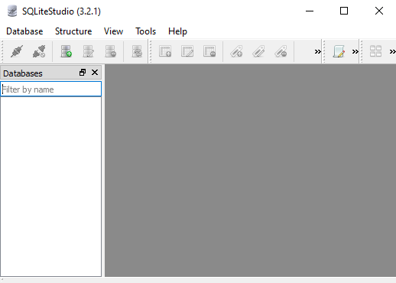
3.3 Install SQLite Studio
https://www.youtube.com/watch?v=cVJXLzZc8L4&list=PLTgRMOcmRb3Oxj1oKJYsW2-JjRjtlFvoQ&index=3
Select a Database System
Double click SQLiteStdio to start

Slide 15
3.4 Database Configuration

Slide 16
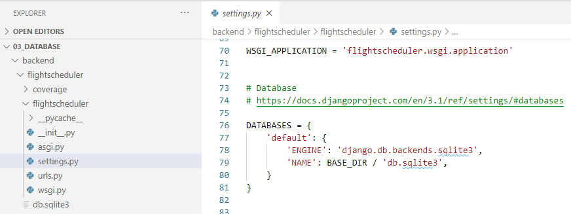
3.4 Database Configuration
https://www.youtube.com/watch?v=cVJXLzZc8L4&list=PLTgRMOcmRb3Oxj1oKJYsW2-JjRjtlFvoQ&index=3
Database Configuration
Back to VS code: settings.py
DATABASES defines engine and database location (BASE_DIR/db.sqlie3).

Slide 17
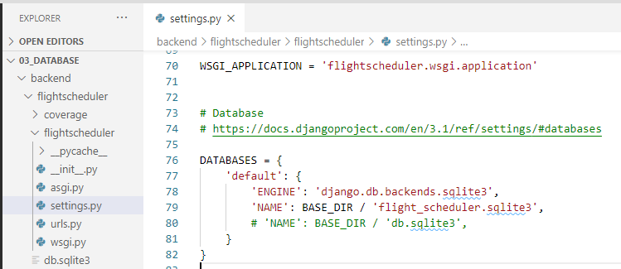
3.4 Database Configuration
https://www.youtube.com/watch?v=cVJXLzZc8L4&list=PLTgRMOcmRb3Oxj1oKJYsW2-JjRjtlFvoQ&index=3
Database Configuration
Change Database name from “db.sqlite3” into “flight_scheduler.sqlite3”.
When we perform migration, the ‘flight_scheduler.sqlite3” will be generated.

Slide 18
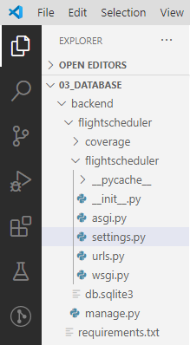
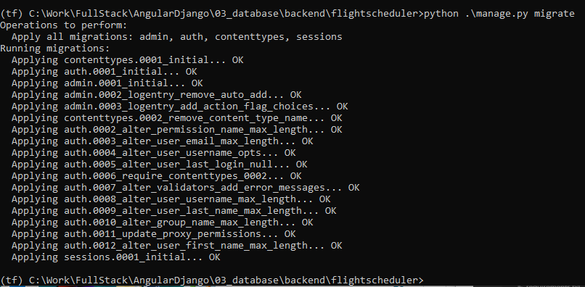
3.4 Database Configuration
https://www.youtube.com/watch?v=cVJXLzZc8L4&list=PLTgRMOcmRb3Oxj1oKJYsW2-JjRjtlFvoQ&index=3
Database Configuration
The database is not here yet. We are going to create with migration.
In flighschulder folder
> python .\manage.py migrate

Slide 19
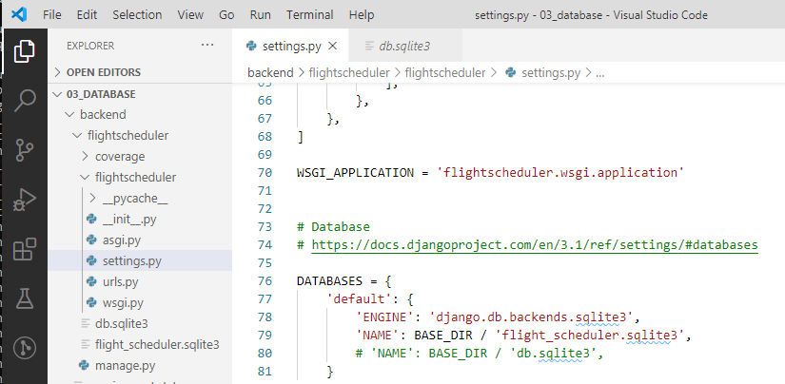
3.4 Database Configuration
https://www.youtube.com/watch?v=cVJXLzZc8L4&list=PLTgRMOcmRb3Oxj1oKJYsW2-JjRjtlFvoQ&index=3
Database Configuration
> python .\manage.py migrate
After migration, we have the new database ‘flight-scheduler.sqlite3’.

Slide 20
3.5 Database Utility

Slide 21
3.5 Database Utility
https://www.youtube.com/watch?v=cVJXLzZc8L4&list=PLTgRMOcmRb3Oxj1oKJYsW2-JjRjtlFvoQ&index=3
Database Utility
We will use sqlite3 utility (dbshell and sqlite3) to see the content of sqlite3 database.
> pyhton .\manage.py dbshell
The dbshell utility is similar to MySQL Monitor.

Slide 22
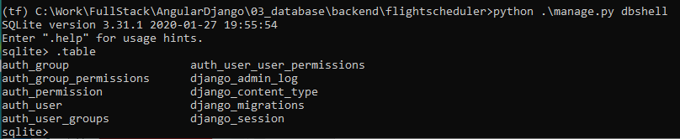
3.5 Database Utility
https://www.youtube.com/watch?v=cVJXLzZc8L4&list=PLTgRMOcmRb3Oxj1oKJYsW2-JjRjtlFvoQ&index=3
Database Utility
Table command
> .table
You can see entire schema table.

Slide 23
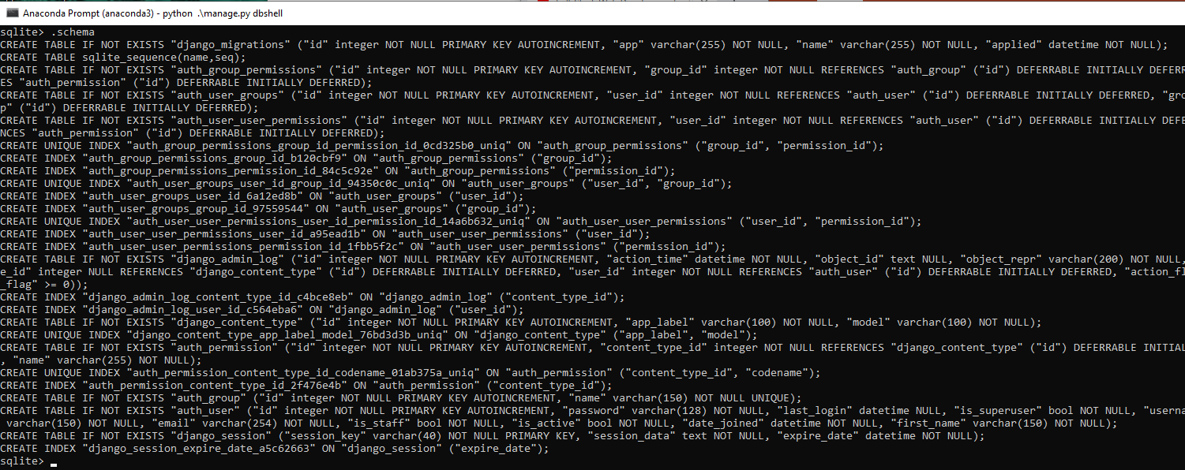
3.5 Database Utility
https://www.youtube.com/watch?v=cVJXLzZc8L4&list=PLTgRMOcmRb3Oxj1oKJYsW2-JjRjtlFvoQ&index=3
Database Utility
Schema command
> .schema
You can see entire schema.
These are all the SQL commands to create all the tables.

Slide 24
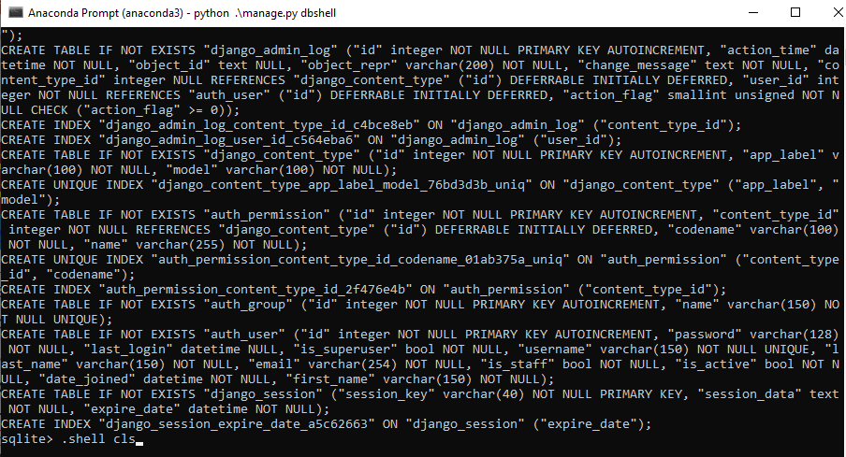

3.5 Database Utility
https://www.youtube.com/watch?v=cVJXLzZc8L4&list=PLTgRMOcmRb3Oxj1oKJYsW2-JjRjtlFvoQ&index=3
Database Utility
Clear command
> .shell cls

Slide 25
3.5 Database Utility
https://www.youtube.com/watch?v=cVJXLzZc8L4&list=PLTgRMOcmRb3Oxj1oKJYsW2-JjRjtlFvoQ&index=3
Database Utility
Schama <Table-name>
> .schema auth_user
You can see the schema table “auth_user”
This is the actual schema that create the table “auth_user”.

Slide 26
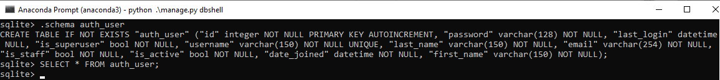
3.5 Database Utility
https://www.youtube.com/watch?v=cVJXLzZc8L4&list=PLTgRMOcmRb3Oxj1oKJYsW2-JjRjtlFvoQ&index=3
Database Utility
SQL Command to read data
> SELECT * FROM auth_user;
There is nothing there in the table “auth_user”
We will see more when we create the database.

Slide 27
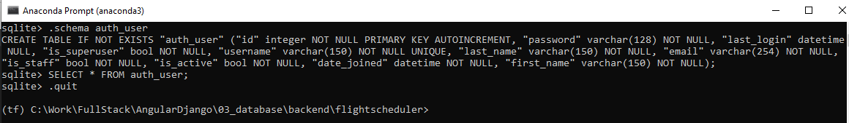
3.5 Database Utility
https://www.youtube.com/watch?v=cVJXLzZc8L4&list=PLTgRMOcmRb3Oxj1oKJYsW2-JjRjtlFvoQ&index=3
Database Utility
Quit Command
> .quit

Slide 28
3.6 Database SQLiteStudio

Slide 29
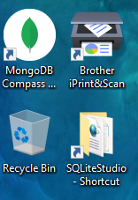
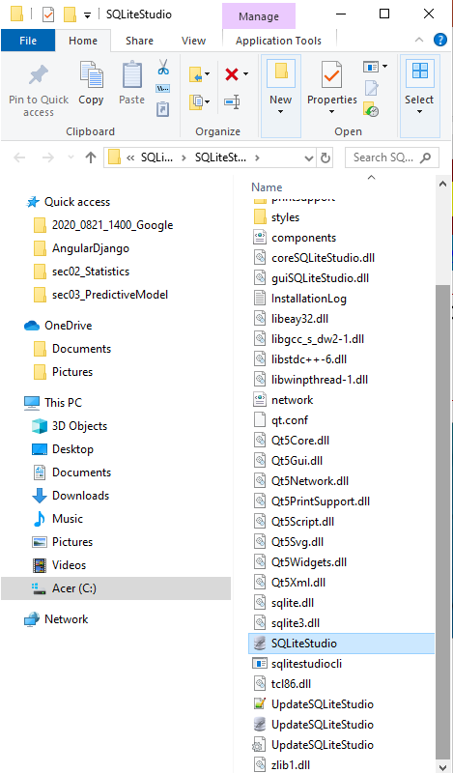
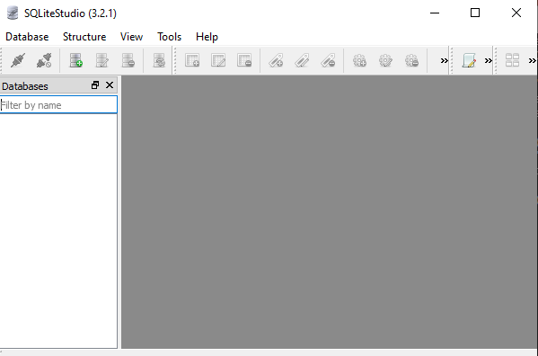
3.6 Database SQLiteStudio
https://www.youtube.com/watch?v=cVJXLzZc8L4&list=PLTgRMOcmRb3Oxj1oKJYsW2-JjRjtlFvoQ&index=3
Database SQLiteStudio
Start the SQLiteStudio

Slide 30
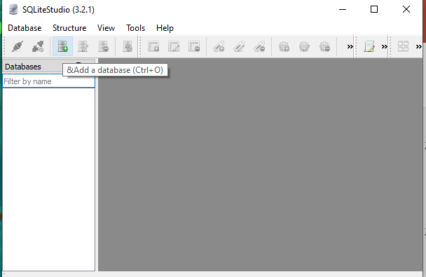
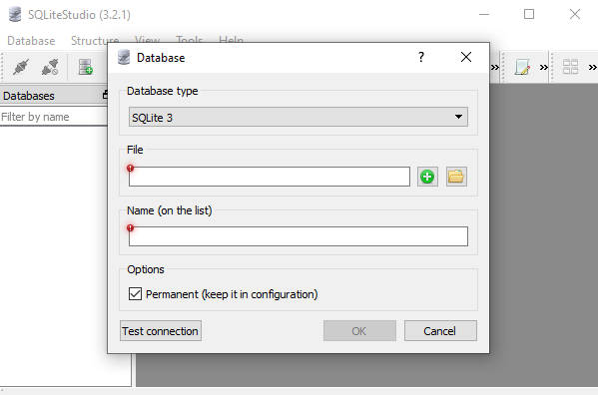
3.6 Database SQLiteStudio
https://www.youtube.com/watch?v=cVJXLzZc8L4&list=PLTgRMOcmRb3Oxj1oKJYsW2-JjRjtlFvoQ&index=3
Database SQLiteStudio
Click “Add a database”

Slide 31
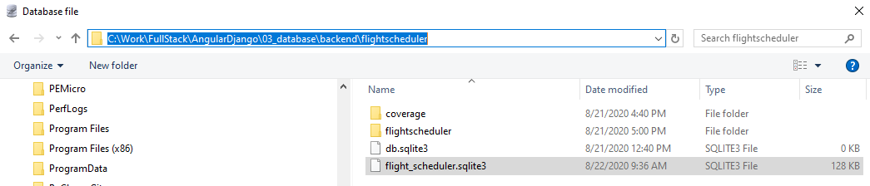
3.6 Database SQLiteStudio
https://www.youtube.com/watch?v=cVJXLzZc8L4&list=PLTgRMOcmRb3Oxj1oKJYsW2-JjRjtlFvoQ&index=3
Database SQLiteStudio
We need to find where is the project:
1. Select “SQLite3”
2. Browse the path of project location of “flightschedule”.
1
2

Slide 32
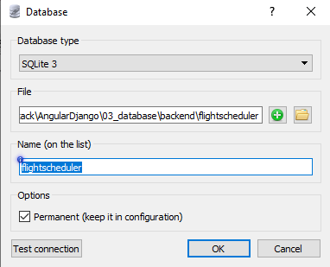
3.6 Database SQLiteStudio
https://www.youtube.com/watch?v=cVJXLzZc8L4&list=PLTgRMOcmRb3Oxj1oKJYsW2-JjRjtlFvoQ&index=3
Database SQLiteStudio
Copy the project location: “C:\Work\FullStack\AngularDjango\03_database\backend\flightscheduler”
and Name “flightscheduler” is automatically filled.

Slide 33
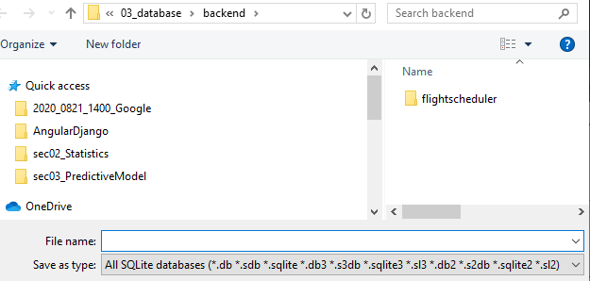
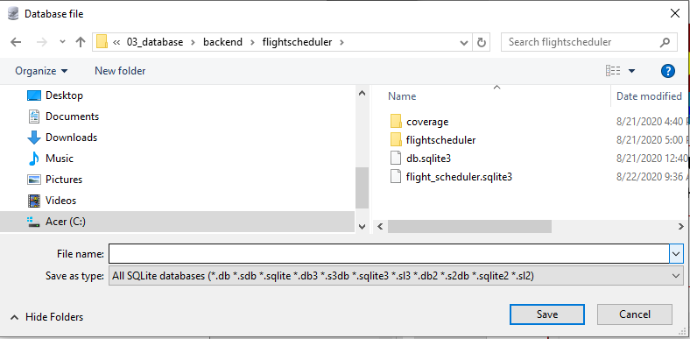
3.6 Database SQLiteStudio
https://www.youtube.com/watch?v=cVJXLzZc8L4&list=PLTgRMOcmRb3Oxj1oKJYsW2-JjRjtlFvoQ&index=3
Database SQLiteStudio
We need to fill the correct information for File and Name. To do that:
1. We can click “+” to see where is it.
2. Double click the project “flightscheduler” to see the database inside the project.

Slide 34
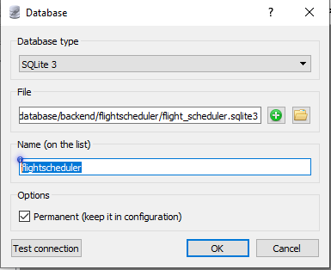
3.6 Database SQLiteStudio
https://www.youtube.com/watch?v=cVJXLzZc8L4&list=PLTgRMOcmRb3Oxj1oKJYsW2-JjRjtlFvoQ&index=3
Database SQLiteStudio
Database File: C:\Work\FullStack\AngularDjango\03_database\backend\flightscheduler\flight_scheduler.sqlite3
Project Name: flightscheduler

Slide 35
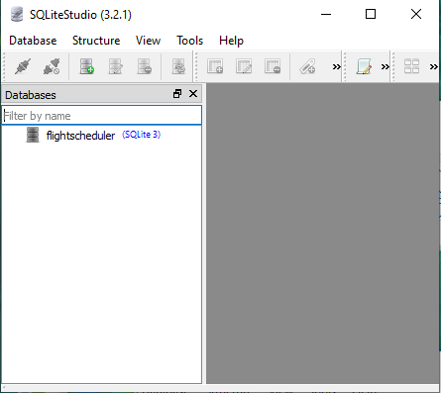
3.6 Database SQLiteStudio
https://www.youtube.com/watch?v=cVJXLzZc8L4&list=PLTgRMOcmRb3Oxj1oKJYsW2-JjRjtlFvoQ&index=3
Database SQLiteStudio
Database: Fightscheduler (SQlite3)

Slide 36
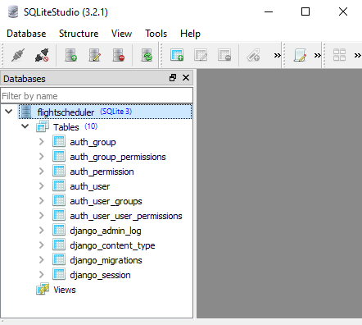
3.6 Database SQLiteStudio
https://www.youtube.com/watch?v=cVJXLzZc8L4&list=PLTgRMOcmRb3Oxj1oKJYsW2-JjRjtlFvoQ&index=3
Database SQLiteStudio
Double click “Fightscheduler (SQlite3)” to expand the database tables.

Slide 37
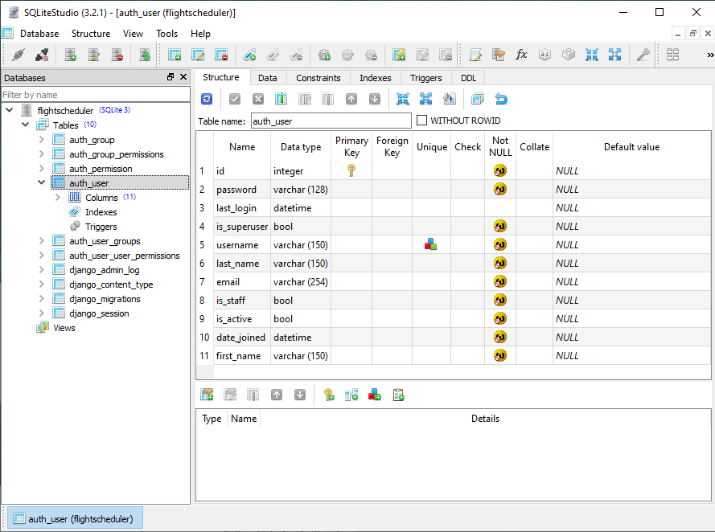
3.6 Database SQLiteStudio
https://www.youtube.com/watch?v=cVJXLzZc8L4&list=PLTgRMOcmRb3Oxj1oKJYsW2-JjRjtlFvoQ&index=3
Database SQLiteStudio
We double the “auth_user”. We can see the columns and row structure in this table.

Slide 38
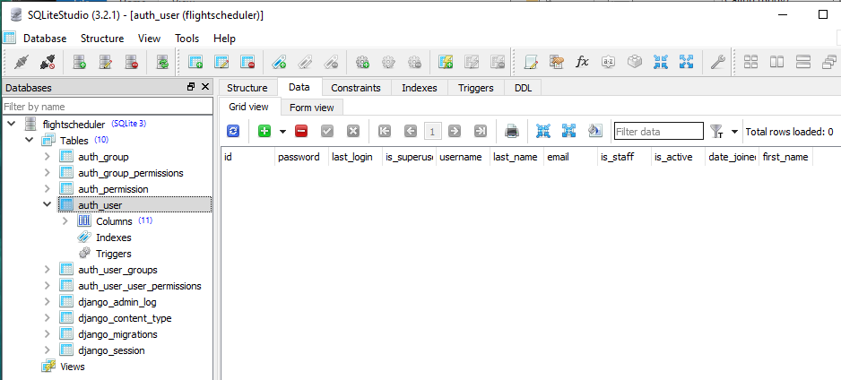
3.6 Database SQLiteStudio
https://www.youtube.com/watch?v=cVJXLzZc8L4&list=PLTgRMOcmRb3Oxj1oKJYsW2-JjRjtlFvoQ&index=3
Database SQLiteStudio
Click other Data Tab. We can see the defined attribute inside.

Slide 39
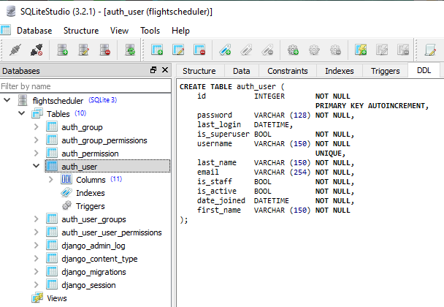
3.6 Database SQLiteStudio
https://www.youtube.com/watch?v=cVJXLzZc8L4&list=PLTgRMOcmRb3Oxj1oKJYsW2-JjRjtlFvoQ&index=3
Database SQLiteStudio
Click other DDL Tab. We can see the DDL schema inside.

Slide 40
3.7 Database Query

Slide 41
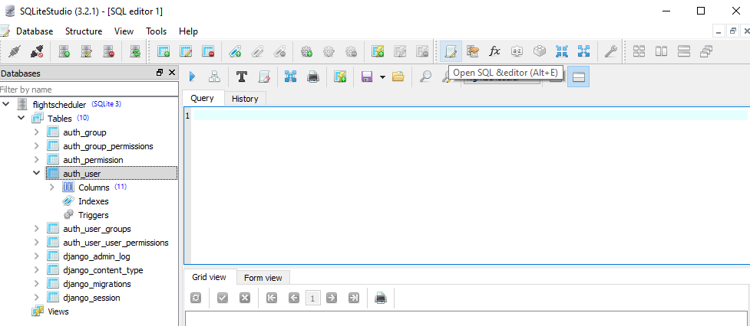
3.7 Database Query
https://www.youtube.com/watch?v=cVJXLzZc8L4&list=PLTgRMOcmRb3Oxj1oKJYsW2-JjRjtlFvoQ&index=3
Database Query
To Create a Query, click “Open SQL editor (Alt+E)”. This is similar to any other SQL Server.

Slide 42
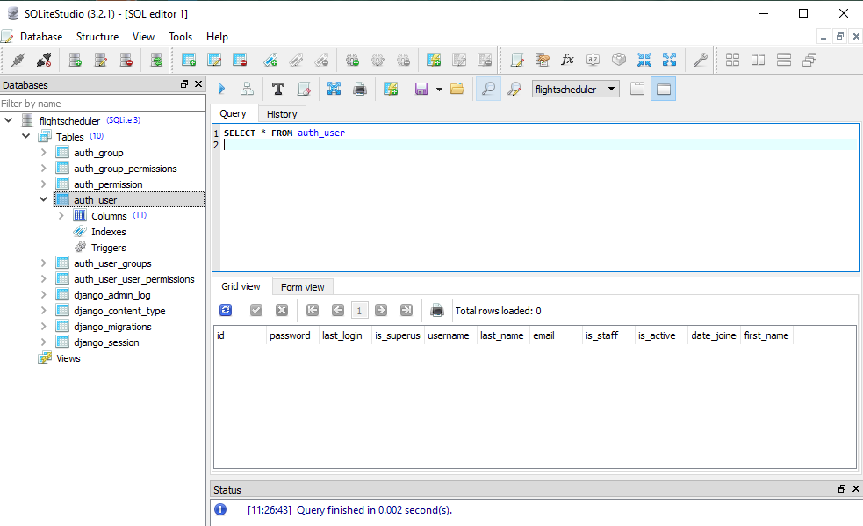
3.7 Database Query
https://www.youtube.com/watch?v=cVJXLzZc8L4&list=PLTgRMOcmRb3Oxj1oKJYsW2-JjRjtlFvoQ&index=3
Database Query
1. Type
> SELECT * FROM auth_user
2. Click “>”
3. Query result
2
We cannot see anything here because the default database created is empty.
1
3

Slide 43
3.7 Database Query
https://www.youtube.com/watch?v=cVJXLzZc8L4&list=PLTgRMOcmRb3Oxj1oKJYsW2-JjRjtlFvoQ&index=3
Database Query
SQLiteStudio is a very handy tool for Database.
If you are comfortable with GUI based, you can use SQLiteStudio, otherwise, you can use command based SQL utilities (SQLite3, dbshell, sqldiff) instead.

Slide 44
End of Chapter

