Slide 1

64 Routing
Peter H. Chen

Slide 2
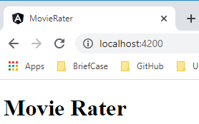
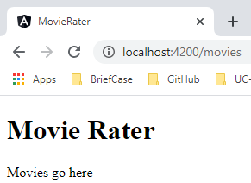
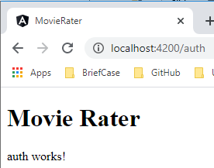
64 Routing
https://www.udemy.com/course/full-stack-development-web-app-mobile-app-back-end-api/learn/lecture/15139330#overview
Routing
How to make the router between three different components (root, movies, and auth component)?

Slide 3
64.1 App Component

Slide 4
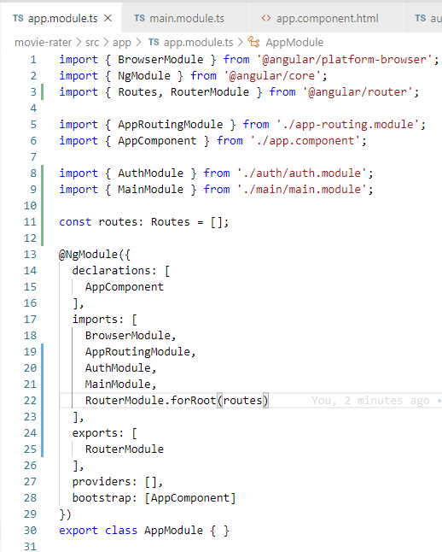
64.1 App Component
https://www.udemy.com/course/full-stack-development-web-app-mobile-app-back-end-api/learn/lecture/15139330#overview
App.moduels.ts
> import { Routes, RouterModule } from ‘@angular/router’
> const routes: Routes = [];
> imports: [ …,
> RouterModule.forRoot(routes)
>],
> exports: [
> RouterModule
>]

Slide 5
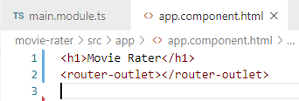
64.1 App Component
https://www.udemy.com/course/full-stack-development-web-app-mobile-app-back-end-api/learn/lecture/15139330#overview
App.moduels.html
> <router-outlet></router-outlet>

Slide 6
64.2 Auth Component

Slide 7
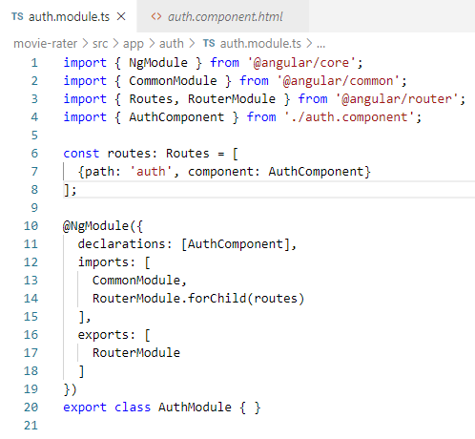
64.2 Auth Component
https://www.udemy.com/course/full-stack-development-web-app-mobile-app-back-end-api/learn/lecture/15139330#overview
auth.moduels.ts
> import { Routes, RouterModule } from ‘@angular/router’
> const routes: Routes = [
> { path: ‘auth’,
> component: AuthComponet
> ];
> imports: [ …,
> RouterModule.forChild(routes)
>],
> exports: [
> RouterModule
>]

Slide 8

64.2 Auth Component
https://www.udemy.com/course/full-stack-development-web-app-mobile-app-back-end-api/learn/lecture/15139330#overview
auth.component.html

Slide 9
64.3 Main Component

Slide 10
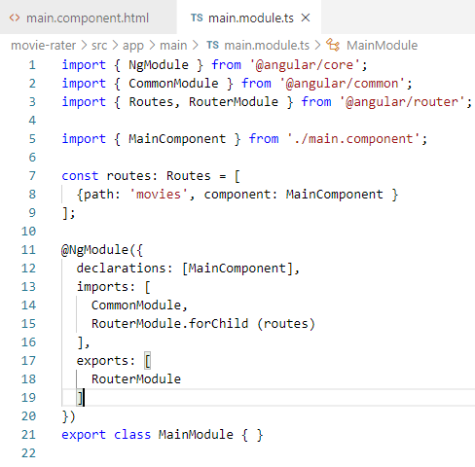
64.3 Main Component
https://www.udemy.com/course/full-stack-development-web-app-mobile-app-back-end-api/learn/lecture/15139330#overview
main.moduels.ts
> import { Routes, RouterModule } from ‘@angular/router’
> const routes: Routes = [
> { path: ‘movies’,
> component: MainComponet
> ];
> imports: [ …,
> RouterModule.forChild(routes)
>],
> exports: [
> RouterModule
>]

Slide 11
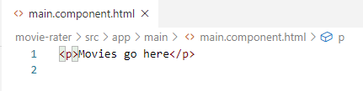
64.3 Main Component
https://www.udemy.com/course/full-stack-development-web-app-mobile-app-back-end-api/learn/lecture/15139330#overview
main.component.html

Slide 12
64.4 Verify

Slide 13
64.4 Verify
https://www.udemy.com/course/full-stack-development-web-app-mobile-app-back-end-api/learn/lecture/15139330#overview
Verify
> ng server --open
Open Chrome
> localhost:4200
> localhost:4200/movies
> localhost:4200/auth

Slide 14
64.5 Summary

Slide 15
64.5 Sumamry
https://www.udemy.com/course/full-stack-development-web-app-mobile-app-back-end-api/learn/lecture/15139330#overview
Summary
We route different components: root, movies, and auth

Slide 16
End of Chapter

