Slide 1

63 New Project
Peter H. Chen

Slide 2
63 New Project
https://www.udemy.com/course/full-stack-development-web-app-mobile-app-back-end-api/learn/lecture/15136572#overview
Frontend Web App
We create a new Frontend Web App.
Our application is a movie rater
> cd 063_new-proj
> ng new movie-rater

Slide 3
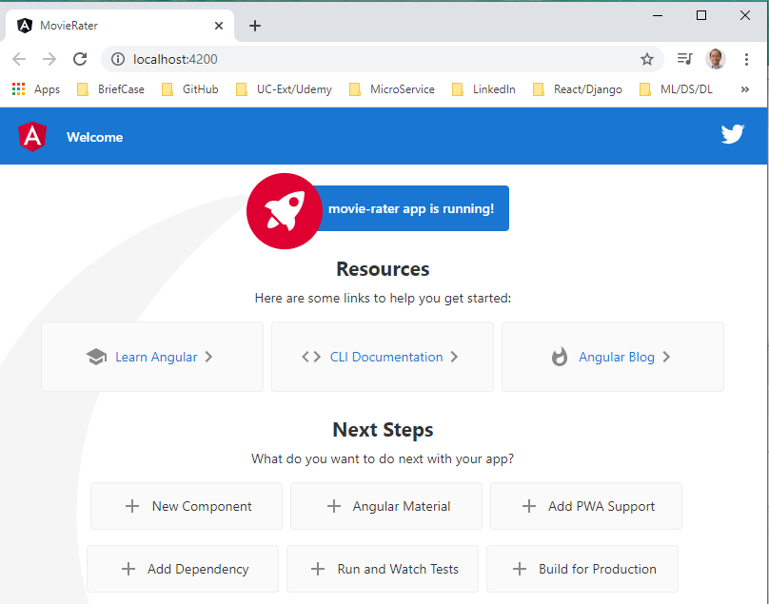
63 New Project
https://www.udemy.com/course/full-stack-development-web-app-mobile-app-back-end-api/learn/lecture/15136572#overview
Frontend Web App
Open Chrome
> ng serve --open

Slide 4
63.1 App

Slide 5

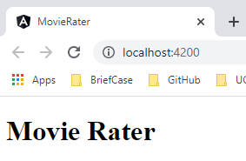
63.1 App
https://www.udemy.com/course/full-stack-development-web-app-mobile-app-back-end-api/learn/lecture/15136572#overview
App.component.html

Slide 6
63.2 Create Modules: auth and main

Slide 7
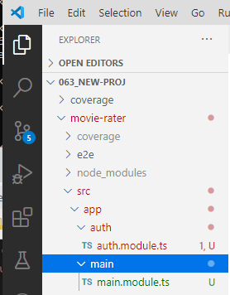
63.2 Create Modules: auth and main
https://www.udemy.com/course/full-stack-development-web-app-mobile-app-back-end-api/learn/lecture/15136572#overview
App
(tf)\..\movie-rater> ng generate module auth
(tf)\..\movie-rater> ng generate module main

Slide 8
63.3 Component main in Module main

Slide 9
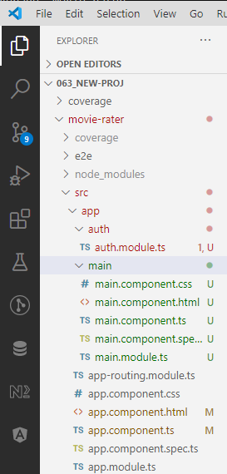
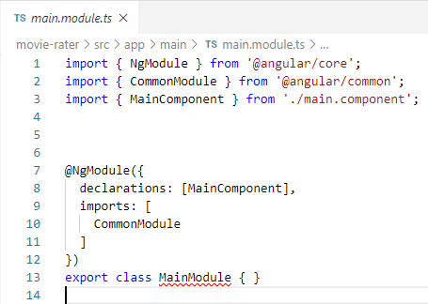
63.3 Component main in Module main
https://www.udemy.com/course/full-stack-development-web-app-mobile-app-back-end-api/learn/lecture/15136572#overview
Create Component main in Module main
(tf)\..\movie-rater> ng generate main --module=main
The MainComponent automatically added to main.modules.ts

Slide 10
63.4 Module main under Module App

Slide 11
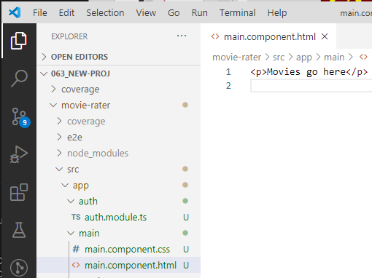
63.4 Module main under Module App
https://www.udemy.com/course/full-stack-development-web-app-mobile-app-back-end-api/learn/lecture/15136572#overview
Attached Module main under Module App
> main.component.html
> <p>Movies go here </h1>

Slide 12
63.5 Component auth under Module auth

Slide 13
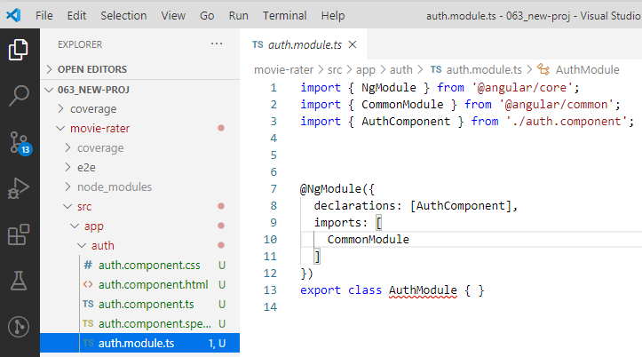
63.5 Component auth under Module auth
https://www.udemy.com/course/full-stack-development-web-app-mobile-app-back-end-api/learn/lecture/15136572#overview
Component auth under Module auth
> ng generate component auth --module=auth

Slide 14
63.6 Add auth and main under App

Slide 15
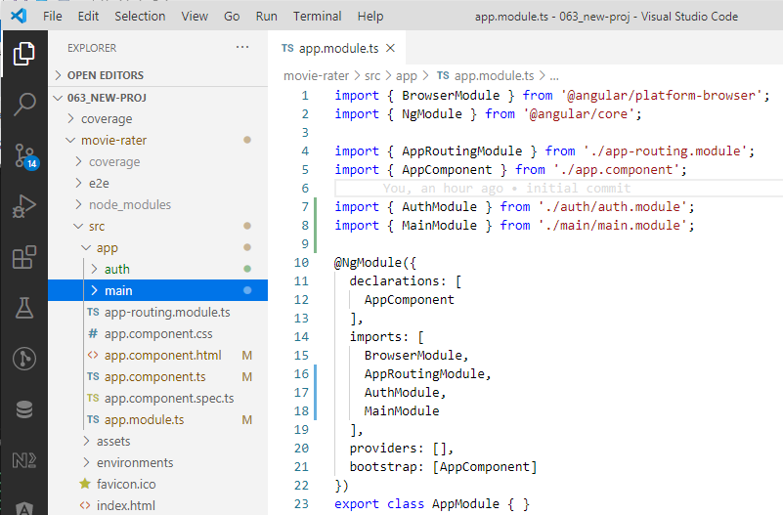
63.6 Add auth and main under App
https://www.udemy.com/course/full-stack-development-web-app-mobile-app-back-end-api/learn/lecture/15136572#overview
Add Components auth and main under Component App

Slide 16
63.7 Verify

Slide 17
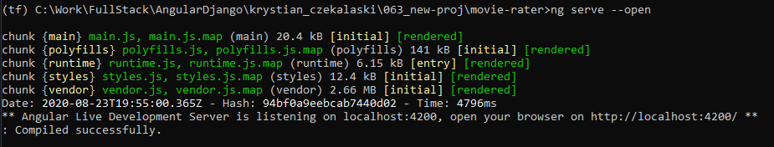
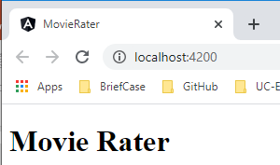
63.6 Verify
https://www.udemy.com/course/full-stack-development-web-app-mobile-app-back-end-api/learn/lecture/15136572#overview
Verify
> ng server --open

Slide 18
End of Chapter

