Slide 1

5 Create Admin User
Peter H. Chen

Slide 2
5 Create Admin User
https://www.youtube.com/watch?v=dwzj5uPYKpM&list=PLTgRMOcmRb3Oxj1oKJYsW2-JjRjtlFvoQ&index=5
Create Admin User
Register data models with admin.
Perform CRUD operations via the admin interface.

Slide 3
5.1 Create Django Admin Interface

Slide 4
5.1 Create Django Admin Interface
https://www.youtube.com/watch?v=dwzj5uPYKpM&list=PLTgRMOcmRb3Oxj1oKJYsW2-JjRjtlFvoQ&index=5
Create Django Admin Interface
We need to create a super user.
Admin interface is enabled by default: When we create a project, we can verify to make sure that these requirements are added to the installed app settings and the settings.py file.

Slide 5
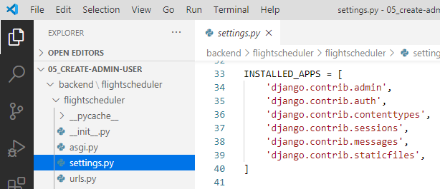
5.1 Create Django Admin Interface
https://www.youtube.com/watch?v=dwzj5uPYKpM&list=PLTgRMOcmRb3Oxj1oKJYsW2-JjRjtlFvoQ&index=5
Create Django Admin Interface
INSTALLED_APPS:
django.contrib.admin
django.contrib.auth
django.contrib.contenttypes
django.contrib.messages
django.contrib.sessions

Slide 6
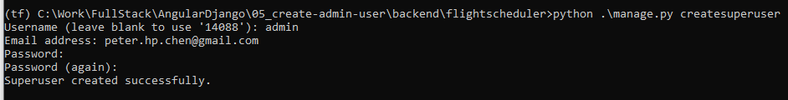
5.1 Create Django Admin Interface
https://www.youtube.com/watch?v=dwzj5uPYKpM&list=PLTgRMOcmRb3Oxj1oKJYsW2-JjRjtlFvoQ&index=5
Create Django Admin Interface
Under the
> (tf) …\05_create-admin-user\backend\flightscheduler>python .\manage.py createsuperuser
>> Username (leave blank to use ‘14088’): admin
>> Email address: peter.hp.chen@gmail.com
>> Password: Pc1997xxx
>> Password (again): Pc1997xxx
>> Superuser created successfully.

Slide 7
5.1 Create Django Admin Interface
https://www.youtube.com/watch?v=dwzj5uPYKpM&list=PLTgRMOcmRb3Oxj1oKJYsW2-JjRjtlFvoQ&index=5
Create Django Admin Interface
Note:
1.Make sure the you are in 05_create-admin-user folder to create database user name and password.
Create in different folder (database is different). You can see the data in different database.
2. Remember the username “admin” and Password “Pc1997xxx”.

Slide 8
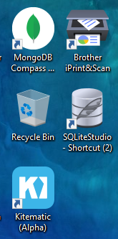
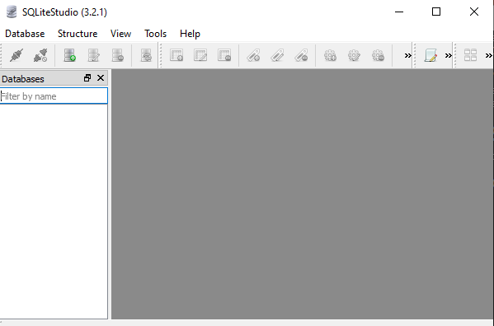
5.1 Create Django Admin Interface
https://www.youtube.com/watch?v=dwzj5uPYKpM&list=PLTgRMOcmRb3Oxj1oKJYsW2-JjRjtlFvoQ&index=5
Create Django Admin Interface
Now, we have admin install and added in there.
Start the SQLiteStudio.

Slide 9
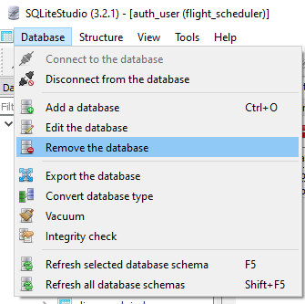
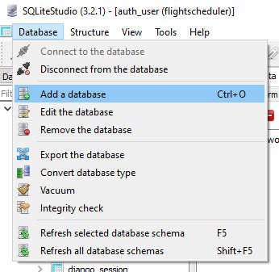
5.1 Create Django Admin Interface
https://www.youtube.com/watch?v=dwzj5uPYKpM&list=PLTgRMOcmRb3Oxj1oKJYsW2-JjRjtlFvoQ&index=5
Create Django Admin Interface
Remove the previous database:
> Database > Remove the database
Add a new database:
> Database > Add a database

Slide 10
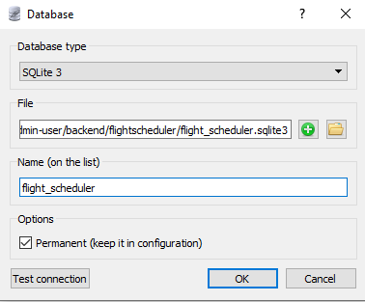
5.1 Create Django Admin Interface
https://www.youtube.com/watch?v=dwzj5uPYKpM&list=PLTgRMOcmRb3Oxj1oKJYsW2-JjRjtlFvoQ&index=5
Create Django Admin Interface
Select database under 05_create-admin-user\backend\flightscheduler\flight_scheduler.sqlite3,

Slide 11
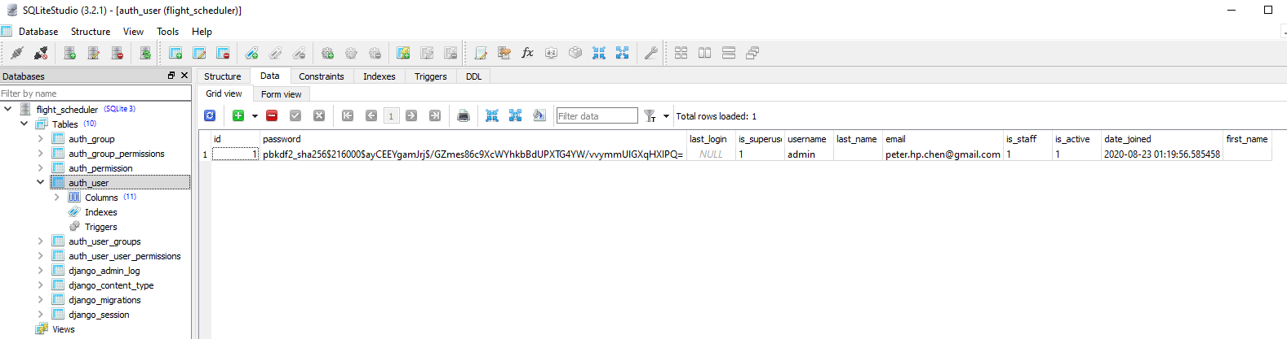
5.1 Create Django Admin Interface
https://www.youtube.com/watch?v=dwzj5uPYKpM&list=PLTgRMOcmRb3Oxj1oKJYsW2-JjRjtlFvoQ&index=5
Create Django Admin Interface
In the auth_user, click “Data” tab to check the login id and password.
You can use ‘-’ to remove data. Right mouse button to commit.
The use refresh (as below) to save the database.
We see the username “admin” and email “peter.hp.chen@gmail.com”.
The password is encrypt and cannot see them.

Slide 12
End of Chapter

