Slide 1

4 Django to Angular
Peter H. Chen

Slide 2
4 Django to Angular
https://www.youtube.com/watch?v=95di7WjvTFc&list=PLTgRMOcmRb3Oxj1oKJYsW2-JjRjtlFvoQ&index=4
Django Frontend with Angular
In this section, we work on the frontend with Angular.
Create An Agular Application.
Create Flight Scheduler list component.
Create Flight Schedule input form component: We need an input form to add to the form.
Create Routers: Router also need to be created
Create Angular Dependency Injection (DI) System: The Angular Dependency Injection (DI) system that is allowed us to Inject Data from an outside source to the internal source with internal class.
Add a New Flight Schedule: We will do some API operations using the Add for adding a new flight schedule.
Update an Existing Flight Schedule: Update Flight Schedule from frontend.
Delete Flight Schedule: Delete Flight Schedule from frontend.

Slide 3
4.1 Install Angular

Slide 4
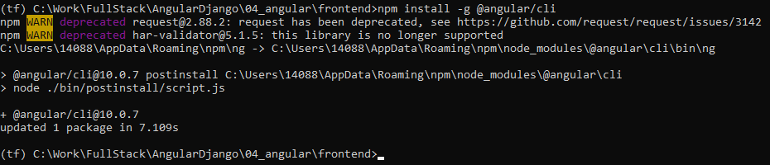
4.1 Install Angular
https://www.youtube.com/watch?v=95di7WjvTFc&list=PLTgRMOcmRb3Oxj1oKJYsW2-JjRjtlFvoQ&index=4
Install Angular
> cd frontend
> npm install -g @angular/cli

Slide 5
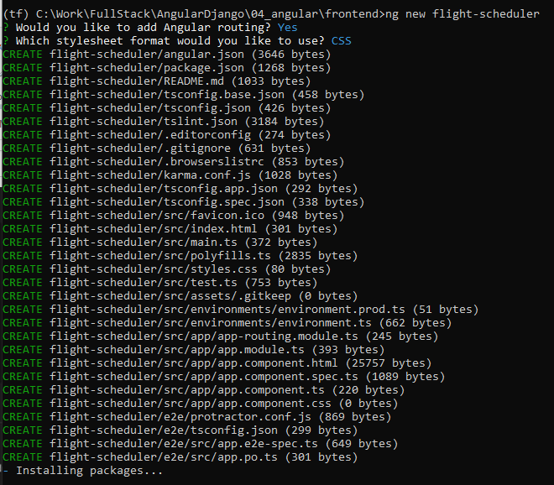
4.1 Install Angular
https://www.youtube.com/watch?v=95di7WjvTFc&list=PLTgRMOcmRb3Oxj1oKJYsW2-JjRjtlFvoQ&index=4
Install Angular
Ng new prompts for routing installation and CSS support
> ng new flight-scheduler

Slide 6
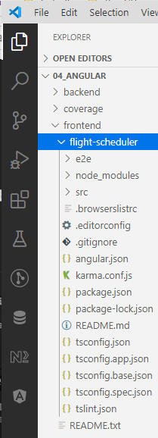
4.1 Install Angular
https://www.youtube.com/watch?v=95di7WjvTFc&list=PLTgRMOcmRb3Oxj1oKJYsW2-JjRjtlFvoQ&index=4
Install Angular
After the frontend flight-schedular is created, the following folders are created.

Slide 7
4.2 ng serve

Slide 8
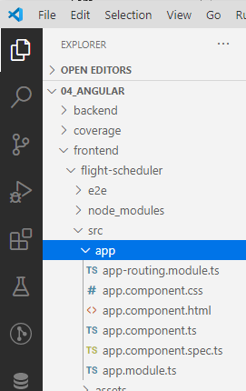
4.2 ng serve
https://www.youtube.com/watch?v=95di7WjvTFc&list=PLTgRMOcmRb3Oxj1oKJYsW2-JjRjtlFvoQ&index=4
Install Angular
The src/app is where our app starts.
Then up to src/app, i.e., below flight-scheduler, everything is good.

Slide 9
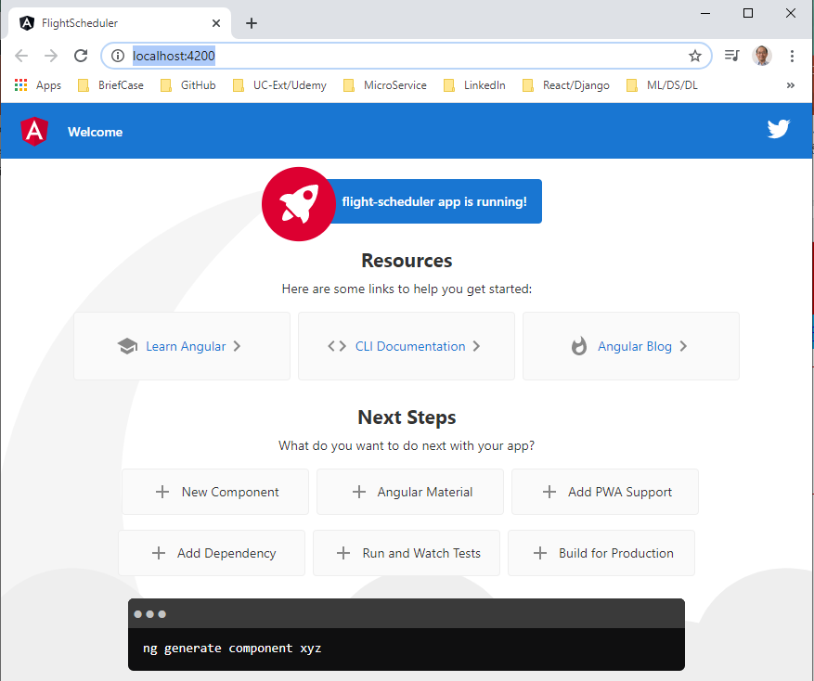
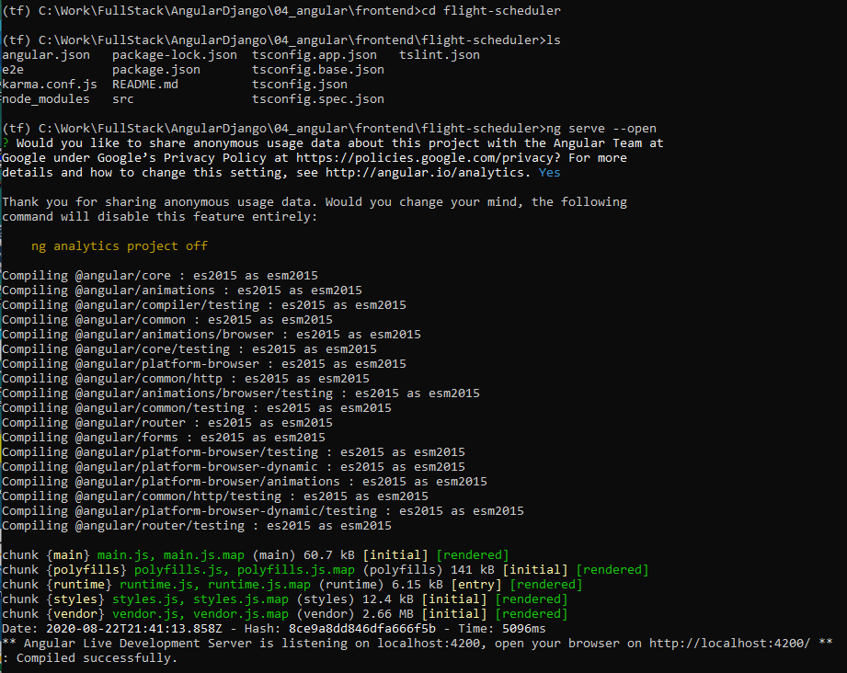
4.2 ng serve
https://www.youtube.com/watch?v=95di7WjvTFc&list=PLTgRMOcmRb3Oxj1oKJYsW2-JjRjtlFvoQ&index=4
Install Angular
We can run up to app.
> cd flight-scheduler
Open chrome
> ng serve --open

Slide 10
4.2 ng serve
https://www.youtube.com/watch?v=95di7WjvTFc&list=PLTgRMOcmRb3Oxj1oKJYsW2-JjRjtlFvoQ&index=4
Install Angular
OK.
We are good for front end Angular. Control-C to quit.
From here, we will built the front end API from here to access the backend using the REST API.
So, we are good to go with our application.

Slide 11
End of Chapter

